Slide 1
Pool CFD modelling lessons from the SESAME project
V. Moreau, M. Profir (CRS4), A. Alemberti, M. Frignani, F. Merli (ANN)
M. Belka, O. Frybort, T. Melichar (CVR), M. Tarantino (ENEA), S. Franke, S. Eckert (HZDR),
A. Class, J. Yanez (KIT), D. Grishchenko, M. Jeltsov, P. Kudinov (KTH),
F. Roelofs, K. Zwijsen, D.C. Visser (NRG), A. Badillo, B. Niceno (PSI), D. Martelli (UNIPI)
SESAME International Workshop, March 19-21, 2019
Petten, Netherlands

Slide 2
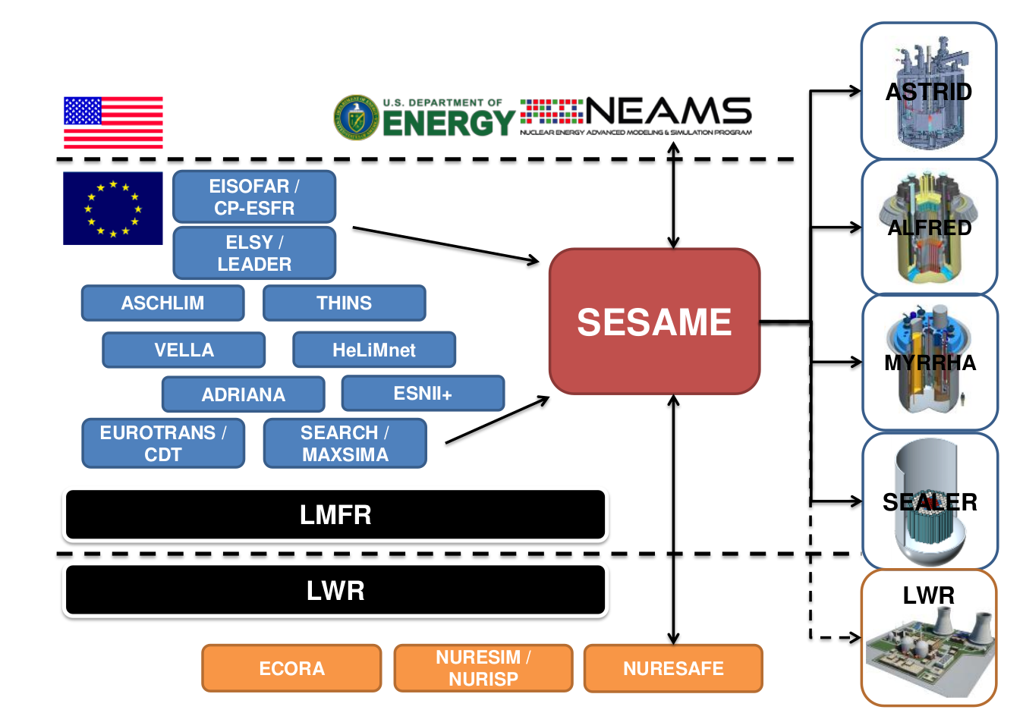
Background
Pool modeling is part of the SESAME project inserted in a rich historical and international context (extracted from proposal).

Slide 3
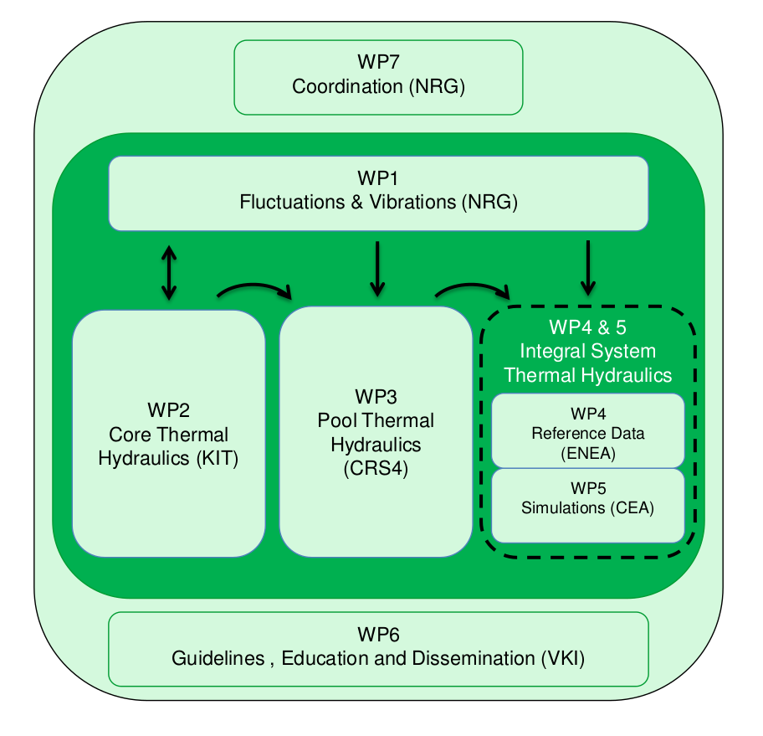
SESAME structure
Organized in 7 WPs (still from proposal)

Slide 4
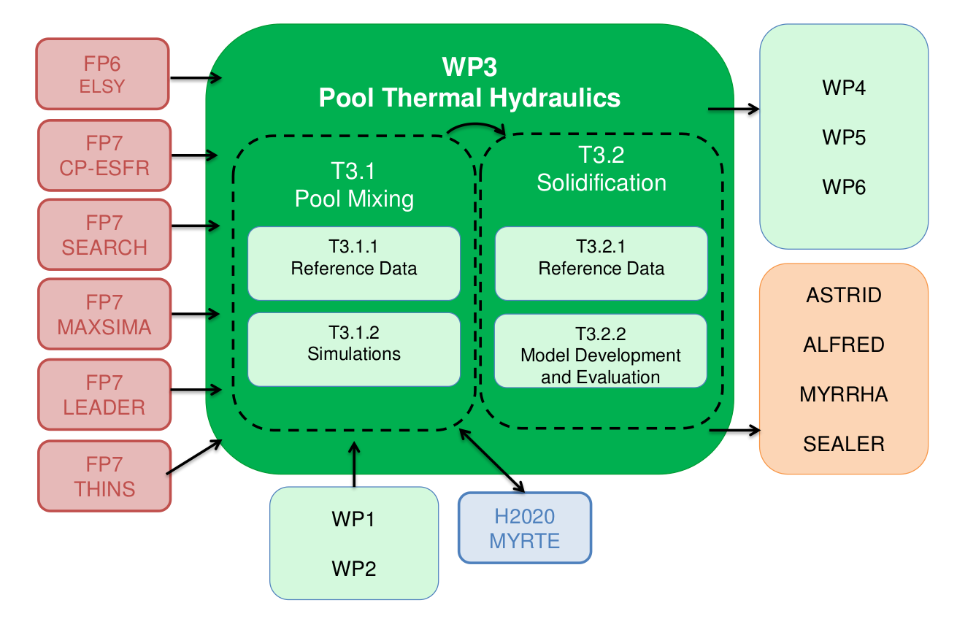
Pool Thermal Hydraulics
Structure (again from proposal)

Slide 5
Pool Thermal Hydraulics
Structure based on redundancy and diversification
Pool Mixing
Reference data
Simulations
Solidification
Reference data
Model development and evaluation

Slide 6
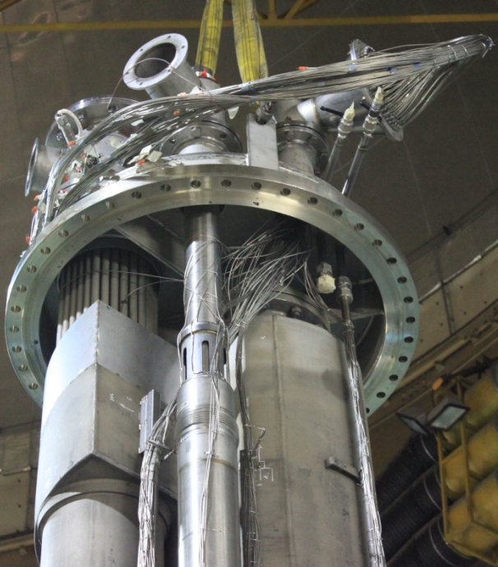
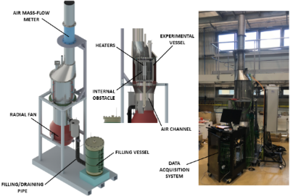
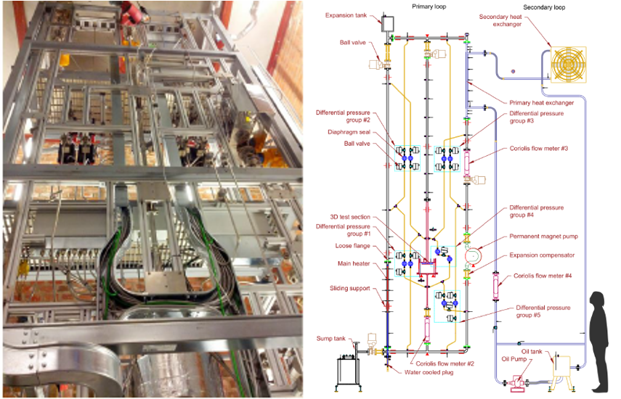
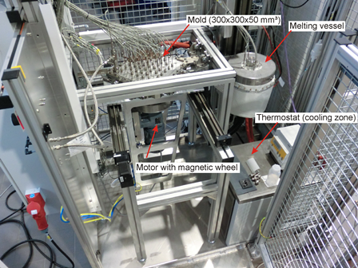
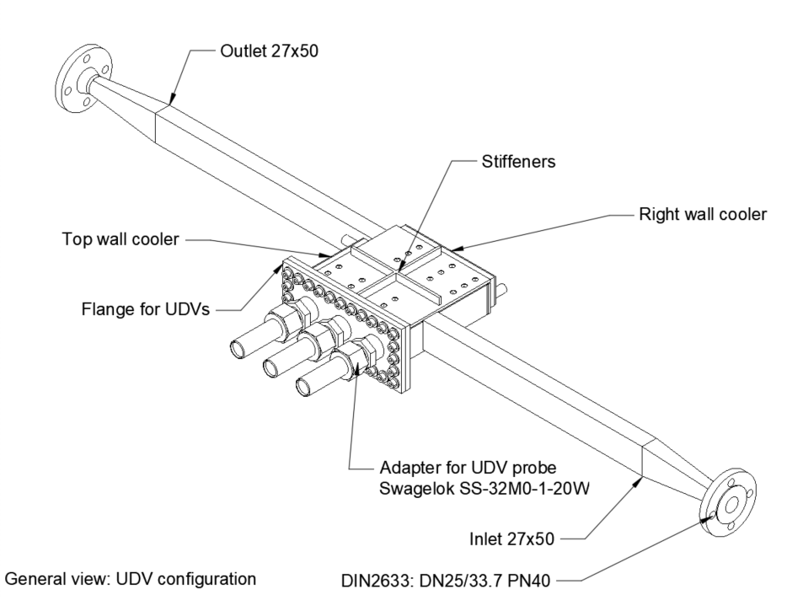
The facilities
CIRCE (ENEA)
SESAME-stand (CVR)
TALL-3D (KTH)
HZDR-pool (HZDR)
STS (KTH)

Slide 7
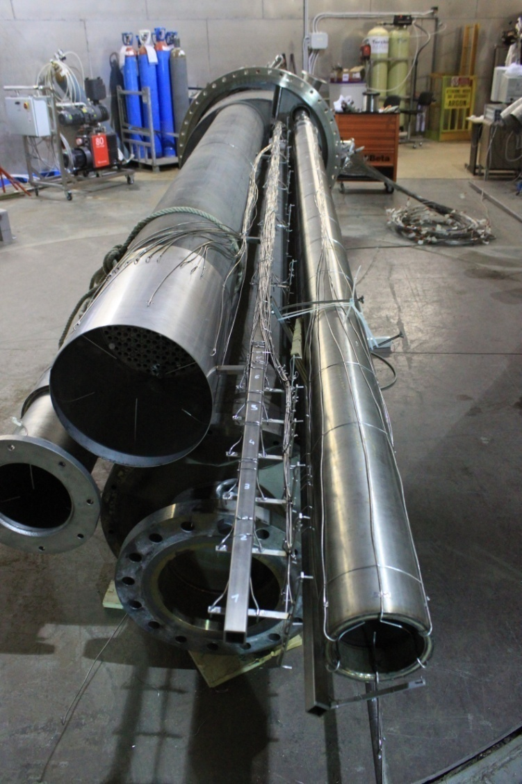
CIRCE (ENEA)
Experimental campaign: forced flow high power steady states and transition to reduced power natural convection, main features of a PLOF incident.
forced circulation is driven by Argon injection (gas-lift).
fuel pin simulator (FPS) used up to 750 kW,
heat exchanger: double wall bayonet type with helium gap + Air DHR
Several tens of tons of LBE

Slide 8
TALL-3D (KTH)
6.8m high, operated with LBE, initially composed of two legs,
additional hot leg with a 3D test section.
The experimental campaigns performed with the 3D pool test section investigate mixing phenomena and possible thermal stratification likely to appear also in pool-like lead-cooled reactors.

Slide 9
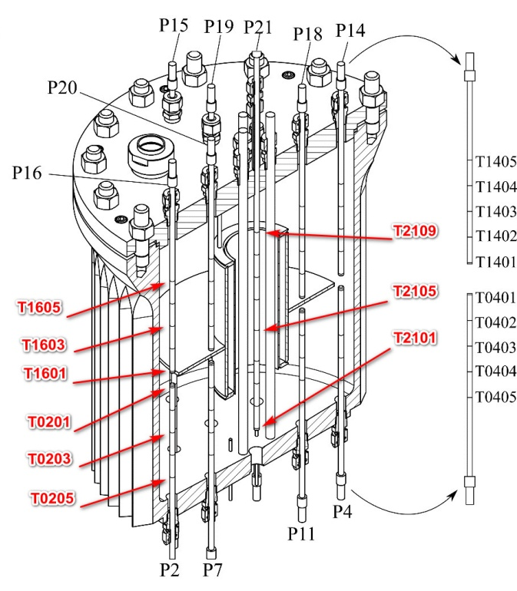
SESAME-stand (CVR)
Operated with pure lead in natural convection
Mostly axial-symmetrical shape, with four heaters near the axis and cooled by an external controlled air flow.
An internal obstacle separates the internal heating from the external cooling.
The experimental campaigns aim at studying the appearance and evolution of a freezing front with different internal obstacles, at different power and air flow rate.

Slide 10
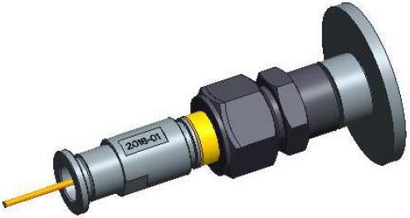
STS (KTH-HZDR)
The STS was designed to be installed in the hot leg of the TALL-3D facility of KTH
It is a square box 20 cm large and 50 mm deep with decentred inlet and outlet.
It was thought to be operated in turn with three different sets of instrumentation:
  (i) TCs for temperature measurement outside and inside the pool,
  (ii) FBGs for temperature measurement inside the pool and
  (iii) UDVs (from HZDR) for measurement of the LBE flow velocity and location of the solidification front.

Slide 11
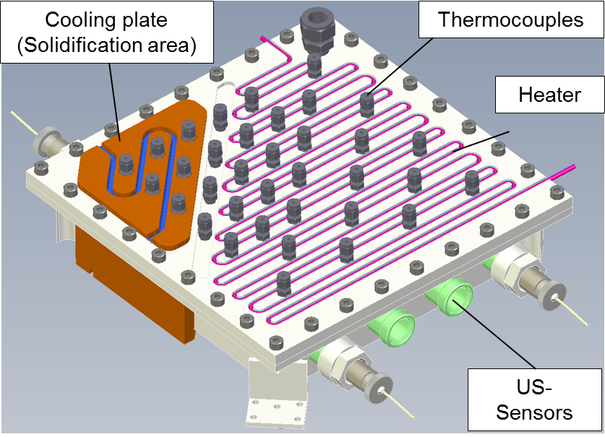
HZDR-pool (HZDR)
The design and manufacture of the UDV probes to be installed in the STS was to be performed by HZDR.
Facing a number of open questions and issues concerning the solidification front measurement, HZDR decided to build its own instrumentation pool experimental facility.

Slide 12
Risk evaluation
CIRCE: very safe
Existing facility already operated
Design already finalized
Back up option from previous experimental campaign.
Tall-3D: quite safe
Already built test section (3rd leg) in already operated facility
Design already finalized.
STS: not so safe
Variant of TALL-3D pool 3D test section foreseen (less time available)
Conception and design from scratch
Intense collaboration required for the UDV adaptation, calibration and use.
SESAME-stand: challenging and somewhat risky
Only one conceptual vessel to be recycled
Everything yet to be defined.
Lead coolant: higher operational temperature.

Slide 13
Risk mitigation
The work package is built on the nuclear safety concept of redundancy and diversification.

Slide 14
Redundancy
Pool Mixing
Reference data
Simulations
Solidification
Reference data
Model development and evaluation
Experiments: two experiments per kind.
Data sets: two data-sets per kind.
Pre-test CFD by two partners for each experiment.
Post-test confront and validation CFD by at least two partners
Modeling extrapolation to nuclear reactors by two partners.

Slide 15
Diversification
Experiments focus: consistency of the thermal-hydraulic loop vs. capture of solidification front
Experiment size: from a few litters to several cubic meters.
Experiment facility: both existing and new, or at least new test section.
Carrier fluid: both lead and lead-bismuth eutectic (LBE)
Software: commercial STARCCM+ and FLUENT or in-house PSI-BOIL
Theoretical modeling consideration vs. effective model implementation, mainly with regards to solidification.
Develop and test a highly innovative CFD approach, the Proper Orthogonal Decomposition Reduced Order Method (POD-ROM).
Pool Mixing
Reference data
Simulations
Solidification
Reference data
Model development and evaluation

Slide 16
Conceptual objectives
The global objective of the WP is to qualify CFD as a valid instrument for Gen-IV nuclear design.
In order to reach this goal, several intermediate objectives are pursued.
Reach operability on relevant experimental facilities, sufficiently instrumented.
Operate successfully these facilities
Generate consistent data bases
Model the experimental facilities with CFD during the pre-design, design phase and experimental campaign definition.
Run successfully the CFD model, possibly giving useful input during the design phase
Run the CFD model with the more similar possible operating condition of the experimental campaign.
Manage to use the data bases for a confront with the numerical results.
Confront numerical and experimental results, find relevant data to be confronted.
Analyze possible discrepancies.
Improve the numerical model and/or reinterpret experimental data.
Hopefully validate the numerical models.
Highlight remaining issues.
Consistently extrapolate the numerical models for real-size nuclear design.

Slide 17
From conceptual to practical (1/2)
From the experimental point of view:
Operate the CIRCE ENEA facility to generate a data base from a dedicated experimental campaign
Operate the TALL-3D KTH facility and extract from the data base the data relevant of the 3D test section.
Conceive, build, instrument and operate a new facility, to be later named as SESAME-stand, at CVR to investigate the solidification front propagation in a buoyancy driven pure lead pool. Generate a comprehensive data base.
Conceive, build, instrument and operate a new or modified test section of TALL-3D, later called the Solidification Test Section (STS), to investigate the solidification front propagation and stability of Lead Bismuth Eutectic (LBE) under various forced flow conditions. Produce the related data base.

Slide 18
From conceptual to practical (2/2)
From the numerical point of view:
Build the CFD model of the TALL-3D 3D test section and of CIRCE, developing know-how and getting technical confidence with all the relevant aspects of the simulations.
Make numerical pre-tests, post-tests, confront and validation from experimental results.
Support the conceptual, pre-design and design phase of SESAME-Stand and STS with preliminary (often simplified) simulations.
Investigate the theoretical and technical issues relative to the incorporation of the solidification feature in a CFD simulation.
Combine the new solidification features with the now consolidated thermal pool modeling to build and operate a CFD model representative of SESAME-Stand and STS experimental campaigns.
Confront the experimental and the numerical results, focusing on the front position or propagation. Hopefully, validate the numerical model now upgraded with the solidification representation.
Use acquired know-how to Build CFD models of ALFRED.

Slide 19
Results
Thanks to the redundancy and diversification strategy, and even with the failure of some practical objective, the conceptual objective have all been substantially reached:
Database have been created and shared
Numerical simulations have been performed
Results have been confronted.
Understanding has been improved.
Modeling has been improved.
Better (or even satisfying ) simulations have been performed.
Extrapolation to ALFRED has been performed, with improved understanding of rationales.
Many of the progress have been made thanks to information sharing.
Promoted by redundancy
Promoted by diversification.
We now give a “best of” selection of practical examples.

Slide 20
Basics that we learned
Lacking of physical properties should not be blocking:
Thermal conductivity of solid LBE is not available or inconsistent (PSI)
CRS4 stuck for modeling STS…
KTH proceeding swiftly. How? Taking melting temperature value. So simple…
Information shared, CRS4 unstuck!
Steady state results of an oversimplified thermal loops can depend on initial conditions (CIRCE model, NRG)
Issue already confronted and solved by CRS4.
Reason: constant and equal heat source and sink means total heat content conserved.
Workaround: heat sink temperature dependent, simple 2-parameters model
Once understood, also allow speed up of the simulation convergence.
Typical issue when first confronted with a closed loop.

Slide 21
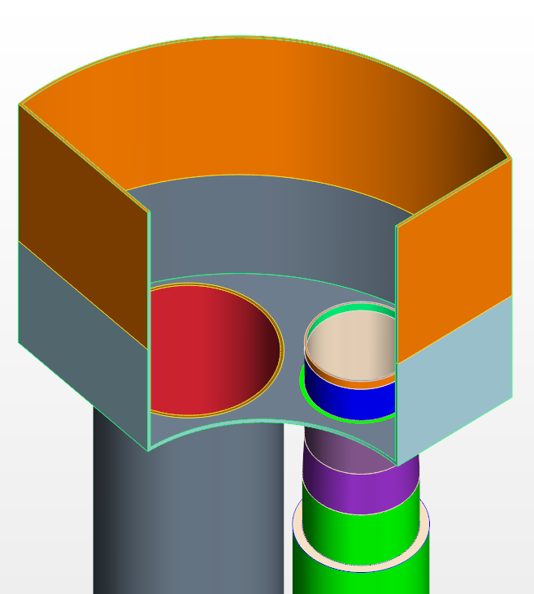
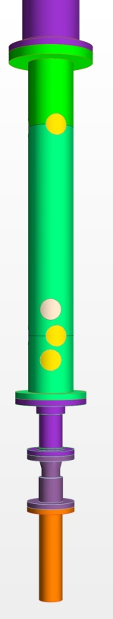
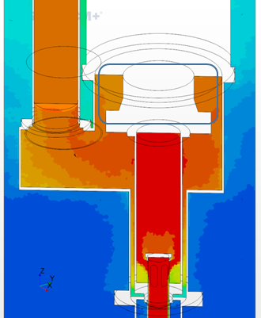
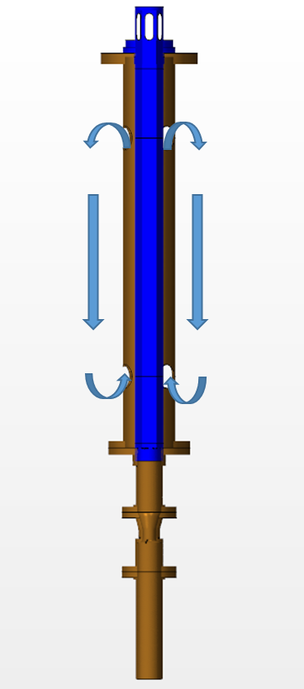
The devil in the details
The first CFD results from CRS4 on CIRCE where not satisfying. The real thermal stratification was not captured. Looking for a scapegoat, we found a few candidates:
LBE or entrapped Argon?
LBE or entrapped Argon?
Possible enhanced local buoyant loop
Droplets jumping above the gas separator
Thermal conductivity issue
Leakage at the riser connection

Slide 22
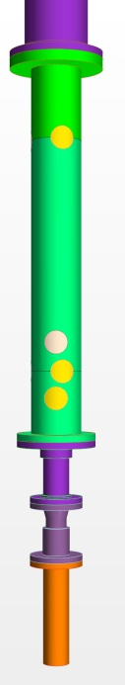

The devil in the details
The first CFD results from CRS4 on CIRCE were not satisfying. The real thermal stratification was not captured. Looking for a scapegoat, we found a few candidates:
Corrective actions taken
Increased awareness

Slide 23
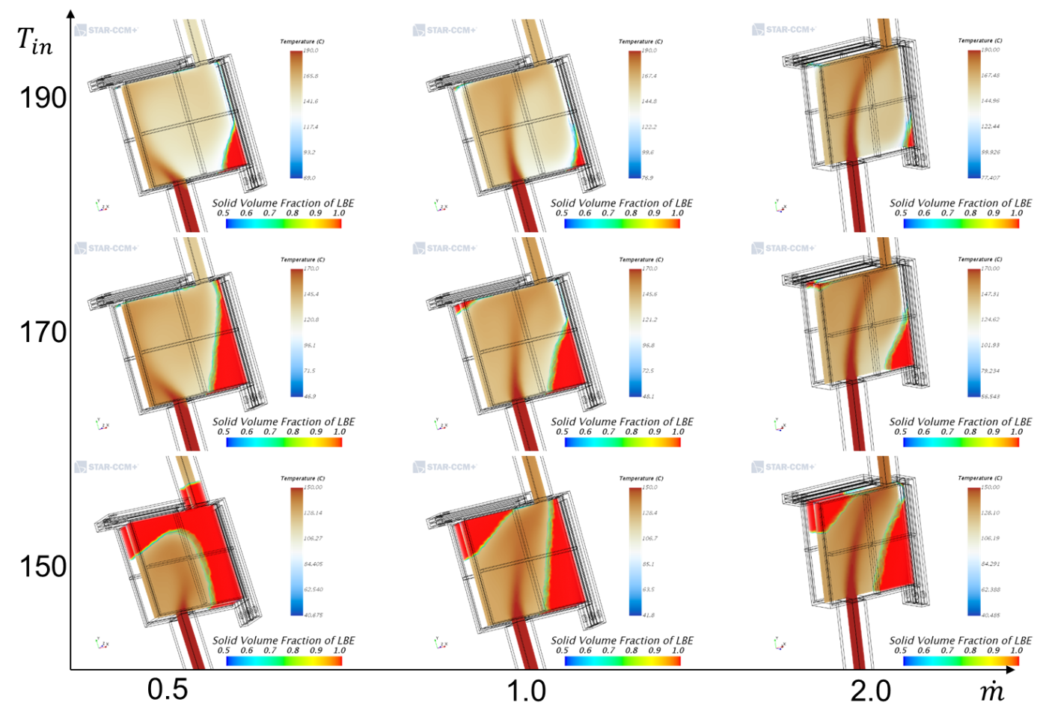
Cross checking may serve
STS design finalized by KTH: focus on LBE freezing front and positioning of instrumentation

Slide 24
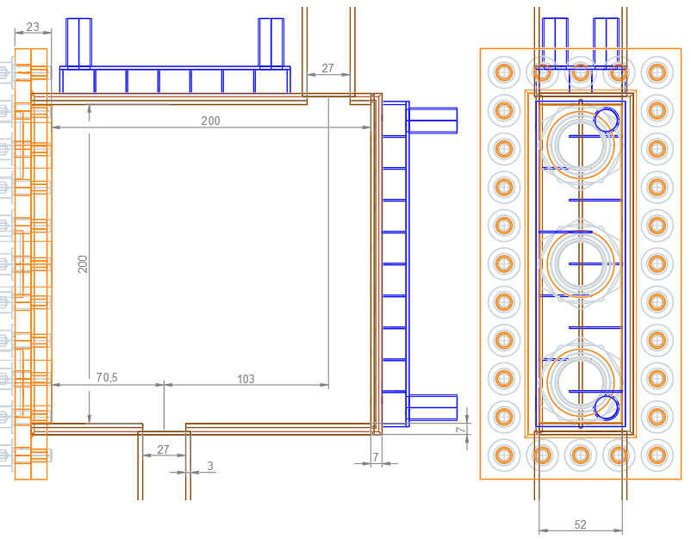
Cross checking may serve
KTH sent the design to CRS4 for “fast” check

Slide 25
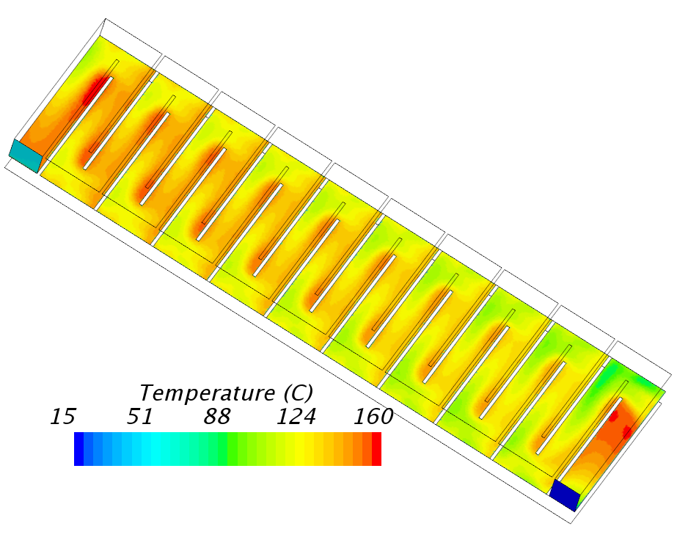
Cross checking may serve
Fast but sufficiently detailed simulation by CRS4:
2 fluids: LBE and water
Solid material and CHT
Excessive water maximum temperature found

Slide 26
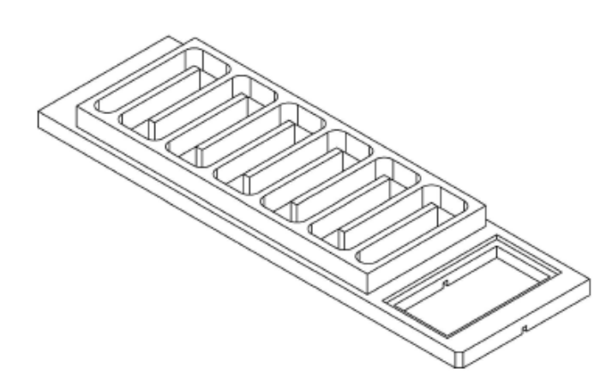

Cross checking may serve
Hard work made in // and collaboration between KTH and CRS4 to explore possible solution
KTH came first within a few days with a satisfying improved cooler design

Slide 27
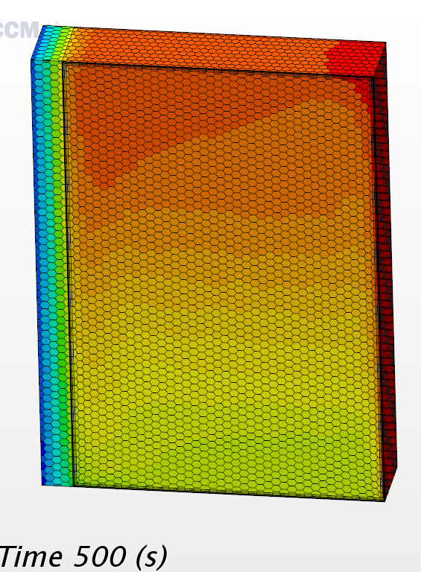
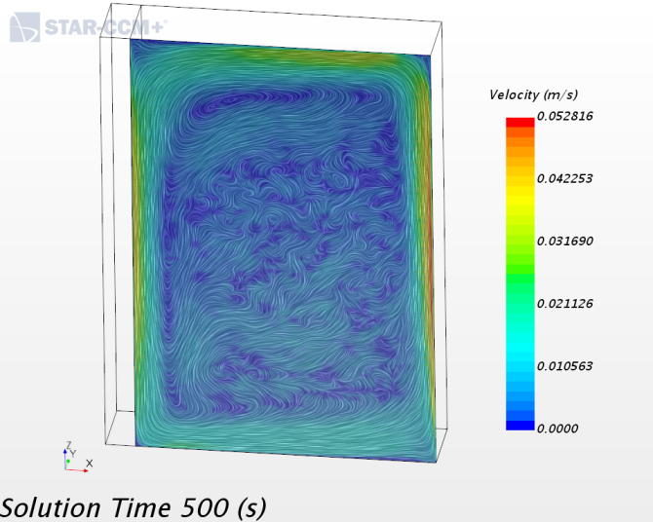
Freezing simulation issue
Simulation of solidification front propagation is affronted for the first time in our context:
2D simulations from PSI are completely under control
3D simulations in forced convection flow (KTH and CRS4) have been rapidly handled
3D simulations in buoyancy driven flow resulted extremely problematic:
CVR was forced to renounce to unstructured mesh because of simulation crashes, and structured mesh forced some geometrical simplification.
CRS4 was faced with occasional and non-averted simulation crash making the work very difficult and frustrating. Moreover, visual inspection of pre-test simulation as well as confront with CVR results brought serious concern on their likeness. Mainly, dubious very low velocity spotted patterns appeared steadily.

Slide 28
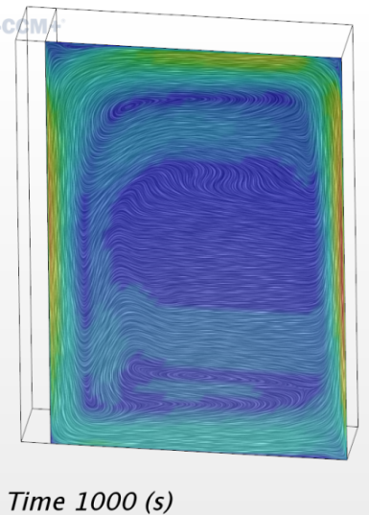
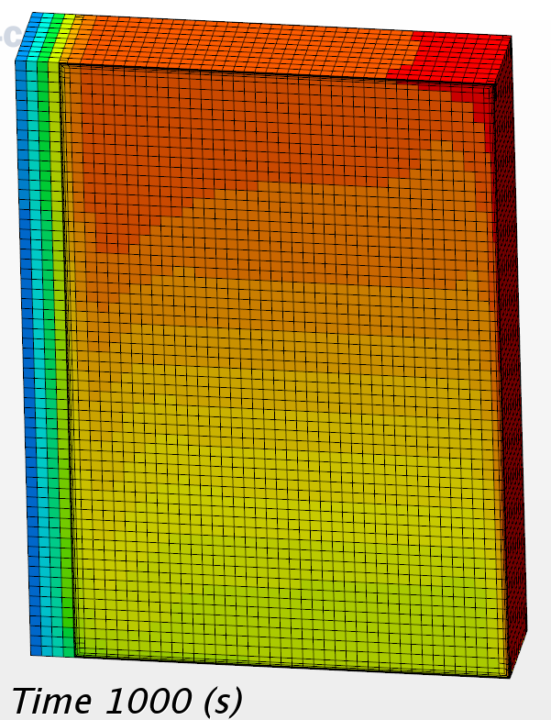
Freezing simulation issue
First SESAME-stand experimental results were a disastrous reality check.
Time (for CRS4) to reinvestigate the technical issues in order to be able to focus on the physics of the problem.
Starting with the spotted velocity field…
Systematic analysis with a simplified but not trivial 3D test case: turbulence model, convergence parameters, turbulence, mesh size, CFL and reference density
No way.
In despair, taking input from CVR backup strategy: trimmed cell mesher.
Problem solved…
We can focus on the physics!

Slide 29
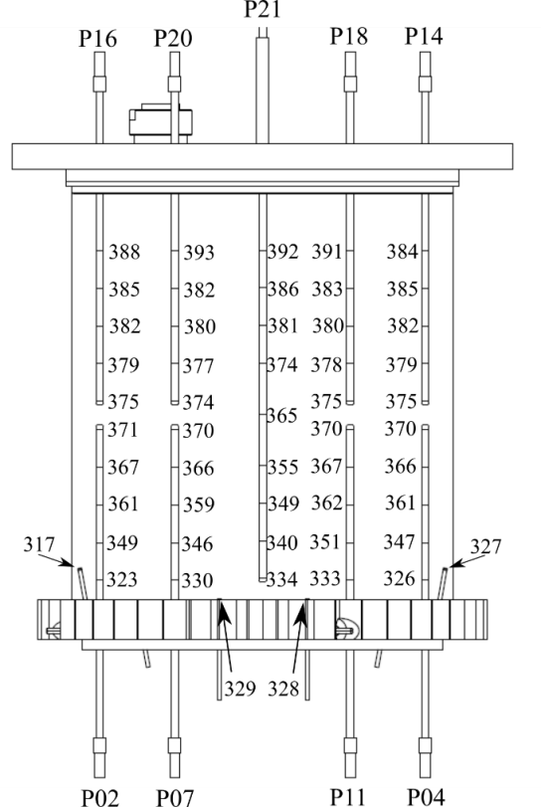
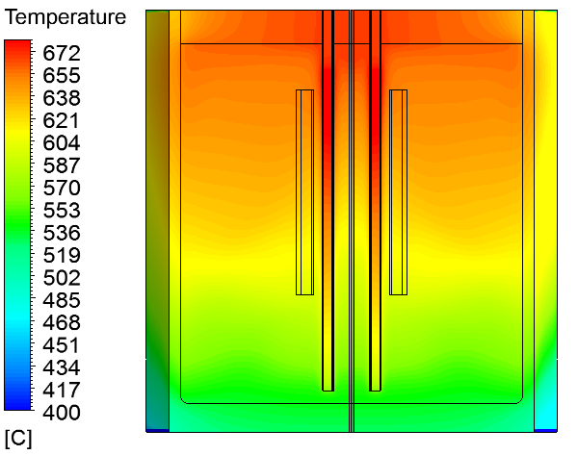
Thermal radiation issue
First noticed by NRG with the CIRCE riser insulation: thermal resistance is one order less than expected. Simulated by reducing the air gap width.
Feature incorporated in CRS4 model of CIRCE as an increased temperature dependent (in T³) thermal conductivity. Also applied to the dead volume insulation.
Then came the first experimental results from CVR on SESAME-stand:
Simulation ~250 K hotter !
Thermal radiations ignored!

Slide 30
Thermal radiation issue
Techniques developed for CIRCE adapted ands expanded to SESAME-stand.
Required additional measures on the air channel external wall.
Large uncertainty on the wall emissivity.
Variable view factors have been implemented.
Heat losses at the bottom, top and lateral top had to be estimated.
Thermal radiation appears to be roughly half the total heat loss.
Case | Heat source (kW) | Air MFR (kg/s) | Frozen fraction % | Frozen fraction experiment
1 | 5.6 | 0.145 | 4.5 | 5%
2 | 5.6 | 0.167 | 12 | 16%
3 | 4.96 | 0.101` | 0 | 0
4 | 4 | 0.101 | 58 | 45%
Very good result considering the sensitivity of the frozen %

Slide 31
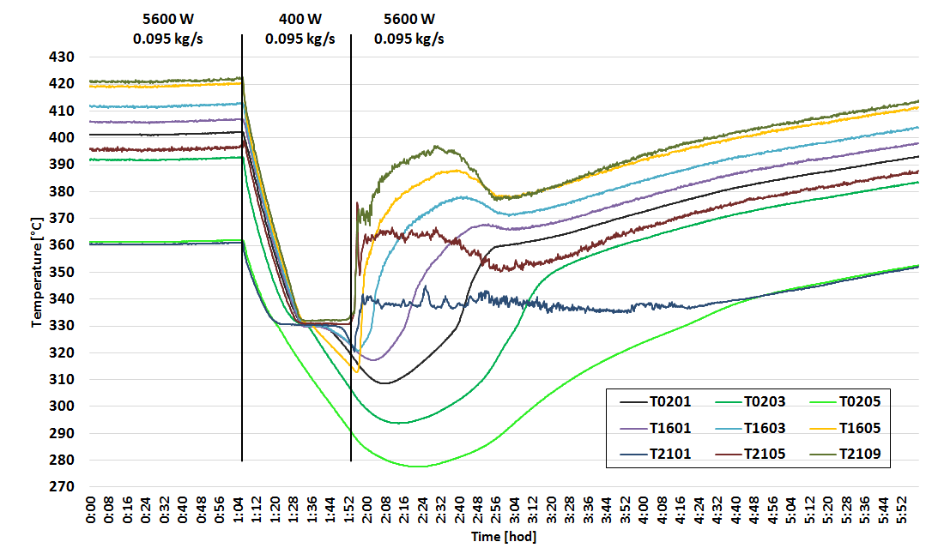

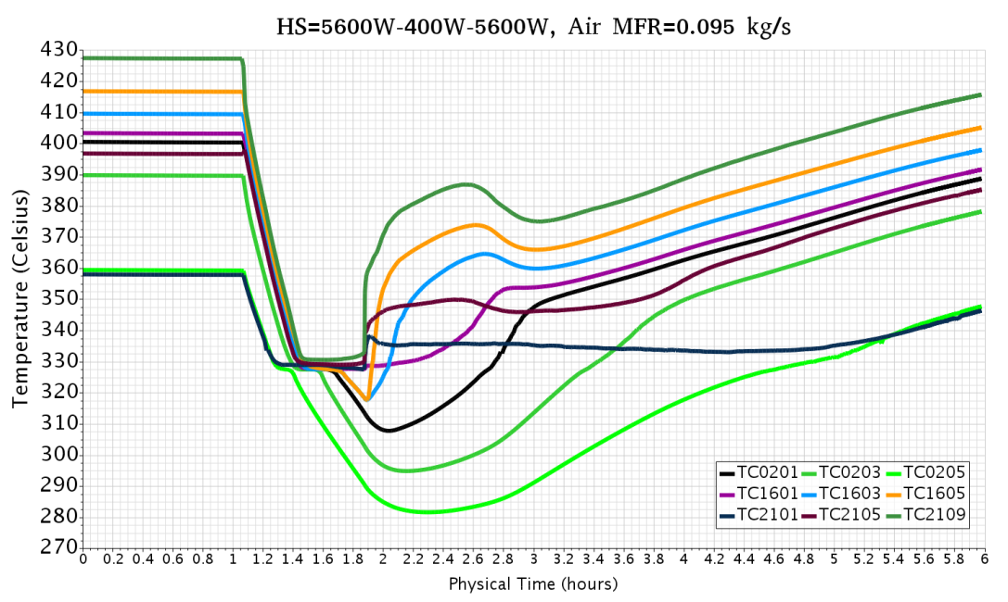
From disastrous to excellent
Experimental
Steady-state good enough to simulate transient…
Still small differences
Numerical

Slide 32
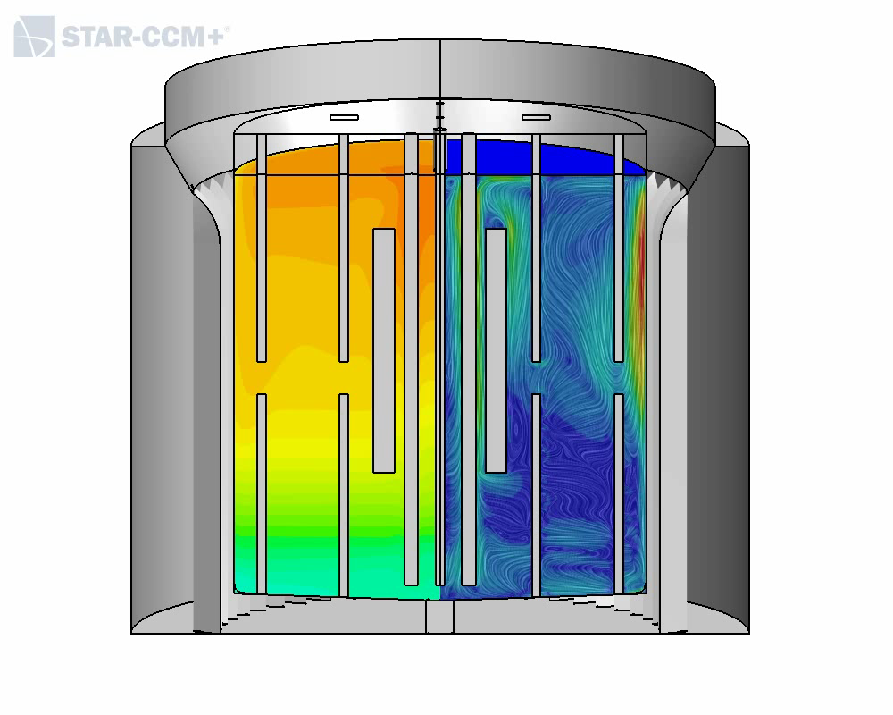

The movie

Slide 33
About turbulence modeling
Turbulence modeling is not yet the limiting factor:
No real initial steady-state in CIRCE
Inconsistent thermal heat balance in TALL-3D
Large uncertainty on wall emissivity in SESAME-stand
Simulation errors are still dominated by uncertainty on the physical representation:
Boundary conditions
Time degradation of materials
Physical properties of these materials
For the time being, and for pool modeling, classical 2-equations turbulence models cannot yet honestly serve as scapegoat.

Slide 34
About Pod-Rom
As any innovative methodology, the POD-ROM modelling was supposed to provide great results at very little cost.
As for any innovative technology put in practice, things are somewhat more articulated.
However, the development performed during the project have led to the following consideration:
The methodology has confirmed its potential.
It is technically more complex than expected, requiring not only an energy minimisation but also a minimisation of the gradients associated.
Currently restricted to laminar thermal flows. Minimum maturity for GEN-IV application requires inclusion of turbulence and conjugate heat transfer.
Method indicated when 3D information is relevant and when a huge number of parametric test cases must be simulated, making CFD too expensive.

Slide 35
Extrapolation to ALFRED
No particular issues. On the contrary, the experience gained and the know-how acquired during the first part of the project has been readily applied, following the specificities of the tasks.

Slide 36
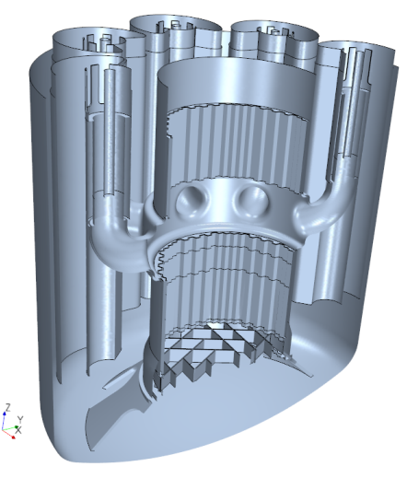
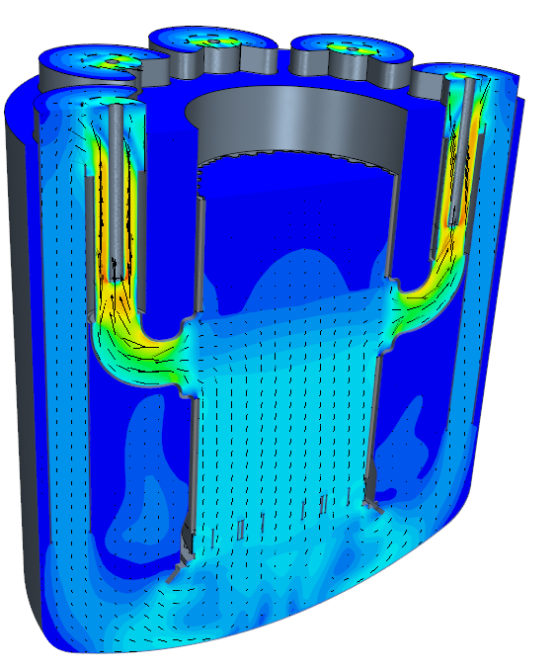
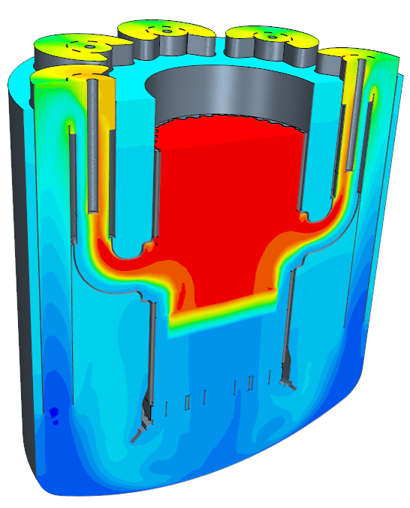
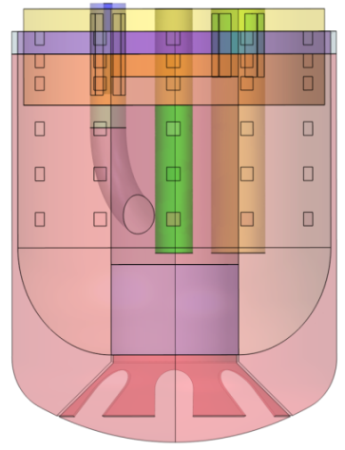
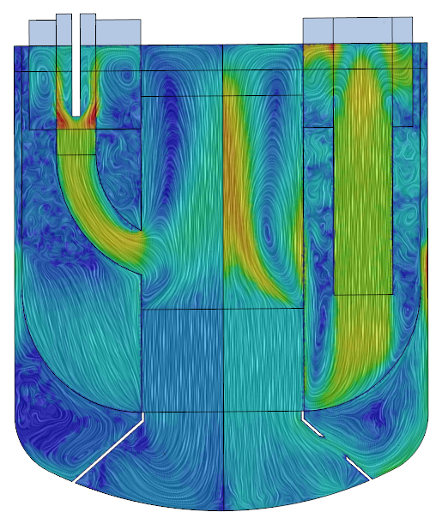
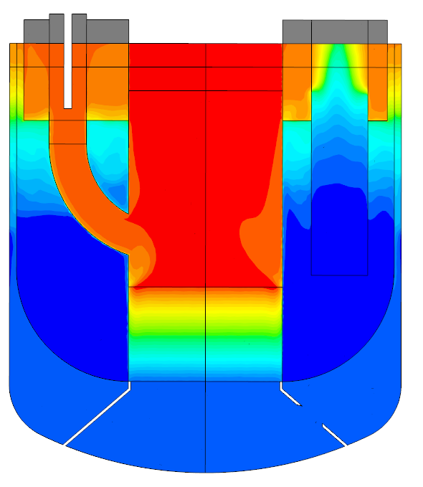
Extrapolation to ALFRED
Detailed ALFRED geometry by NRG based on LEADER design
Simple parametric ALFRED geometry by CRS4 based on new Ansaldo design

Slide 37
Concluding words
Thanks to the “redundancy and diversification” strategy, the conceptual objectives of the Pool CFD modeling work package have been substantially reached, even with the failure of some practical objectives.
Underlying this strategy, many issues and pitfalls have been overcome thanks to the collaborative spirit of the partners.
This result has been obtained keeping a complete autonomy of the partners with regards to the tools, methods and technics employed.
The collaboration between experimentalists and CFD analyst has gone both ways and improved mutual understanding .
Improvement of CFD simulation results from pre-tests to post-tests is the result of better understanding of the experiments and of the physics required.
For application to GEN-IV designs, CFD appears as a valuable tool, still to be manipulated with due care.

Slide 38
Thank you for your attention
acknowledgment
The authors would like to thanks the European Commission for its financial support within the HORIZON2020 SESAME program (n⁰ 654935).

