Slide 1
CFD SIMULATIONS at CRS4 in SUPPORT
to LIQUID METAL FAST REACTORS DESIGN
Vincent Moreau, Manuela Profir
CRS4, Sardinia, Italy
Virtual meeting CRS4-Newcleo
October 25, 2021
Notes:
1
CFD

Slide 2
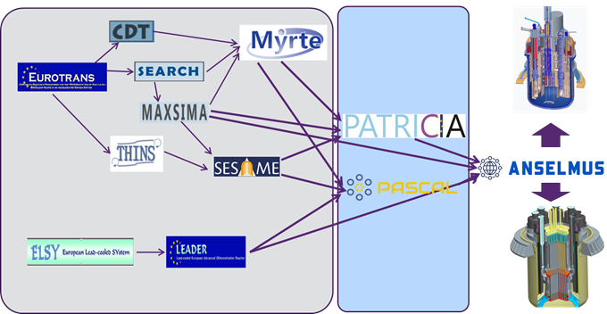
By which mean?
Through participation in European projects
2001-2004 2005-2009 2010 2011 2012 2015-2019 2020 2022
PDS-XADS
Windowless channel
Inherited from
L. Maciocco
leaving to AAA
Prehistory History Present Future
2

Slide 3
Main actors
SCK.CEN: Belgian nuclear, promoting MYRRHA
  Facilities: COMPLOT, …
  EU projects leader
ENEA: promoting ALFRED and MYRRHA,
  Facilities: CIRCE, NACIE, …
  EU projects leader
  Co-leading the FALCON consortium
  Lead and coordinate the Italian “galaxy”
Ansaldo Nucleare: designing and promoting ALFRED
  Co-Leading the FALCON consortium
NRG: Netherlands nuclear (running an experimental reactor)
  Project leader
  Strong in numerics
VKI: von Karman Institute for Fluid-Dynamics, near Brussels
  Nato funding. Entered in force in 2011 (SEARCH), promoting mainly MYRRHA
  Facilities: SHAKESPEAR seismic table, MYRRHA water mock-ups, …
  Strong in numerics
UniPi, UniRo, KTH and Chalmers U. (Sweden), KIT (German), CVR (Czech rep.), PSI, …
  Most with facilities
  Most strong in numerics
3

Slide 4
FALCON
Fostering Alfred Construction
Led by: Ansaldo Nucleare, ENEA and RATEN-ICN (Romanian nuclear)
Created in 2013.
CRS4 entered the consortium through a MOA in September 2019, renewed for 3 years in September 2020, under Ansaldo Nucleare guidance.
Strongly reinforced the CRS4 position to be part of the EU projects PATRICIA, PASCAL and ANSELMUS (i.e. present and future).
Collaboration for the research of funding
Promoting visibility:
  common papers based on updated design/data
  Framework to finalize/complete works initiated during SESAME
4

Slide 5
Three types of CFD simulation
Direct support to design:
  simulation of (parts of) MYRRHA/ALFRED primary coolant
  In collaboration and under the supervision of the designer
Support to experimental facilities experimental campaigns
  Existing facilities with some new features
  In collaboration and under the supervision of the facility owner
Support to the conception, realization and operation of new facilities or facilities with important changes.
  Conceive the facility in relation to the generic goal
  Precise the goal and operating means
  Strict collaboration between experimentalists and “simulators”.
In most cases, simulations are performed by at least 2 partners, to enforce the “diversification and redundancy” nuclear safety principle
5

Slide 6
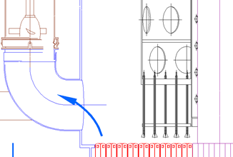
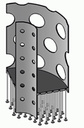
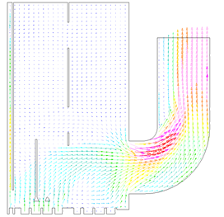
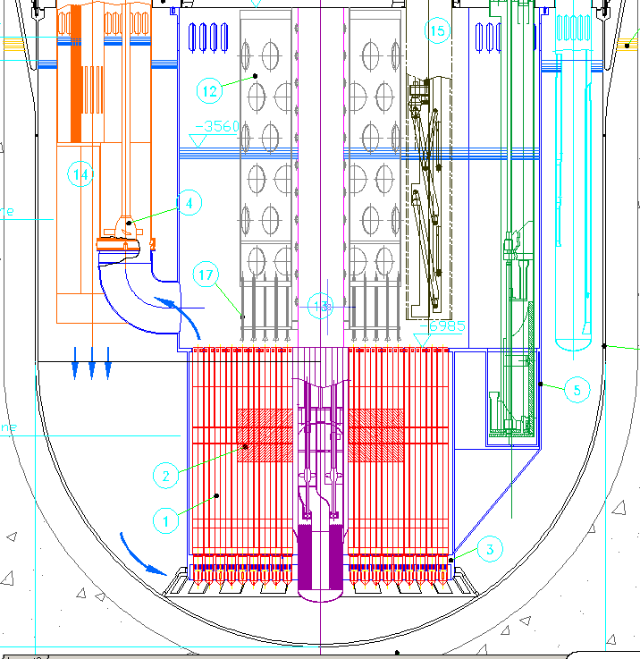
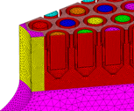
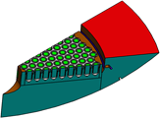
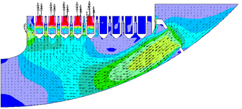
EUROTRANS 2005-2009
At this time (EFIT):
Maximum use of symmetries
Single specific parts

Slide 7
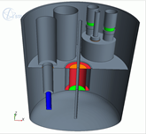
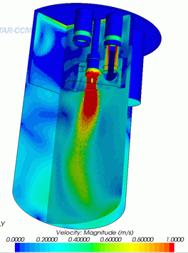
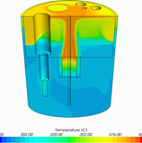
EUROTRANS 2005-2009
At this time (MYRRHA):
Half domain
No structures: baffles
Two regions core
No free-surface…

Slide 8
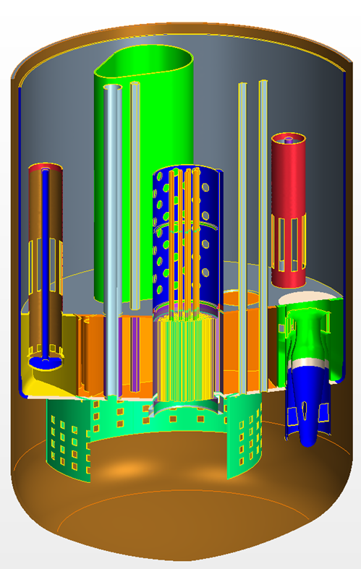
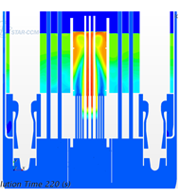
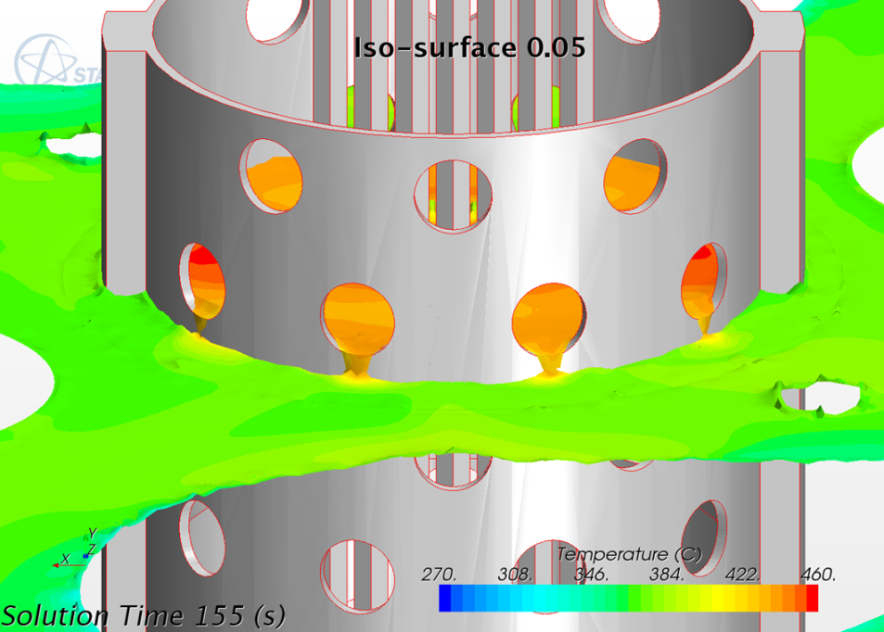
SEARCH 2011-2014
Modelling improved and extended for articulated transients in
MYRTE 2015-2019
Core structures
CR, SR channels
Above core structure
Pumps, HXs
At this time (MYRRHA):
Entire domain
Most main structures
Core: separates single FAs
Free surface

Slide 9
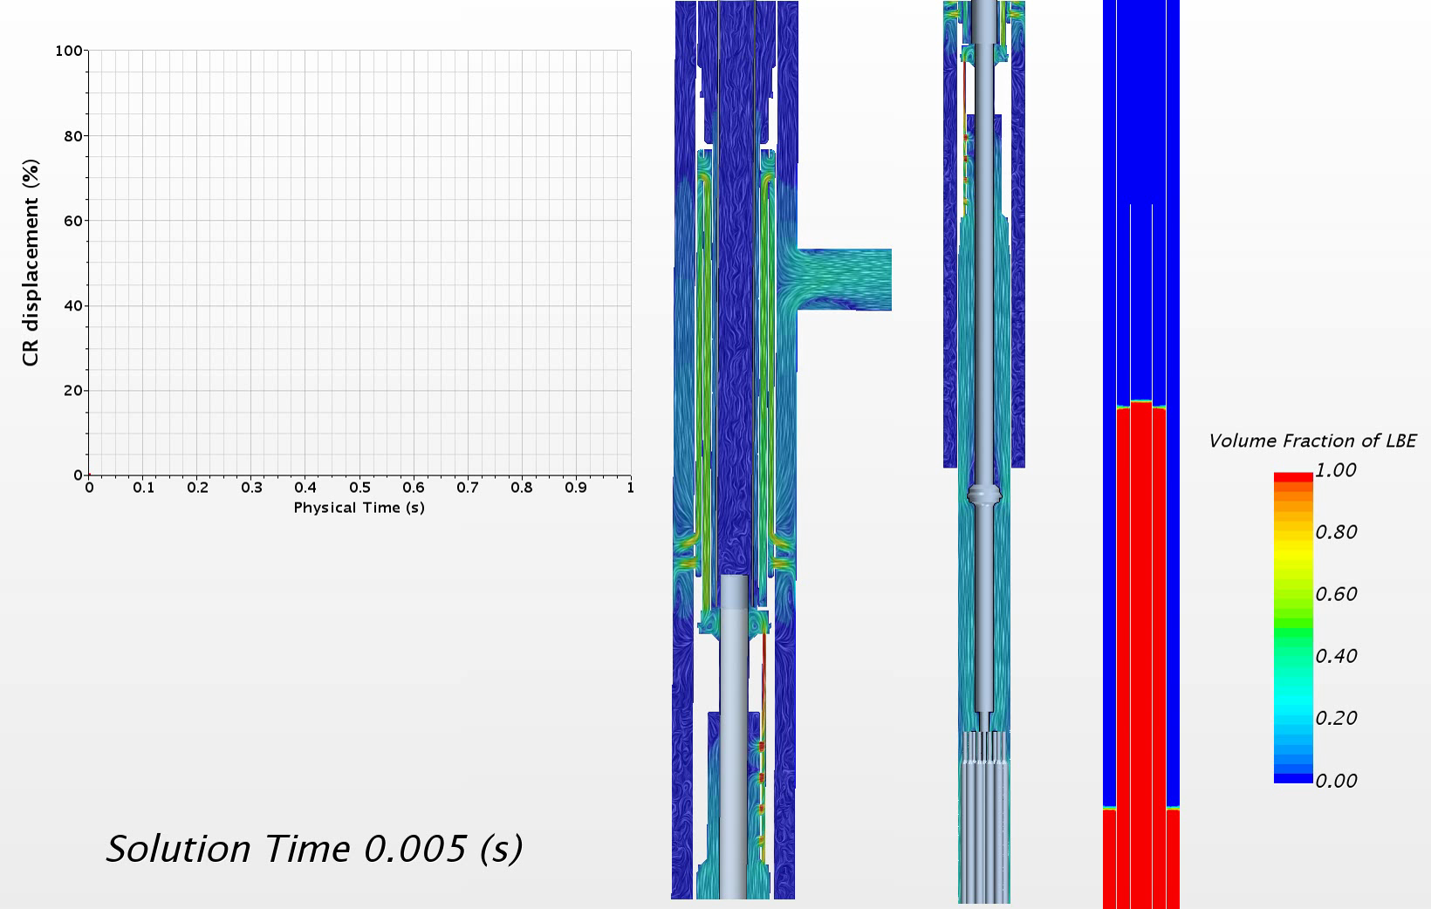
MAXSIMA 2012-2016: Control rod emergency insertion, 1/1 COMPLOT exp. facility.
At this time:
Buoyancy driven
Several free-surfaces
Fast transient
Hydraulic damper
Extremely stiff…

Slide 10
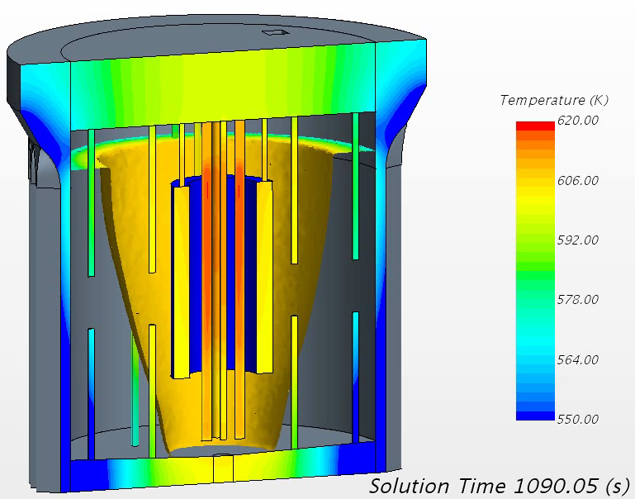
Virtual meeting CRS4-Newcleo, October 25, 2021
SESAME: 2015- 2019
Sperimenti e simulazioni a confronto: propagazione di un fronte di solidificazione in piombo.
At fist: ¼ domain
Then entire domain.
Phase change
Cooling air flow
Thermal radiation issue
Long transients.
Sezione sperimentale costruita in Rep. Ceca e simulazione della solidificazione : CRS4 e CVR.

Slide 11
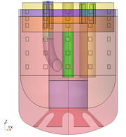
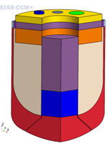
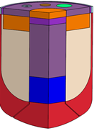
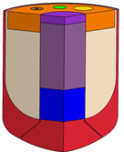
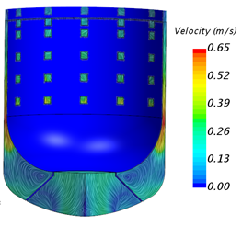
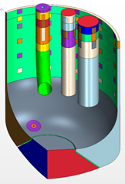
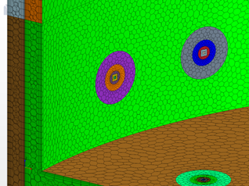
SESAME 2015-2019: “fast” investigation on variants and flow conditions
ALFRED
1/3 domain
No structures: baffles
No free-surface
Opening variants
Hole effects
Same .sim file…
nominal PLOF PLOF+LOCA

Slide 12
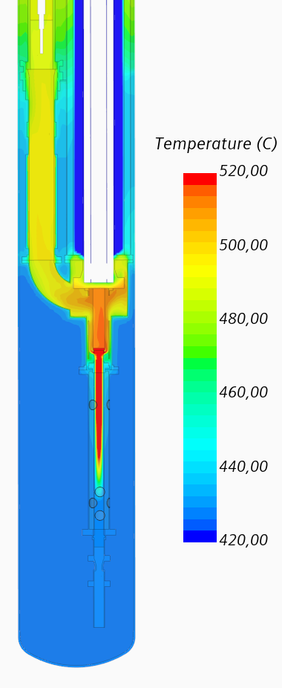
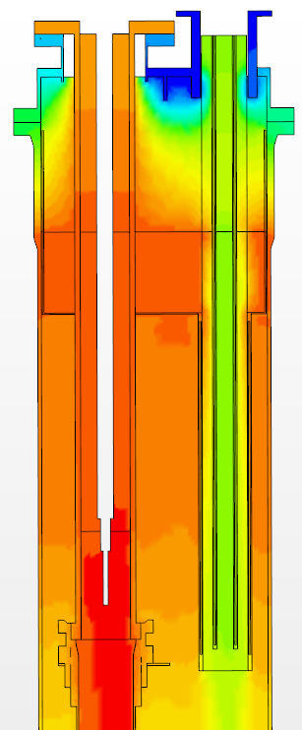
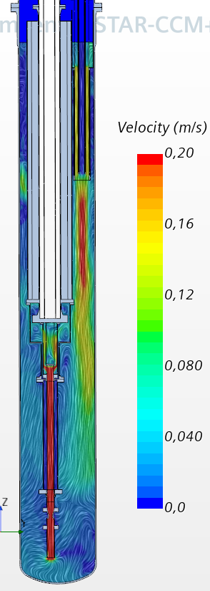
PATRICIA 2020-2024: ENEA facility CIRCE-THETIS modeling, on going…
THETIS
New HX
New pump
RVACS (not shown)
Thermal radiation
Objective:
Steady-state characterization varying power
Decay heat transients with:
  HX in DHR mode
  RVACS mode
  Concurrent DHR + RVACS

Slide 13
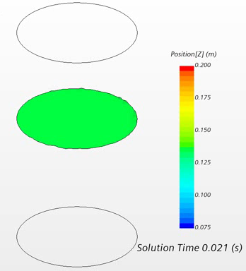
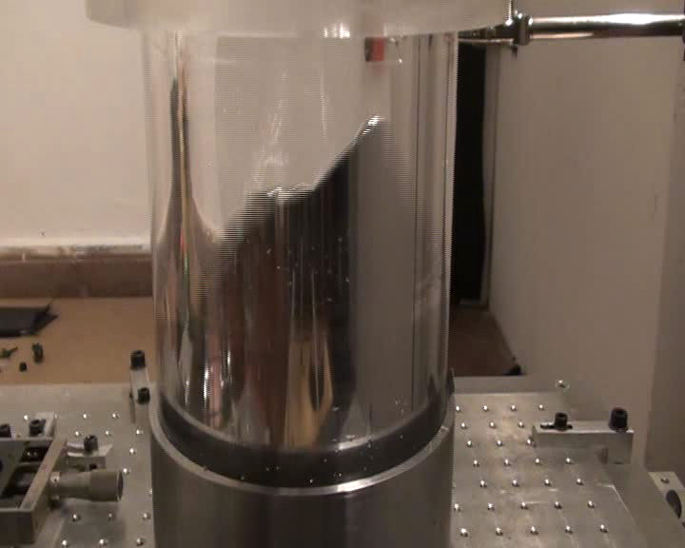
PASCAL 2020-2024: Sloshing
Objective (Taken from part B): To further enhance the modelling and computational readiness level of sloshing dynamics in compact liquid-metal filled pools and to retrieve the expected impact forces and dislocations on the involved components for a reference system (e.g. ALFRED);
VKI SHAKESPEAR seismic table
Starting from simple cylinder
Progressively including MYRRHA/ALFRED like internals
Improve free-surface measurements
Numerically going from qualitative to quantitative

Slide 14
ANSELMUS: 2022-2026 hopefully, two different items
The foreseeable Future
Qualification of the MYRRHA safety rod
Building on the Control Rod simulation in MAXSIMA
Support to the experimental campaign
Pre-test and post-test simulations,
Comparison, improvement, validation.
Investigate deformed grid spaced rod bundles
Provide pre-test support to experiments and perform post-test validation of CFD for deformed grid-spaced bundles.

Slide 15
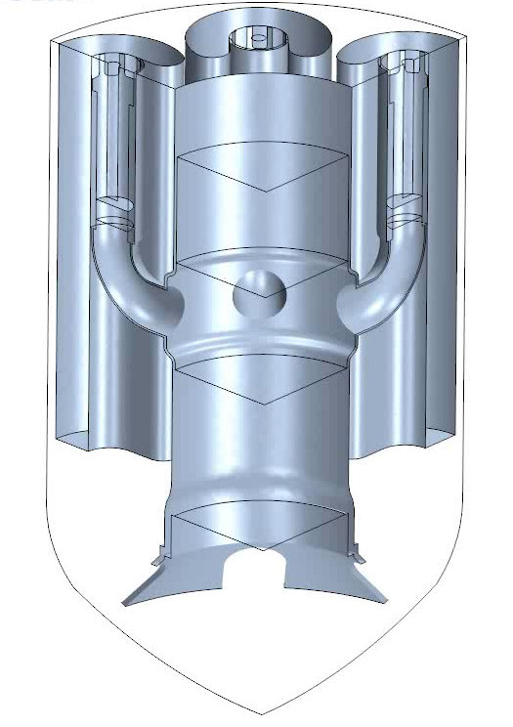
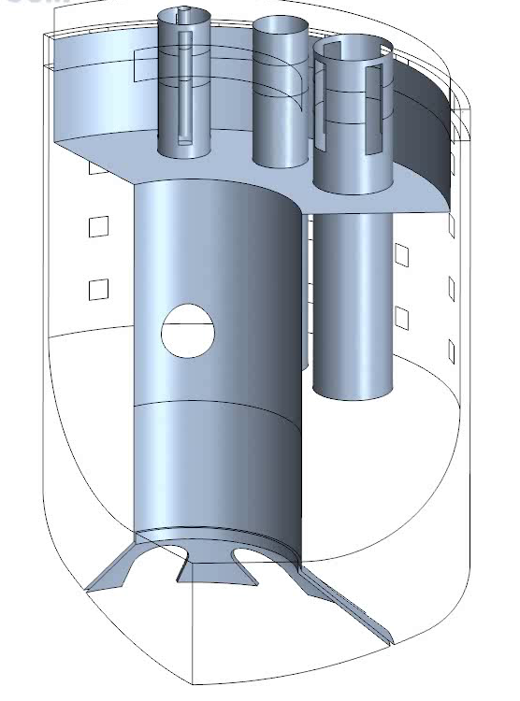
Thank you for your attention

