Slide 1
WP3.1.1 Pool Thermal-hydraulics Starccm+ for MYRRHA
Vincent Moreau (CRS4)
Fourth Progress meeting, March 9, 2017
NRG Petten, Netherlands

Slide 2
Foreword
An operational CFD model of MYRRHA was presented 6 month ago at KIT, with many improvement/new features
The model had 2 major issues:
Wrong free surface height ( about 1.2m too low)
Unpractical and unfit ACS numerical structure
An updated model is presented here with:
A corrected free-surface level
An ACS model structure consistent with SCK.CEN input.

Slide 3
Summary
Numerical model structure:
Three domain structure:
Outer domain
Intermediary domain
Central domain
Outer domain relevant features:
Split of upper BC
Split to allow directed parts
Bypass
PP with swirl and resistance
Intermediary domain relevant features:
Core Barrel description
Bypass
Central domain relevant features
Vertical organization
Horizontal structure
ACS Model
Steady state configuration
Flow field
Hydraulic resistances and PP thrust
Mass flow rates, volumes & characteristic times
Maps
Temperature,
Heat source/sink
Tables
Maps
Time scales, heat flux
ACS mixing efficiency
First Thermal transient: Energy burst in Core LBE
Evolution of the maximum temperatures
Effect on the free surface temperature
Effect on the HX
Conclusion
ACS variant
Maps
Efficiency gain
IVFS/Cold ring issue
Temperature trend
Possible solution
Concluding words

Slide 4
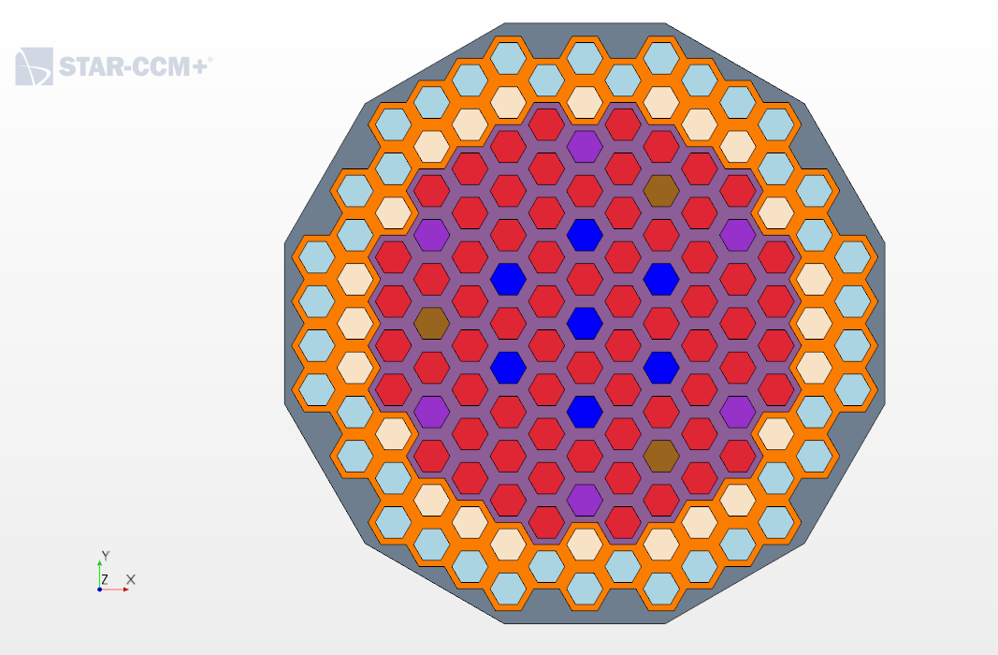
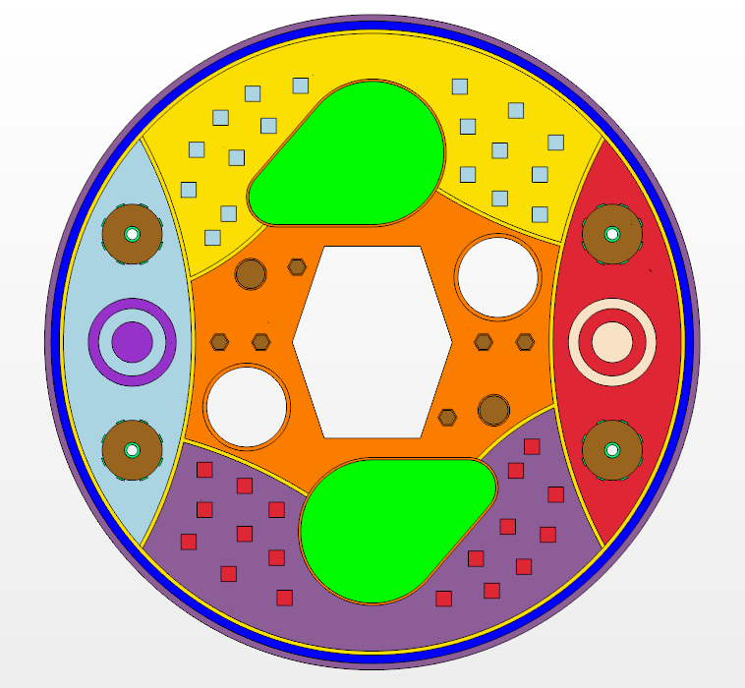
Numerical model structure
Three macro domains:
Outer domain: ancillary systems
Intermediary domain: core barrel surrounding
Central domain: core line

Slide 5
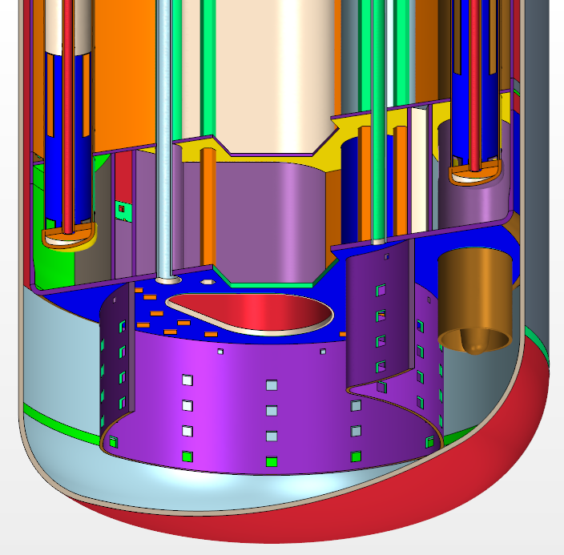
Outer Domain: HX cut
Added bypass
Vertical penetrations up to top

Slide 6
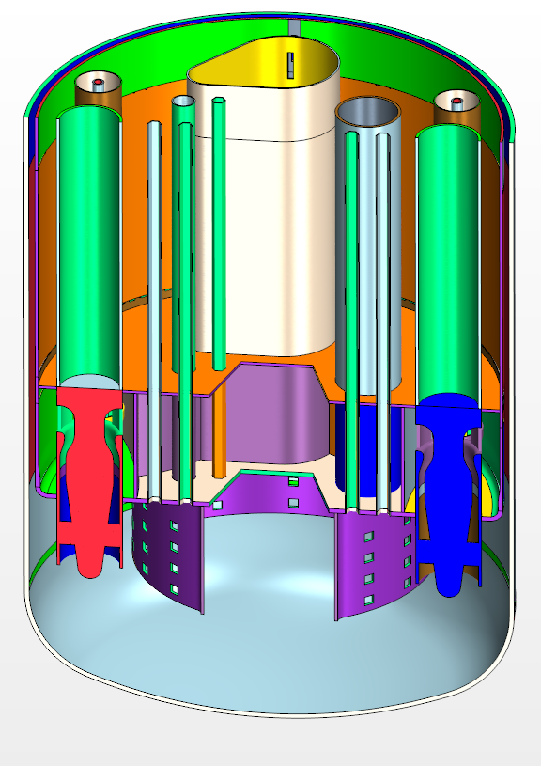
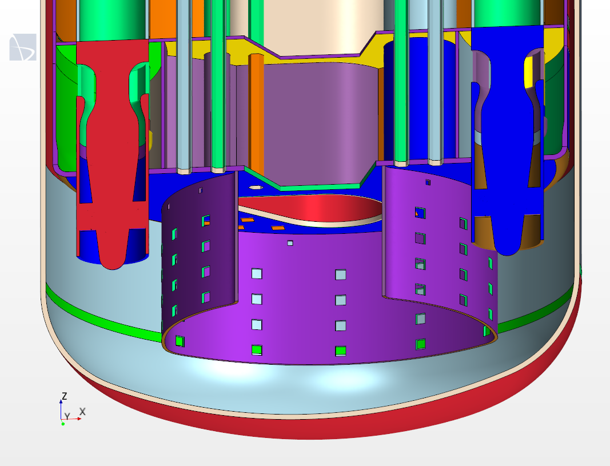
Outer Domain: PP cut
Added bypass
Vertical penetrations up to top

Slide 7
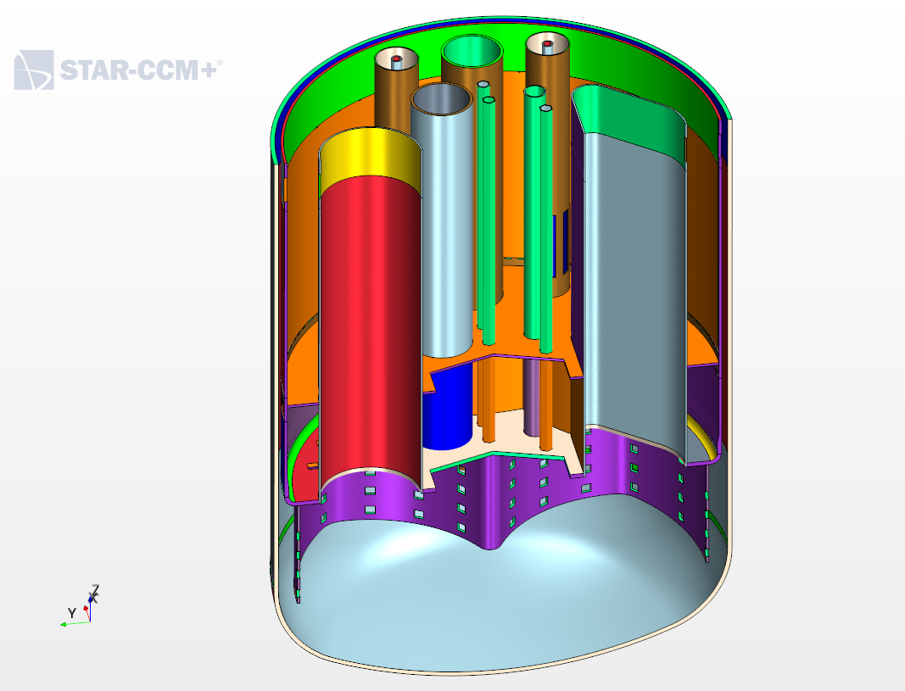
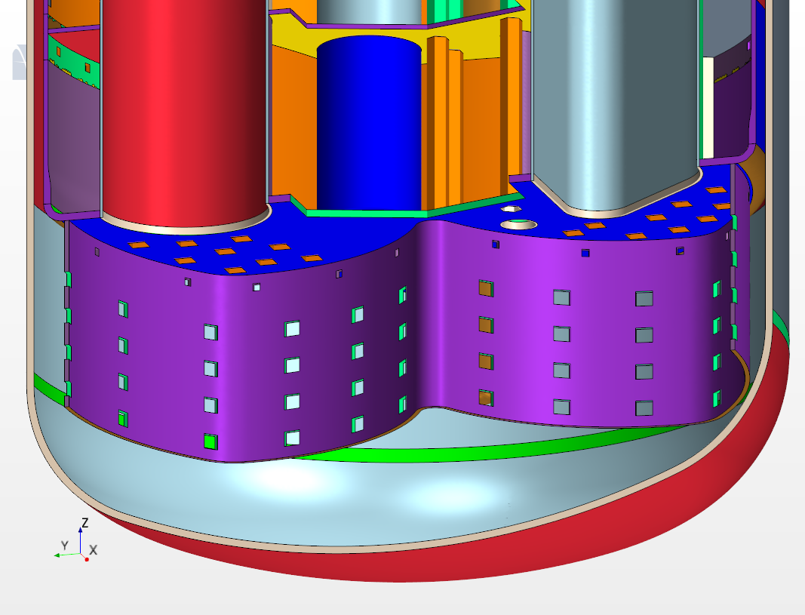
Outer Domain: IVFH cut
Added bypass
Vertical penetrations up to top

Slide 8
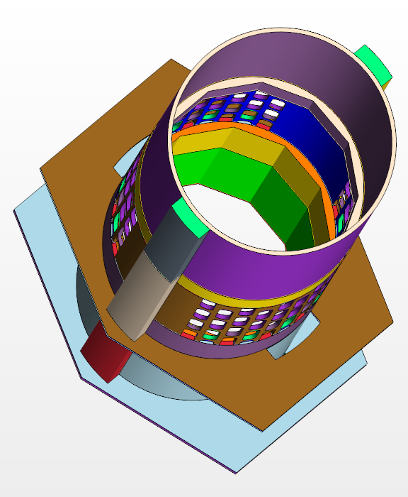
Intermediary Domain
Structural part

Slide 9
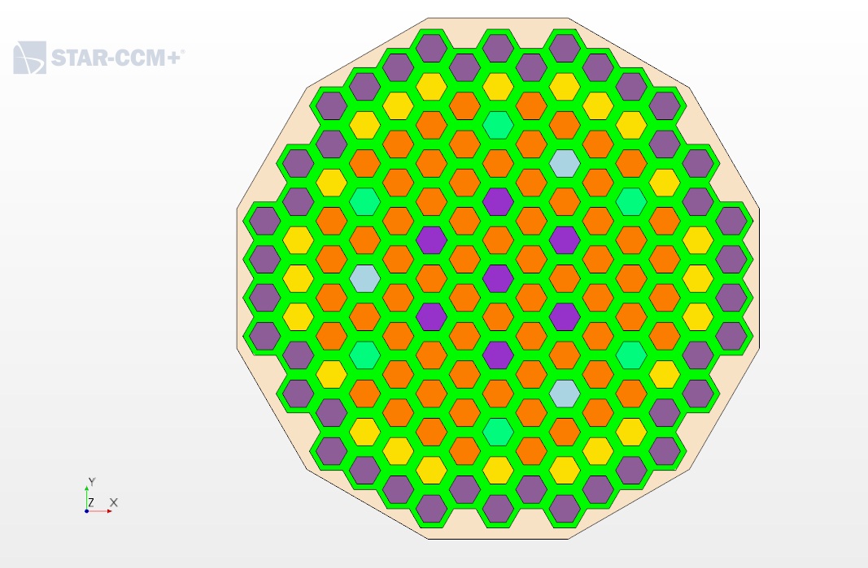
Central Domain: stratification
Four vertical levels + 2 plugs
Core level
ADS Dummy Open level

Slide 10
Outer domain relevant features
Split of upper BC
Split to allow directed parts
Bypass
PP with swirl and inertial resistance

Slide 11
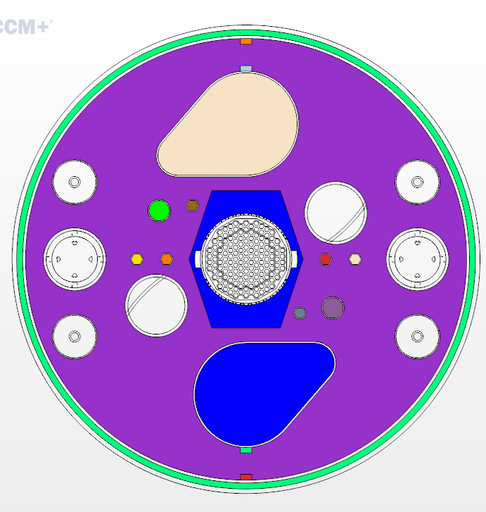
Split of upper BC/upper layer
Before, the upper layer of the simulation domain was connected and a numerical outlet was added
Now, the vertical penetrations connect to the top and each one has a specific pressure outlet
The IVFHs and the inter-vessel ring have a specific upper layer to localize the treatment of the cover gas and free-surface.

Slide 12
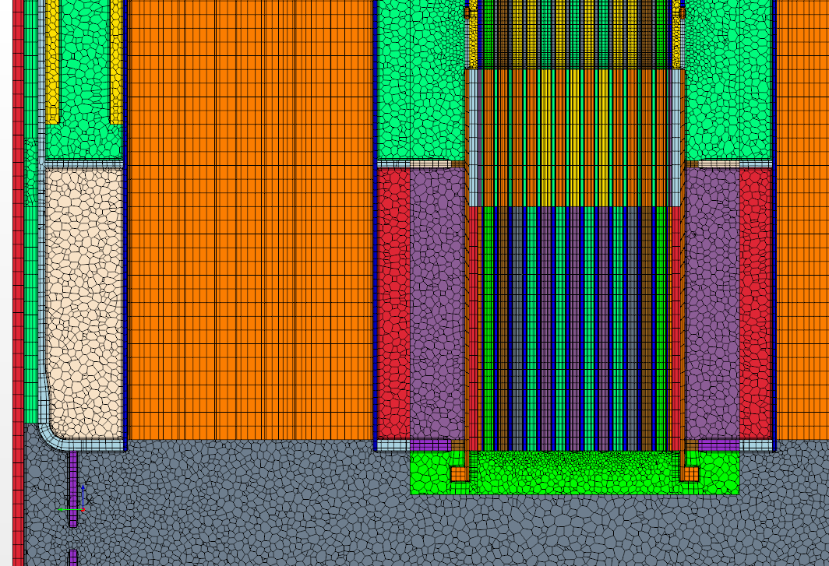
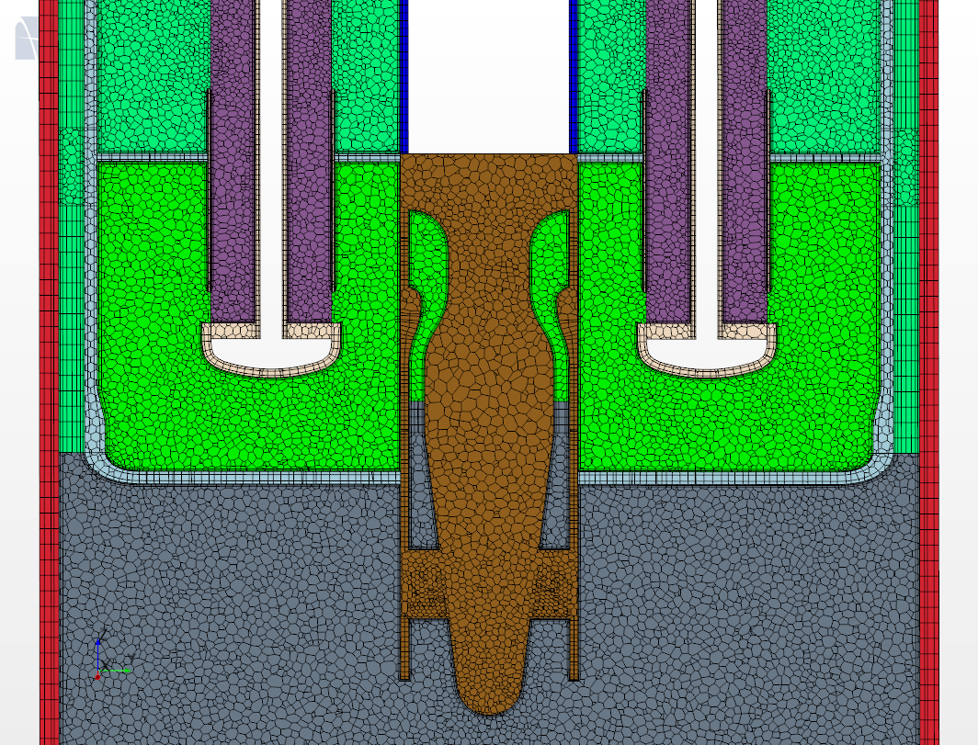
Split to allow directed parts
Where possible, a directed mesh has been privileged
The domain splitting in part reflect this attempt
The structures, the IVFHs, the inter-vessel ring and the vertical penetrations use totally or partially this meshing method.

Slide 13
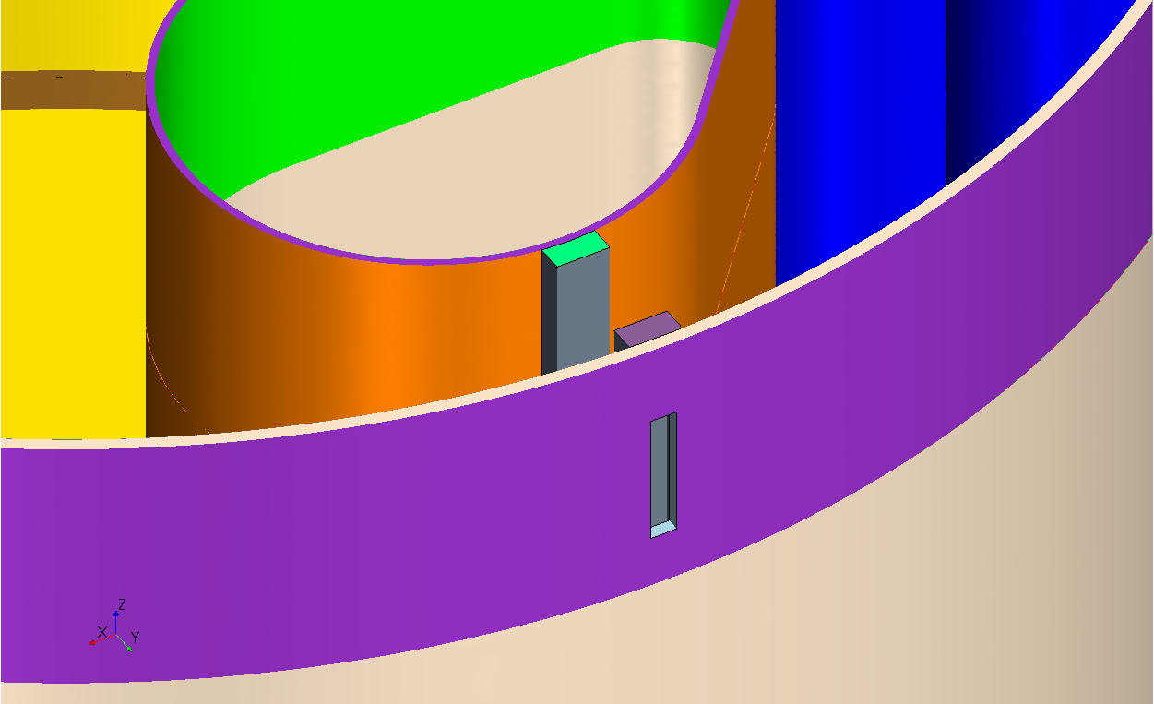
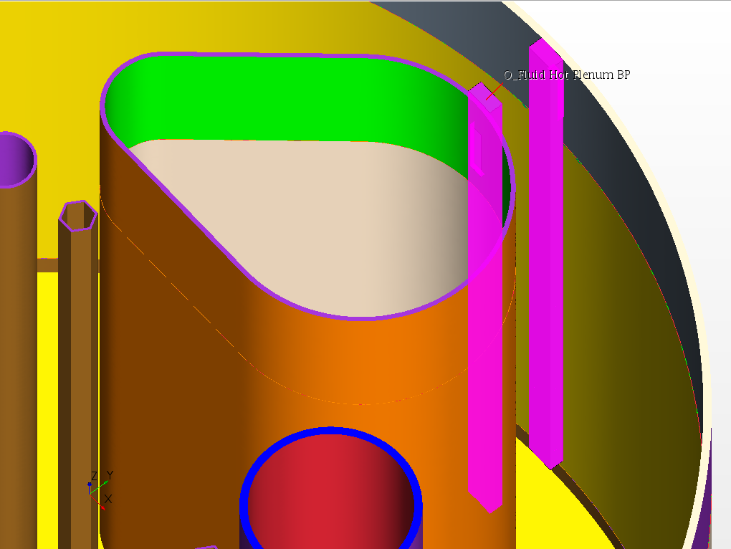
Bypass
Rectangular slices drilled in the inner vessel and IVFH wall
Rectangular (almost) box to bring the cold flow at the hot plenum bottom.
Mass flow control at the bottom with a resisting porous baffle.

Slide 14
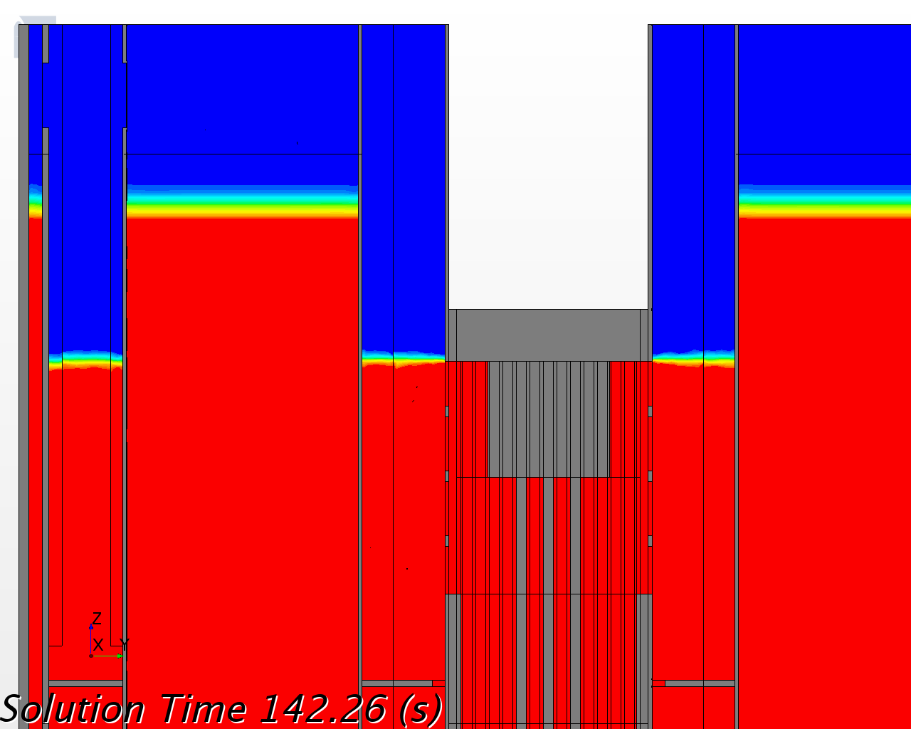
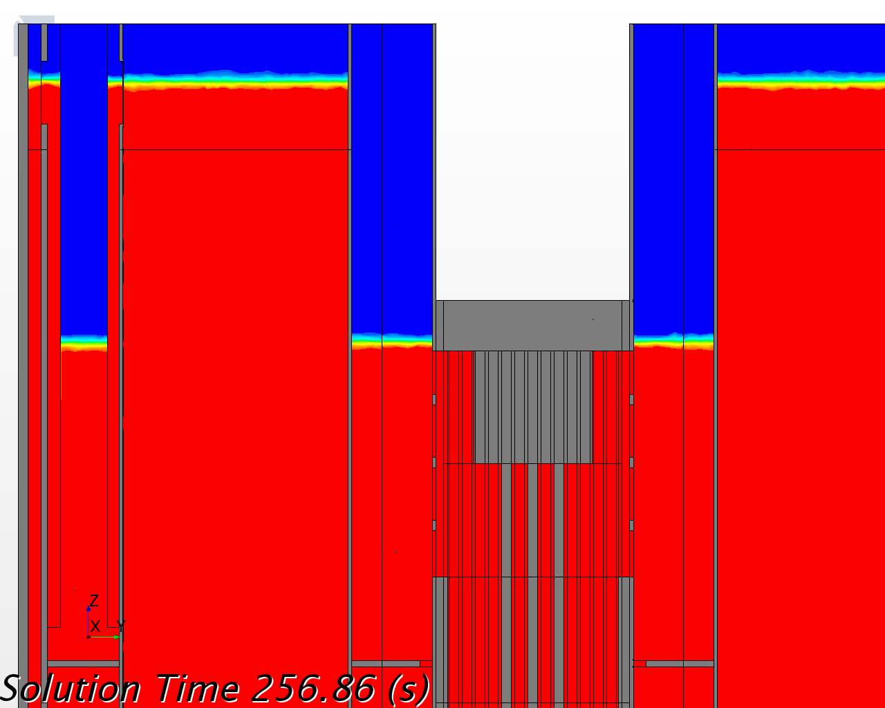
Bypass: filling
Bypass operational only around nominal condition
Upper free surface level depend on: (i) LBE inventory, (ii) PP thrust and (iii) distribution of hydraulic resistances.
Right level by trial and errors on (i) and (ii)
Before
After

Slide 15
PP with swirl and resistance
Initially only volume force : => worked fine, slightly unbalanced
Added swirl in outlet: => unbalanced outflow!
Added inlet inertial resistance (~1 Bar): => fine again
No swirl
Swirl
Swirl + resistance

Slide 16
PP with swirl and resistance
Hydraulic resistance: resistance coefficient 8 => ~1 Bar at nominal
Volume force: ~15 Bar/m on 20 cm => ~3 Bar
Swirl: 15% (V_{θ}=0.15 V_{Z})
Hydraulic resistance
Volume force
Swirl

Slide 17
PP with swirl and resistance
The Movie
368s start of animation, only body force
493s swirl added
540s inertial resistance added and body force increased
580s end of animation

Slide 18
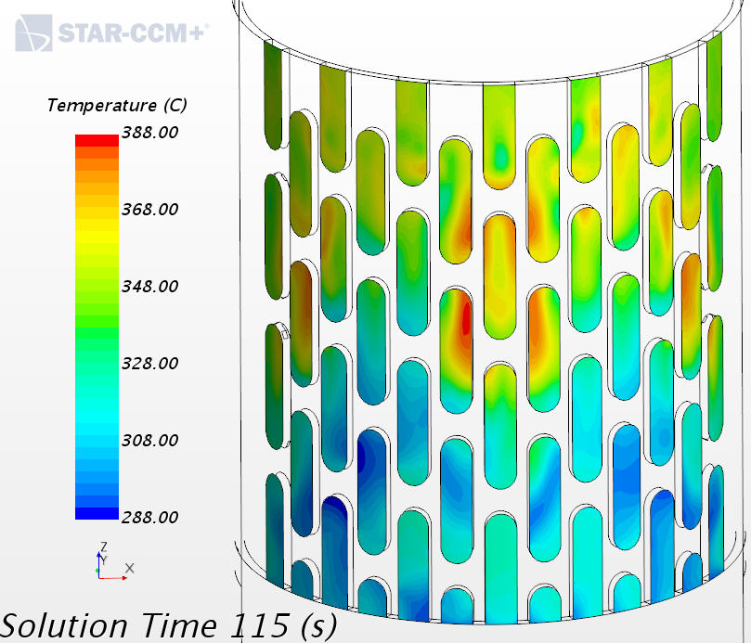
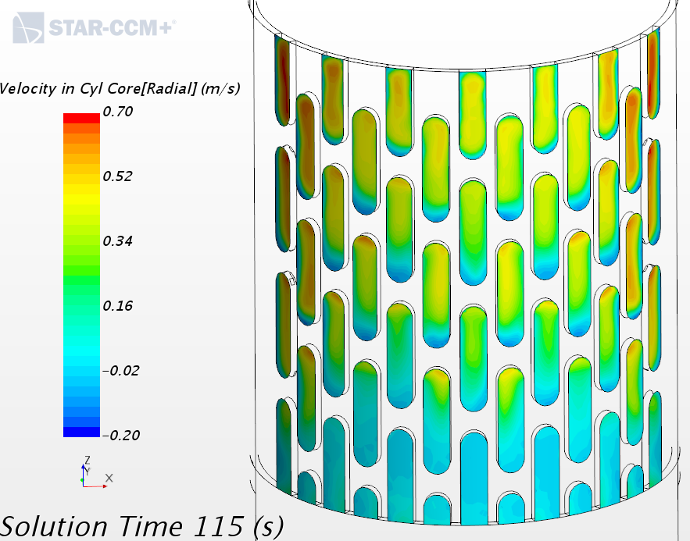
Intermediary Domain relevant features
Barrel holes have specific parts/interface on a layer basis
Can be used for visualization/measure or to have a local flow control

Slide 19
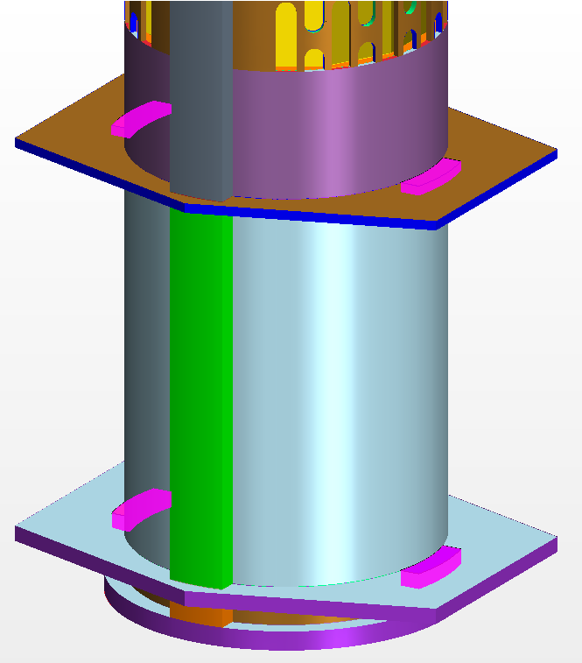
Intermediary Domain relevant features
Bypass next to barrel: lower and upper diaphragm
Control of mass flow rate with inlet porous baffle resistance

Slide 20
Central domain relevant features
Vertical organization
Horizontal structure
Vertical differentiation
Overall differentiation
ACS model adherence to current design

Slide 21
Central domain: vertical organization
Top plug
ACS Dummy Open
ACS All Open
ACS Closed
Core level
Bottom plug

Slide 22
Central domain: horizontal structure
Inner Jacket
Outer Dummies
Inner Dummies
Fuel Assemblies
CR
Core plenum
SR
IPS
Core level

Slide 23
Central domain: horizontal structure
Inner Jacket
Outer Dummies
Inner Dummies
Fuel Assemblies
CR
ACS outer plenum
SR
IPS
ACS inner plenum
ACS levels

Slide 24
Central domain: vertical differentiation
ACS Dummy Open
Solid: FA, ACS inner plenum, CR, SR, IPS
Fluid: jacket, Inner dummies, outer dummies, ACS outer plenum
ACS All Open:
Solid: IPS
Fluid: all except IPS
ACS Closed/Core level
Solid: Jacket, IPS
Fluid: all except jacket & IPS

Slide 25
Central domain: overall differentiation
First level
Solid
Fluid normal
Fluid porous
Second level for fluid/fluid interfaces:
Bottom/Top: internal or resistive baffle
Lateral side: internal, resistive porous baffle or plain baffle

Slide 26
ACS Model
Adherence to the current design
ACS Dummy Open
ACS All Open
ACS closed
Core level

Slide 27
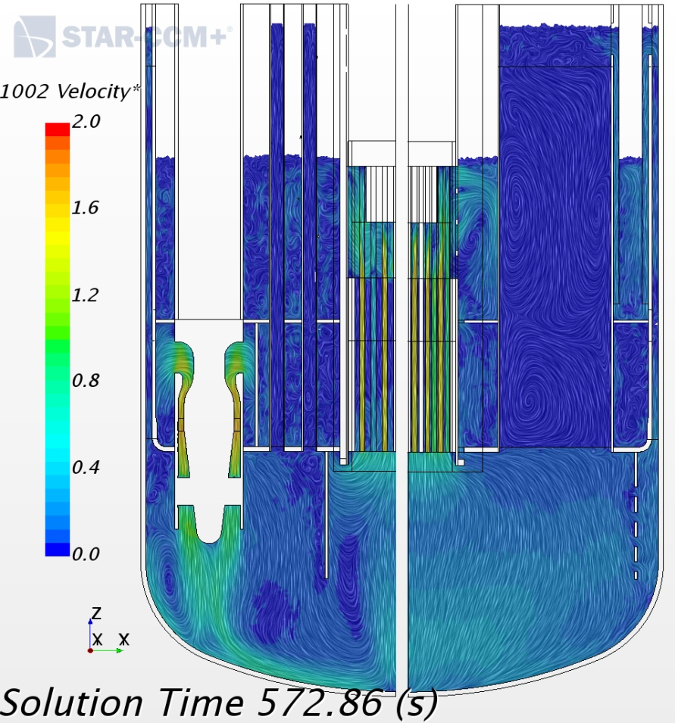
Steady-state configuration
Simulation run for a sufficient time to have constant mass flow rates and almost constant temperatures at critical positions.
Pumps mass flow rate: 9538 kg/s
Core mass flow rate: 9181 kg/s
PP thrust 2.38 Bar
Core power: 100 MW
Total heating 103.5 MW
Core Inlet temperature: 270 C
HX inlet temperature: 340 C
Holt plenum free surface level: ~3.4 m.
Cold plenum free surface level:~5.5 m

Slide 28
Steady-state configuration: mass flows
Main core mass flows as from design
Position | CR | Inter-Wrapper | Inner Dummies | Outer Dummies | SR | FAs | Total Core
Design mass flow [kg/s] | 258 | 400 | 1714 | 2166 | 19 | 4926 | 9483
Simulation mass flow [kg/s] | 280 | 412 | 1719 | 1777 | 46 | 4947 | 9181
Same mass flow for each FA
FA ring/number | 1/6 | 2/6 | 3/18 | 4/15 | 5/24 | Total
Total mass flow [kg/s] | 426 | 428 | 1288 | 1078 | 1726 | 4947
Single FA mass flow [kg/s] | 71.1 | 71.4 | 71.6 | 71.9 | 71.9
Balance changed due to bypass
 | Heat Exchanger | RVACS
Heat Sink [MW] | 101.3 | 0.52

Slide 29
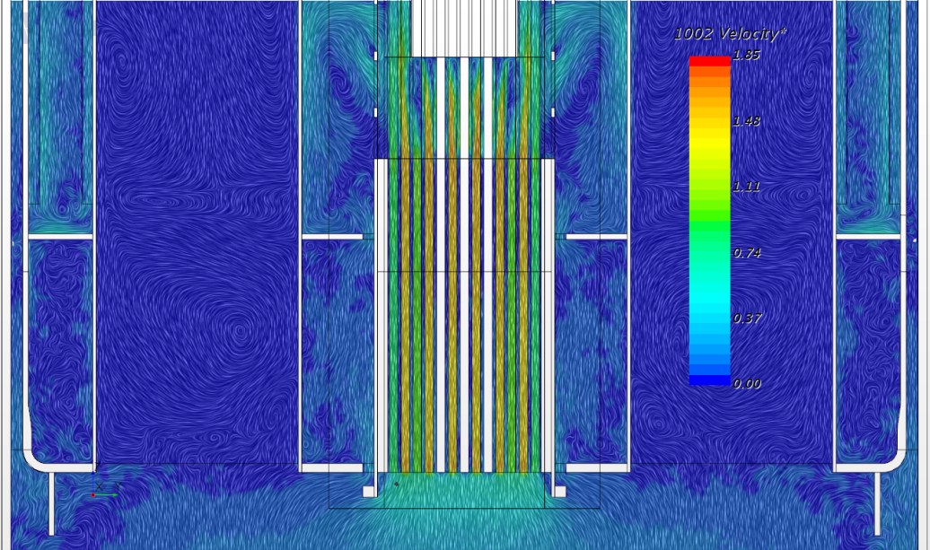
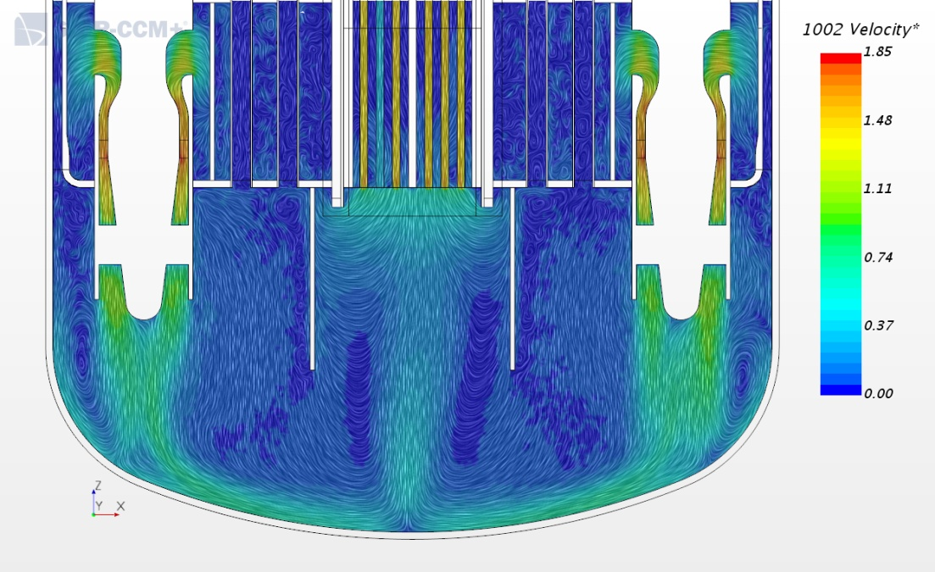
Steady-state: velocity maps

Slide 30
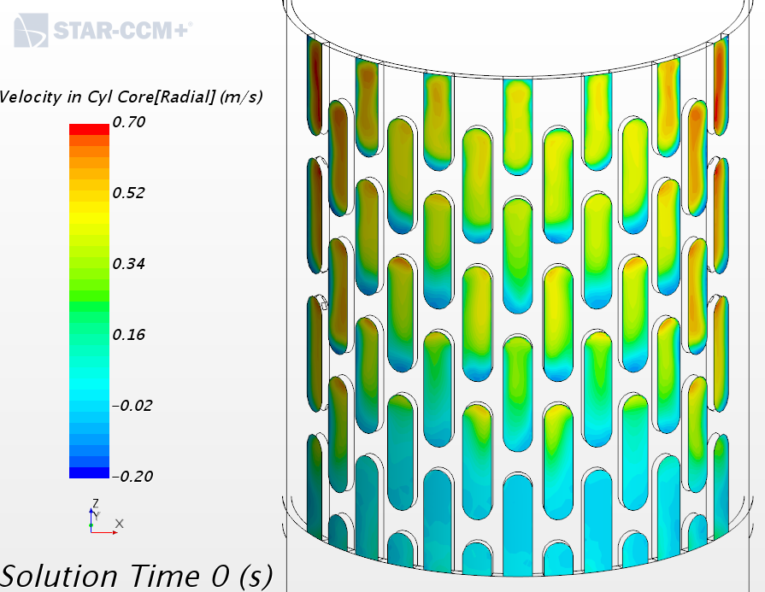
Steady-state: velocity maps
Strong tangential component near the shafts
Room for other hole columns

Slide 31
Steady-state: heat source/sink
Heat sources
 | Polonium | Pumps | Fuel Storage | SR | CR | Inner dummies | Outer dummies | FAs | Total
Heat Source [MW] | 0.59 | 1 | 2 | 0.12 | 0.24 | 0.1 | 0.4 | 99.1 | 103.55
Heat source for each FA
FA ring/number | 1/6 | 2/6 | 3/18 | 4/15 | 5/24 | All/69
Heat source by ring [MW] | 12.43 | 11.74 | 30.48 | 20.97 | 23.56 | 99.1
Mean heat source by FA | 2.07 | 1.96 | 1.69 | 1.40 | 0.98 | 1.44
Balance changed due to bypass
Position | Bypass Barrel | Bypass Cold Ring | Bypass IVFH | Total Bypass | Primary pumps
Simulation mass flow [kg/s] | 192 | 83 | 83 | 358 | 9538

Slide 32
Steady-state: Temperatures
Main core outflow temperatures
Position | CR | Inter-Wrapper | Inner Dummies | Outer Dummies | SR | FAs
Outflow temperature [C] | 276 | 270 | 270 | 272 | 288 | 408
Temperatures for each FA ring
FA ring/number | 1/6 | 2/6 | 3/18 | 4/15 | 5/24 | All
Mass flow averaged outlet Temperature [C] | 471 | 459 | 433 | 404 | 364 | 408

Slide 33
Steady-state: Temperatures
IVFS and HX
 | Fuel Storage In | Fuel Storage Out (top) | IVFS Out | Heat Exchanger In | Heat Exchanger Out
Mass flow averaged T [C} | 270 | 309 | 290 | 340 | 268
FAs and above
Position | FA | ACS All Open | ACS Dummy Open | Hot Plenum (Intermediate) | Hot Plenum (Outer) | Free Surface
Maximum Temperature [C] | 476 | 476 | 466 | 387 | 367 | 361

Slide 34
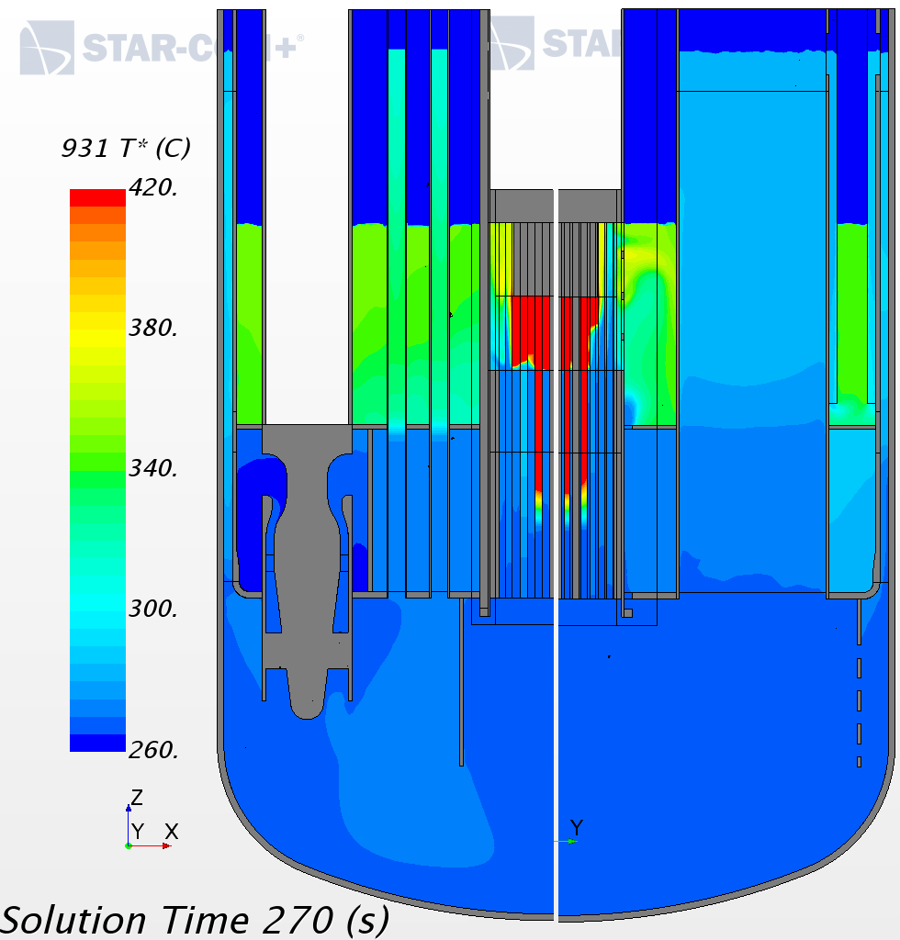
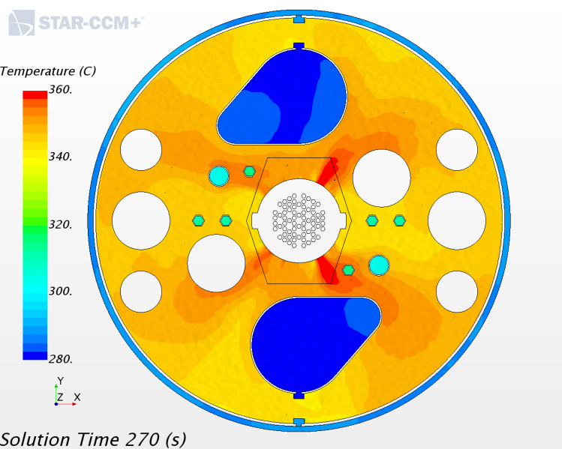
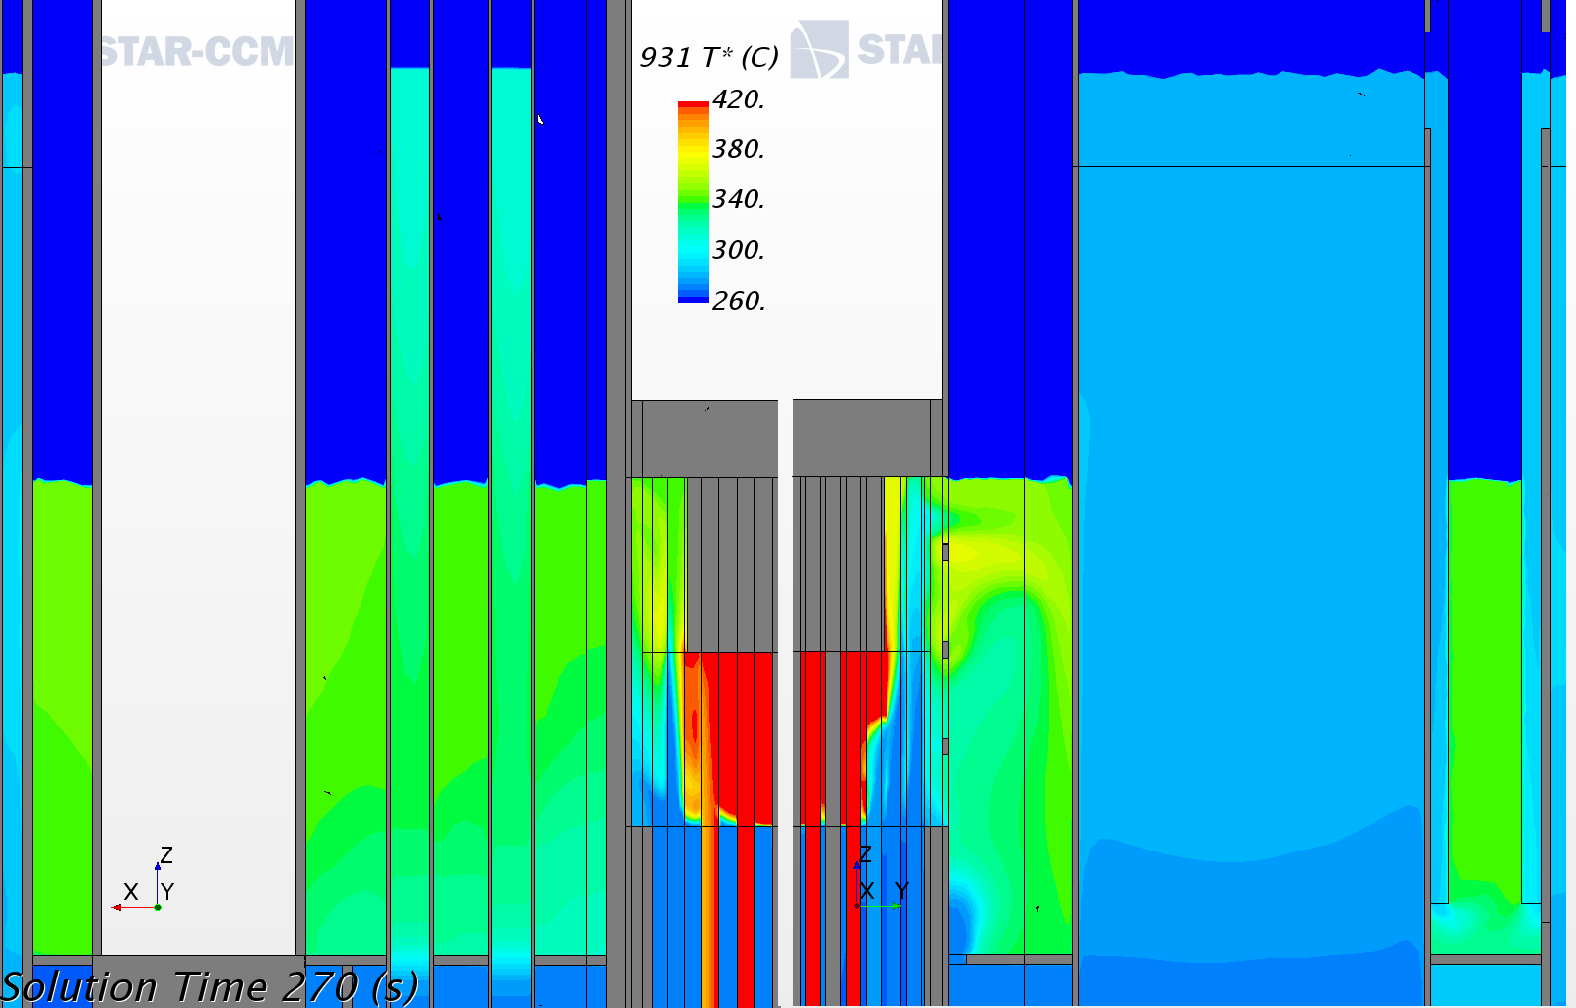
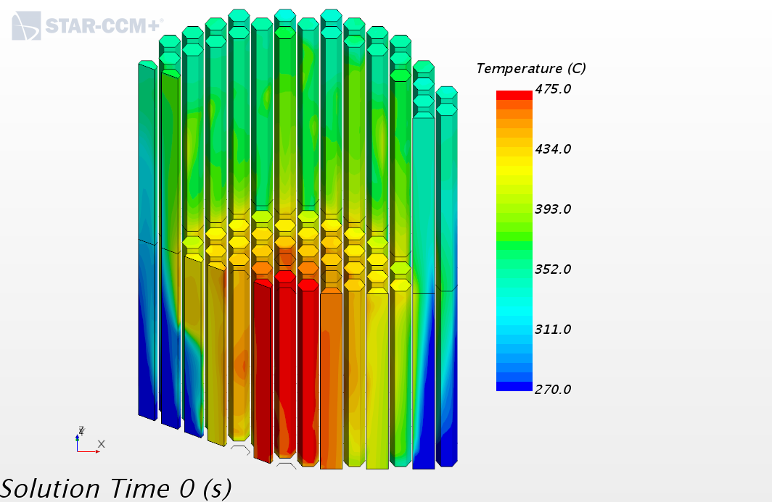
Steady-state: Temperature maps
Main core outflow temperatures

Slide 35
Time scales
From the volumes and the flow rates, we can derive some time scales
Region | LBE volume [m³] | Mass flow [kg/s] | Time scale [s], ([min])
MYRRHA | 376.5 | 9,500 | 410, (6.50)
Hot plenum | 77 | 9,500 | 84, (1.24)
Cold plenum main | 161 | 9,500 | 176, (2.56)
IVFH | 43.5 | 83 | 5440, (90)
Mid Plenum | 13 | 192 | 700, (11.40)
Cold Ring | 17 | 83 | 2130, (35)
IVFS | 30 | ~180 | 1730, (29)
Vertical penetrations | small | ~0 | ~∞

Slide 36
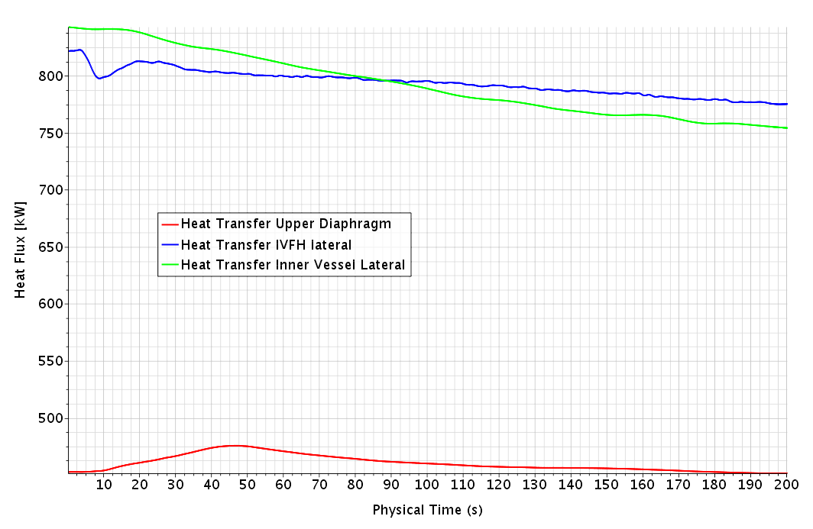
Heat flux
The main conducting heat flux are not yet stabilized. Consistently with the considerations on the characteristic time scales, they show a slow but essentially monotonous variation. Below is typical example.

Slide 37
Steady-state: Mixing efficiency
We define a mixing efficient such that mixing is “perfect”, with value 1, when the maximum temperature on the free surface equals the mean global hot flow temperature:
Total power: 103.5 MW
Total mass flow (PP): 9538 kg/s
Mean flow dT: 75 K
Meat hot flow T: 270+75= 345 C
Maximum FS T: 361 C
Mixing efficiency: 1-(361-345)/75= 79%

Slide 38
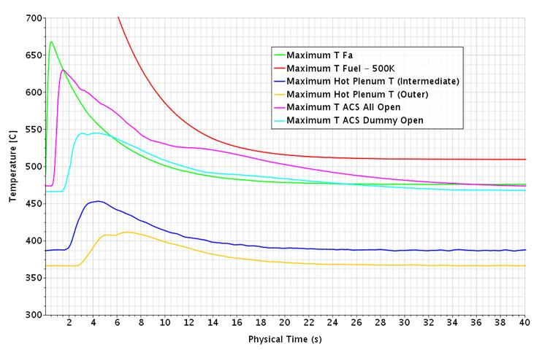
First thermal transient
Energy burst in Core LBE
The characteristic time of heat transfer from the fuel to the flowing LBE was too high resulting in an excessive fuel temperature
This characteristic time has been reduced to 3.25s to get the maximum fuel temperature at about 1000 C.
As a consequence, a quite large quantity of energy, about 700 MJ, has been released in a short time to the LBE flowing through the core
The thermal transient investigates the effects of this release.

Slide 39
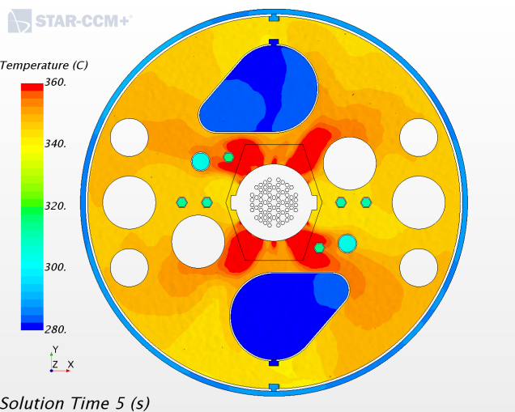
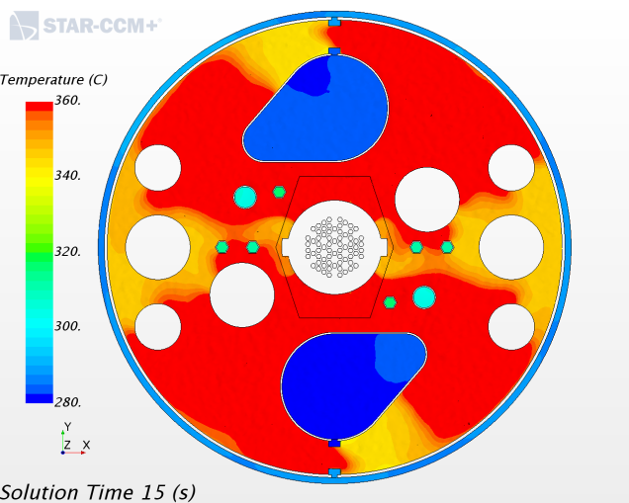
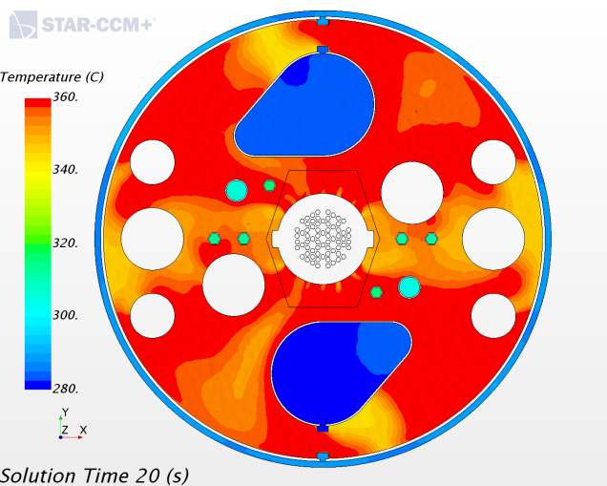
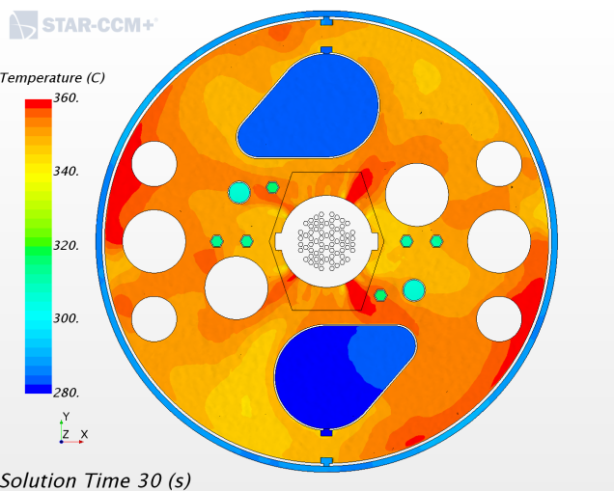
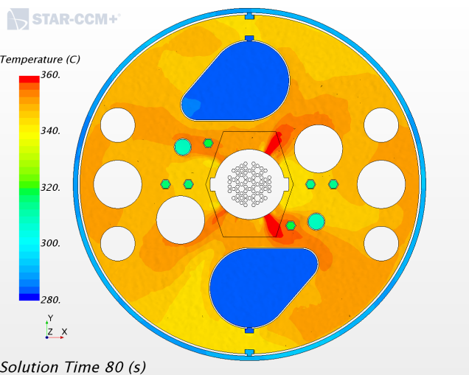
First thermal transient
Effect on the free surface temperature
Free surface temperature essentially recovered after 80s

Slide 40
First thermal transient
Effect on the free surface temperature: the movie!

Slide 41
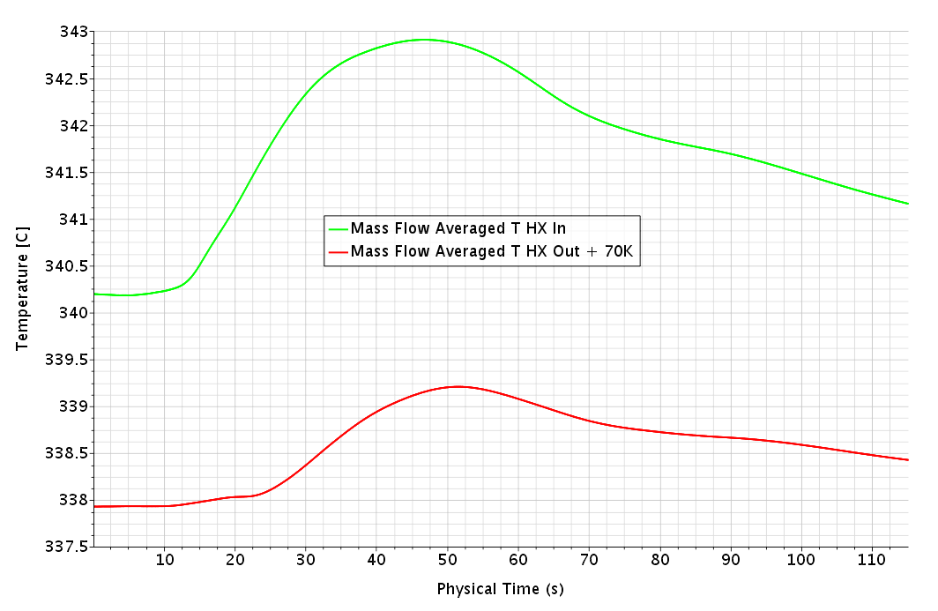
First thermal transient
Effect on HX inlet/outlet temperature
From 150 K in the Core to 3 K in the HX and 1.5 K out of the HX

Slide 42
First thermal transient: conclusion
Fast recover of the hot plenum temperature field
Very good mixing in the hot plenum
Diluted and marginal impact on the HX
=>
Configuration very resilient to energy burst

Slide 43
ACS variant
Closing of the outer dummies lateral wall at the “ACS All Open Level”
Before: porous baffle with inertial resistance coefficient 30 (~20% porosity)
After: plain baffle (no cross flow)

Slide 44
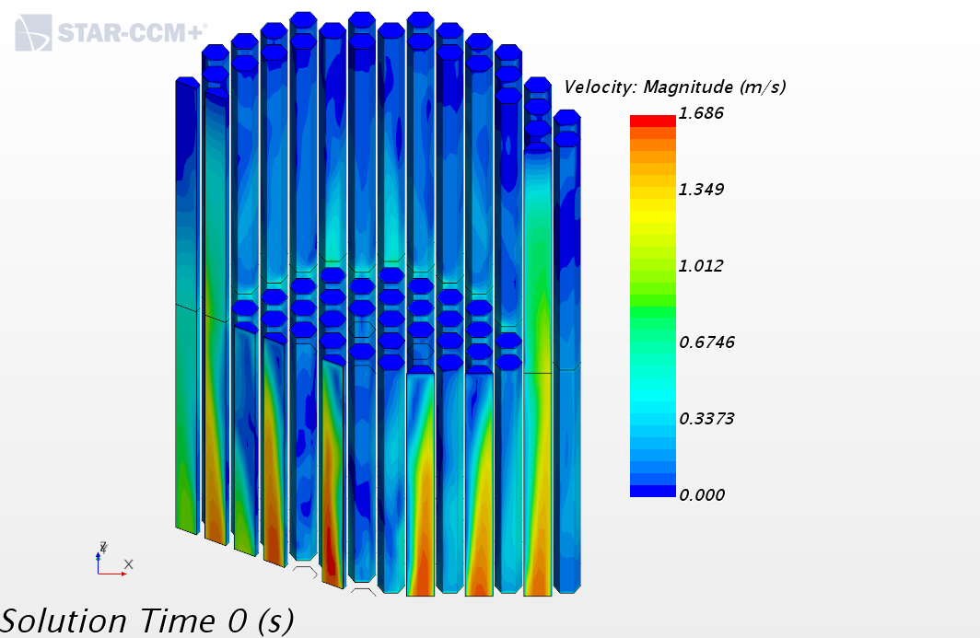
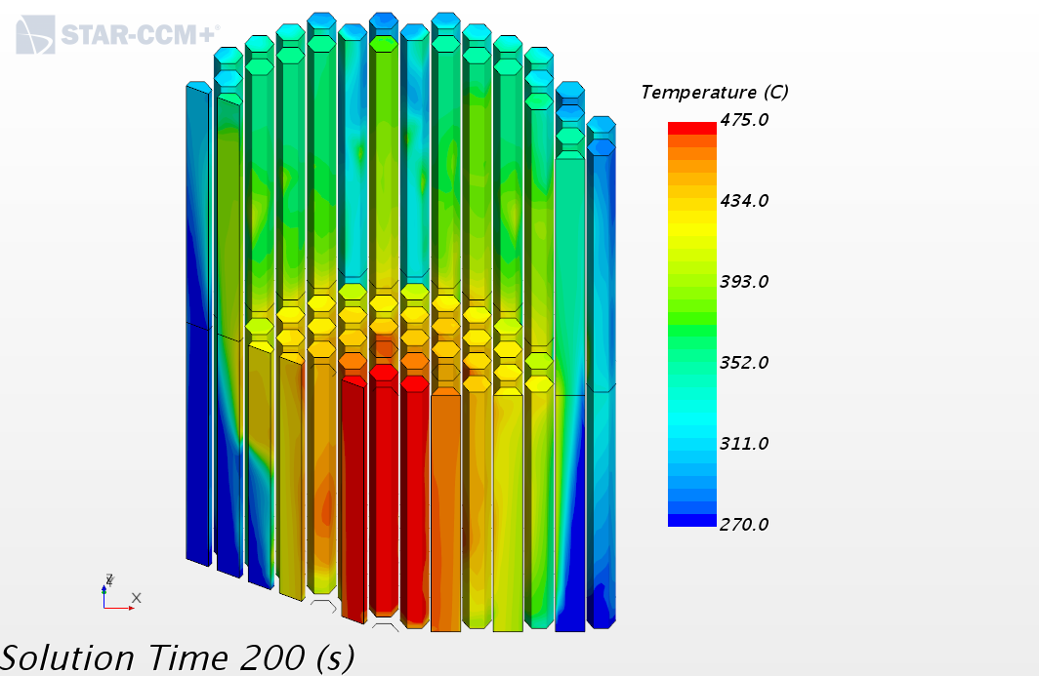
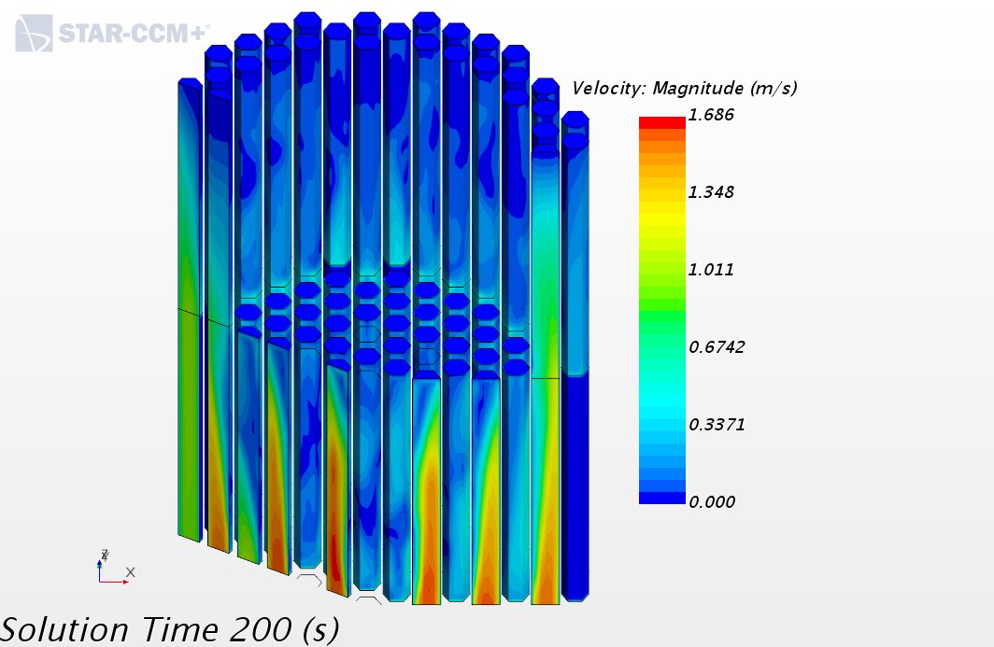
ACS variant
ACS guides Temperature and velocity, before and after
Before
After

Slide 45
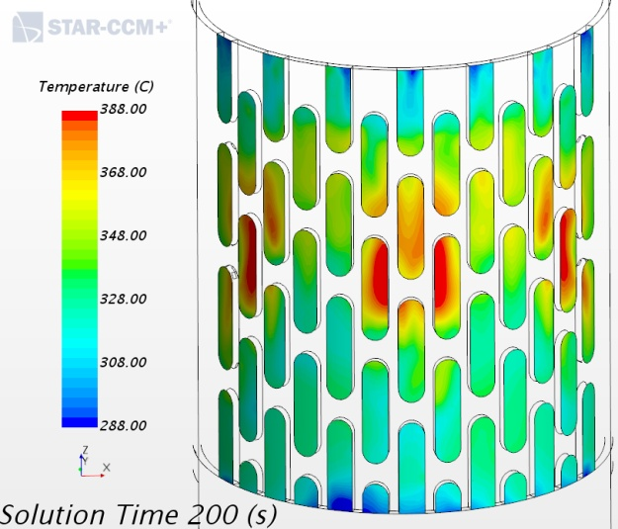
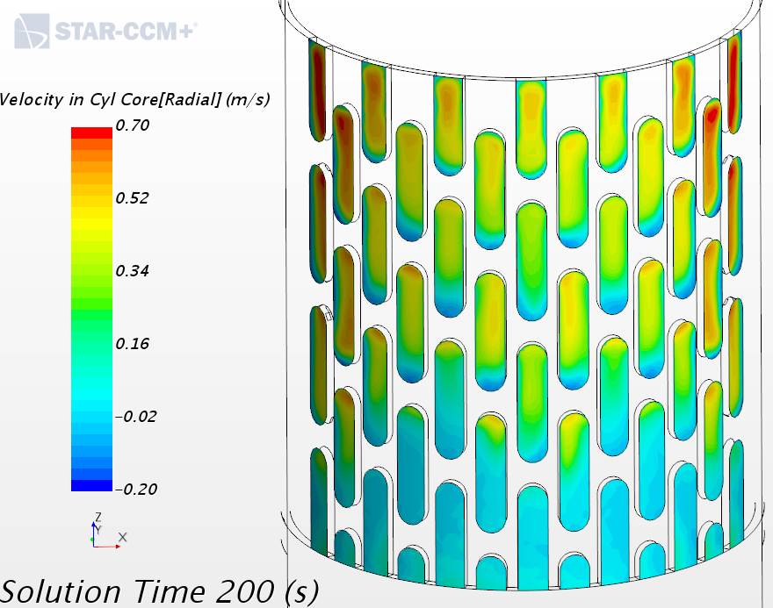
ACS variant
Barrel outlets Temperature and velocity, before and after
Before
After

Slide 46
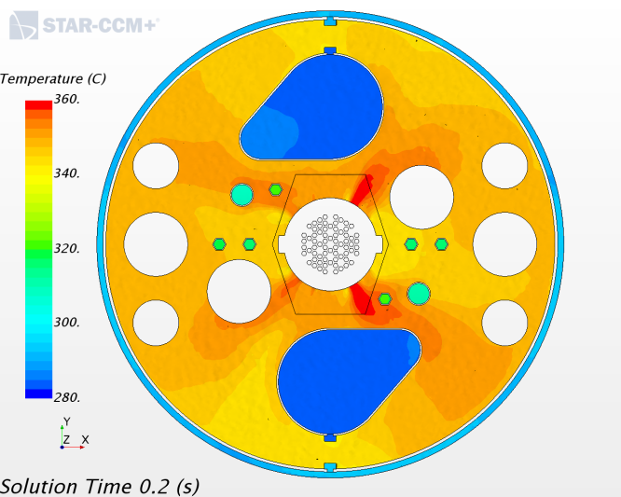
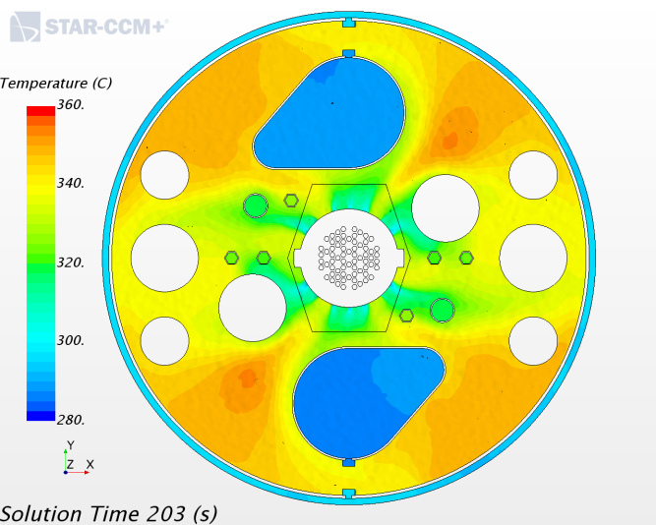
ACS variant
Free surface Temperature before and after
Before: max T=361 C
Efficiency= 79%
After: max T=353 C
Efficiency= 89%

Slide 47
ACS variant
The movie

Slide 48
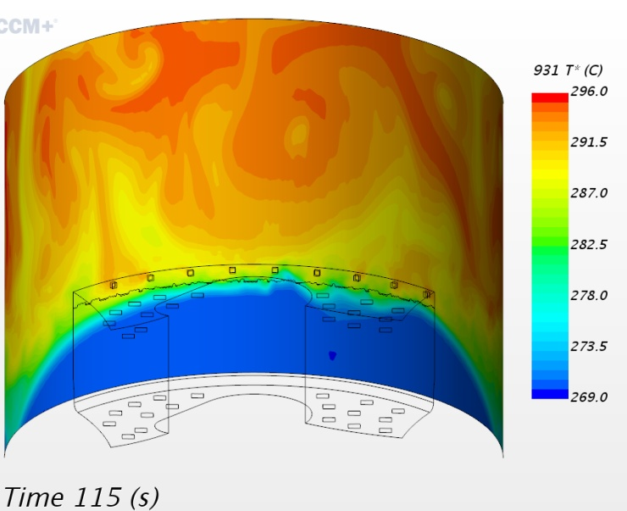
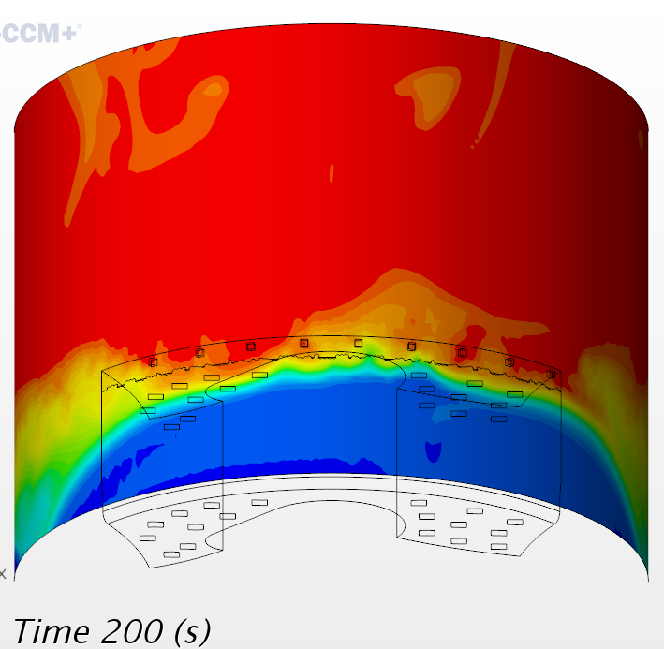
IVFS/Cold ring issue
The IVFS temperature and mass flow rate are far to be settled
They are strongly coupled with the temperature and mass flow rate of the cold ring
Main influencing parameters are:
FS heat source
IVFS global hydraulic resistance
IVFS conduction heat flux to all neighbors
Bypass flow rate.
“Cold” ring temperature, end of first and second transients

Slide 49
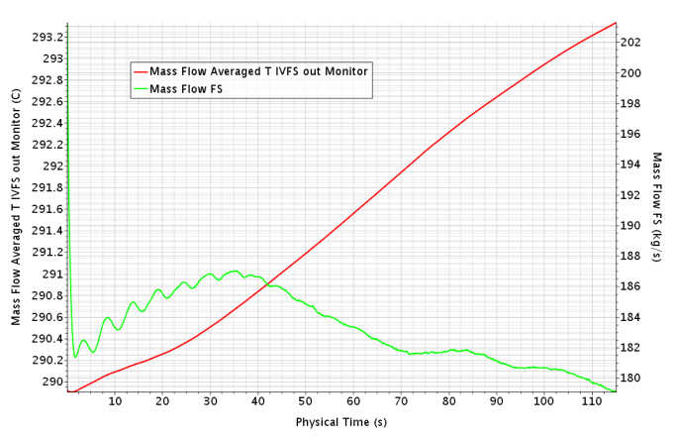
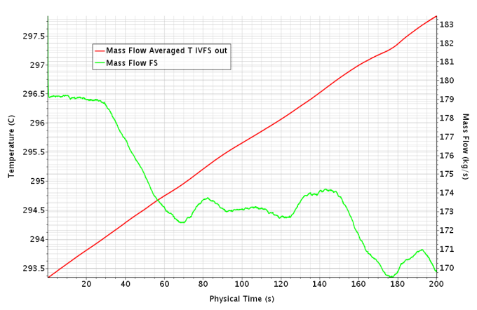
IVFS/Cold ring issue
At 2MW and 180 kg/s, the equilibrium temperature at the IFFS outlet is hotter than in the hot plenum!
As the flow rate goes down things can come quite nasty…
IVFS outlet T and flow rate during first and second transients

Slide 50
IVFS/Cold ring issue: solution
Once the phenomena understood the solution can be easy:
If the bypass flow rate exceed the IVFS flow rate, then the heat do not propagates downward in the ring and do not damp the buoyancy driven pumping power of the IVFS
The stored fuel decay heat must be evacuated through the bypass and the bypass flow must be sufficient to limit the local temperature increase.
Resetting the heat source to 1MW (probably still conservative) and increasing the cold ring bypass flow to ~200 kg/s should keep the cold ring temperature below the IVFS outlet at cold temperature and above the IVFS outlet below ~310 C.

Slide 51
Concluding words
The new MYRRHA CFD model is operational: 43s/day with 140 CPU
The ACS is compliant with SCK.CEN input and looks quite functional
A slight variant of the ACS can bring a quite cooler free-surface at no cost.
The installed bypass flows brings a new field of investigation that must be addressed
No critical issue has been encountered

Slide 52
Questions?

Slide 53
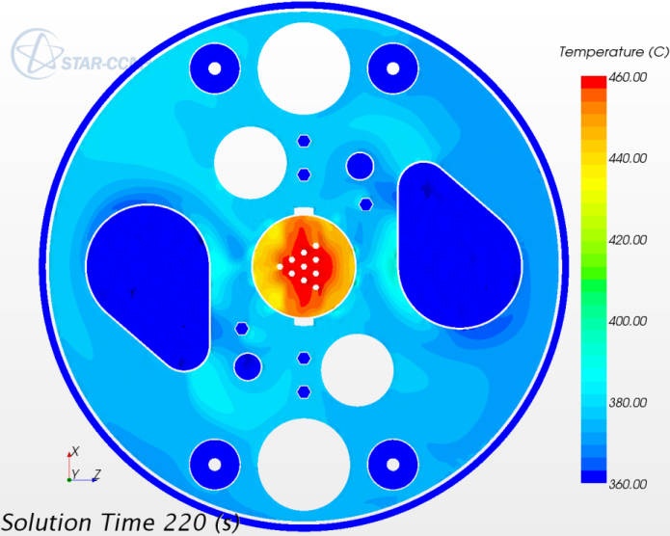
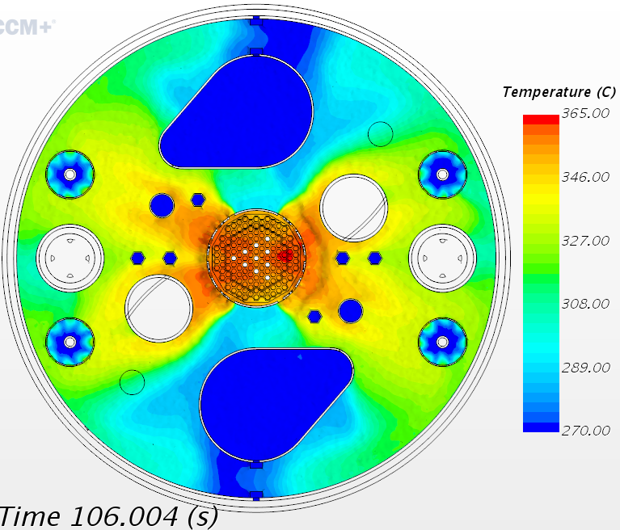
Surface Temperature: SEARCH vs. MYRTE
SEARCH model
1St MYRTE model
2nd MYRTE model
MYRTE ACS variant

