Slide 1
Solidification modelling at CRS4
V. Moreau (CRS4)
Fourth Progress Meeting, March 6-8
NRG Petten, Netherlands

Slide 2
Content
General objective
About MelilooStand
CFD model
Geometry
BC, Cover gas,…
Mesh
Main setting
Step 0: Close to freezing onset
Lessons from first and second freezing attempts
Lessons from third and forth freezing attempts
Overcome of numerical issue
Flow stop consideration
Fifth attempt: the “good” one!
Simulation on track
Instrumentation
History: heat flux, frozen volume
Front propagation
TC T history
Flow field, front sharpness, conductivity issue
Comment on solidification model in Starccm+
Conclusion
What next

Slide 3
General objective
Demonstrate that the overall modeling of HLM complex systems can include some solidification phenomenology by:
Reproducing small/medium scale experiment:
MelilooStand
Tall3Dfreezing (pre-test)
Confronting with experimental results
Adjusting/improving the numerical setting (post-test)
Evaluate time scales, limitations, computational cost
Allow:
To reach initial steady states
An increased number of accessible transients

Slide 4
About Meliloo - stand
Detailed geometrical description in Del 3.2.1_M12 available end of June 2016:
Description of the Meliloo - stand test facility and test matrix
By: Ivan DOFEK, Otakar FRYBORT, Jan VIT, Miroslav SLINC
Issued by CVR
Physical properties of the materials gathered in:
Summary for the recommended physical properties for the main fluid and liquid materials used for the MELILOO-stand and TALL-3D freezing experiments. Prepared by B. Niceno and A. Badillo
Paul Scherrer Institute
Version 1.0, June 20, 2016

Slide 5
Meliloo – Stand model Geometry
Splitting in regions for several causes:
Different material
Steel
LBE (+cover gas)
Air
Probes (steel as first guess)
Different meshers
Unstructured polyhedra
Directed (extruded)
Advancing layer then Boundary layer mesher
Specific source
Heat source: Heaters

Slide 6
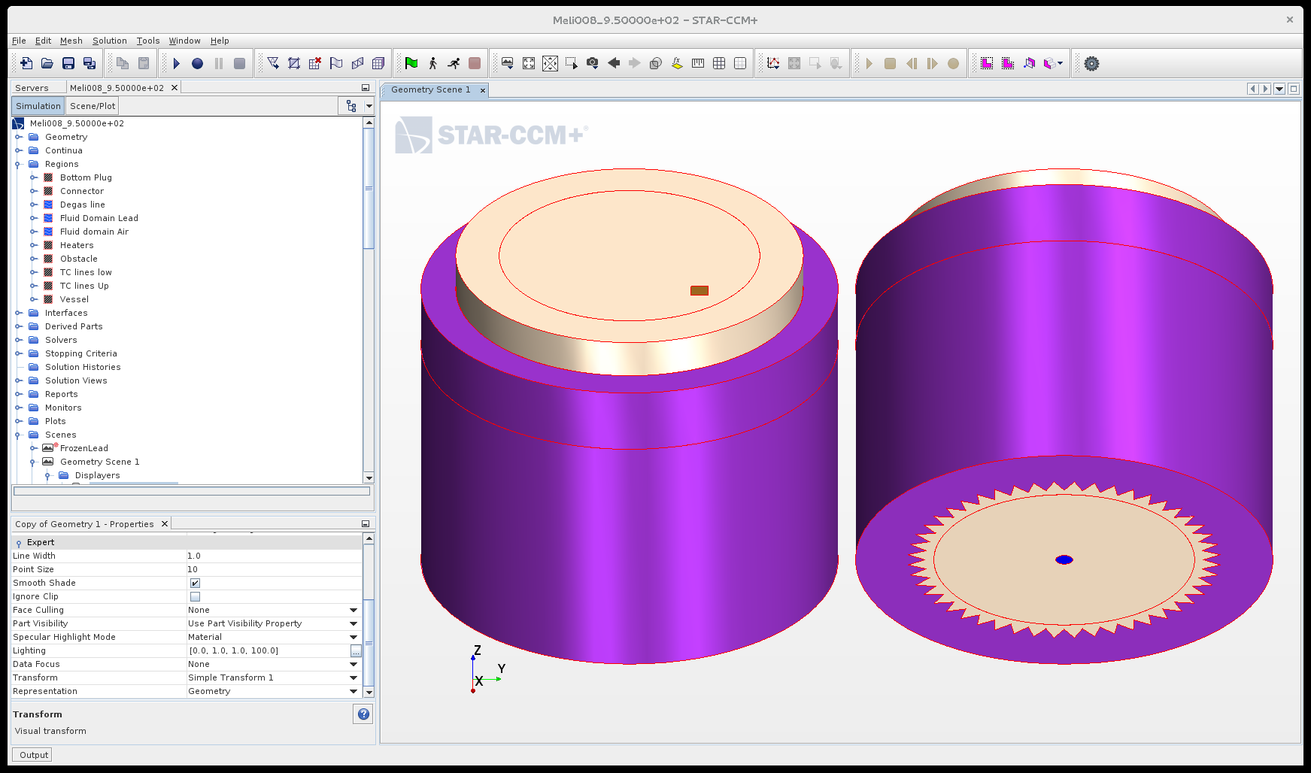
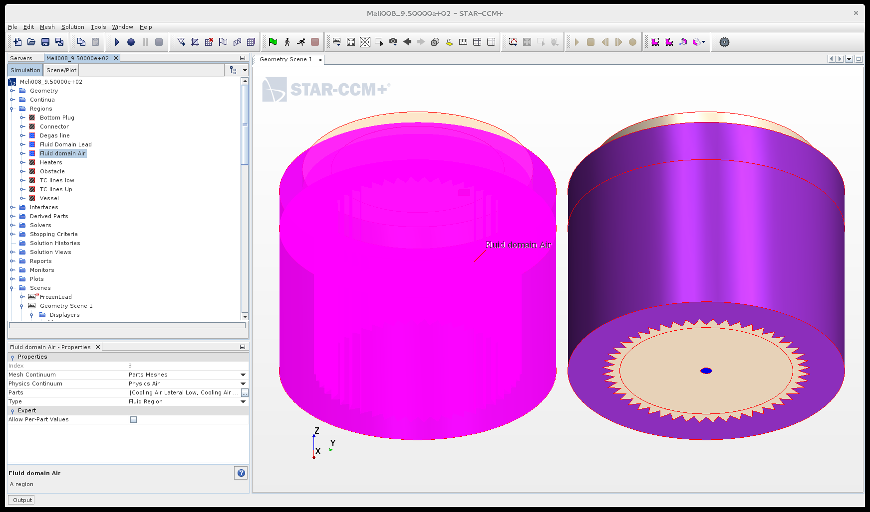
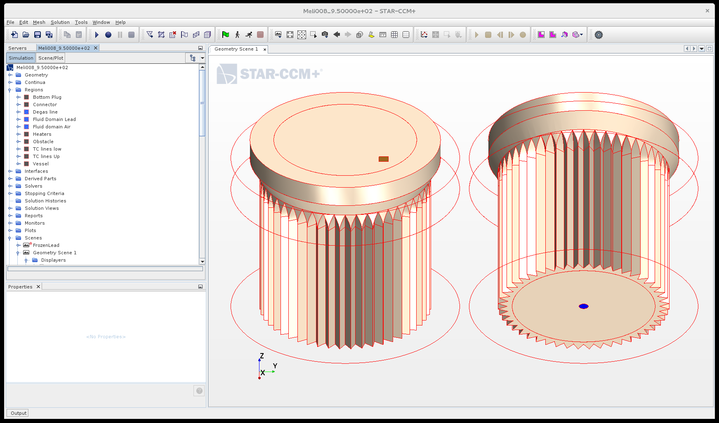
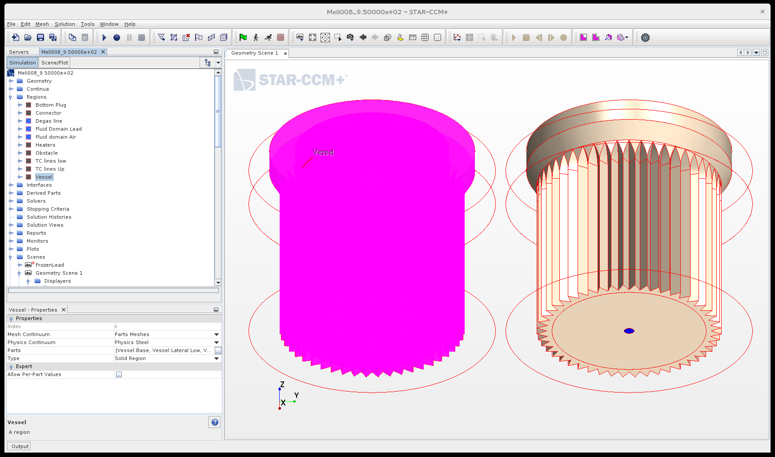
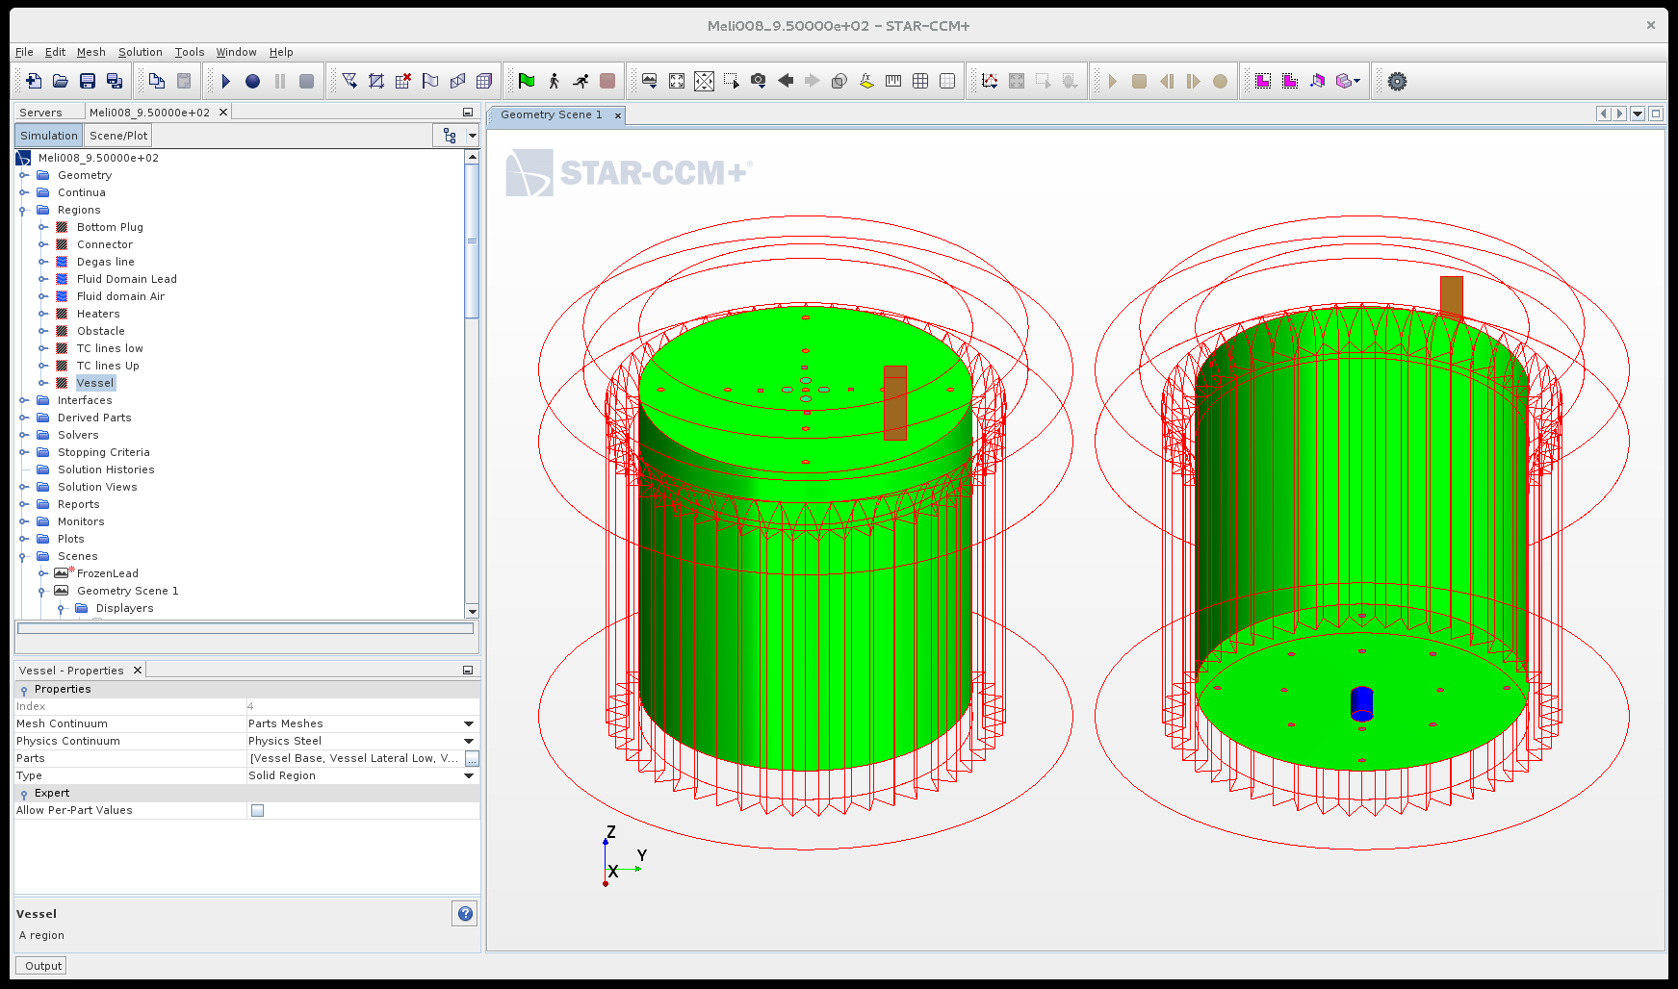
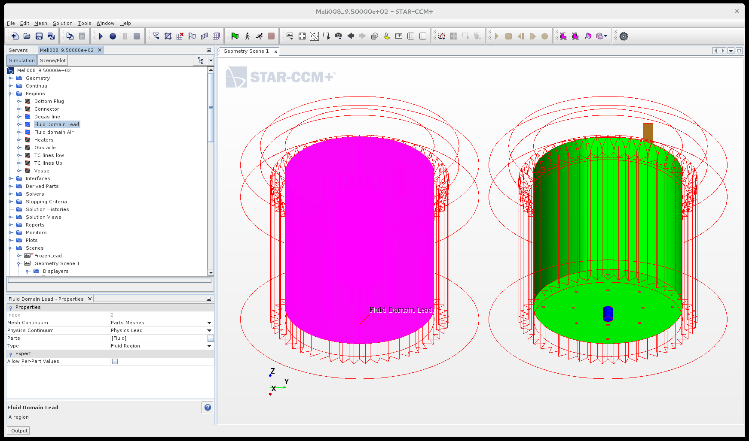
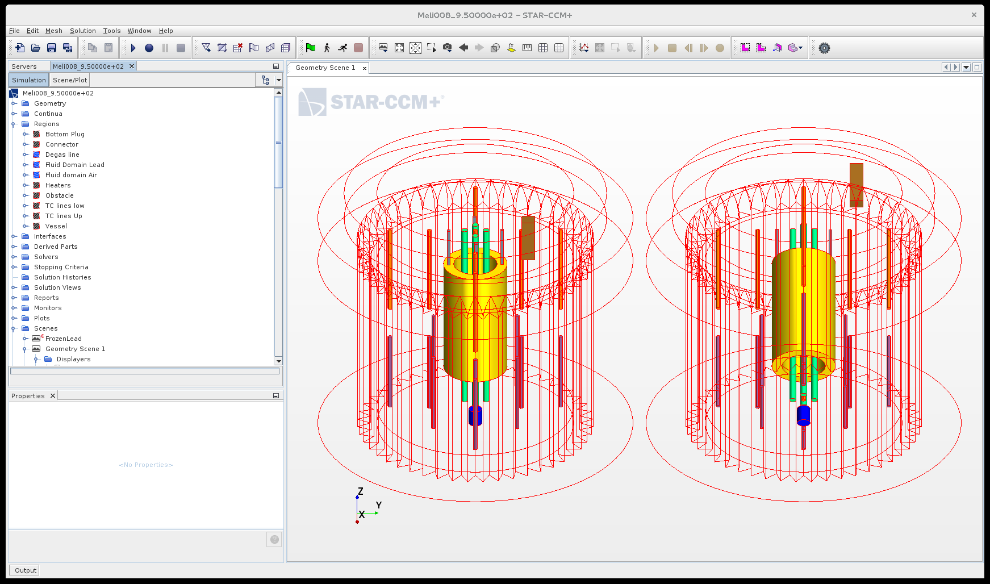
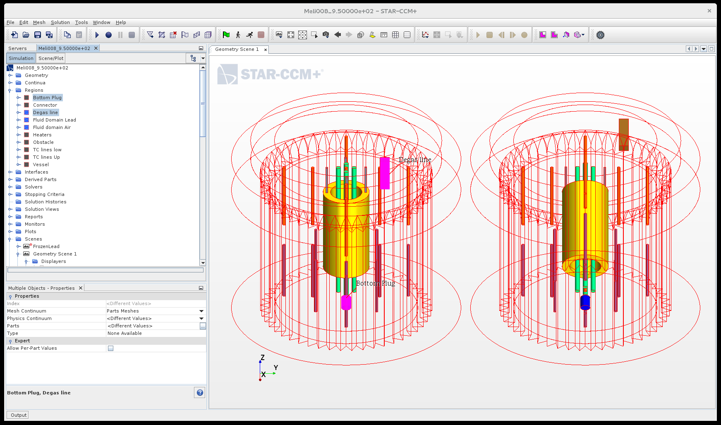
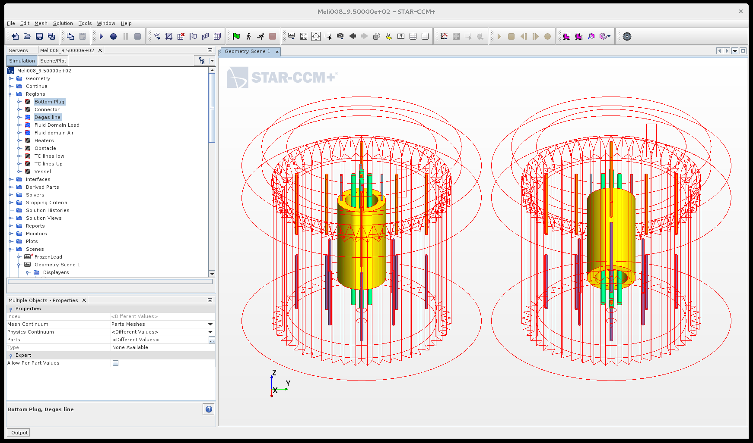
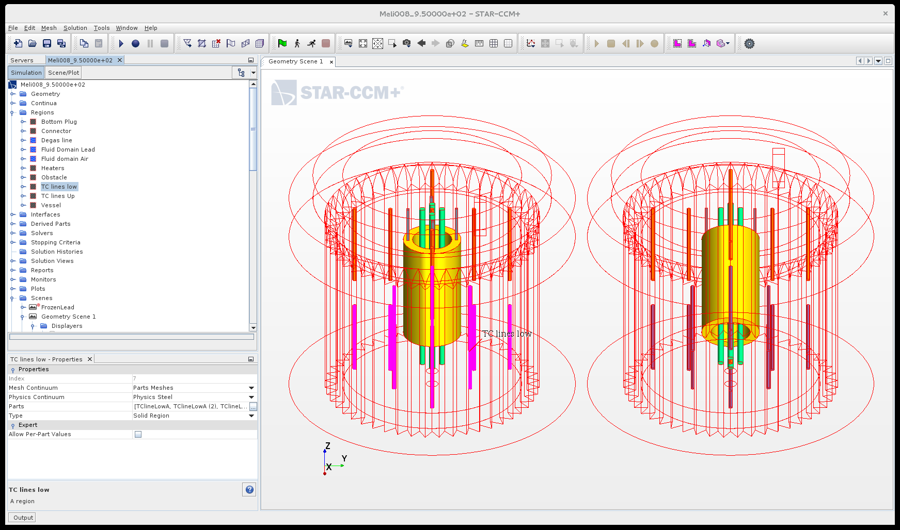
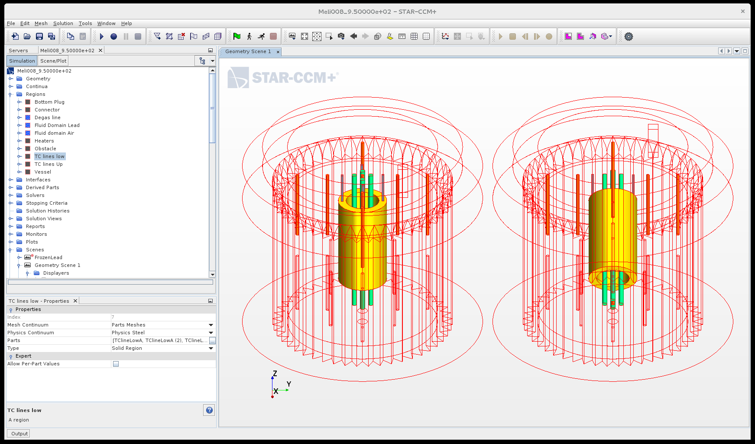
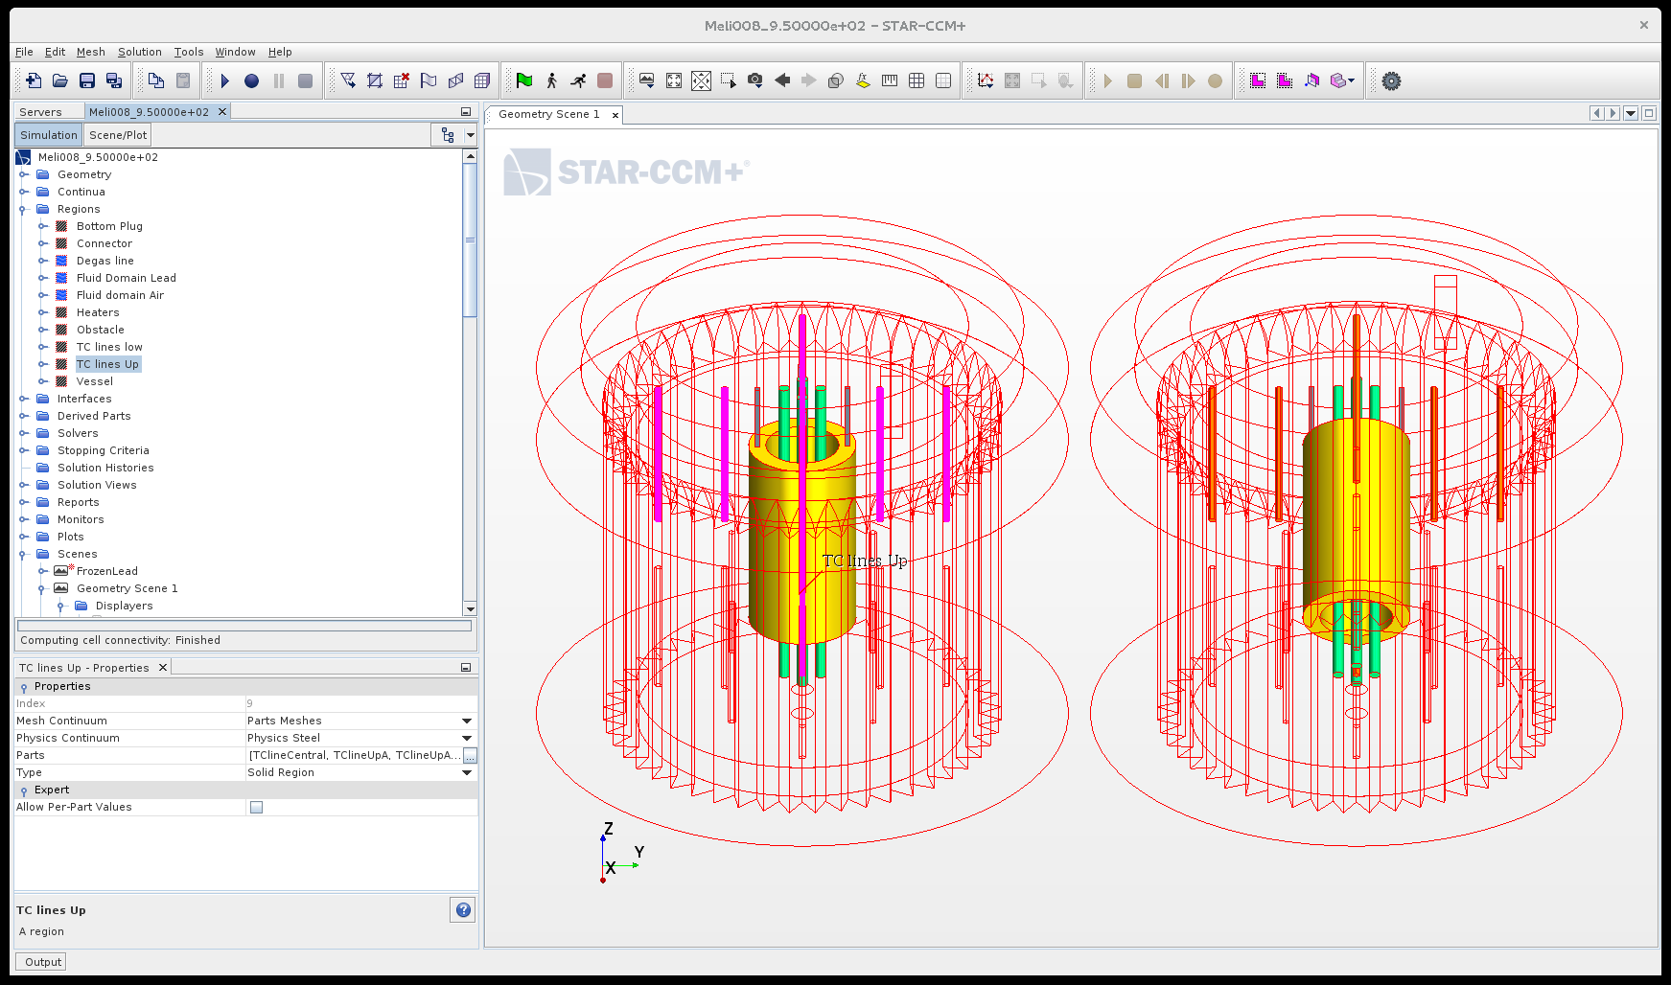
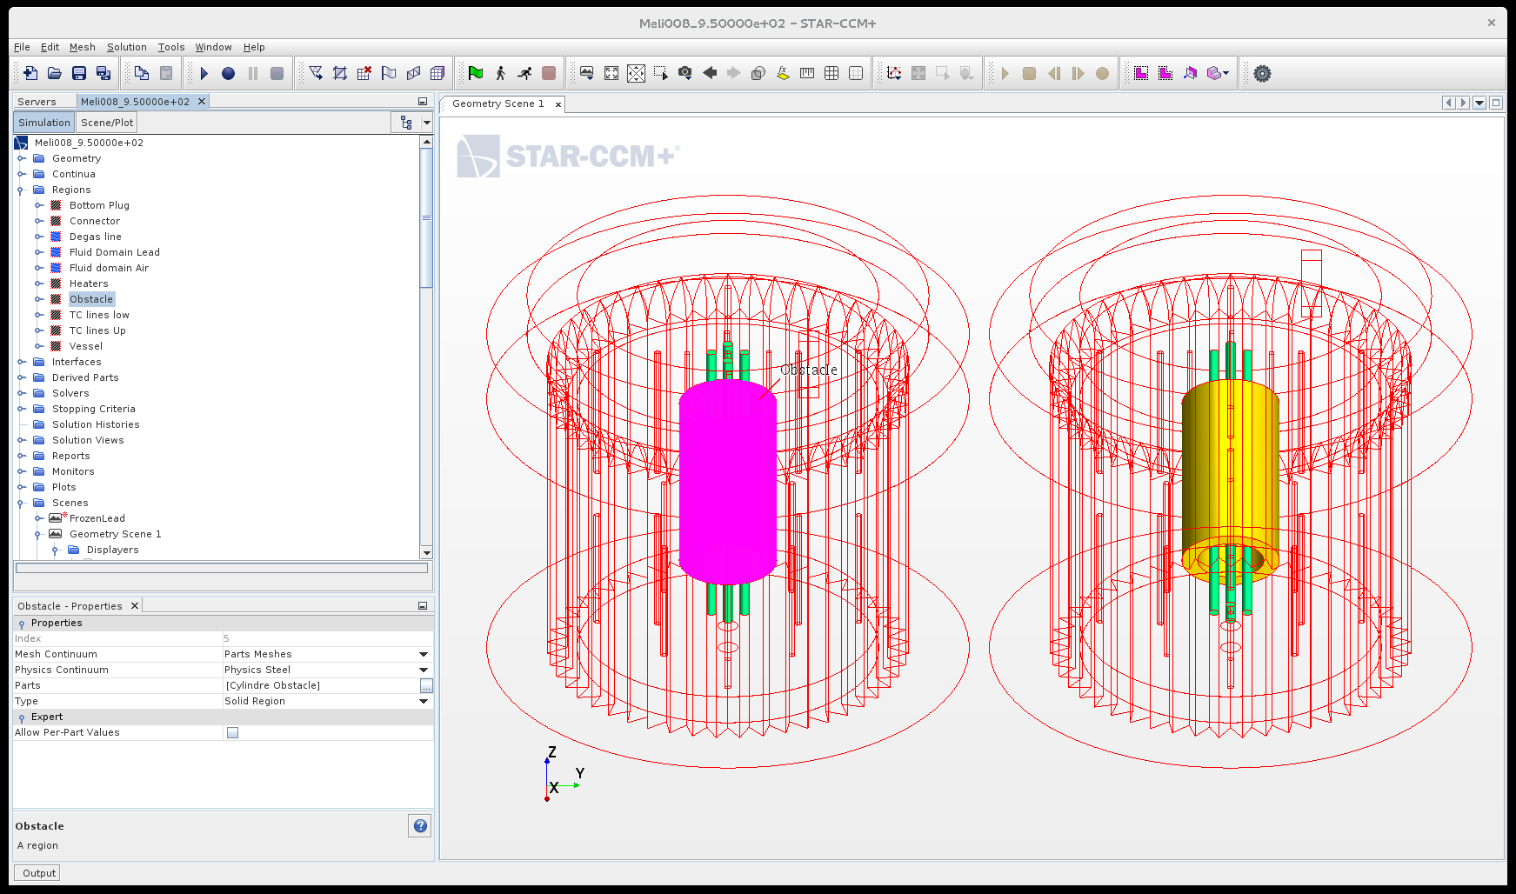
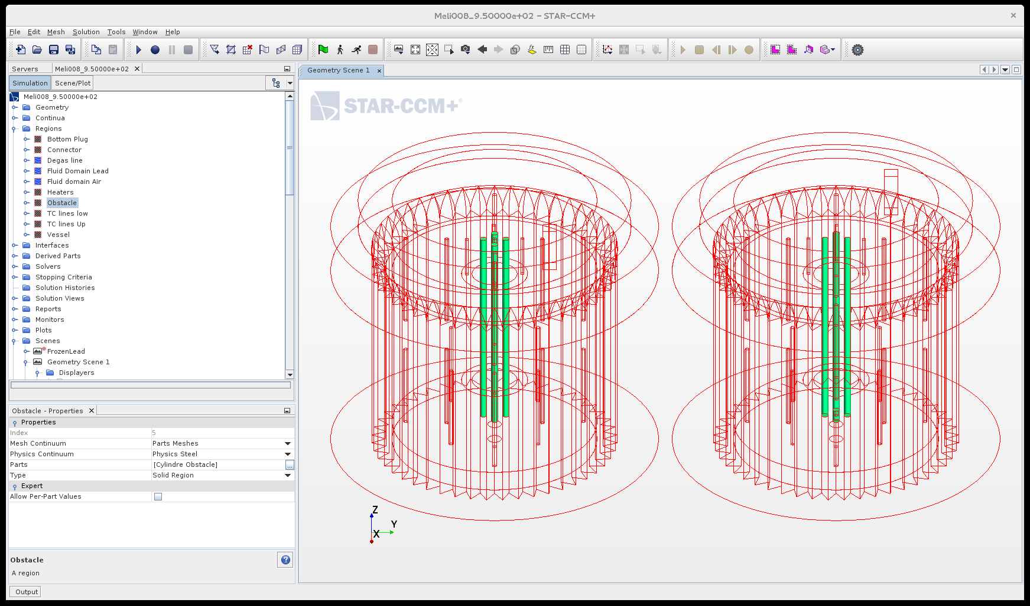
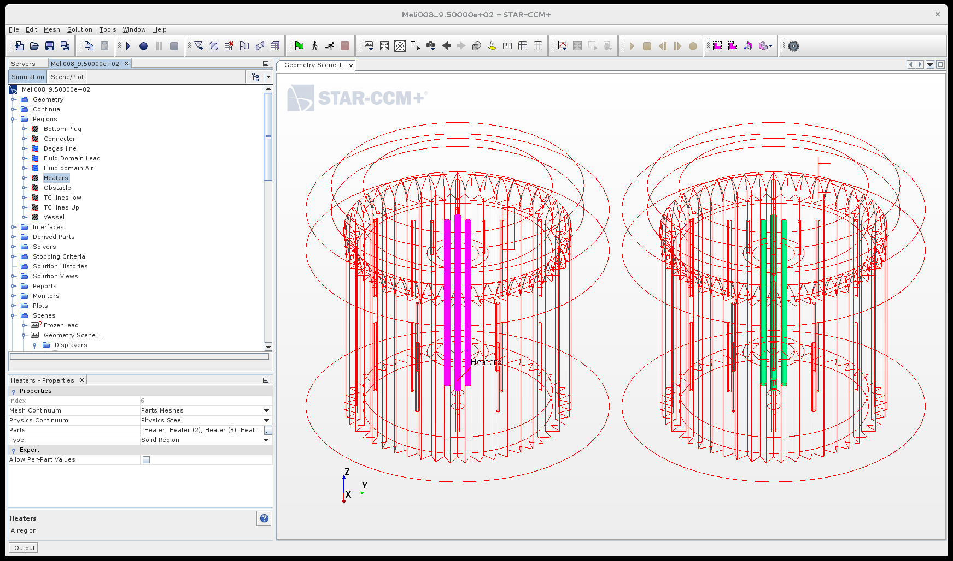
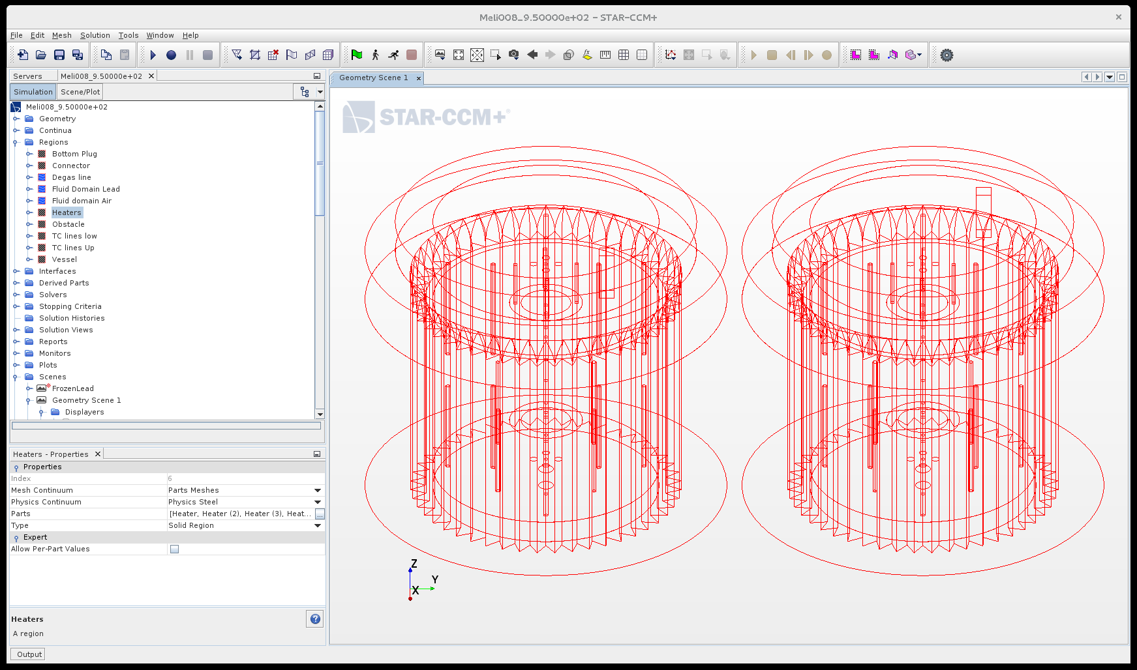
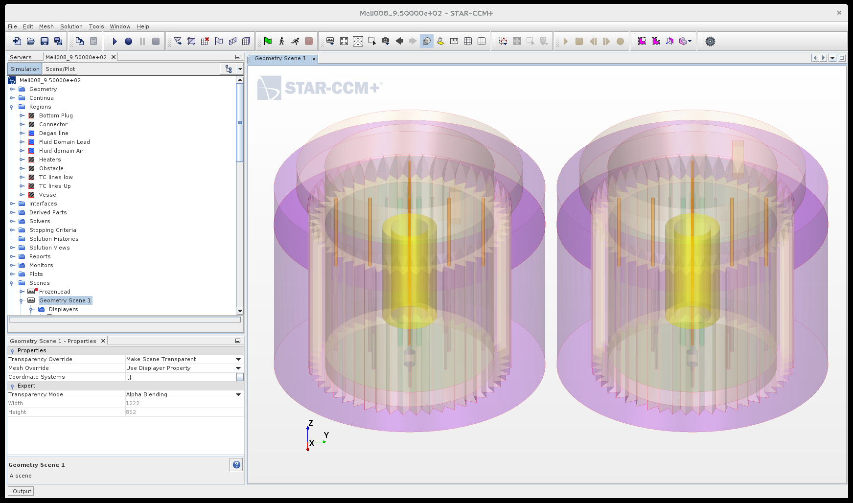
Meliloo – Stand model Geometry

Slide 7
Mesh: polyhedral, advanced layer & directed
Advanced layer resulted unsuited => back to classical boundary layer mesher ~ 1.4 MCell

Slide 8
Main setting
Lead/cover gas with VOF
External cooling air at Ambient temperature
Inlet velocity 10 m/s
Cooling power ~ 10 kW initial, slowly decreasing
Heaters:
Steel
1 kW
K-E turbulence model Realizable
Time-step 0.02s (5 iterations then 10…)
Default Starccm+ settings
Onset of freezing after about 100s initial transient.

Slide 9
Main setting solidification
Solidus temperature: 598.6 K
Liquidus temperature: 600.6 K
Latent heat of fusion: 23070 J/kg (linear distribution)

Slide 10
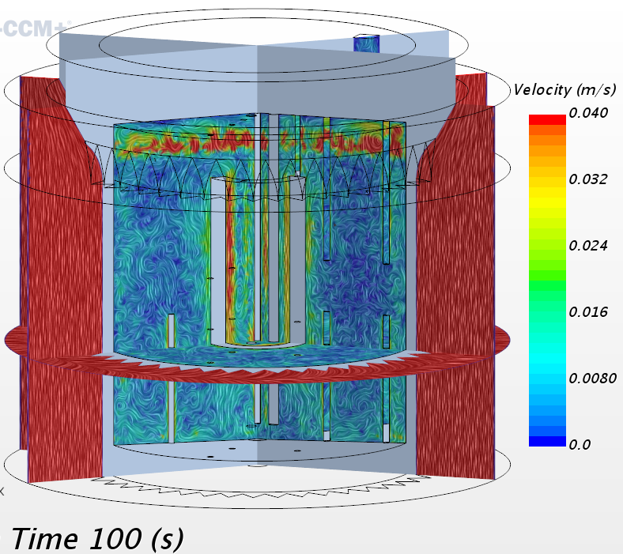
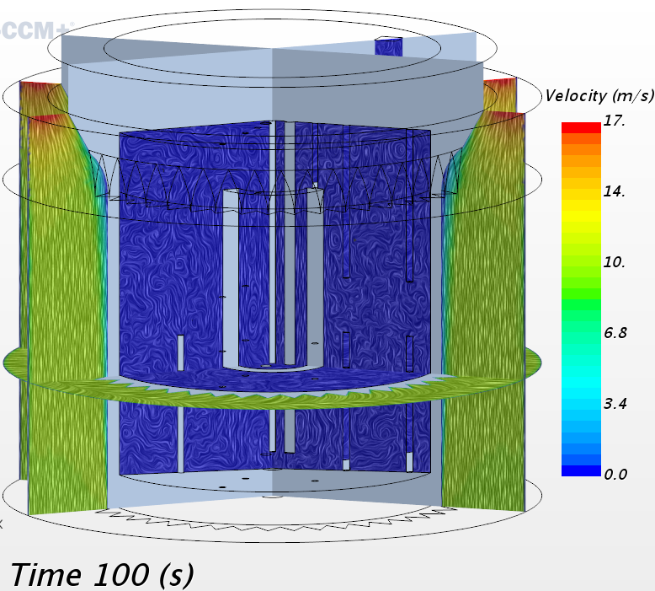
Step 0: Close to freezing onset
CFD model activated and brought in time by the air cooling system close to the onset of LBE freezing.
LBE Velocity
Air Velocity

Slide 11
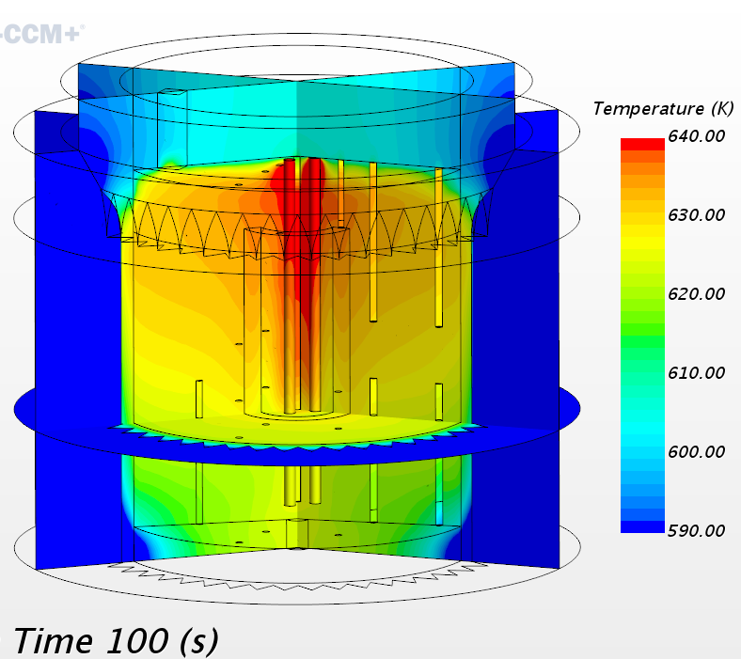
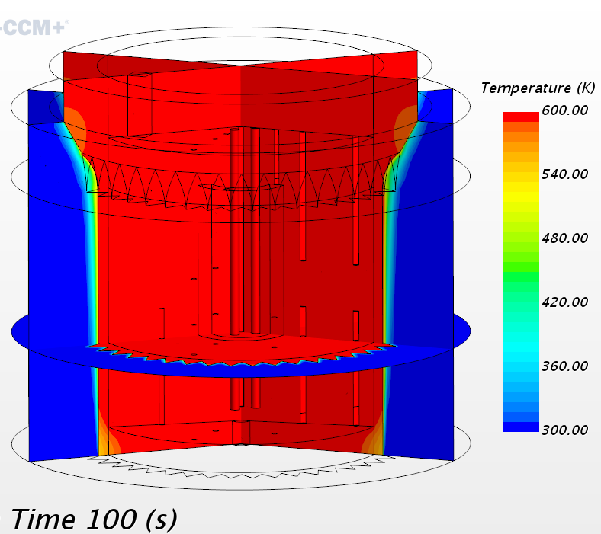
Step 0: Close to freezing onset
CFD model activated and brought in time by the air cooling system close to the onset of LBE freezing.
LBE Temperature
Air Temperature

Slide 12
Lesson from first freezing attempt
Solid phase is transported by the liquid one !
In our case, solidification is expected (!!!) to grow exclusively from the surface.
Need to set the Flow Stop parameter:
Flow stop parameter set to 0.01 => flow stops at T=600.58K

Slide 13
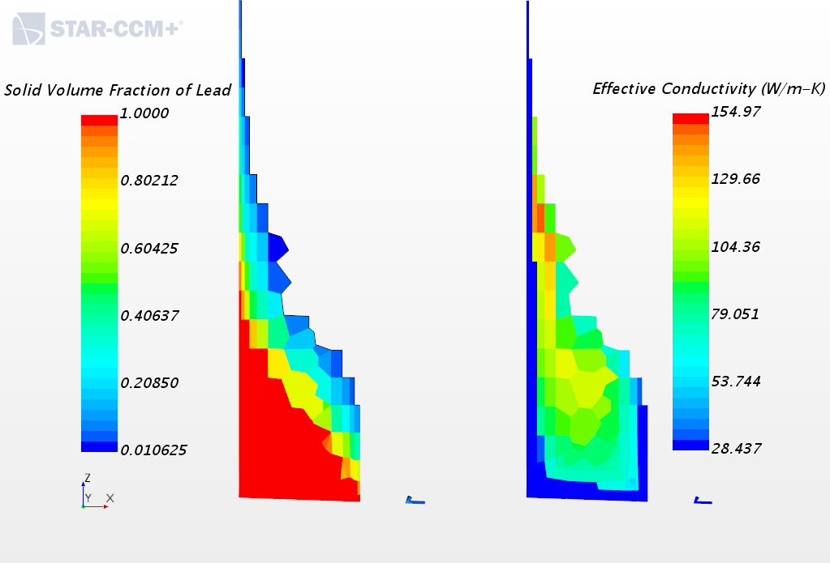
Lesson from the Second freezing attempt
The turbulent quantities are “frozen” together with the flow stop criterion !
=> Solid LBE keeps some turbulent part of the conductivity!
Can be corrected through the turbulent Prandtl number setting
=> Prt set to 10^6 when flow is stopped, 0.9 otherwise.

Slide 14
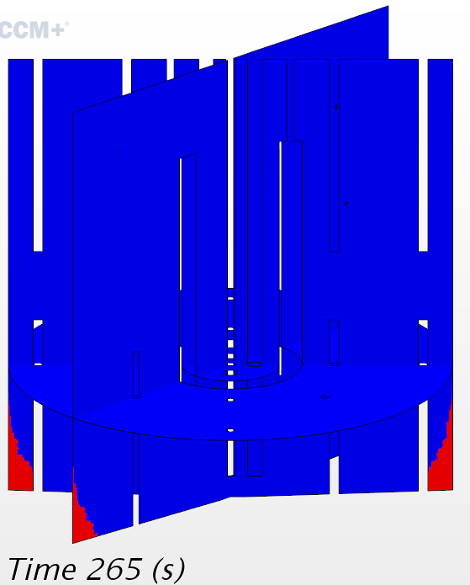
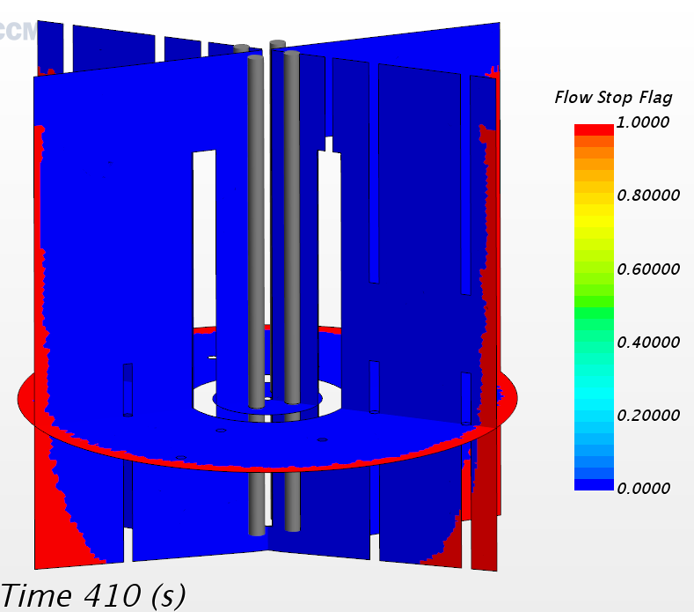
Lesson from third freezing attempt
Simulation proceeds from t=265s up to t=410s with modified Prt

Slide 15
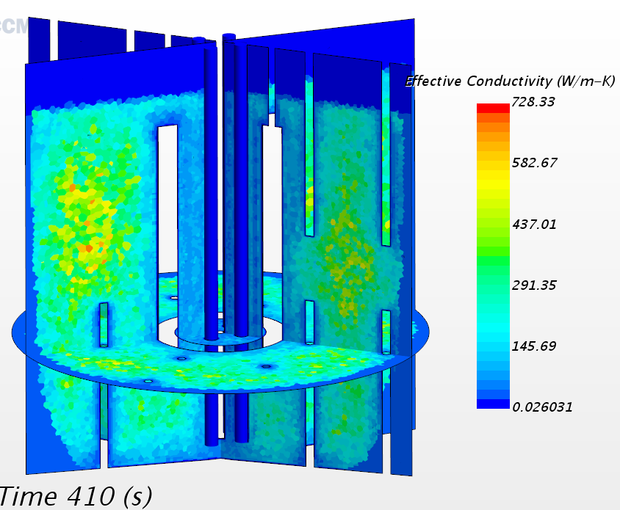
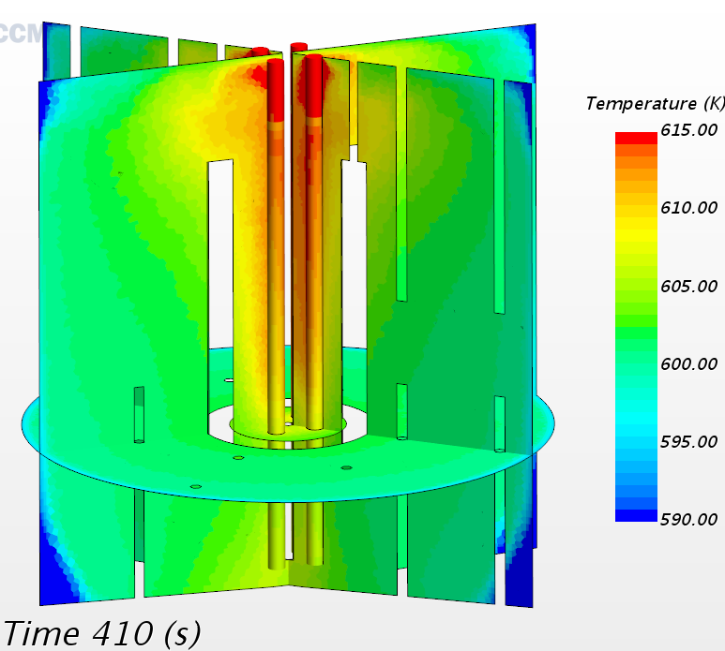
Third freezing
Simulation proceeds from t=265s up to t=410s with modified Prt

Slide 16
Numerical issue: finally solved
Simulation abruptly diverged shortly after t=412s
Epsilon equation seems to diverge first
Changing time step or iteration changes slightly the time of appearance but not the brutality of the event
Changed flow stop criteria from 0.01 to 0.1, useless.
Switched to K-Omega: no way! Etc.
=> need to understand the cause!
Event in coincidence with the freezing front approaching the bottom of 2 TC lines. First cell with unrealistic value near the intersection of the bottom and TC line boundary layer.
Apparently, the advancing layer is not suited for highly curved saddle lines!
=> Re-mesh with classical boundary layer mesher and restart from t=410s.

Slide 17
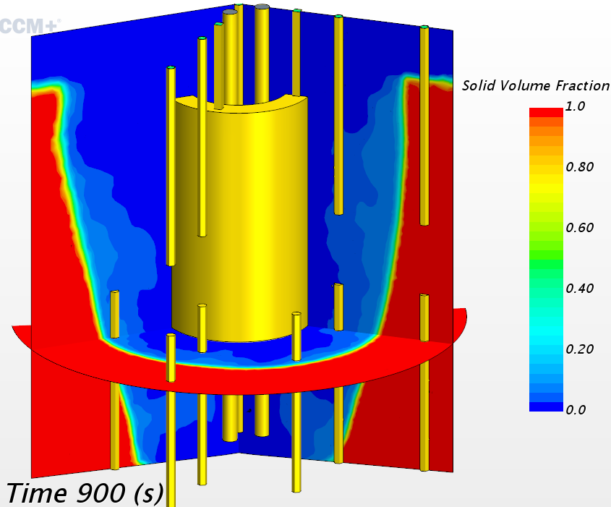
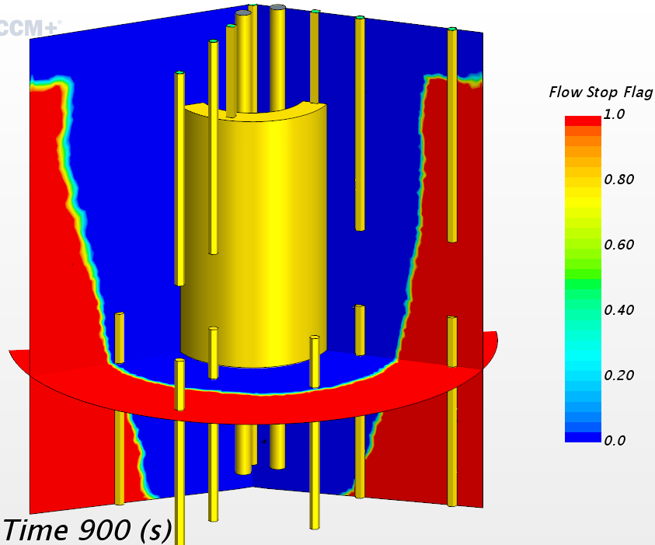
Forth freezing attempt
Simulation proceeds from t=410 up to t=900s (during WE)
Setting flow stop at 10% really excessive

Slide 18
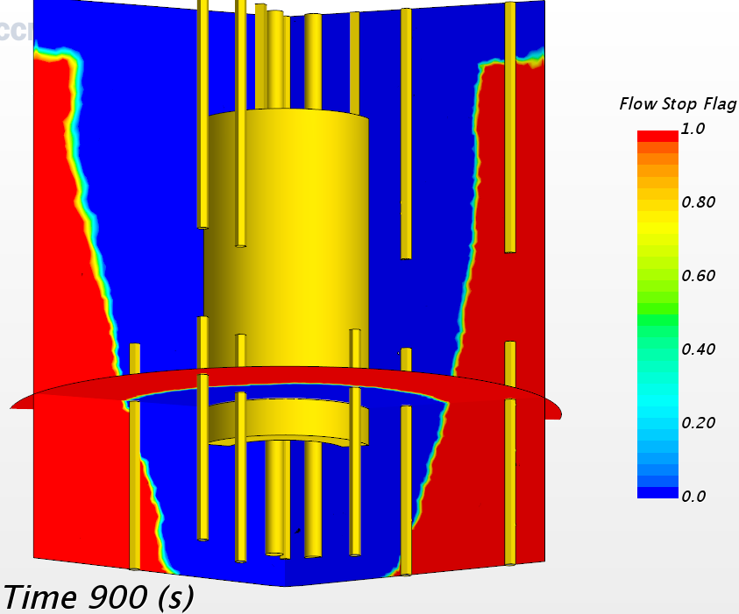
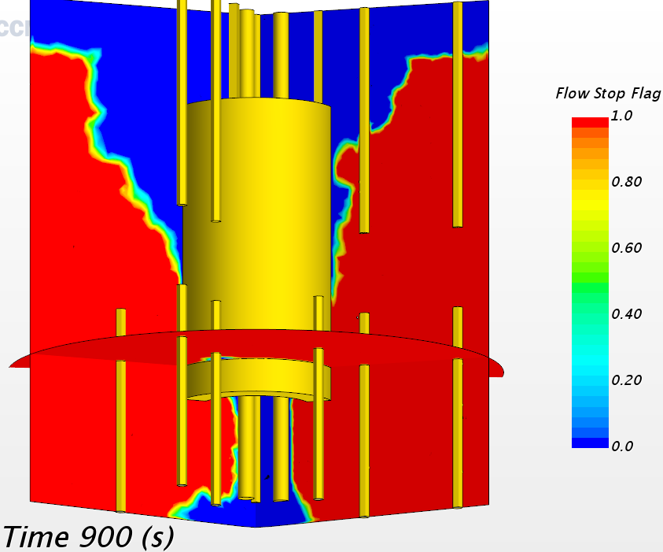
Fifth freezing attempt
Restart after change of Flow Stop Flag: brutal solidification! But simulation proceeded without particular trouble.
Flow stop flag at 10% before
Flow stop flag at 1% after

Slide 19
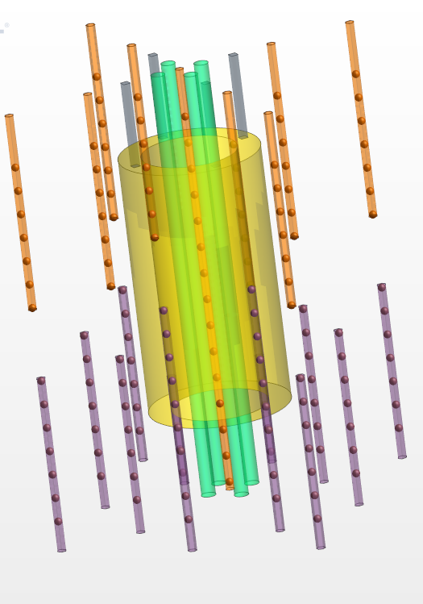
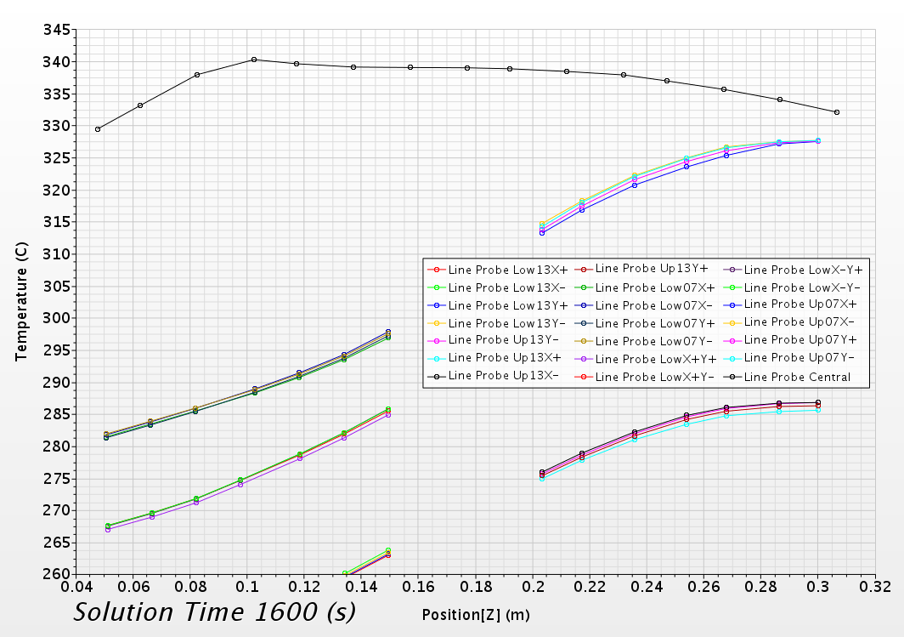
Simulations on tracks: instrumentation
Instrumented TCs on line probes

Slide 20
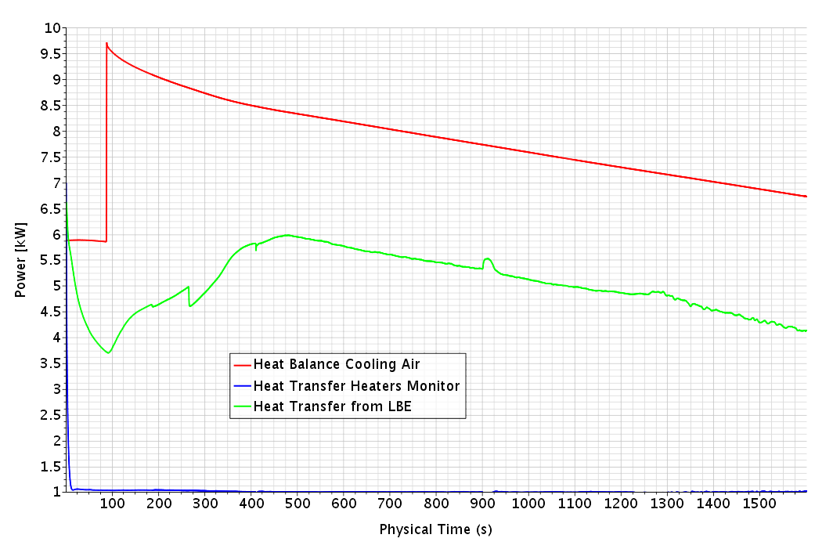
Simulations on tracks: -> 1600s
Heat flux history

Slide 21
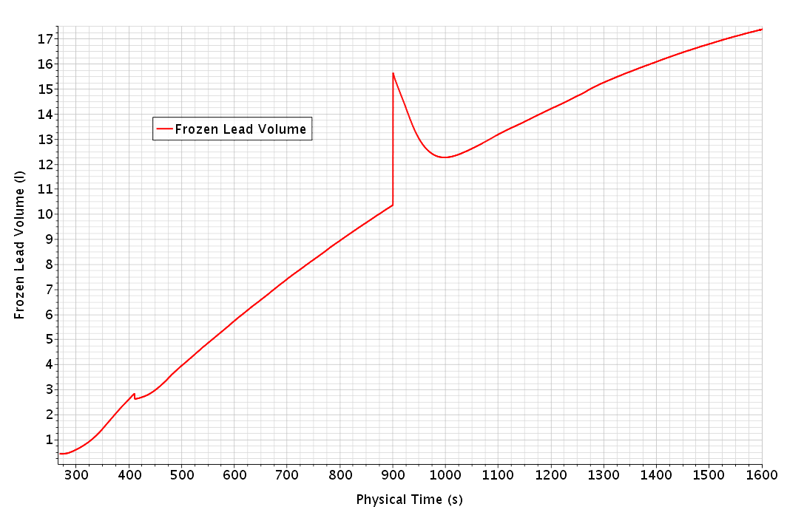
Simulations on tracks: -> 1600s
Solidified Lead Volume history

Slide 22
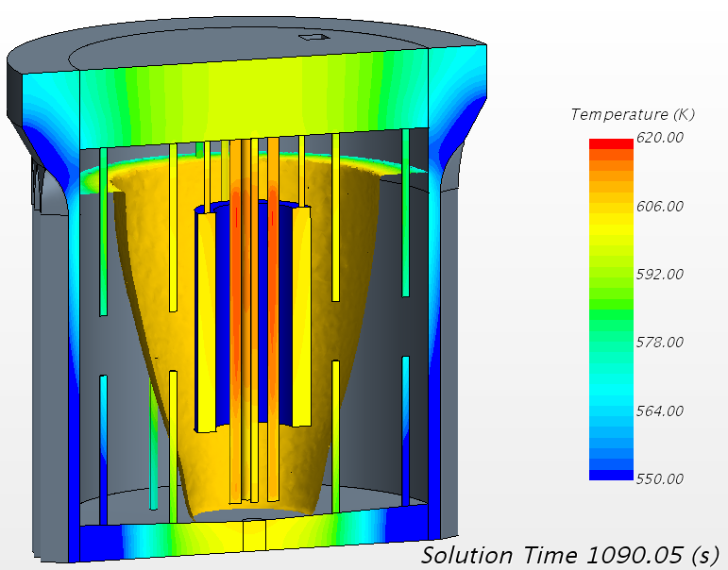
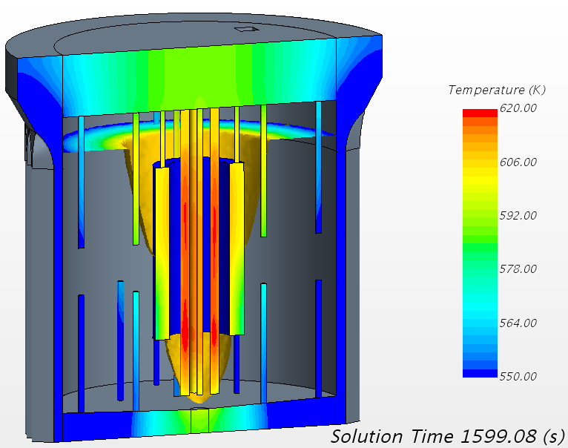
Simulations on tracks: front evolution
Setting on animations and instrumentation from time t=1090s once clear that the simulation was on tracks
Heater Temperature increases when the external flow path closes.

Slide 23
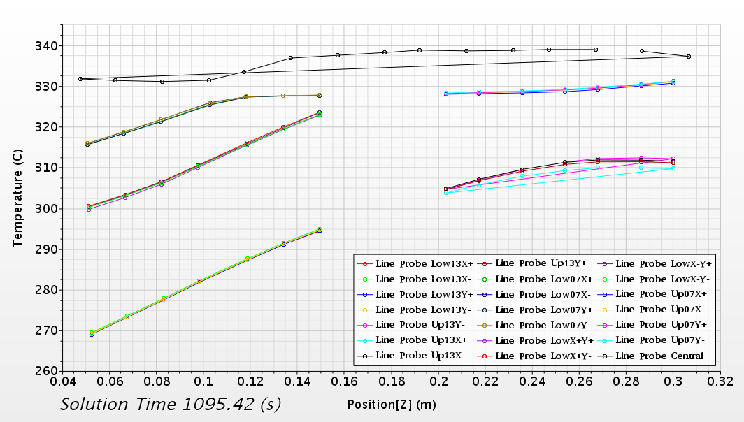
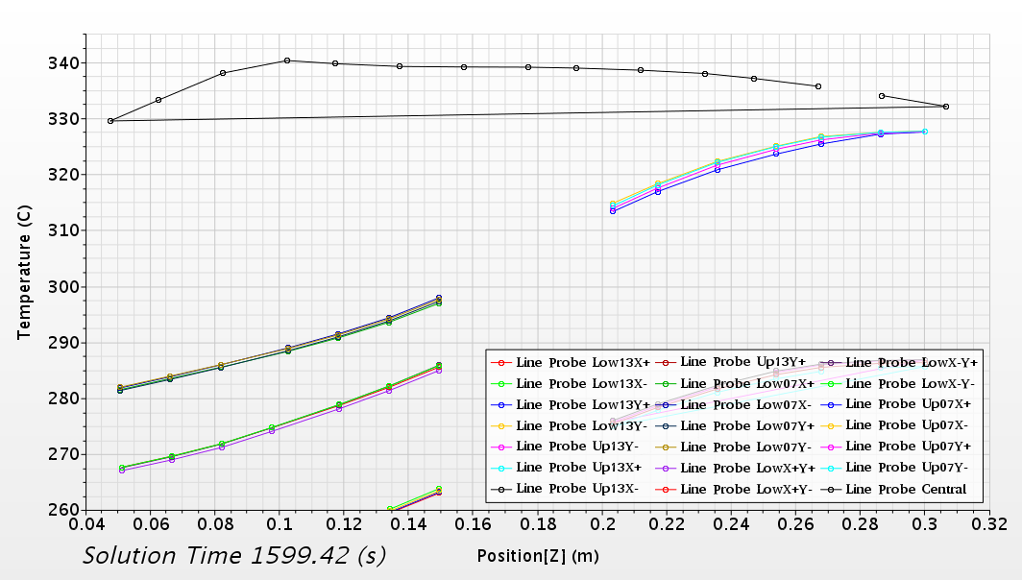
Simulations on tracks: TC T history
Evolution in time of the TCs temperature
Parallel simulation => reordering of cell number!

Slide 24
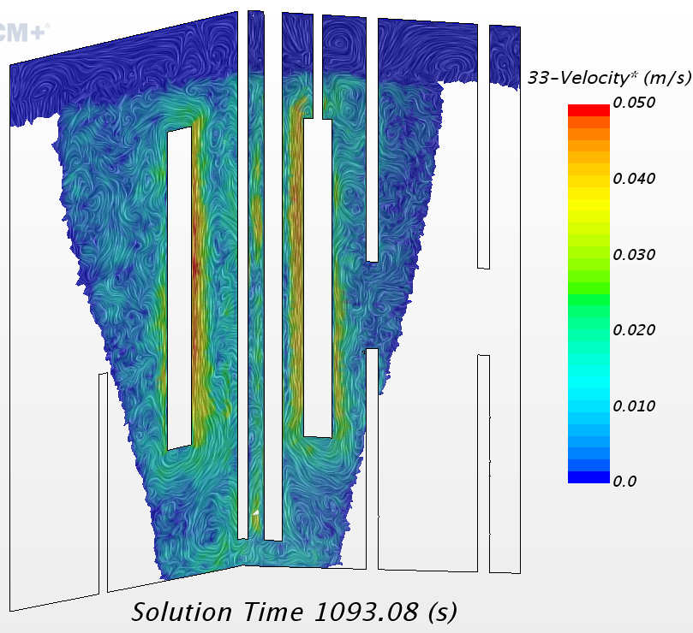
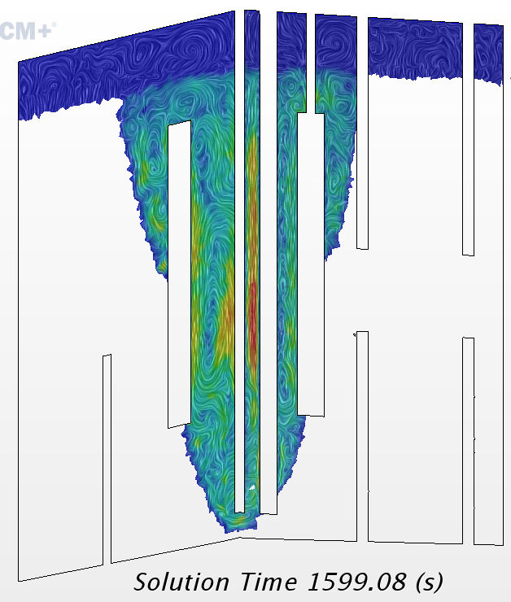
Simulations on tracks: flow field
Evolution in time of the Lead flow field
Very low speed in any case.

Slide 25
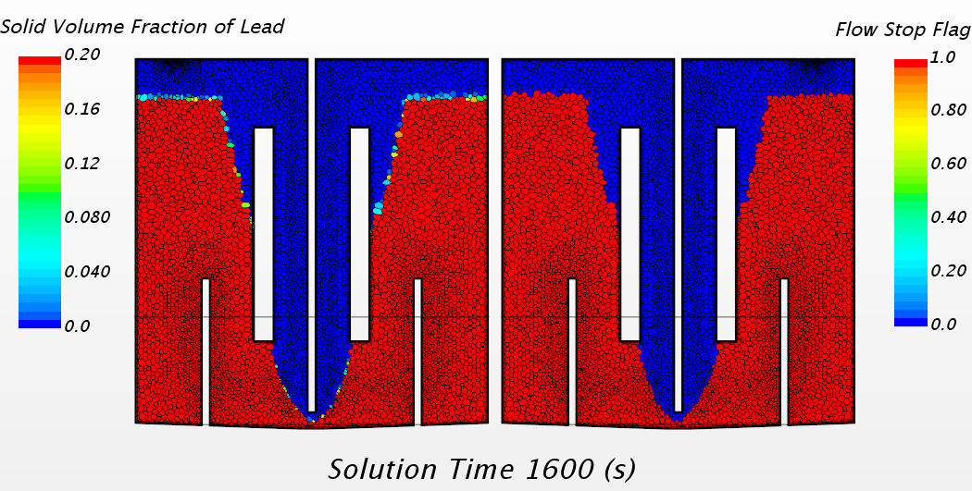
Simulations on tracks: front sharpness
Solidification front remains sharp

Slide 26
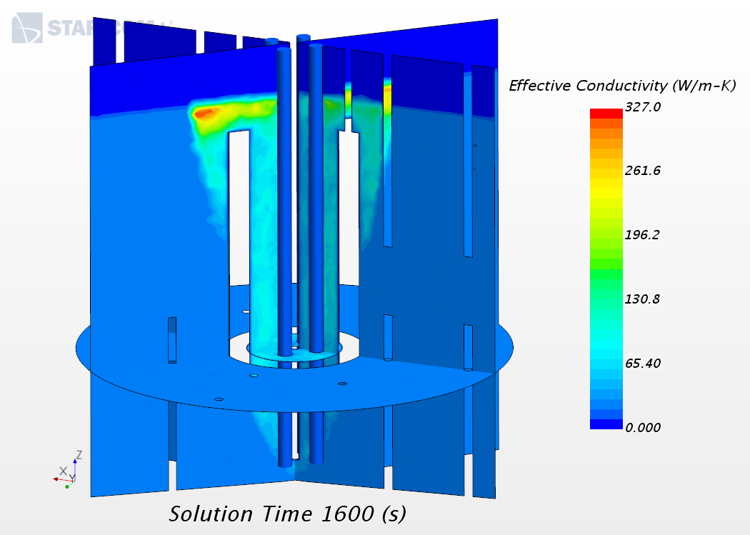
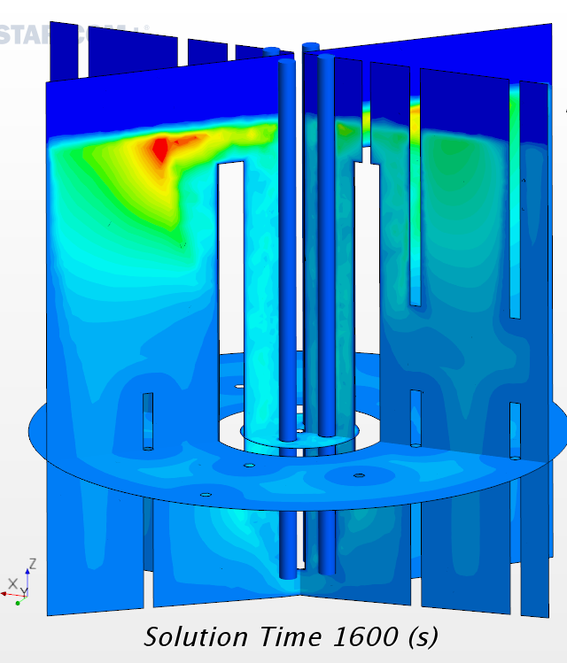
Simulations on tracks: Conductivity…
Effective conductivity with (left) and without (right) action on Prt (same scale)

Slide 27
Comment on the solidification model
The model is developed for laminar flows with features specific of “strangely” freezing fluids:
Slurry Viscosity Model
Mushy Zone Permeability Model
Lead is expected (is it?) to freeze from the wall with a simple and smooth propagation front, not needing these model.
The solidification model is compatible with the VOF model.
The solidification model is compatible with the turbulence model(s). It is a technical compatibility without real physical justification.
The effective conductivity of the frozen Lead must be checked/controlled with the Prt parameter setting, it is presumably a specific STARCCM+ user warning.
The simulation remains highly non-linear: final time step of 0.02s with 10 iterations.
Simulations not cheap: 100s/13h on 60 CPUs.

Slide 28
Conclusion
We have build a preliminary but quite articulate model of the Meliloo – Stand experimental facility.
The solidification model in starccm+ is technically compatible with the VOF formulation and the turbulence models.
Technical/numerical issues have been overcome. Small time step and large number of iterations make the simulation costly and lengthy.
The first experimental results are needed to know whether the expected type of surface growth is adequate.
All technical/numerical issues seem under control.
We are ready for a real pre-test!

Slide 29
Reminder: Requests to developers 1/2
Many thanks to the votes contributors!

Slide 30
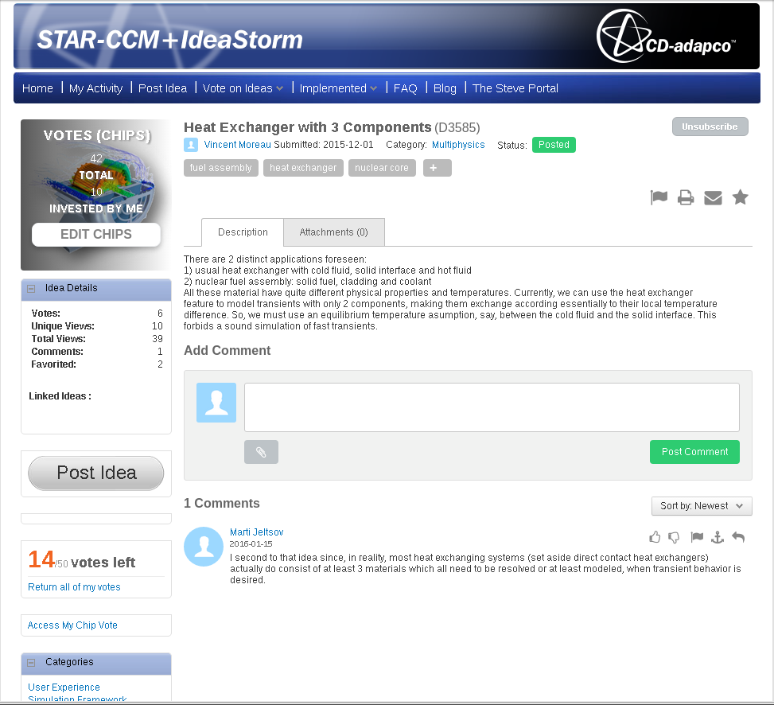
Requests to developers 2/2
Must reach 70 votes to be seriously investigated!

Slide 31
Thank you for your attention
Questions?

