Slide 1
Solidification modelling at CRS4 in SESAME-Stand facility
M. Profir, V. Moreau (CRS4)
5th Progress Meeting, October 17-19
ENEA, Brasimone, Italy

Slide 2
Content
General objective
About Meliloo-Stand become SESAME-Stand
CFD model
Reviewed geometry
Boundary Conditions, Cover gas, Air Channel…
Mesh, Main setting
Instrumentation
History: heat flux, frozen volume
Front propagation
Flow fields
Conclusion
ENEA, Brasimone, October 17-19, 2017
2

Slide 3
General objective
Demonstrate that the overall modeling of HLM complex systems can include solidification phenomenology by:
Reproducing small/medium scale experiment:
SESAME-Stand (pre-test)
Comparison with experimental results
Adjusting/improving the numerical setting (post-test)
Evaluate time scales, limitations, computational cost
Allow:
To reach initial steady states
An increased number of accessible transients
ENEA, Brasimone, October 17-19, 2017
3

Slide 4
About SESAME - Stand
Detailed geometrical description in Del 3.2.1_M12 available end of June 2016: Description of the Meliloo - stand test facility and test matrix
By: Ivan DOFEK, Otakar FRYBORT, Jan VIT, Miroslav SLINC, Issued by CVR
Close collaboration with CVR by means of Matteo Iannone:
useful exchange of information about geometry, but also numerical approach and results comparison
The construction of the numerical model has taken only progressively all the features of the real experimental setting.
Physical properties of the materials gathered in:
Summary for the recommended physical properties for the main fluid and liquid materials used for the MELILOO-stand and TALL-3D freezing experiments.
Prepared by B. Niceno and A. Badillo, Paul Scherrer Institute
Version 2, June 2017-revision by V. Moreau
ENEA, Brasimone, October 17-19, 2017
4

Slide 5
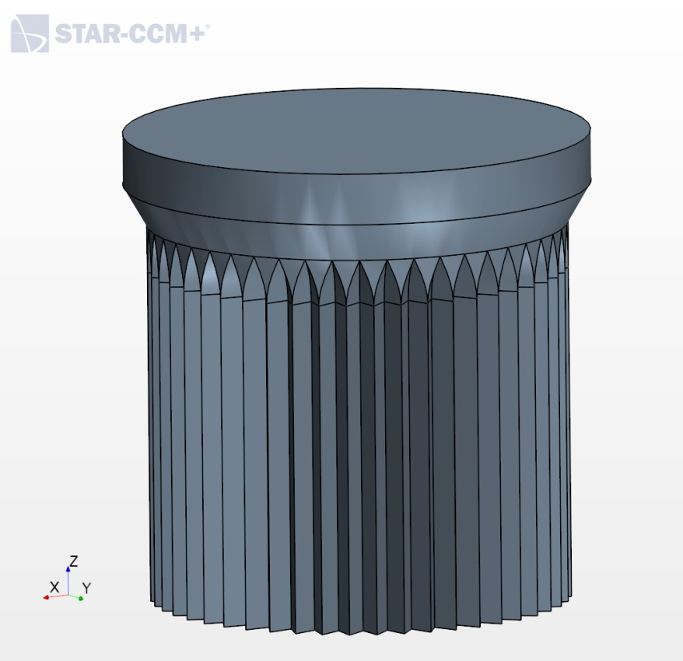
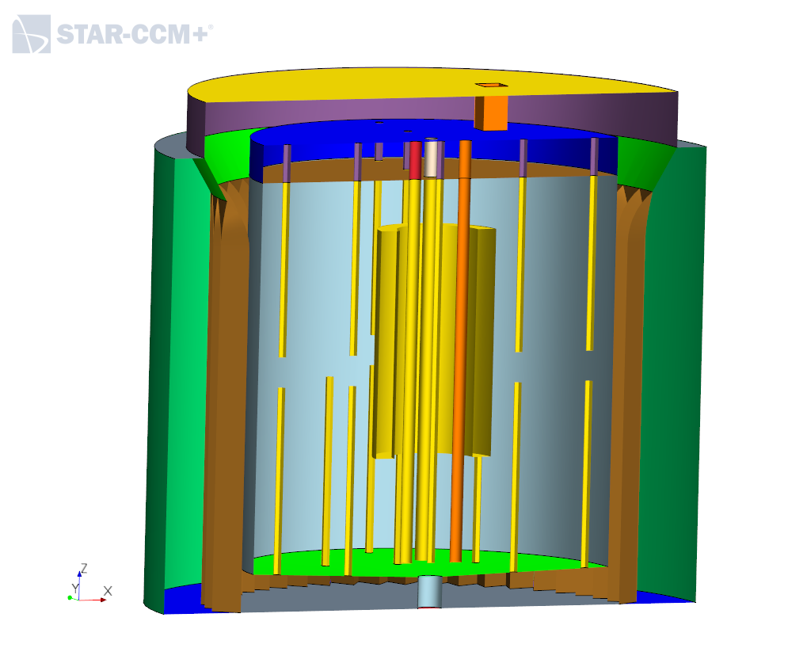
Geometry of the SESAME-Stand facility
steel-casted Experimental Vessel (EV) in which the thermal-hydraulic and freezing processes take place
electric heating rods inside the vessel
an obstacle enhancing the natural circulation
an Air Channel (AC) designed to cool down the system working as a heat sink from the outside of the steel vessel
finned cooling air-exposed region of the vessel to increase the heat exchange area
ENEA, Brasimone, October 17-19, 2017
5

Slide 6
Geometry in the CFD model
The CFD geometry consists of solid walls, fins, main heater, thermocouple probes, obstacle, lead, cooling air and argon domains.
The heater is formed by four heating rods placed in the center
of the EV, as simple steel cylinders.
The inner obstacle is full steel cylinder.
Thermocouples inside the pool: 12 bottom pipes and 8 top pipes
with hexagonal geometry instead of circular, for better mesh matching at the interfaces with the fluid.
The argon occupies the upper part of the vessel’s internal for 40 mm of height above the lead volume.
The bottom of the vessel considers the 2 degrees slope.
Thanks to the central symmetry, a quarter of the domain was also modeled in the last part of the work.
ENEA, Brasimone, October 17-19, 2017
6

Slide 7
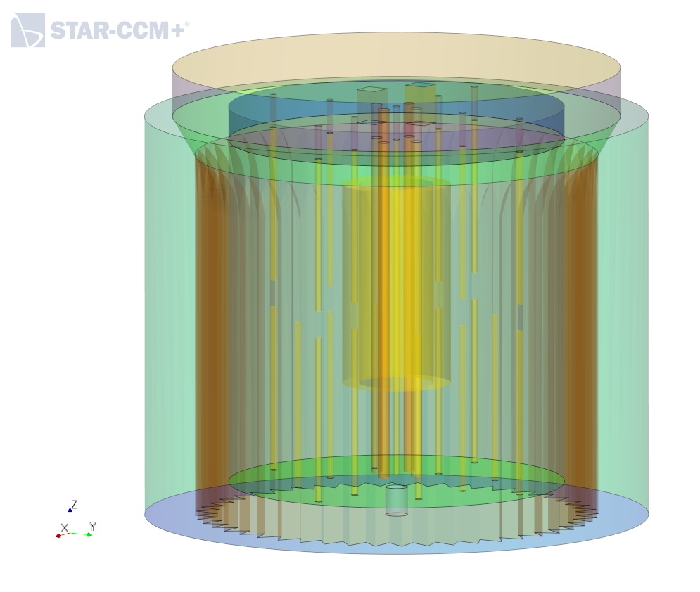
Part based geometry
The CFD geometry is split in regions for several causes:
Different material
Steel
LBE (+cover gas)
Air
Probes (steel as first guess)
Easier substitution of specific components: inner obstacle
Different meshers
Unstructured polyhedral
Boundary layer mesher
Specific source
Volumetric heat source at the heaters
ENEA, Brasimone, October 17-19, 2017
7

Slide 8
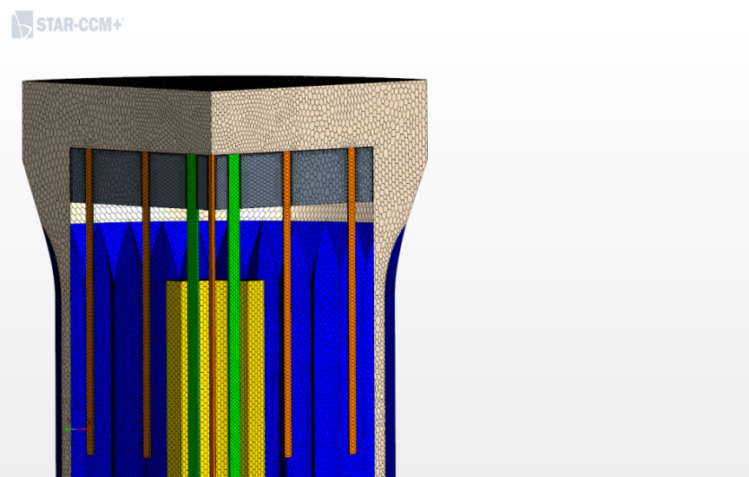
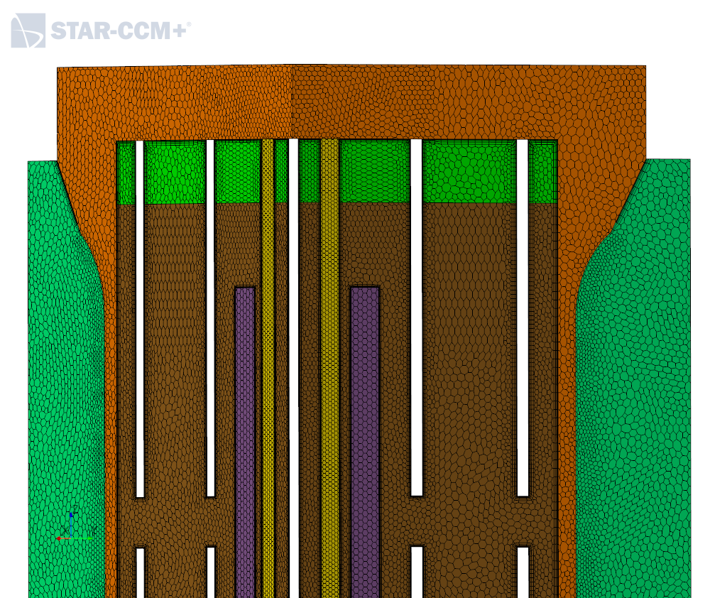
Mesh: polyhedral, conformal everywhere
Both full and a quarter of the domain were discretized.
Volume Mesh ~ 2.6 Mcell for full domain
ENEA, Brasimone, October 17-19, 2017
8

Slide 9
Main setting
The Volume of Fluid (VOF) model is enabled in an Eulerian multiphase configuration with lead as single phase.
The Argon zone at the top of the lead is treated as a separated continuum.
K-E turbulence model Realizable
Steady state and Unsteady state Time-step from 0.001 s to 0.1 s (20 iterations then 5…)
Default STAR-CCM+ settings
ENEA, Brasimone, October 17-19, 2017
9

Slide 10
Main setting for thermal equilibrium
The algorithm used to bring the system to the thermal equilibrium close to freezing onset is the following one:
Impose the cooling air velocity and temperature
First guess of the heat source based on the heat flux removed by the air
Reach the steady state solution
Look at the minimum temperature of the lead
Adapt dynamically the heat source to bring the global enthalpy content to the value that provide the right minimum temperature
Fix the new found heat source to a constant value
The algorithm is necessary because the minimum steady lead temperature is very sensitive to the cooling/heat source value!
ENEA, Brasimone, October 17-19, 2017
10

Slide 11
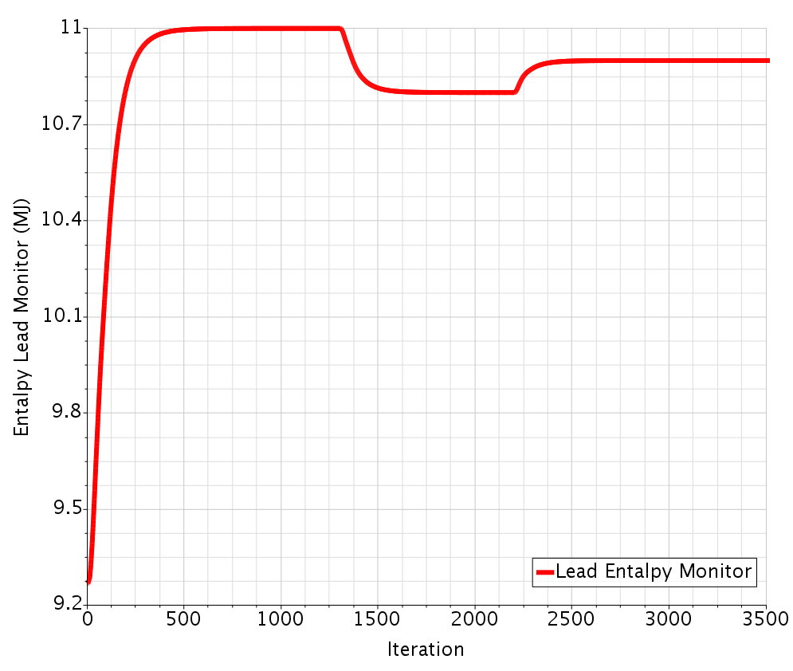
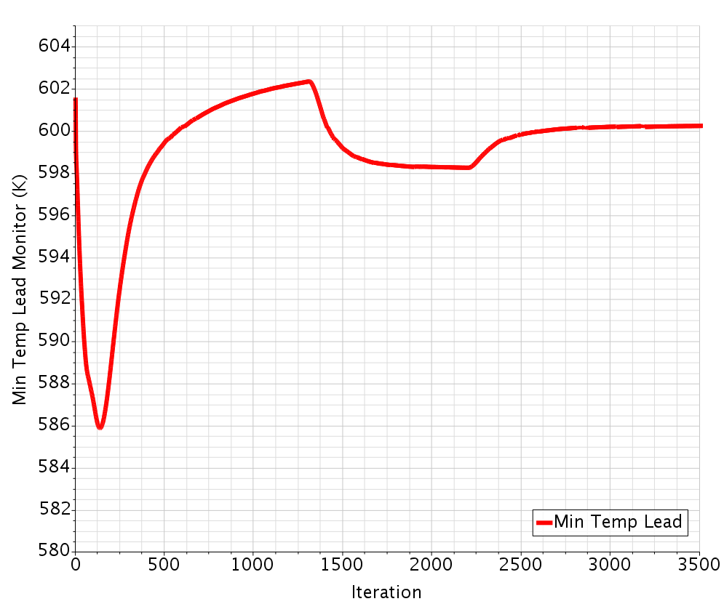
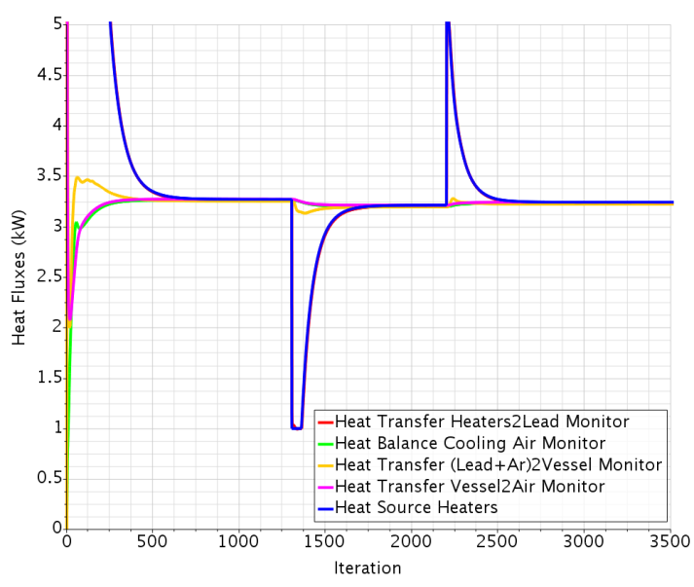
Main setting for thermal equilibrium
ENEA, Brasimone, October 17-19, 2017
11

Slide 12
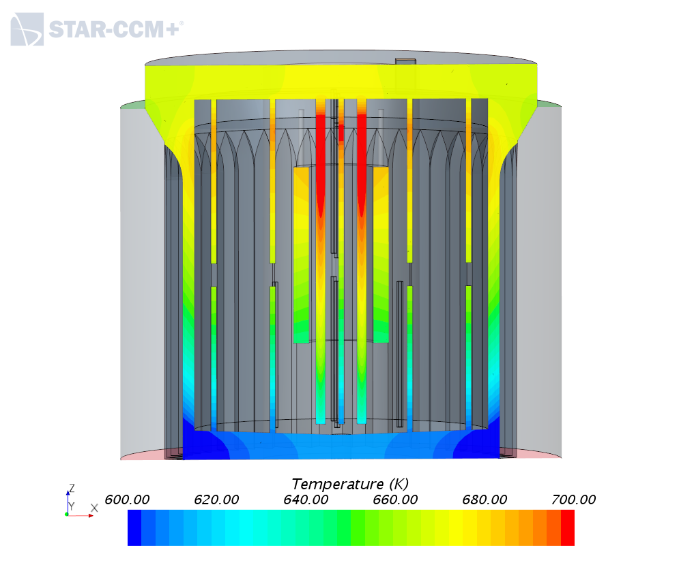
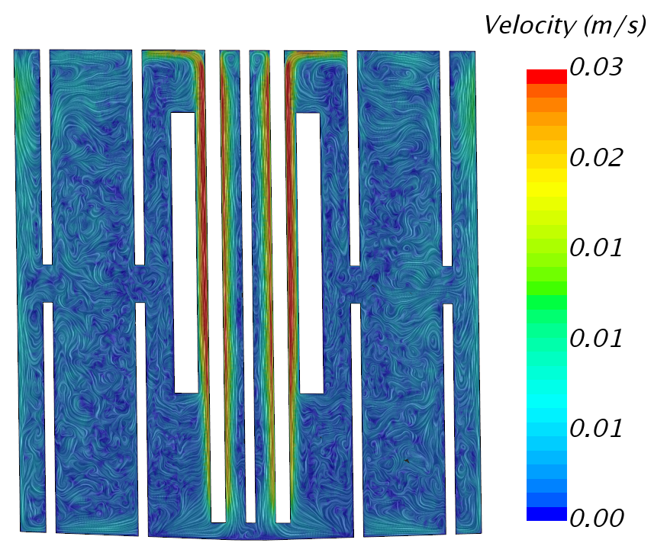
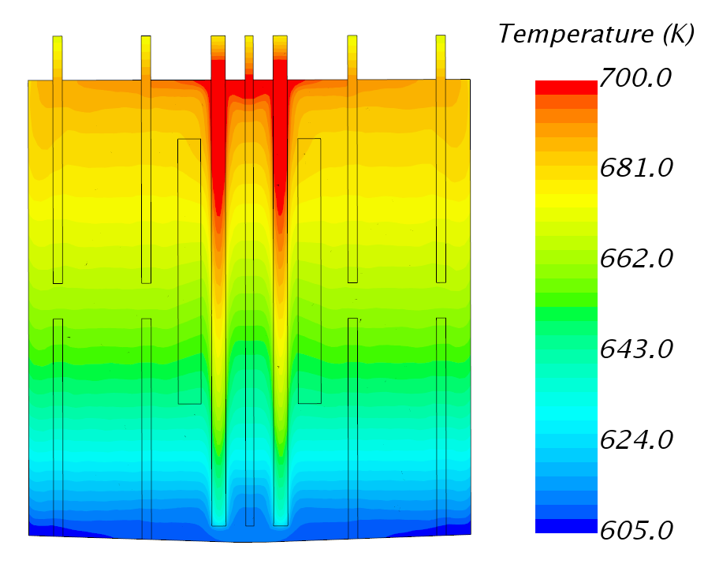
Steady state calculations
The minimum temperature of 601 K is reached for a heat source of 3.12 kW.
The temperature profile shows the expected horizontal stratification.
The lead heated in the internal of the obstacle rises at the top, then is cooled and turns back.
ENEA, Brasimone, October 17-19, 2017
12

Slide 13
Main setting solidification
In the VOF framework, the Melting-Solidification model is enabled with the following settings:
Latent heat of fusion=23070 J/kg
Liquid temperature=600.6 K
Solidus temperature=598.6 K
Flow stop relative solid fraction=0.01
A low Turbulent Prandtl number (10⁻⁶) where the Flow Stop Flag > 0.5 and the default Prandtl number =0.9 otherwise.
The melting-solidification model is activated when the temperature reaches 601 K or above, by increasing the velocity of the air in the cooling channel.
ENEA, Brasimone, October 17-19, 2017
13

Slide 14
Numerical issues related to solidification
Reference density, by default in the VOF framework, is the density of the gas.
Imposing the reference density to 1 kg/m³, the temperature profile didn’t show the expected horizontal stratification.
Moreover, the velocity field was not resolved. In the lower zone of the heater, higher temperatures were present and consequently, higher velocities.
The expected profiles were obtained when the reference density is the lead density- 10⁴ kg/m³
In the case with the low reference density, the solidification proceeded well.
In the case with the high reference density, the simulation diverges brusquely once the temperature is lower than the solidification point.
ENEA, Brasimone, October 17-19, 2017
14

Slide 15
Numerical issues
Workaround strategy
Switch the steady state simulation just before the beginning of the solidification to unsteady state and initiate the solidification in unsteady state for about 100 s.
At this stage, the transient simulation can start with a small time step and a large number of inner iterations and with smaller under relaxation factors in the velocity and pressure solvers.
Further on, the time step is progressively increased, the inner iterations diminished and, since the transient run is quite slow, the simulation is switched back to the steady state, the delayed freezing is recovered and the solidification front advances until almost all the molten lead is frozen.
A quarter of the computational domain was considered in order to reduce the computational time and to be able to proceed with the transient for a more meaningful simulation of the freezing phenomena.
ENEA, Brasimone, October 17-19, 2017
15

Slide 16
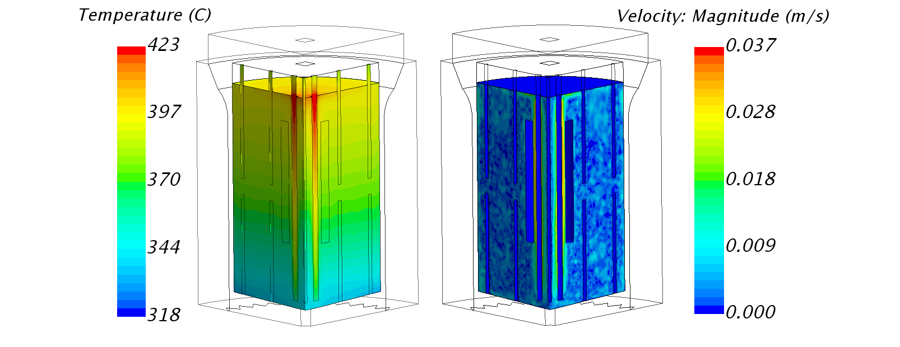
Steady state 100% molten lead
For the initial condition, with an air mass flow rate of 0.145 kg/s (Air velocity=1.8 m/s), the minimum temperature above the freezing point (601 K) is reached for a heat source of 3.12 kW.
Heat source in the CVR model is 3 kW. The difference in the heat source entity may be given by the geometrical difference between the two models.
ENEA, Brasimone, October 17-19, 2017
16

Slide 17
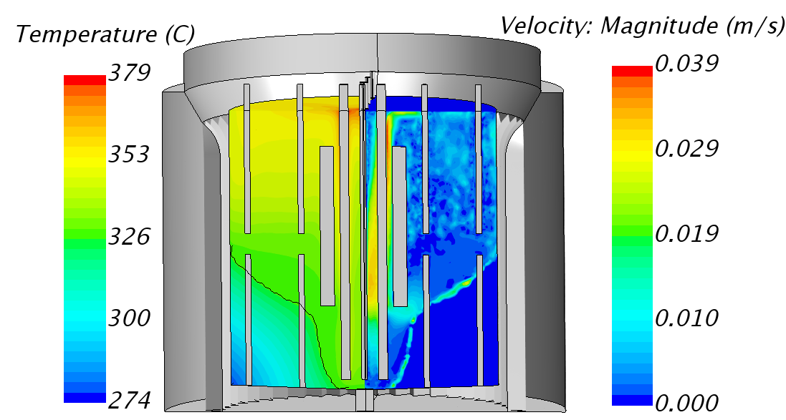
Steady state 67% molten lead
Final state for an experimental run was found for 0.178 kg/s of cooling air mass flow rate (Air velocity=2.2 m/s) and 3.12 kW of heating power: the solidification front arrives very close to the internals (heaters and obstacles) without reaching them.
ENEA, Brasimone, October 17-19, 2017
17

Slide 18
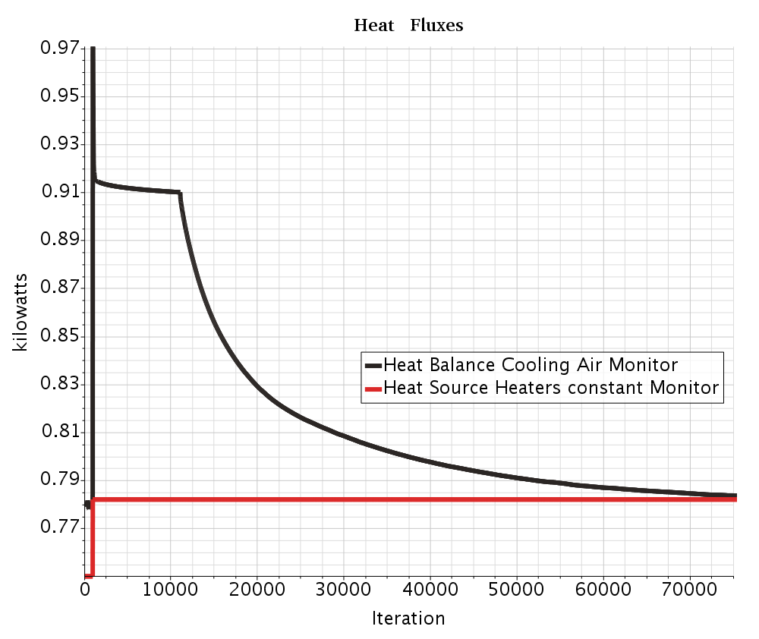
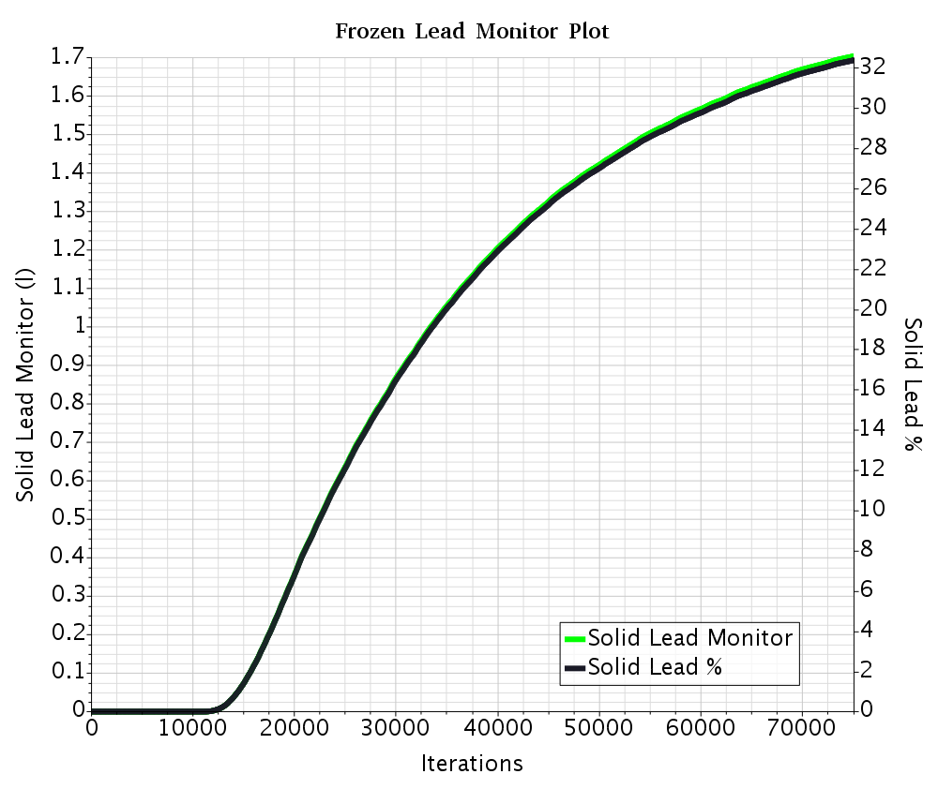
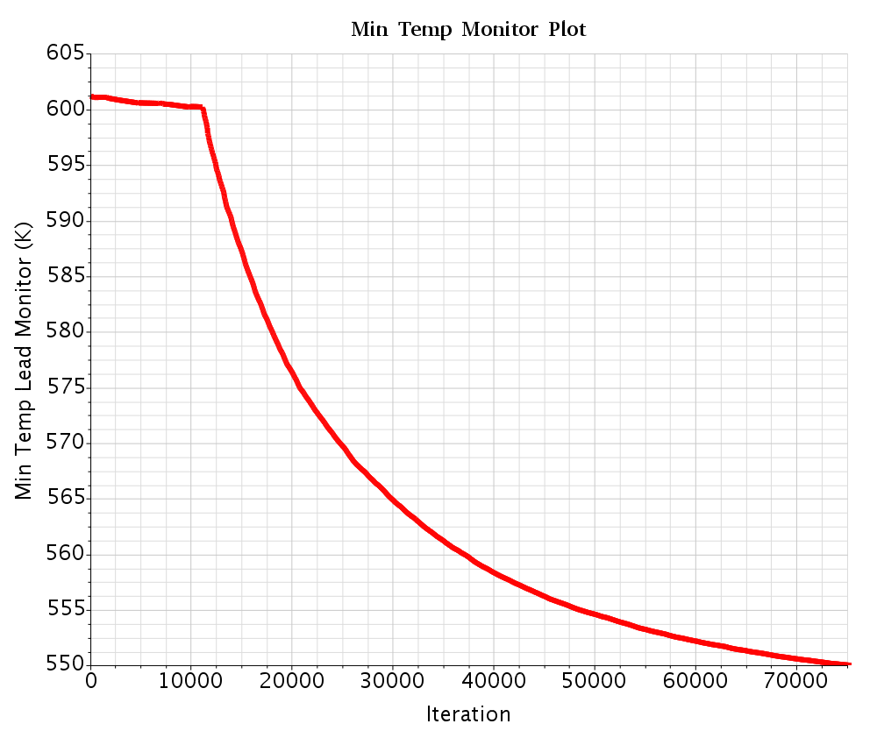
Steady state 67% molten lead
The 33% frozen fraction is chosen as a conservative final condition for experimental phase of vessel’s opening and scan of the solidification front.
ENEA, Brasimone, October 17-19, 2017
18

Slide 19
Transient calculations
The transient calculation was started after reaching the convergence of the initial steady state.
The steps consisted in switching the steady state simulation just before the beginning of the solidification to unsteady state and initiate the solidification with a small time step (10⁻³s), a large number of inner iterations (20) and with smaller under relaxation factors in the velocity and pressure solvers.
Further on, the time step is progressively increased, until 0.1s, the inner iterations are diminished and the under relaxation factors are set to the initial default values.
For the simulation of the transient solidification, the air cooling boundary condition is switched to the maximum reachable from the blower: 0.5 kg/s, keeping the heat source constant.
ENEA, Brasimone, October 17-19, 2017
19

Slide 20
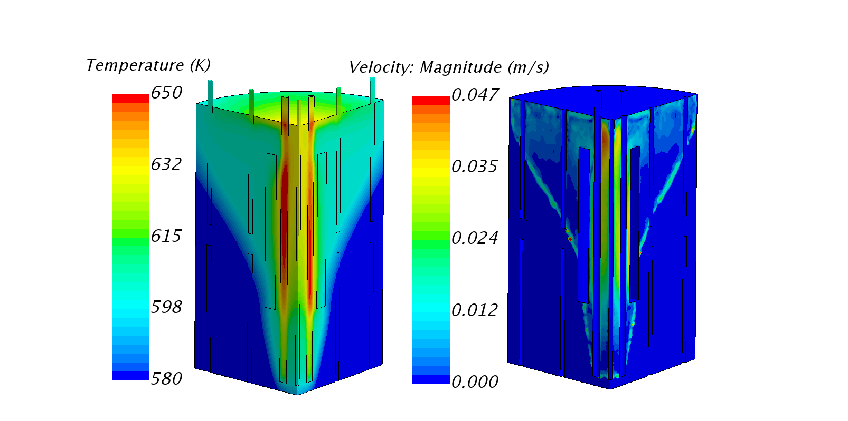
Transient results
Maximum cooling air velocity=6.25 m/s (MFR=0.5 kg/s)
ENEA, Brasimone, October 17-19, 2017
20

Slide 21
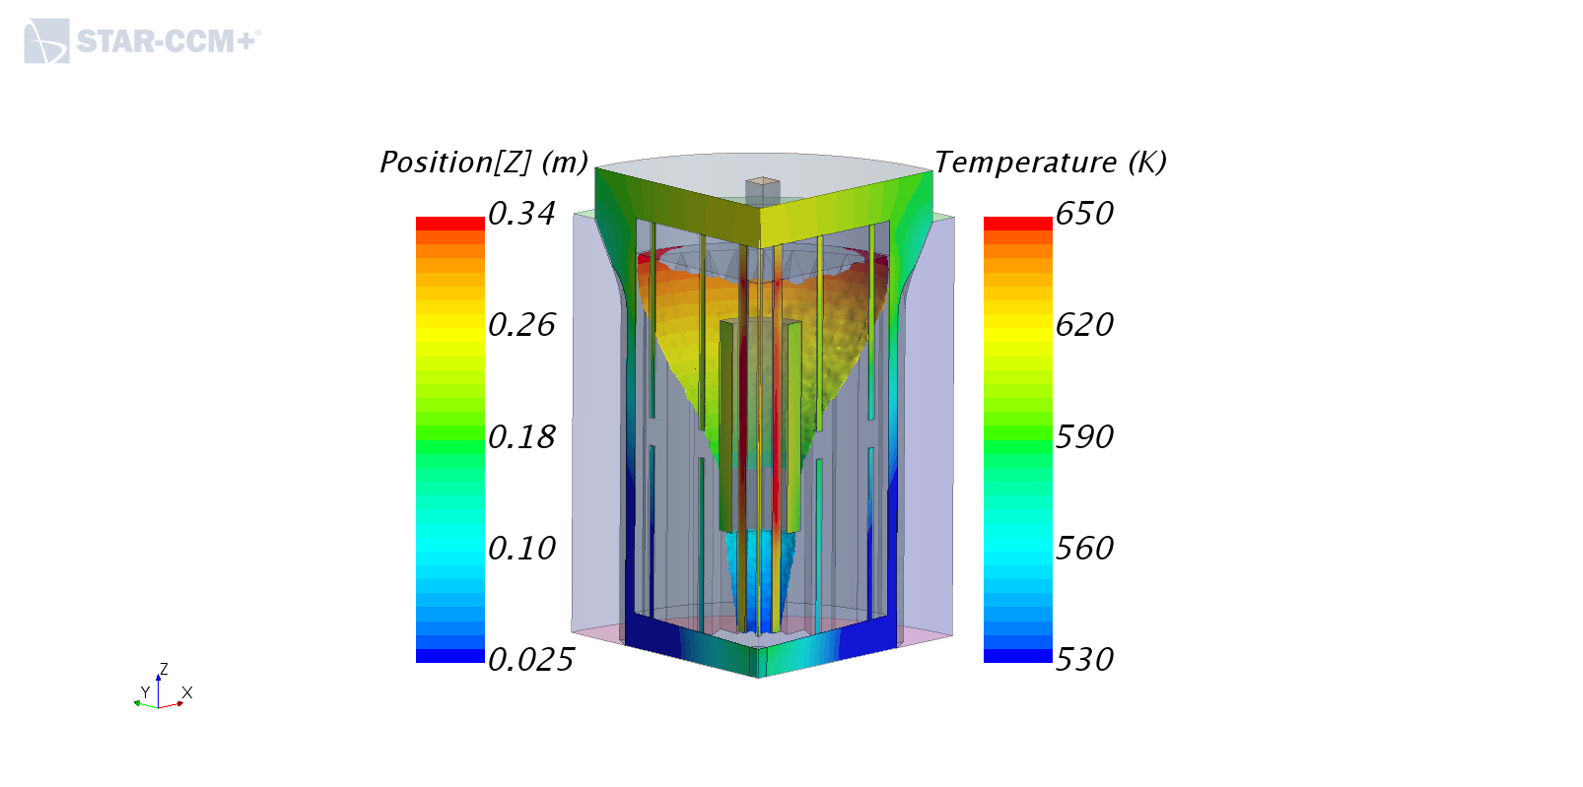
Transient results
The transient was performed in order to evaluate how much time is needed to reach some specific fraction of frozen volume.
The result of the transient simulation indicates that:
a frozen fraction of 33% (the maximum considered for the opening-vessel condition) is reached after 27 minutes (21 minutes in the FLUENT calculation)
the upper limit for the solidified volume in the measure of 67% frozen fraction is reached after 48 minutes (37 minutes in the FLUENT calculation).
ENEA, Brasimone, October 17-19, 2017
21

Slide 22
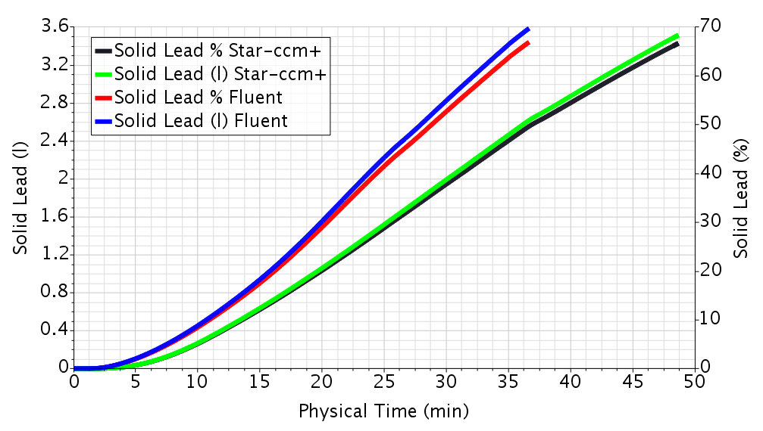
Transient results
ENEA, Brasimone, October 17-19, 2017
22

Slide 23
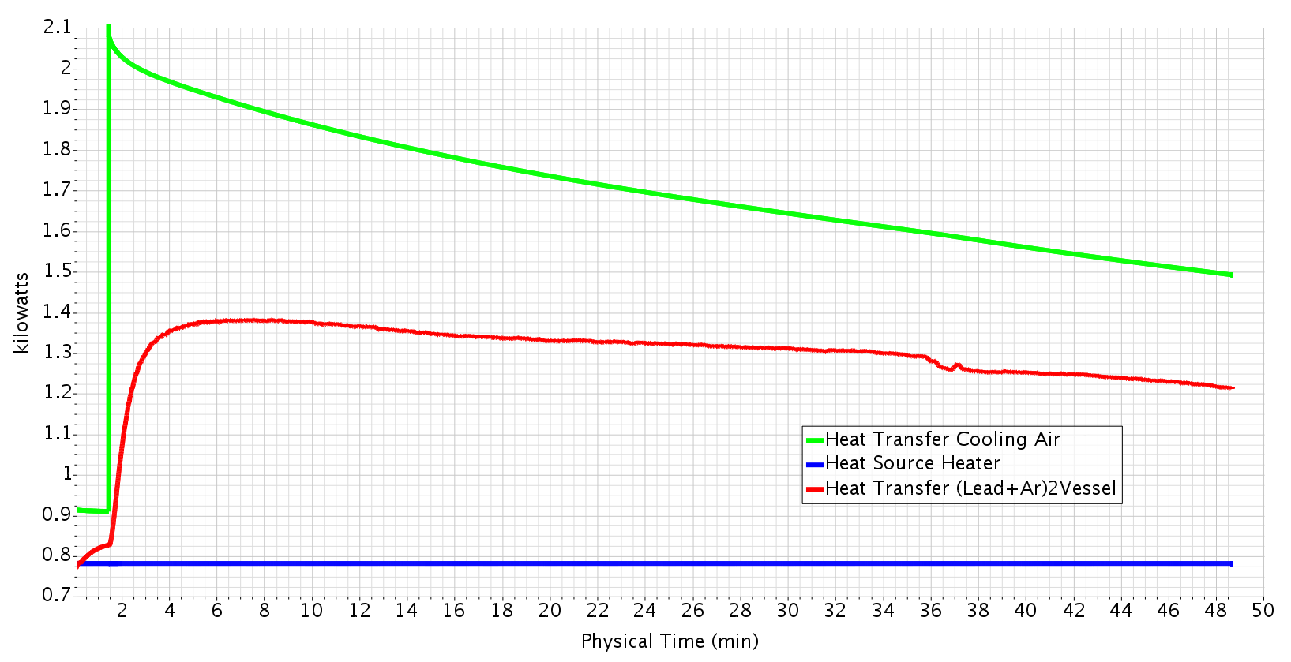
Transient results
The trend of the solidification curve is in agreement with the curve of the heat flux removed by the cooling air which is slowly decreasing towards the thermal equilibrium.
ENEA, Brasimone, October 17-19, 2017
23

Slide 24
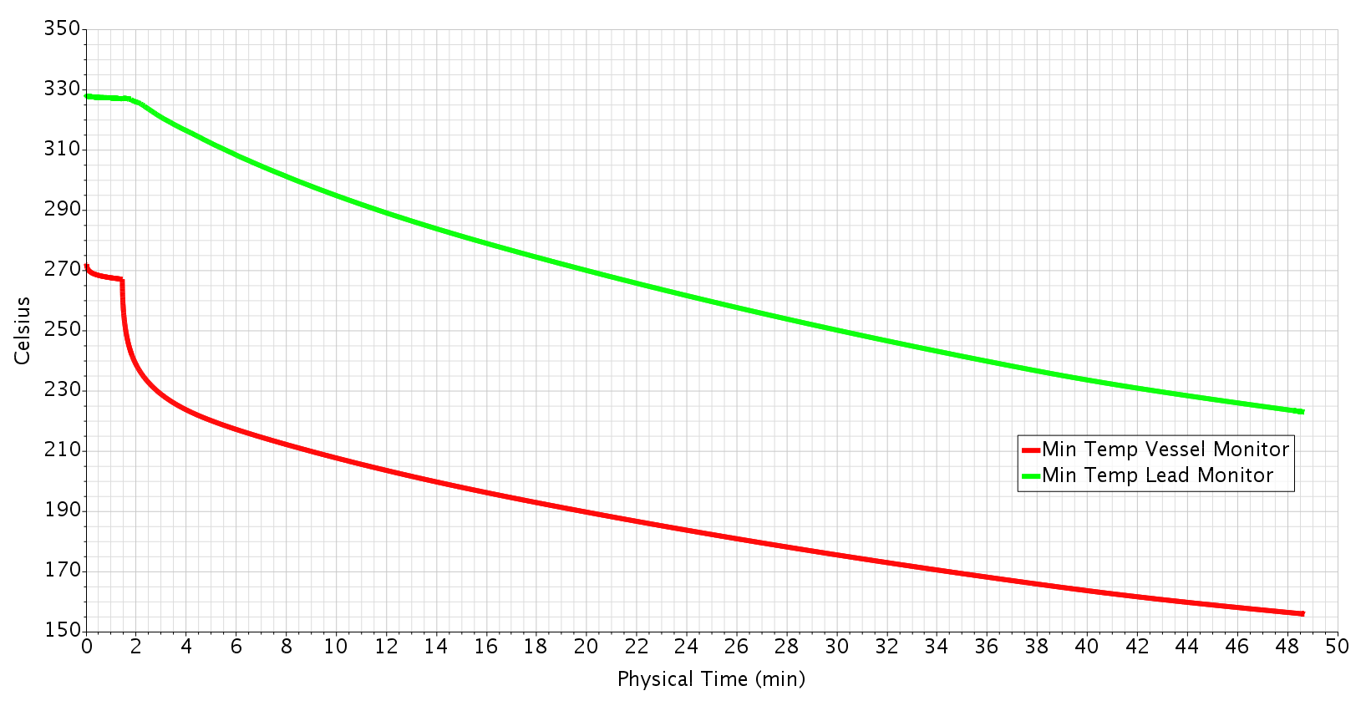
Transient results
ENEA, Brasimone, October 17-19, 2017

Slide 25
Transient results Animation (I)
ENEA, Brasimone, October 17-19, 2017
25

Slide 26
Transient results Animation (II)
ENEA, Brasimone, October 17-19, 2017
26

Slide 27
Freezing front propagation (I)
ENEA, Brasimone, October 17-19, 2017
27

Slide 28
Freezing front propagation (II)
Heater Temperature increases when the external flow path closes.
ENEA, Brasimone, October 17-19, 2017
28

Slide 29
Final considerations
We have build an articulate model of the SESAME – Stand experimental facility in collaboration with CVR. The model has been progressively improved thanks to this collaboration.
Technical/numerical issues have been partially overcome: the initial phase of the freezing in steady state could be realized only by means of an intermediate phase with transient settings.
Comparison with the Fluent model shows similar results in steady state and differences in the transient calculation.
For the fixed heat source of 3.12 kW, steady state freezing in the range 0-100% is obtained for cooling air velocity in the range 1.8-2.6 m/s.
Fast freezing of 33% and 67% from onset is obtained respectively in 27 minutes and 48 minutes showing a quite linear trend.
It seems quite important to carefully measure the air cooling from the outlet air temperature and mass flow rate.
ENEA, Brasimone, October 17-19, 2017
29

