Slide 1
Pool modelling for TALL-3D facility
M. Profir, V. Moreau, (CRS4)
4th Progress Meeting, March 6-8
NRG, Petten, Netherlands

Slide 2
Content
General objective
TALL-3D hot model
Geometry
Instrumentation
Mesh generation
Basic modeling
Run setting
Results. Comparison with experimental data
Analysis
Conclusion

Slide 3
General objective
Premise:
1D System Thermal Hydraulics (STH) codes are generally inadequate for resolving complex transients with mixing and stratification while
CFD codes are computationally too expensive for resolving the whole primary coolant system.
Coupled STH and CFD codes: a viable option for combining computational efficiency of STH with capability of CFD to resolve complex 3D phenomena.
Set-up the first 3D numerical simulations of the test section of the TALL-3D experimental facility-the test section constitutes the CFD domain of the facility
The CFD model allows:
To investigate/reach steady states
Capture the (pseudo-)steady state pool vertical thermal profile
Capture the thermal mixing or stratification phenomena of the LBE inside the test section pool

Slide 4
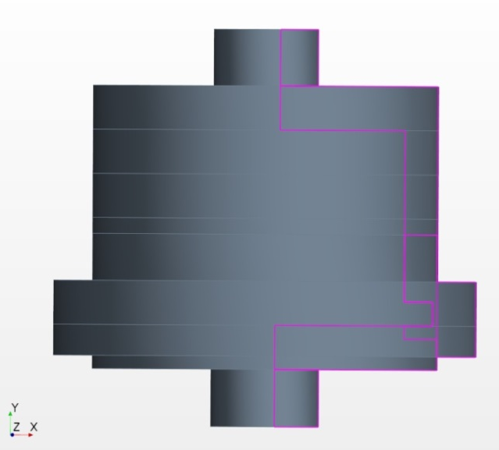
TALL-3D test section model geometry
TALL-3D test section: axisymmetric cylindrical stainless steel vessel with a bottom inlet and a top outlet
Full 3D geometrical model built with the STAR-CCM+ 3D-CAD modeler, according to the sizes indicated in the document M21(DraftD3.1.1) issued by KTH
Pool Inner diameter=300 mm, Height=200 mm, Inlet pipe Inner diameter=17 mm

Slide 5
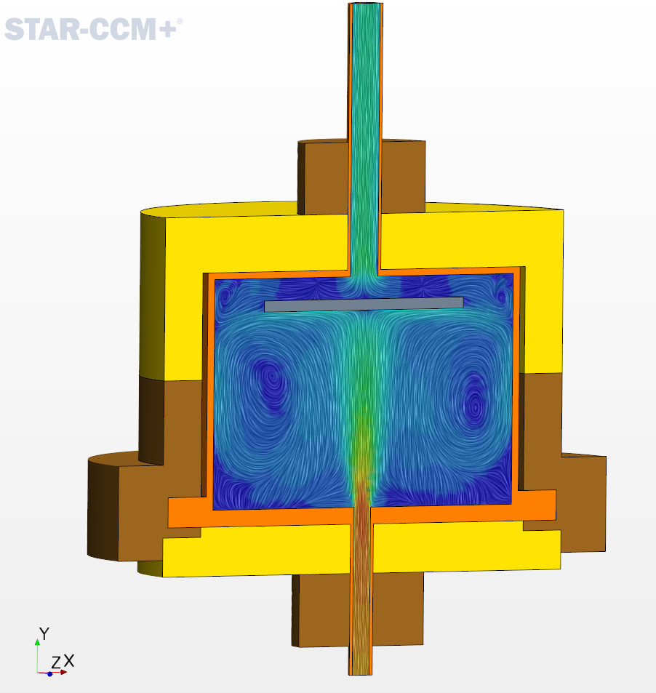
TALL-3D test section model geometry
Splitting in regions for several reasons:
Different materials
Steel
LBE
External insulators: two materials
Part-based meshers
Unstructured polyhedra
Prism layer only in the fluid
Specific source
Heat source: around the lateral walls of the pool

Slide 6
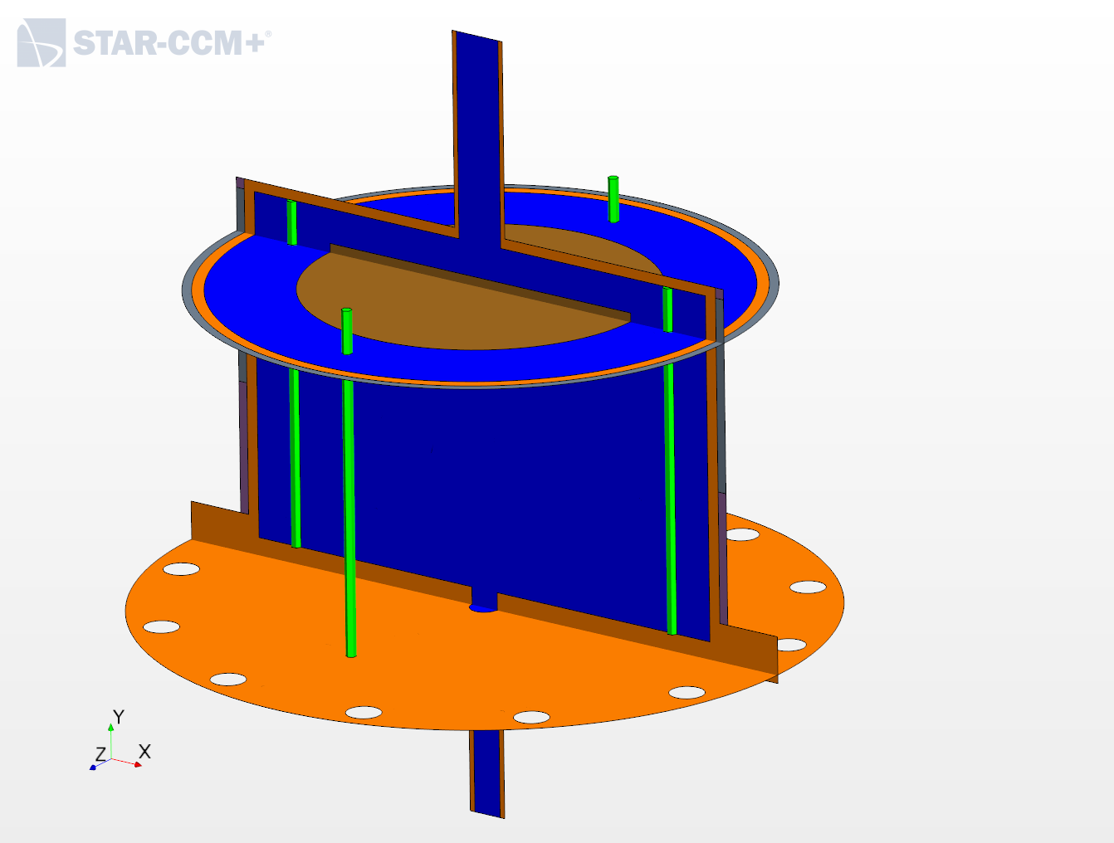
TALL-3D test section model geometry
The main solid internal structure is also made of several parts to get a differentiated access to specific heat fluxes by means of fluid-solid interfaces:
Circular inner plate
Lateral walls
Bottom plate
Inner thermocouples pipes
Heater

Slide 7
TALL-3D model instrumentation
The numerical model is appropriately instrumented:
Mass flow rate through inlet and outlet
Instantaneous and mean flow temperature through inlet, outlet, point and line probes
Instantaneous and mean flow temperature and velocity fields shown on transversal sections
Heat fluxes through fluid/solid interfaces
Replication of the experimental temperature probes:
Inner Pipe Thermocouples (IPT) 4x9 TCs in-pool vertical
Circular Inner Plate (CIP) thermocouples 4x10 TCs horizontal

Slide 8
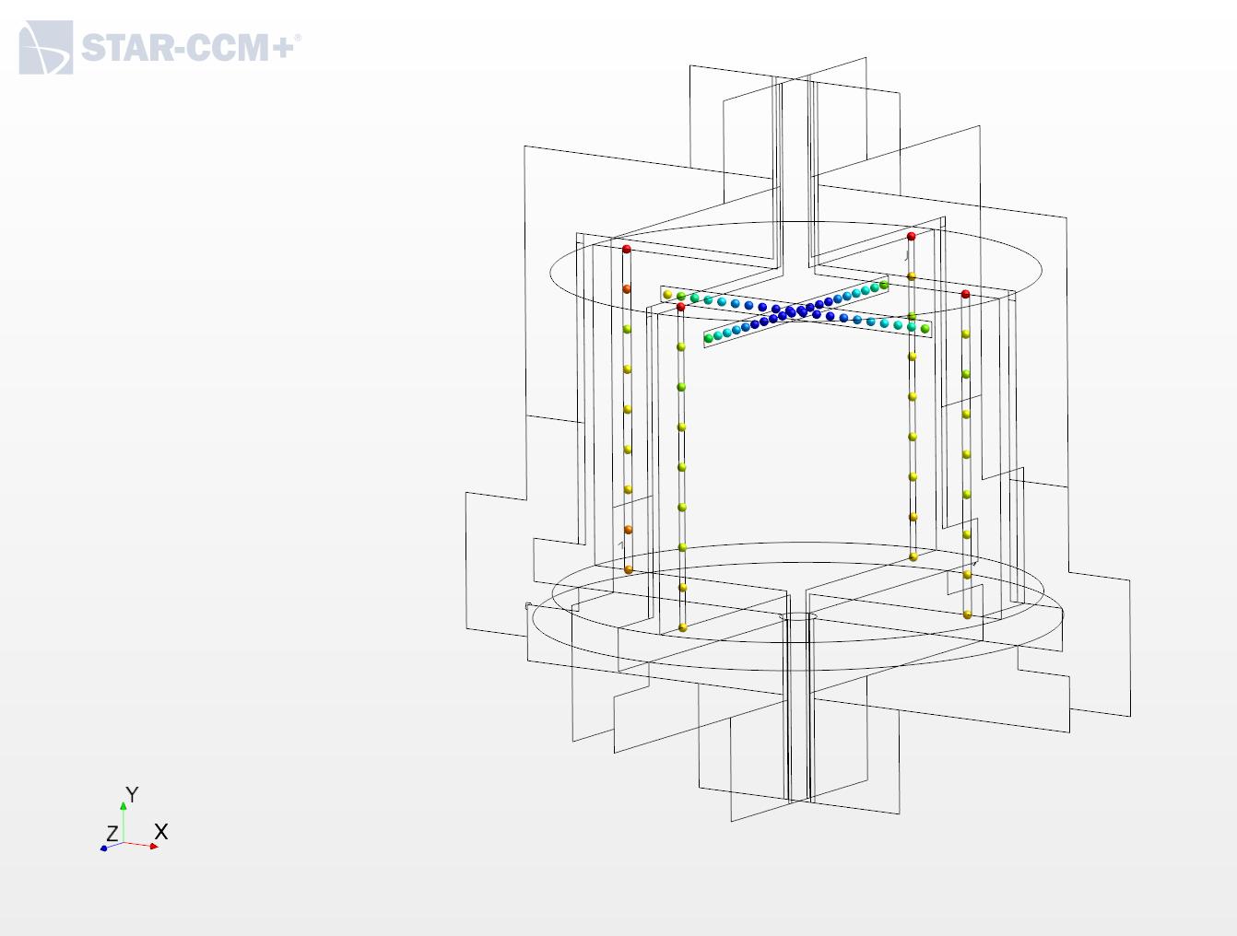
TALL-3D test section thermocouples

Slide 9
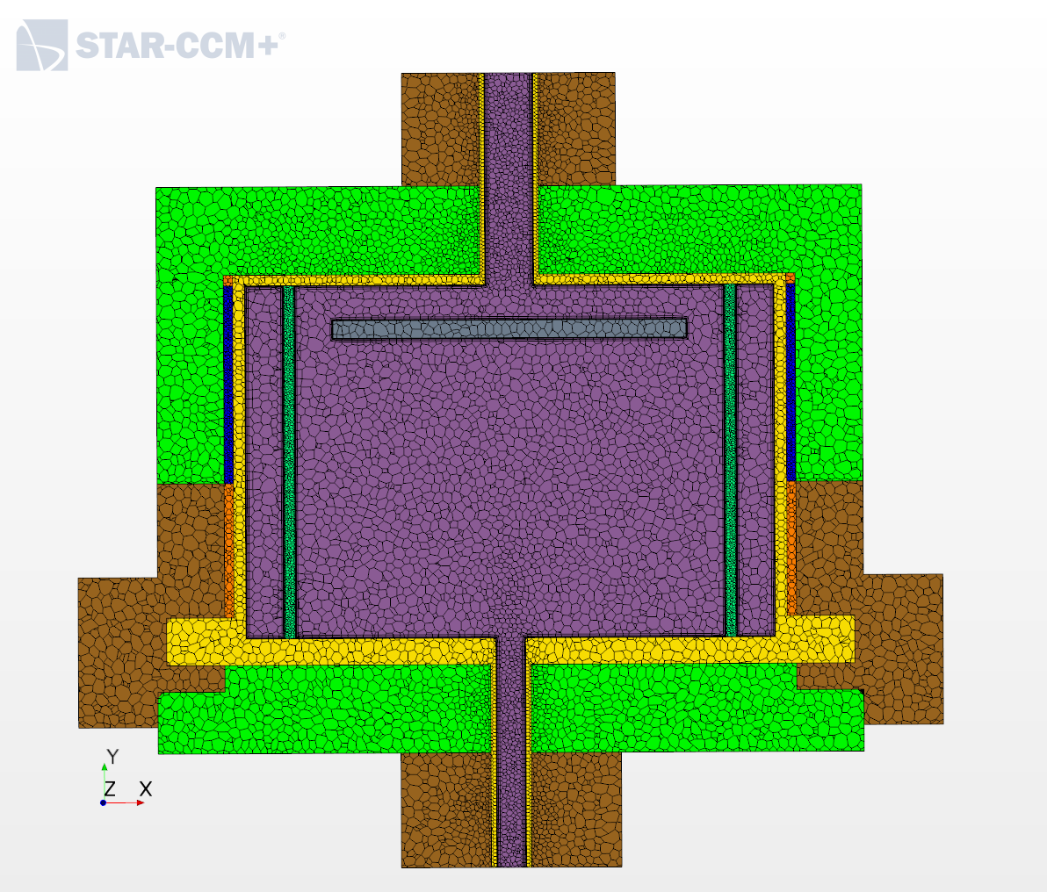
TALL-3D test section mesh
Some thin structures
Mesh size reasonable: customized mesh size in thin zones
Part-based mesh operations allow for relatively small mesh generation times
Non-conform fluid/solid interfaces
Fluid+Solid: 1 Mcells

Slide 10
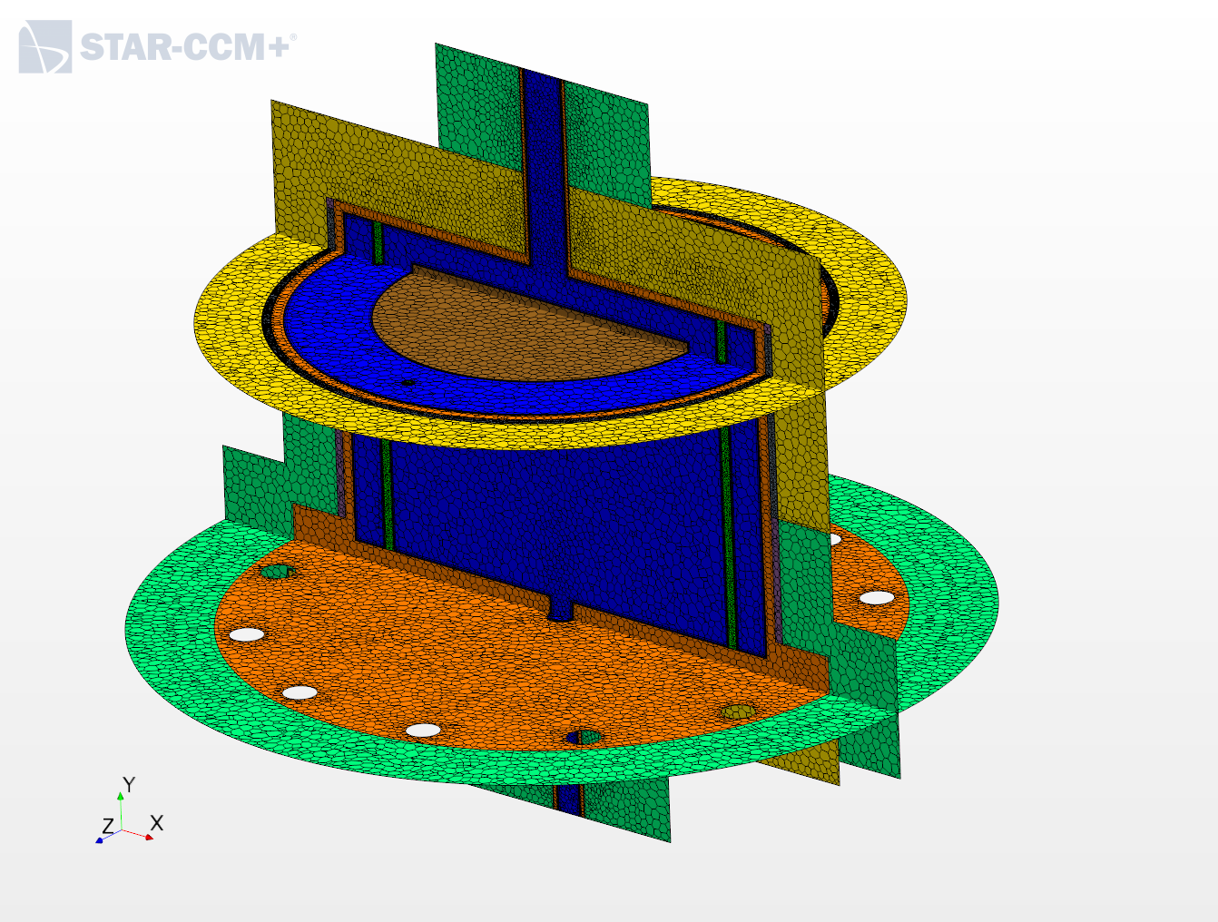
TALL-3D test section mesh

Slide 11
TALL-3D model run setting
Steady state
K-Epsilon realizable Two-Layer All y+
Segregated Fluid Temperature
Segregated Solid Energy
STAR-CCM+ default settings
Error/omissions found/corrected thanks to KTH crosscheck
Gravity lacking : there was no visible thermal stratification in NC
Higher test section power: theoretical maximum instead of effective power leading to l
Performed before KTH database release ! (pre-test)
CFD model ready for post test, comparison, validation

Slide 12
TALL-3D basic modeling: 2 test cases
Distinguished Forced Circulation (FC) and Natural Convection(NC) cases using the experimental test TG03.S301.01 performed by KTH
FC: MFR = 1.8 kg/s, Inlet Temperature=232°C
NC: MFR = 0.366 kg/s, Inlet Temperature=181.1°C
Heat Source in the Heater:
5.5 kW ~ ΔT=20°C (FC), ΔT=100°C (NC),
Fixed temperature=300 K at external walls
Adiabatic top and bottom insulators walls

Slide 13
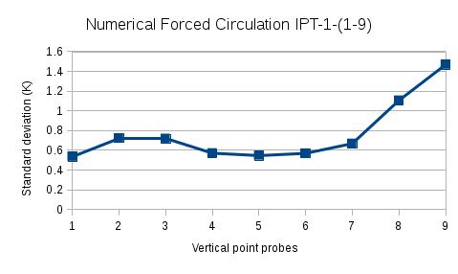
TALL-3D hot simulation results: probes
Numerical results concern the temperature captured on:
the highest of the 9 point probes in each vertical Inner Pipe Thermocouples: IPT-x-9, for x=1,2,3,4
the most external of the 10 point probes in the four lines of the horizontal Circular Inner Plate TCs: CIP-x-10, for x=1,2,3,4
Reasons:
these layers of probes are representative for the more frequent and larger temperature oscillations
the four probes, one on each sector, allow comparison with the experimental data, even without a clear numeric and experimental sectors correspondence

Slide 14
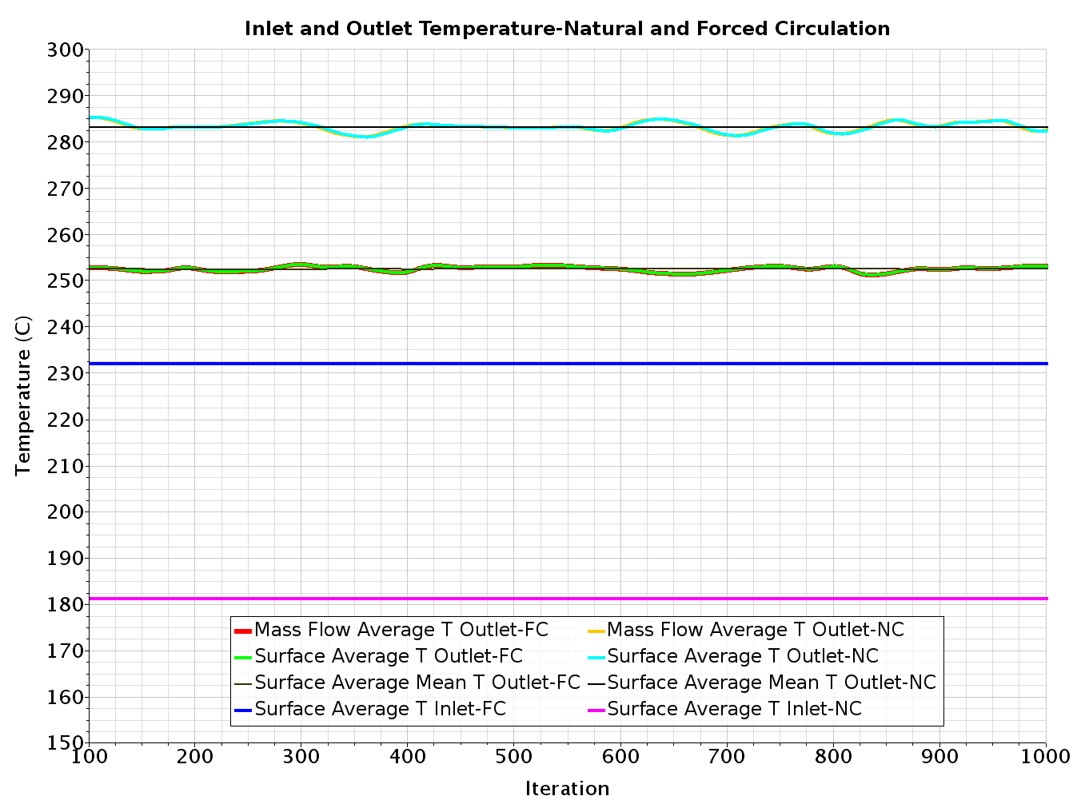
TALL-3D hot simulation results
Fast equilibrium for the test section inlet mass flow
Mass flow Averaged Temperatures and surface averaged temperatures

Slide 15
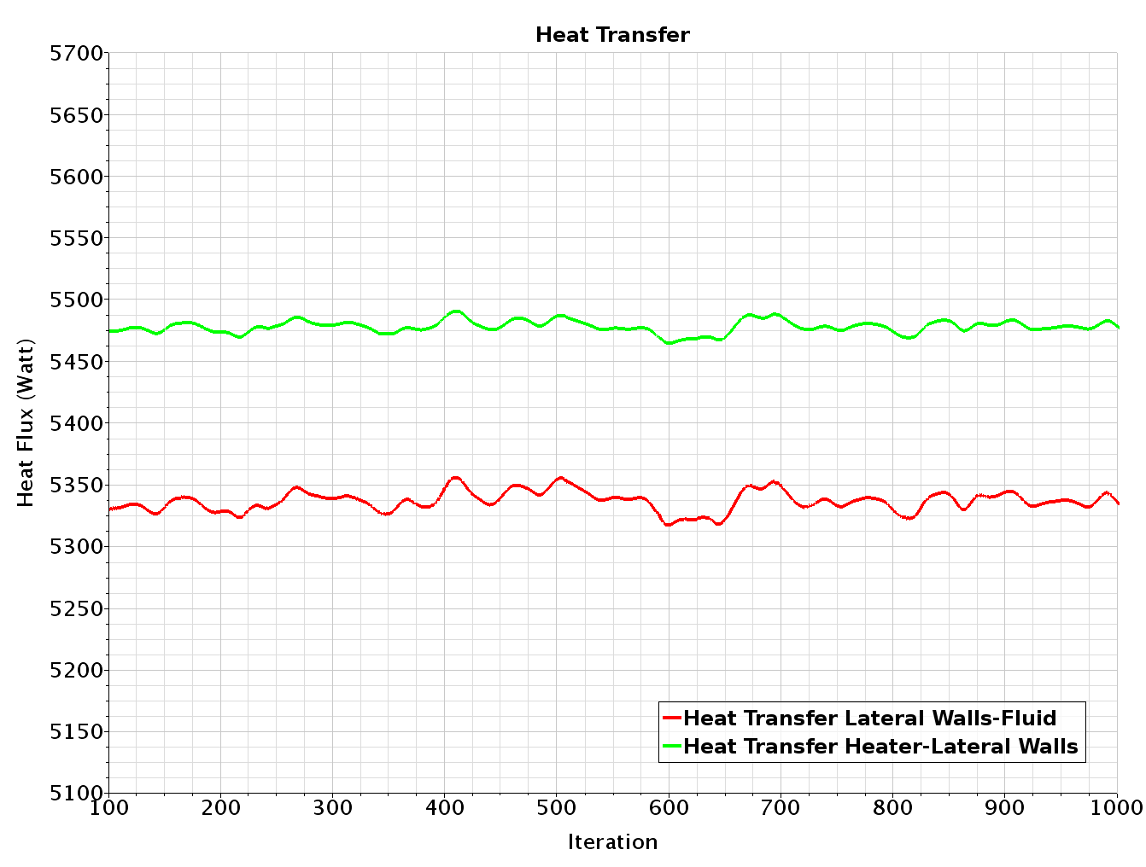
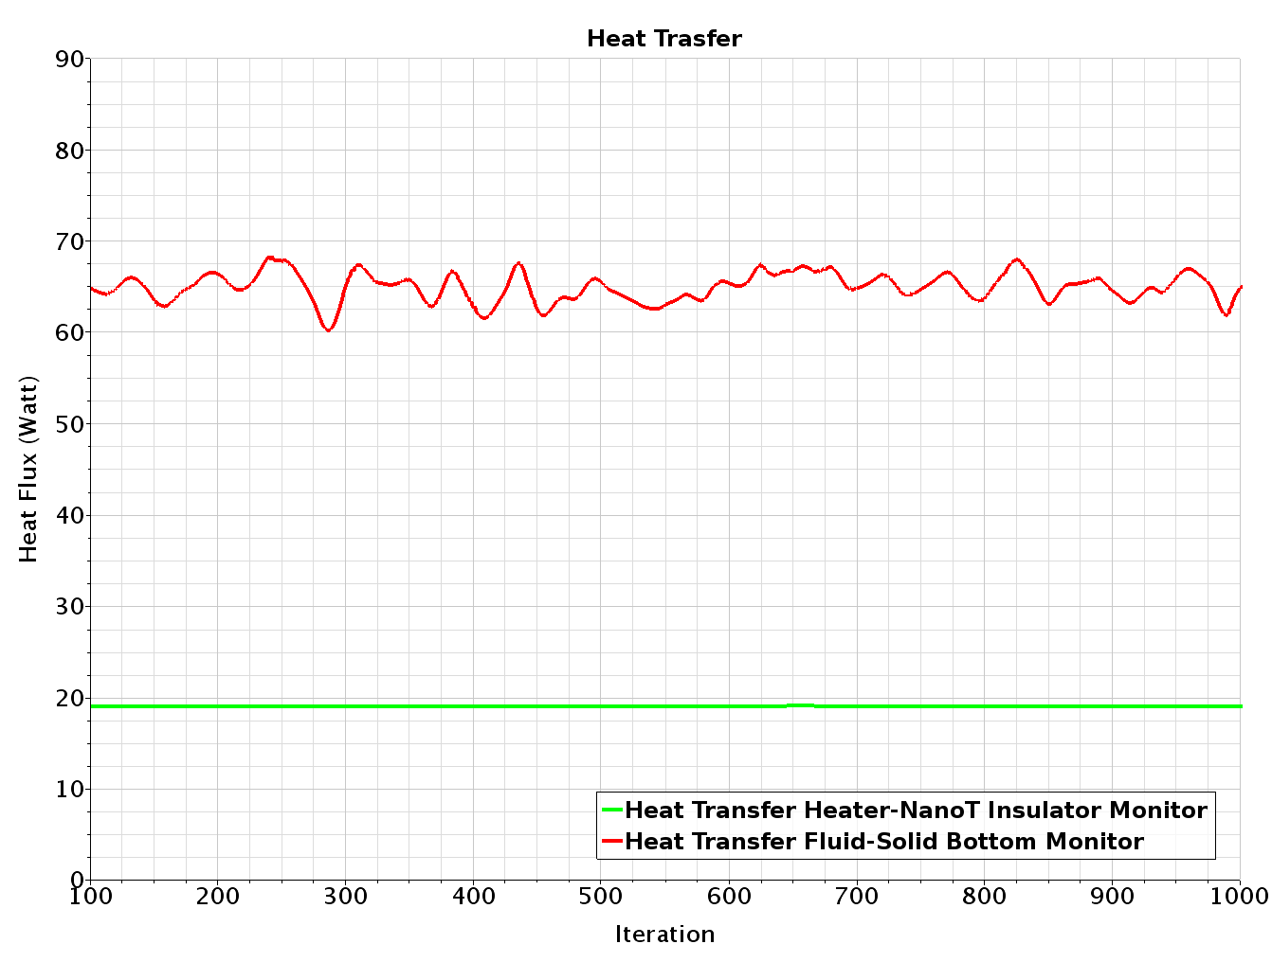
TALL-3D hot simulation results
Heat transfers:
5.5 kW from heater to solid walls
5.35 kW from solid walls to fluid
Heat transfers:
Only 20 W from heater to insulator
65 W from fluid to bottom plate

Slide 16
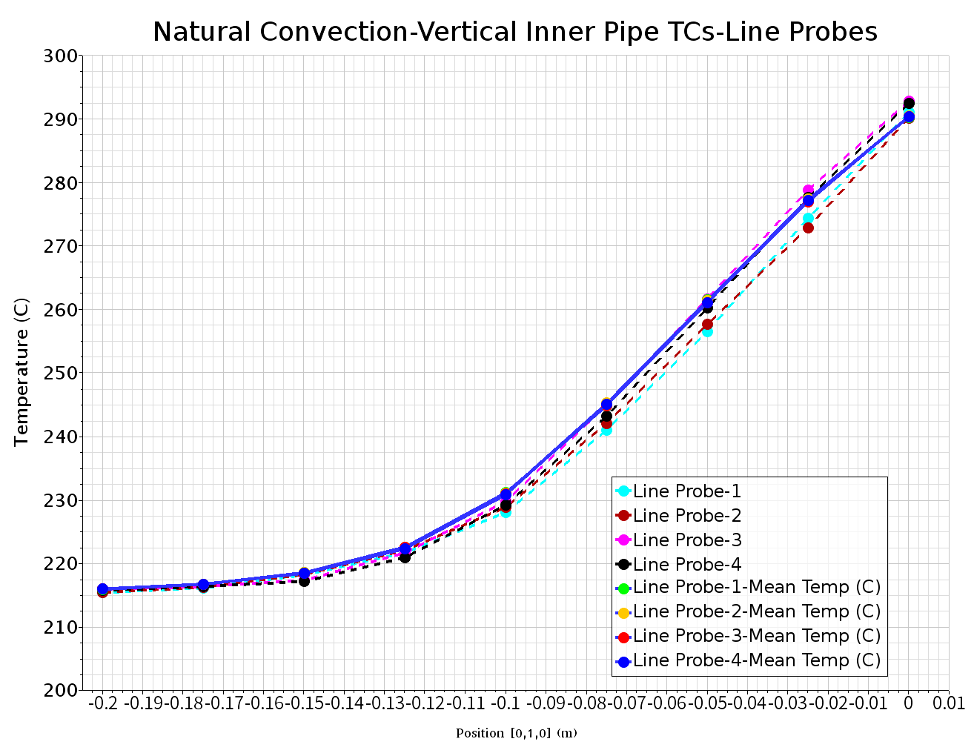
TALL-3D hot simulation results
Thermal stratification in NC captured on the vertical line probes

Slide 17
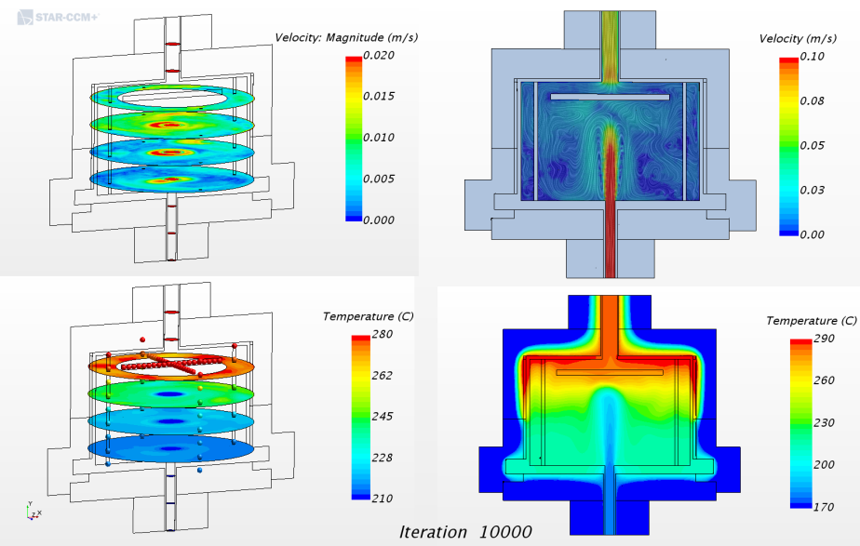
TALL-3D hot simulation results NC
The steady-state simulation do not converge to steady results!
But average temperature and velocity fields are quite steady.

Slide 18
TALL-3D NC Animation Overview

Slide 19
TALL-3D NC Animation with mean fields

Slide 20
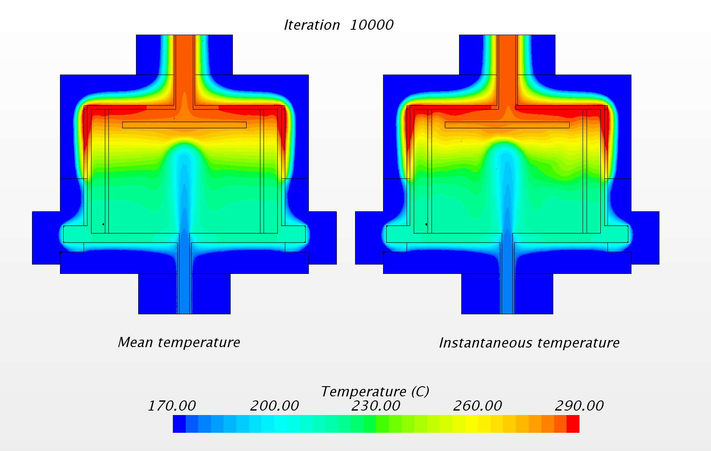
TALL-3D hot simulation results NC
Thermal lock effect well represented: very cold jet penetrating into very hot pool
The average temperature is stable and symmetrical while the point-wise temperature is still oscillating, even after a sufficient number of iterations.

Slide 21
TALL-3D NC Animation temperature

Slide 22
TALL-3D hot simulation results NC
Inlet jet penetration depth compliant with the thermal stratification

Slide 23
TALL-3D NC Animation temperature-velocity

Slide 24
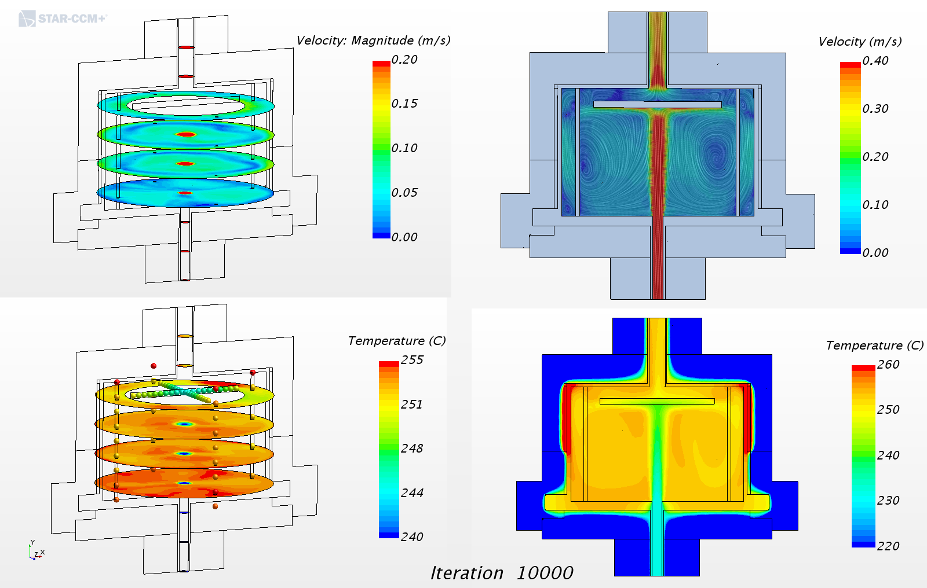
TALL-3D hot simulation results FC

Slide 25
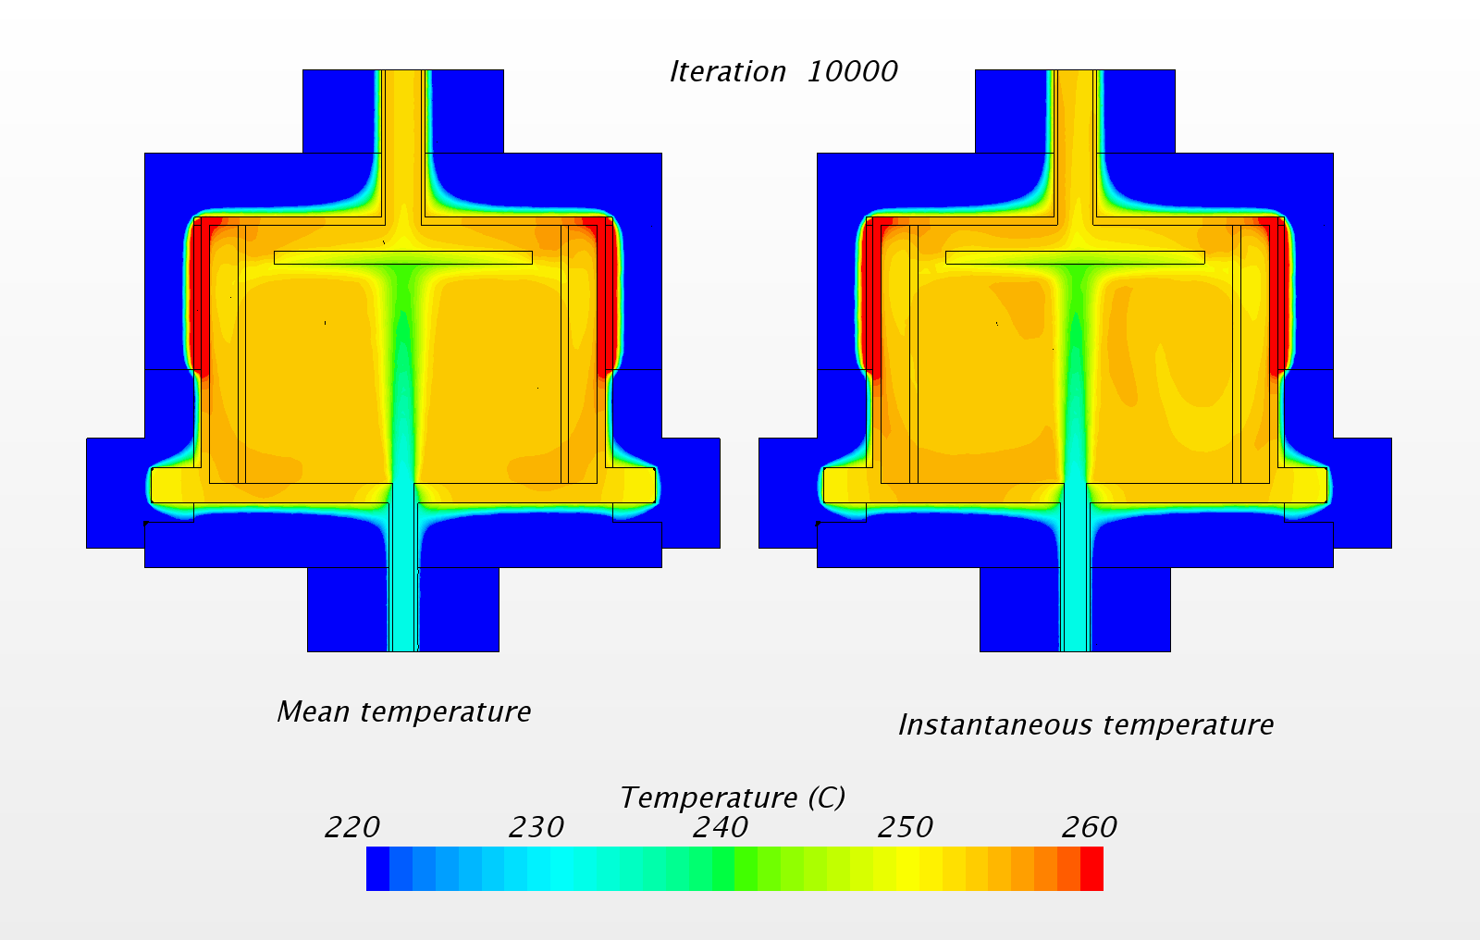
TALL-3D hot simulation results FC

Slide 26
TALL-3D hot simulation results FC

Slide 27
TALL-3D FC Animations

Slide 28
TALL-3D FC Animations

Slide 29
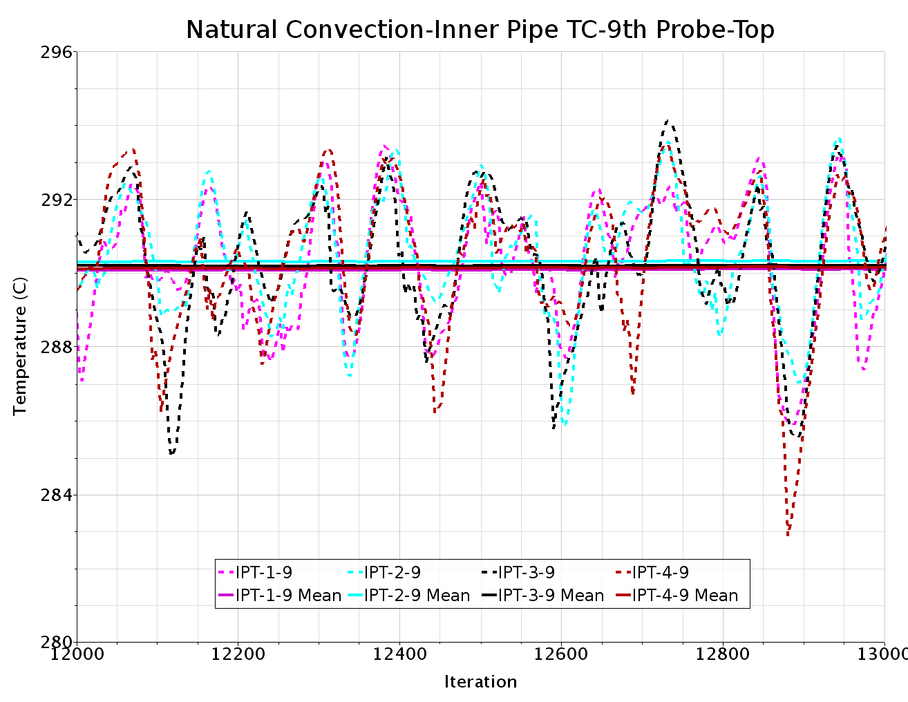
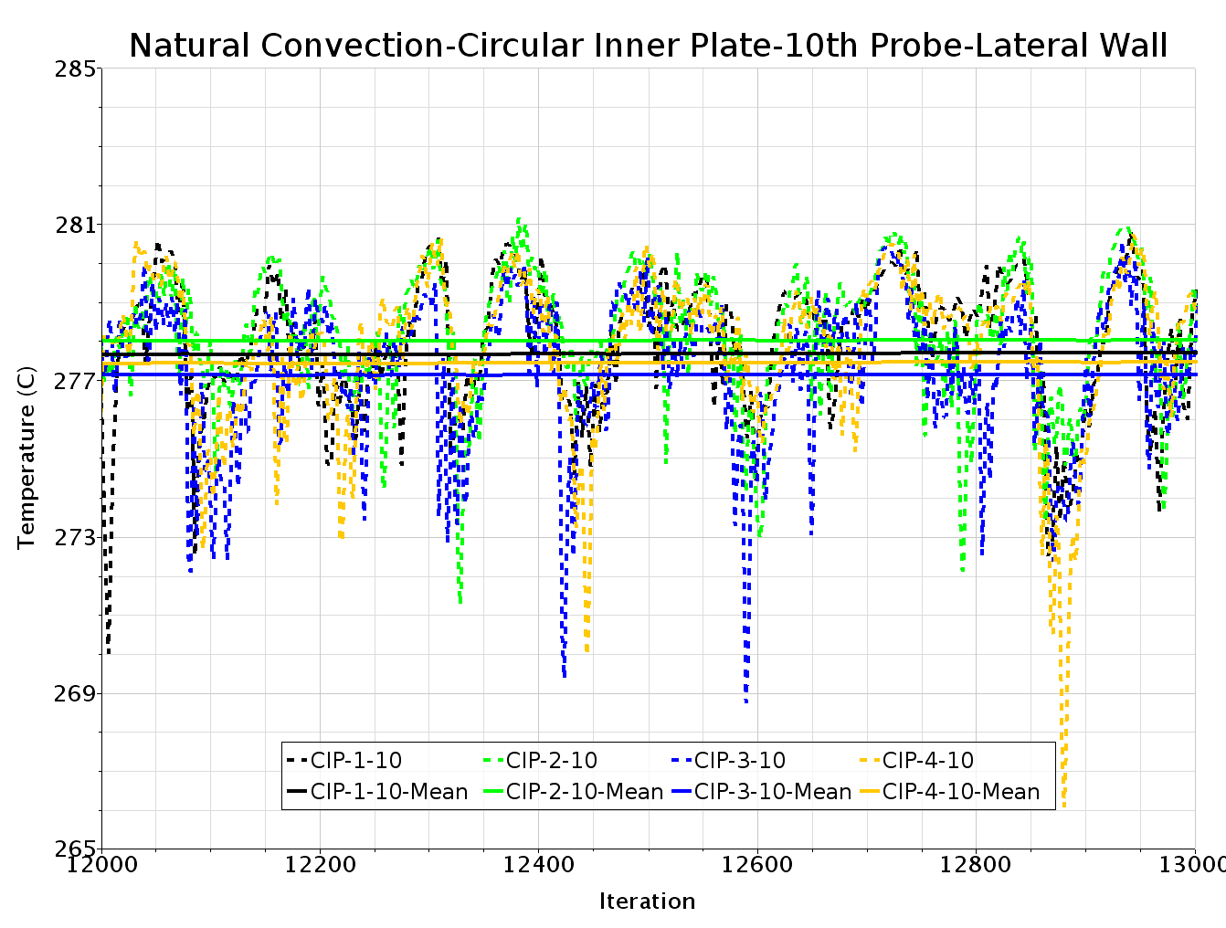
TALL-3D hot simulation results NC
Temperatures at the point probes: Point-wise vs Mean values
Standard deviation dT =1.83K
Standard deviation dT=1.84K

Slide 30
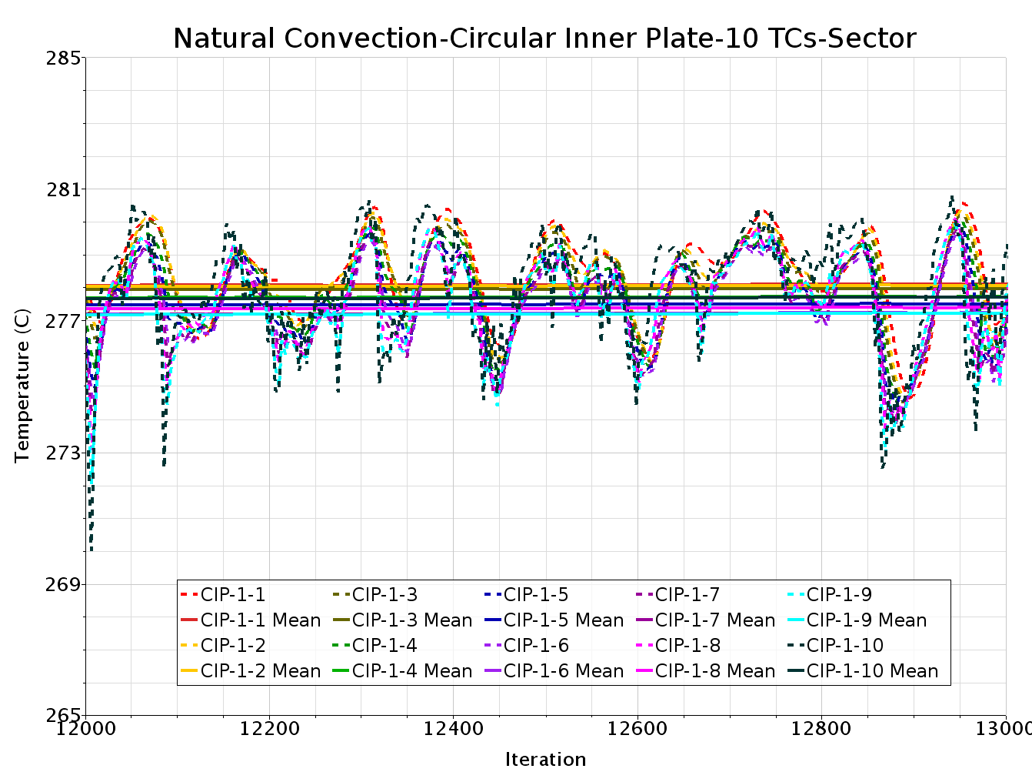
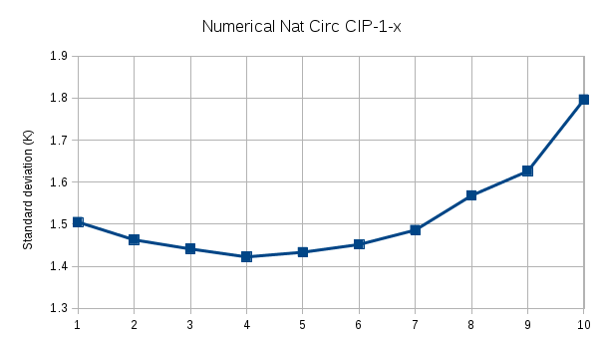
TALL-3D hot simulation results NC
Temperatures at the point probes
Point-wise vs Mean values - Standard deviation: Graphic
The graphic shows the standard deviation of the temperature on the 10 horizzontal CIP probes.
The largest oscillations are at the most external probe (No. 10).

Slide 31
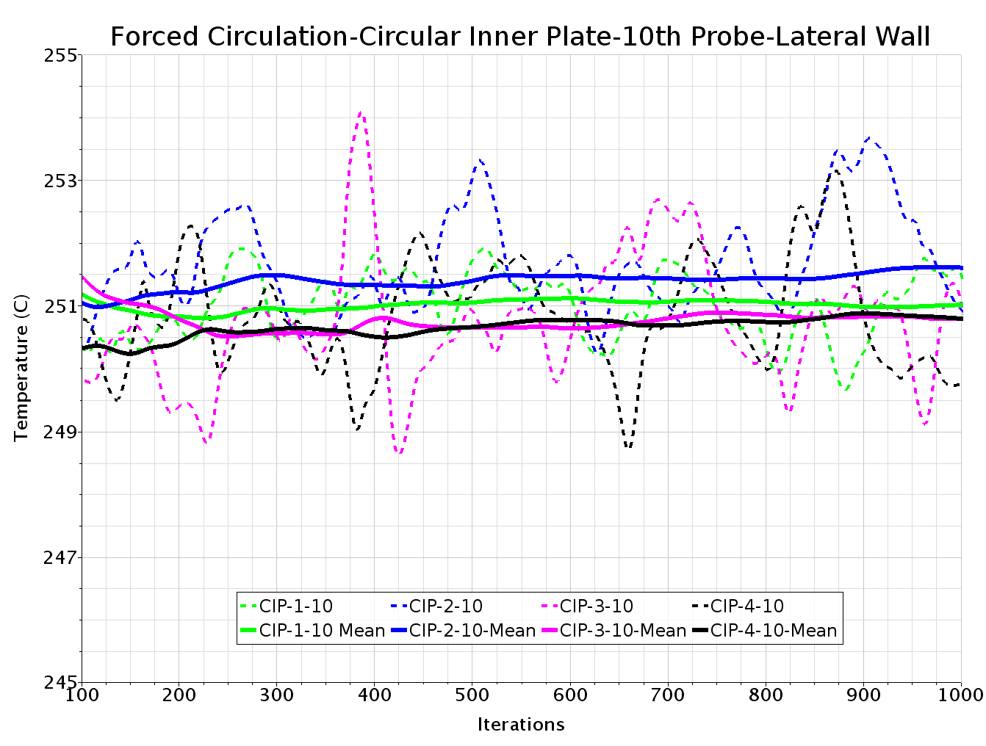
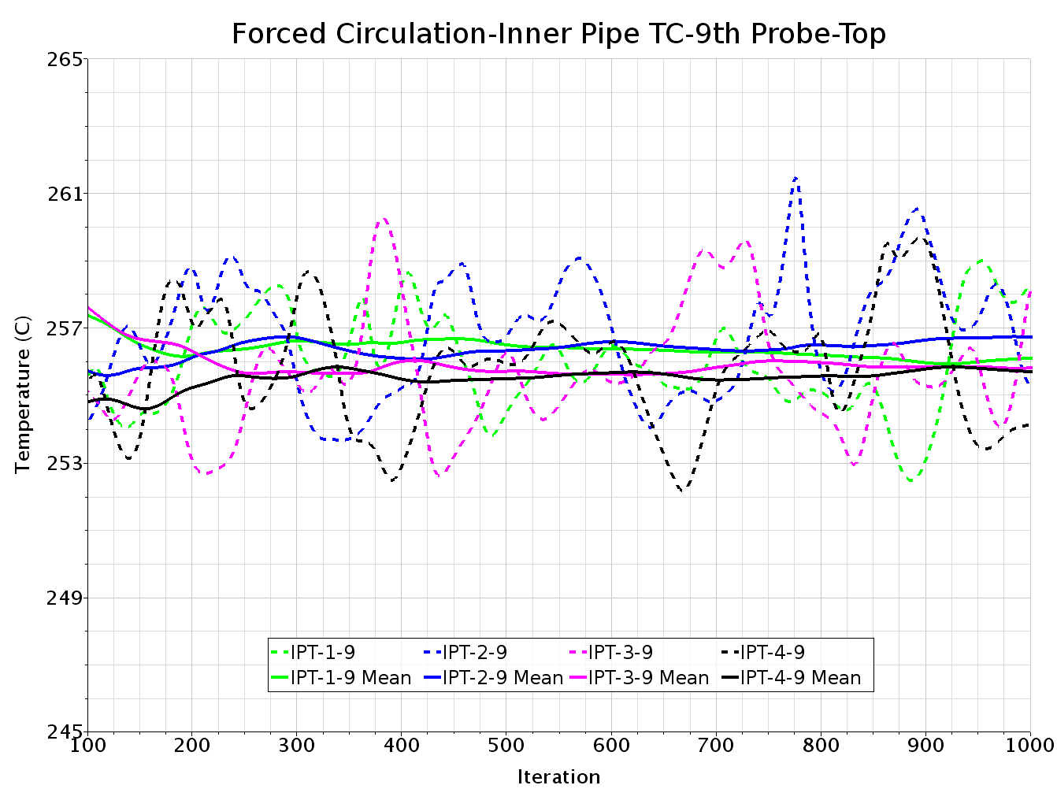
TALL-3D hot simulation results FC
Standard deviation dT=0.81K
Standard deviation dT=1.65K
The graphic (right) shows the standard deviation of the temperature on the 9 vertical IPT probes. The largest oscillations are at the highest probe (No. 9).

Slide 32
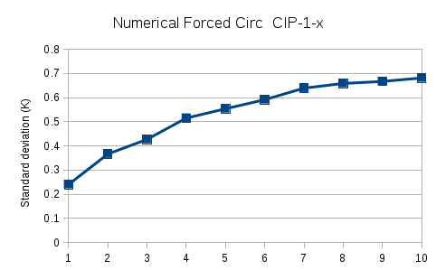
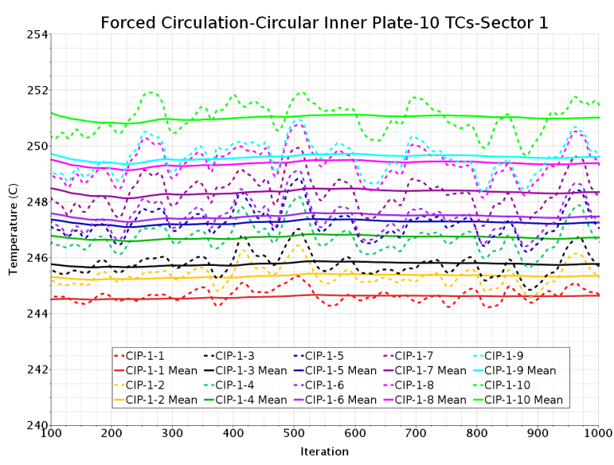
TALL-3D hot simulation results FC
Temperatures at the point probes:
Point-wise vs Mean values - Standard deviation: Graphic
The graphic shows the standard deviation of the temperature on the 10 horizzontal CIP probes.
The largest oscillations are at the most external probe (No. 10).

Slide 33
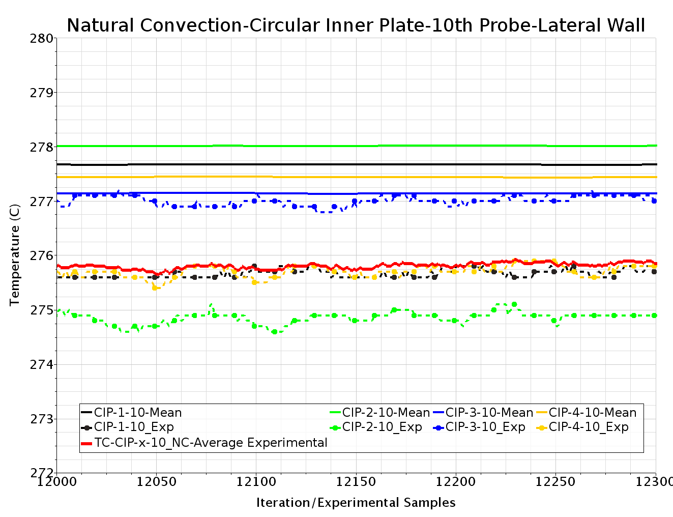
TALL-3D: Comparisons with the experiment

Slide 34
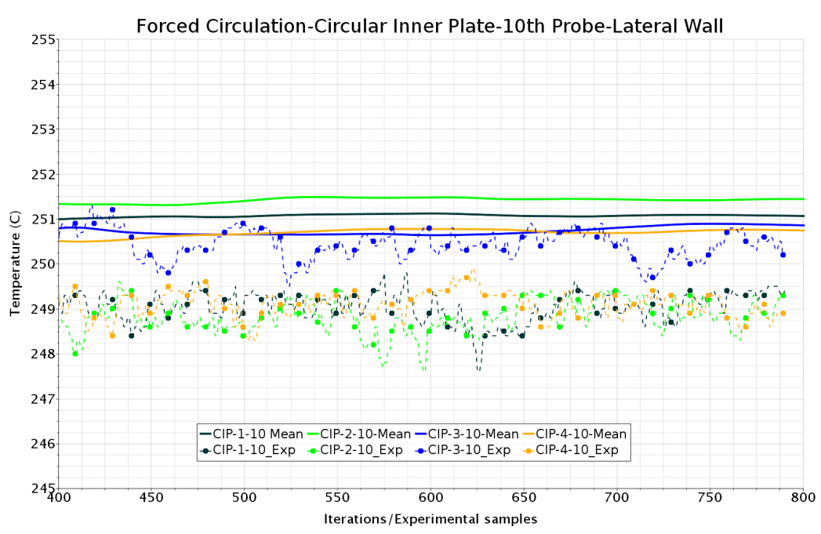
TALL-3D: Comparisons with the experiment

Slide 35
TALL-3D hot simulation results
Comparison simulation/experimental test TG03.S301.01
Case | dT (Experimental-Numerical) (K) |  | ΔT (Inlet-Outlet) (K) | Error dT/ΔT (%)
 | IPT | CIP |  | IPT | CIP
Natural circulation | 0.2 | 2 | 102.6 | 0.19 | 1.94
Forced circulation | 2.9 | 1.74 | 20.5 | 14 | 8
In natural circulation, the numerical results are very similar to the experimental results. The temperature at the IPTs is closer to the experimental values than the CIP probes.
In forced circulation, the numerical results are 2-3 K above the experimental results; the temperature at the CIP probes is closer to the experimental values than the IPTs.

Slide 36
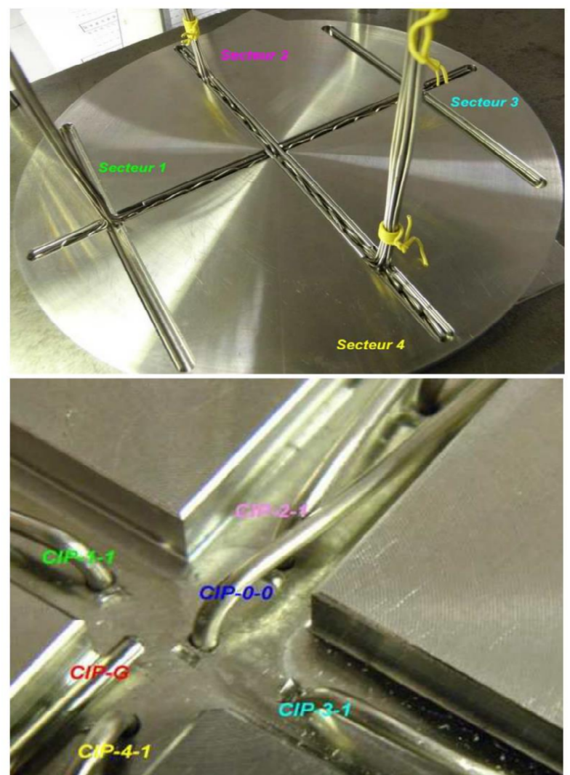
Analysis…
Position of the probes
Inlet velocity (a posteriori 0.33…)
Holes in the top plate…
Good results may be not so good and bad results not so bad.
Work still in progress…

Slide 37
Conclusion
A hot model of theTALL-3D test section, aimed at reproducing its general circulation has been built, progressively improved and appropriately instrumented
Classical steady state convergence in not reached but converges nicely in mean over iterations. Comparison is done between mean in time of experimental results and mean over iterations.
The comparison was made in the two case of NC and FC, considering the numerical values and the corresponding number of experimental samples.
The comparison was made on average temperature, since a steady state convergence was not reached.
Matching with experimental case must be better enforced and the top plate must be better numerically discretized.
Conclusions cannot yet be drawn on the goodness of the turbulence modeling.

