Slide 1
Pool modelling for
TALL-3D facility
M. Profir, V. Moreau, (CRS4)
5th Progress Meeting, October 17-19
ENEA, Brasimone, Italy

Slide 2
Content
TALL-3D model
Geometry
Instrumentation
Mesh generation
Basic modeling
Run setting. Convergence and convergence in mean
Results. Comparison with experimental data
Analysis
Conclusion
ENEA Brasimone, October 2017

Slide 3
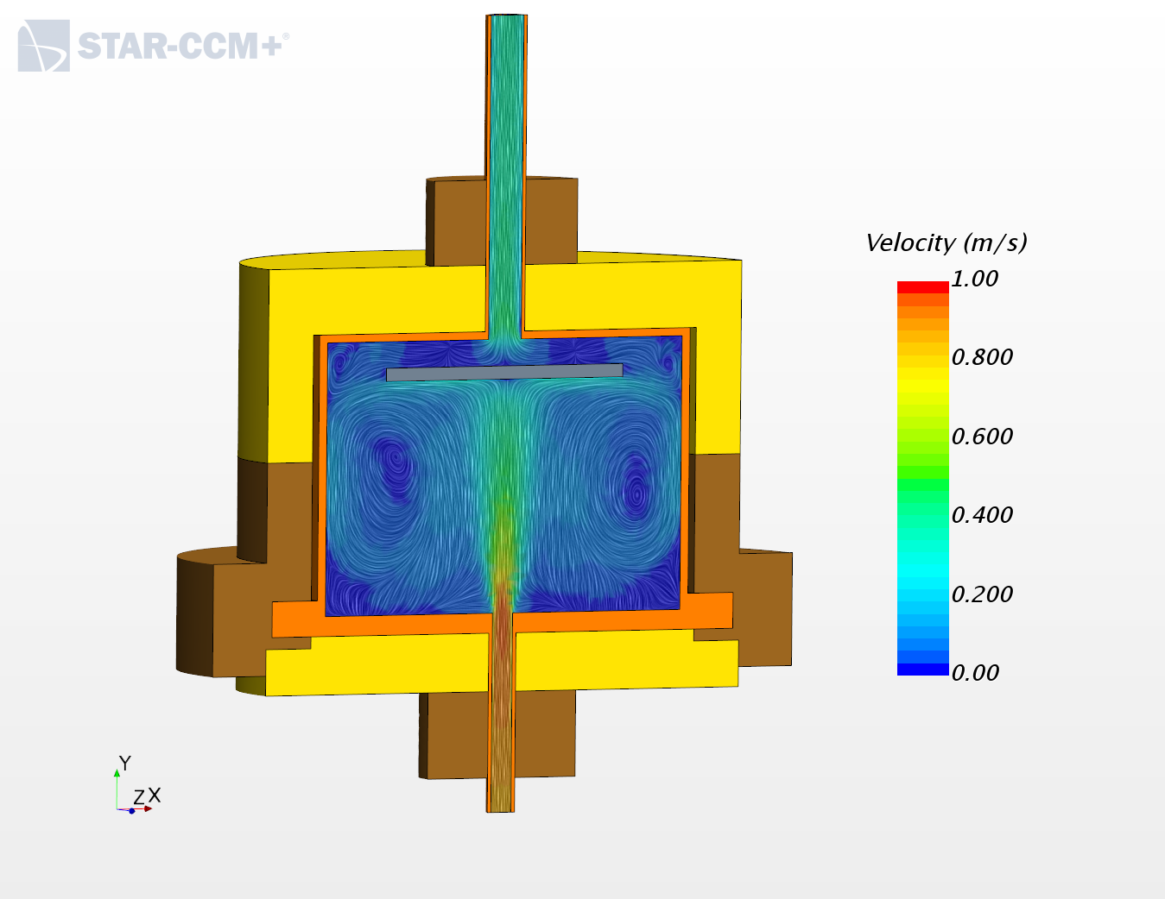
TALL-3D test section model geometry
TALL-3D test section: axisymmetric cylindrical stainless steel vessel with a bottom inlet and a top outlet
Splitting in regions for several reasons:
Different materials
Steel, LBE, External insulators: two materials
Part-based meshers
Unstructured polyhedral
Prism layer only in the fluid
Specific source
Heat source: around the lateral walls of the pool
ENEA Brasimone, October 2017

Slide 4
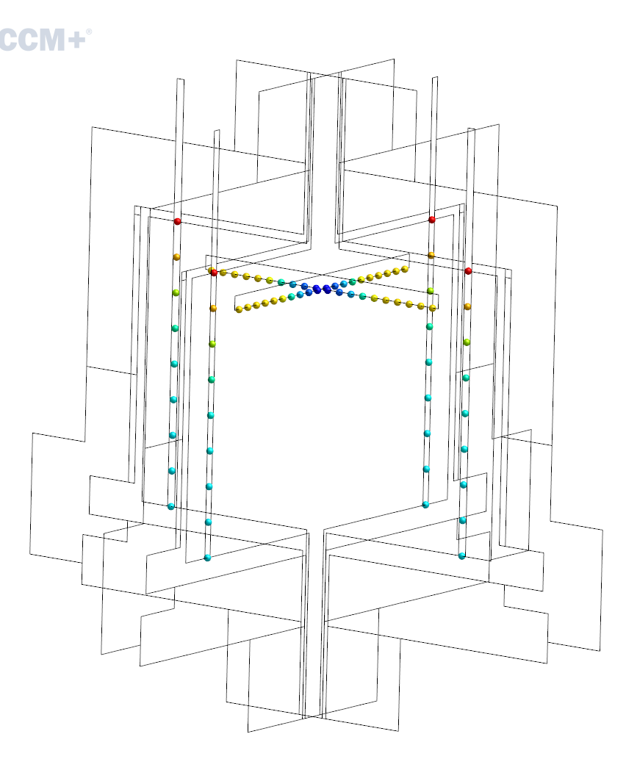
TALL-3D model instrumentation
The numerical model is appropriately instrumented:
Instantaneous and mean flow temperature through inlet, outlet, point and line probes; temperature and velocity fields shown on transversal sections
Heat fluxes through fluid/solid interfaces
Replication of the experimental temperature probes:
Inner Pipe Thermocouples (IPT)
4x9 TCs in-pool vertical
Circular Inner Plate (CIP) thermocouples
4x10 TCs horizontal
ENEA Brasimone, October 2017

Slide 5
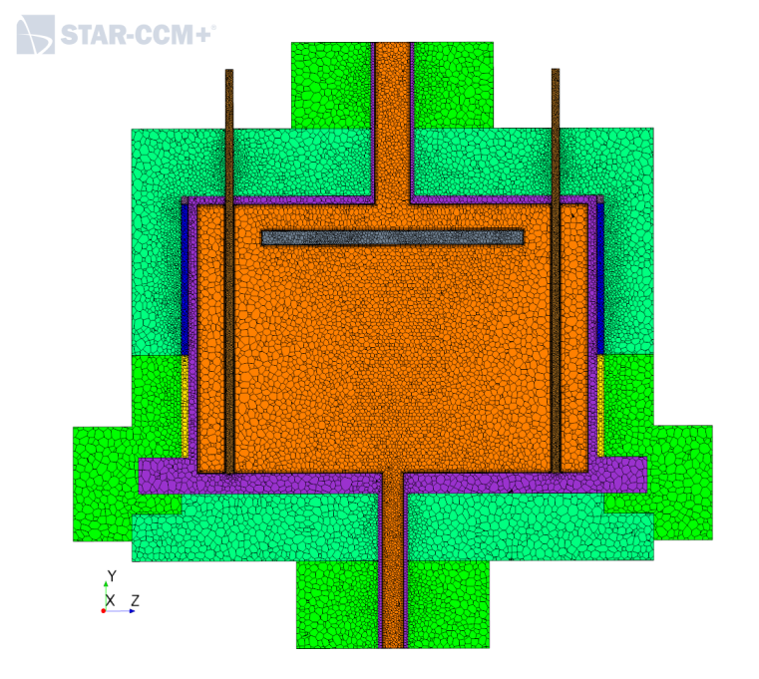
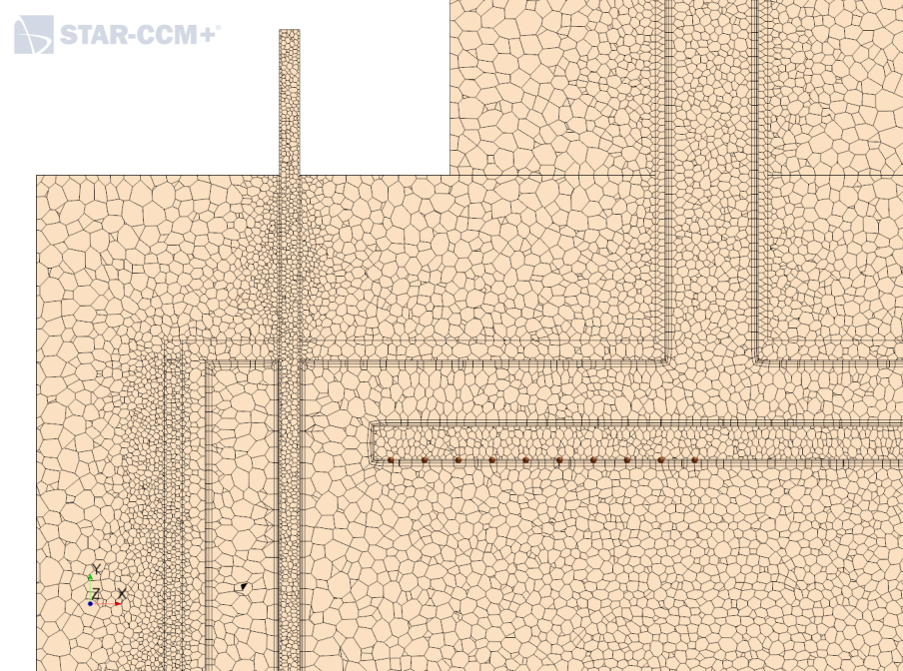
TALL-3D model updates
extended thermocouple Inner pipes
customized and refined mesh size in thin zones: heater, inner plate
corrected position of the inner plate TCs: in the first layer under the plate
Conformal fluid/solid interfaces
Volume mesh Fluid+Solids: increased from 1 to 2 Mcells
ENEA Brasimone, October 2017

Slide 6
TALL-3D model run setting
Steady state
K-Epsilon realizable Two-Layer All y+
Segregated Fluid Temperature
Segregated Solid Energy
Gravity
STAR-CCM+ default settings
Under Relaxation Factors for energy solver to 0.7
CFD model ready for post test, comparison, validation
ENEA Brasimone, October 2017

Slide 7
TALL-3D basic modeling: 2 test cases
Distinguished Forced Circulation (FC) and Natural Circulation (NC) cases using the experimental test TG03.S301.01 (provided in February 2017) and TG03.S01.06 (provided in August 2017) performed by KTH
TG03.S301.01
FC: MFR = 1.8 kg/s, Inlet Temperature=232°C
NC: MFR = 0.33 kg/s, Inlet Temperature=181.1°C
Heat Source in the Heater: 5.5 kW ~ ΔT=18.4°C (FC), ΔT=102.8°C (NC),
TG03.S01.06
FC: MFR = 1.91 kg/s, Inlet Temperature=273.3°C
NC: MFR = 0.53 kg/s, Inlet Temperature=222.4°C
Heat Source in the Heater: 10.6 kW ~ ΔT=35.7°C (FC), ΔT=124.2°C (NC),
Fixed temperature=300 K at external walls
Adiabatic top and bottom insulators walls
ENEA Brasimone, October 2017

Slide 8
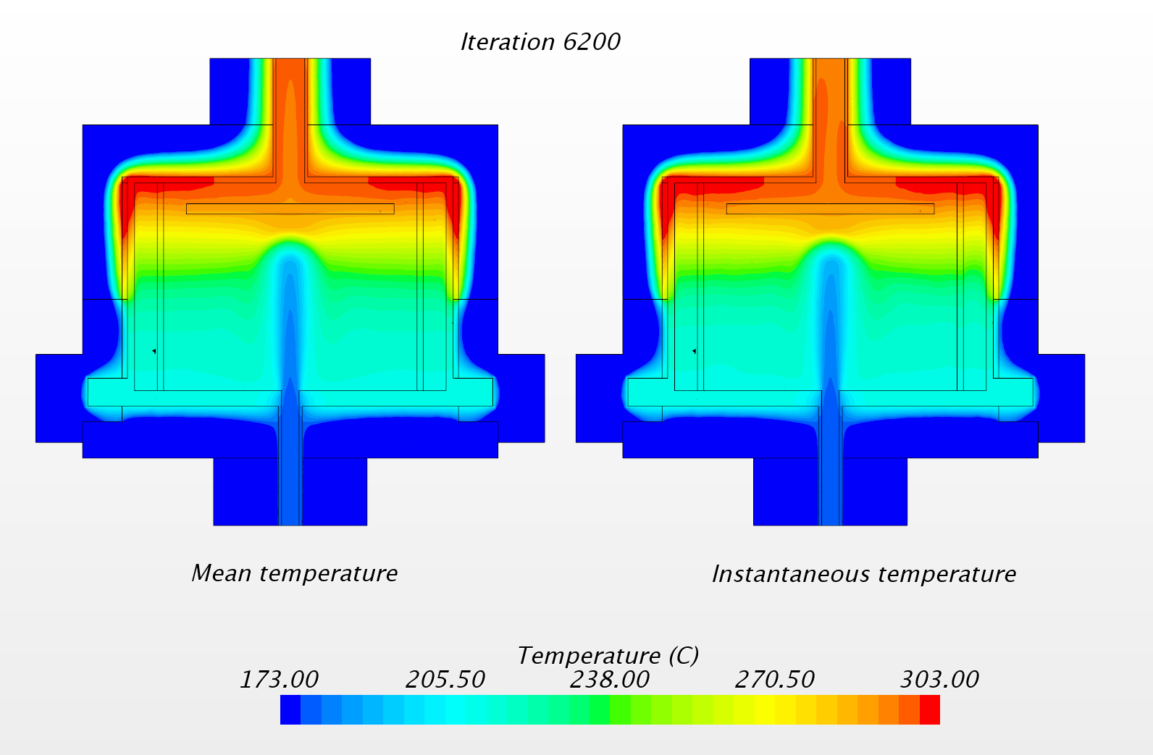
TALL-3D hot simulation results NC
Thermal lock effect well represented: very cold jet penetrating into very hot pool
The average temperature is stable and symmetrical while the point-wise temperature is still oscillating, even after a sufficient number of iterations.
ENEA Brasimone, October 2017

Slide 9
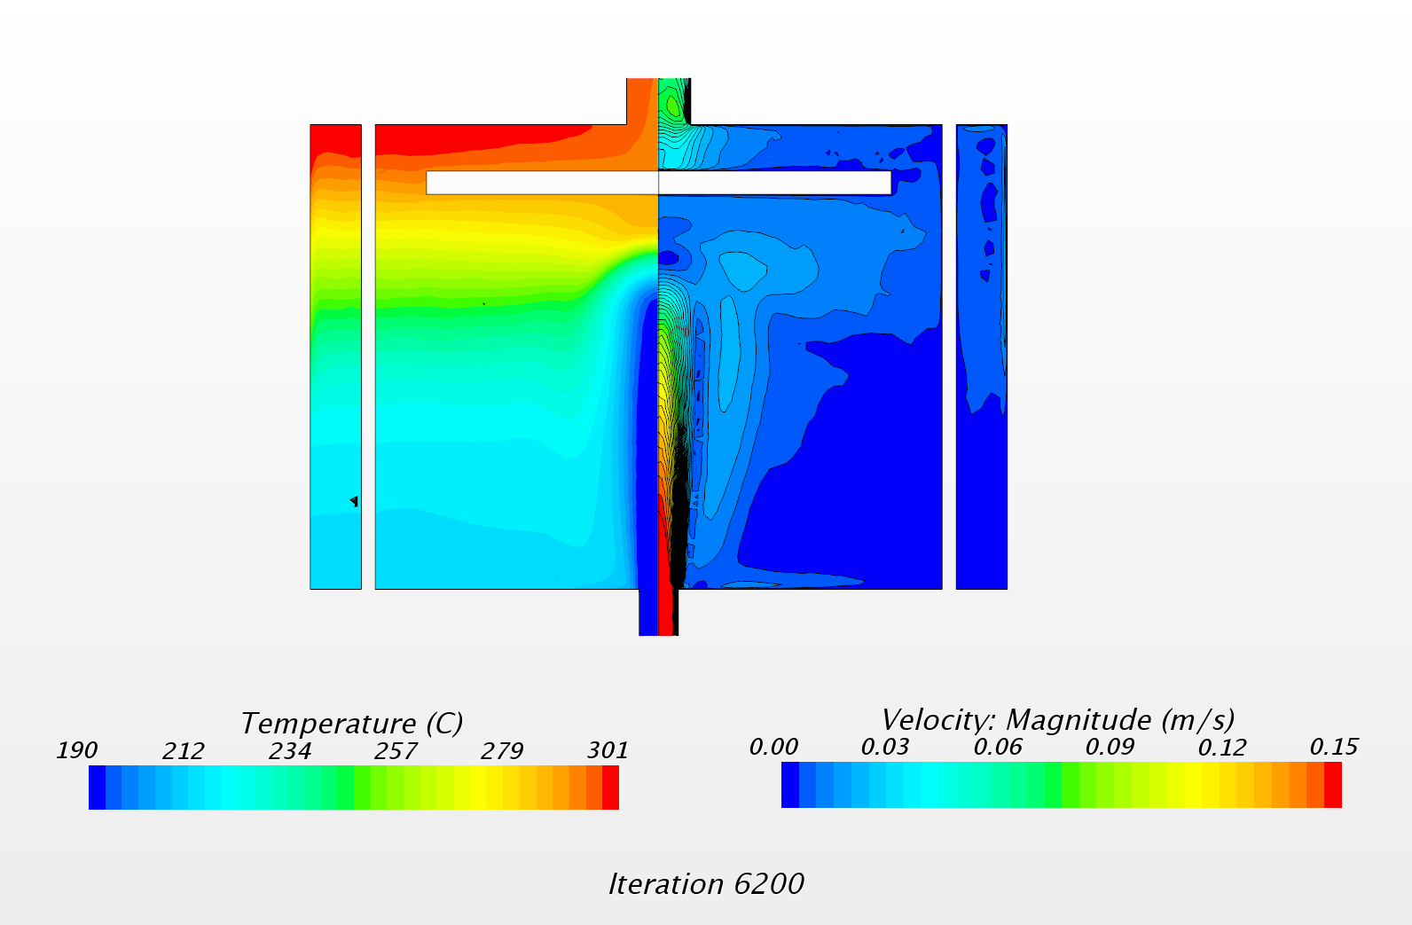
TALL-3D hot simulation results NC
Inlet jet penetration depth compliant with the thermal stratification
ENEA Brasimone, October 2017

Slide 10
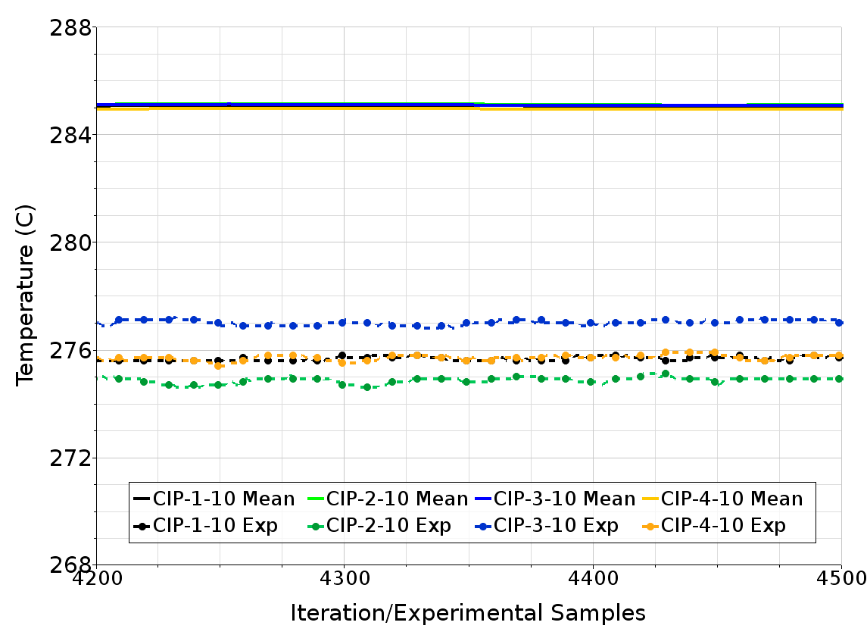
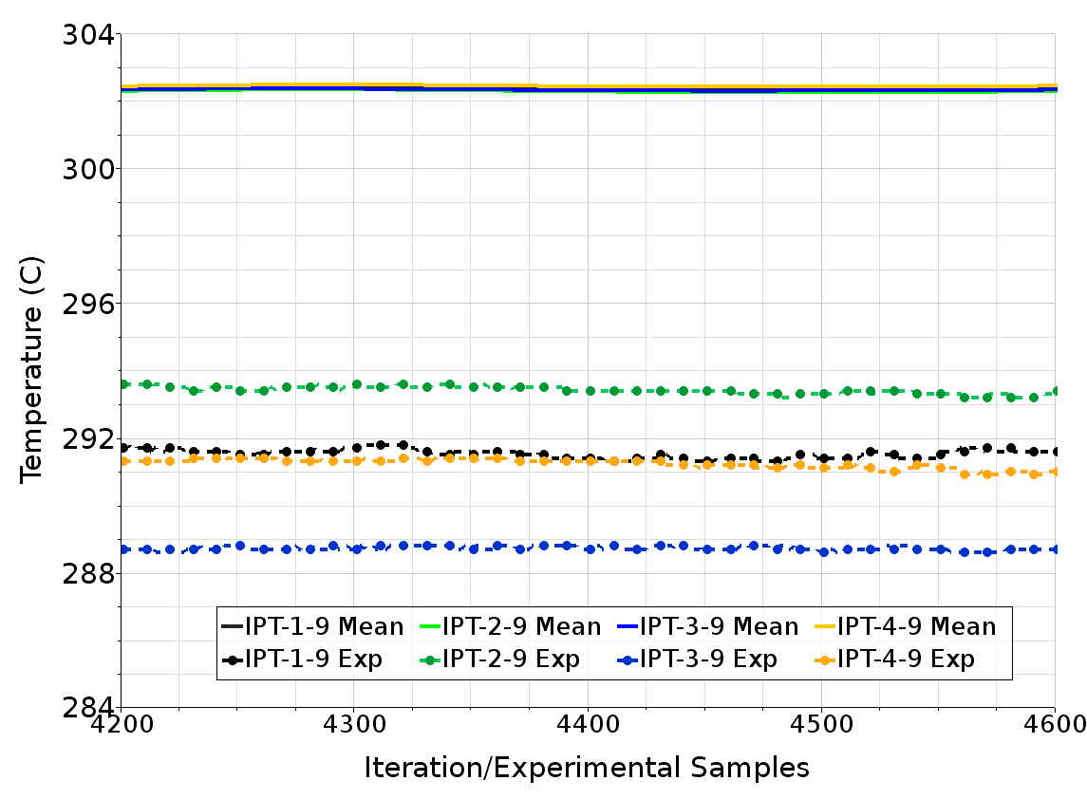
TALL-3D: Comparisons with the experiment NC
Experimental
MFR=0.33 kg/s
Numerical results:
+12 K in outlet
+11 K at the TC.IPT-9
+9 K at the TC.CIP-10
Error (%)
IPT | CIP
10.8 | 8.9
ENEA Brasimone, October 2017

Slide 11
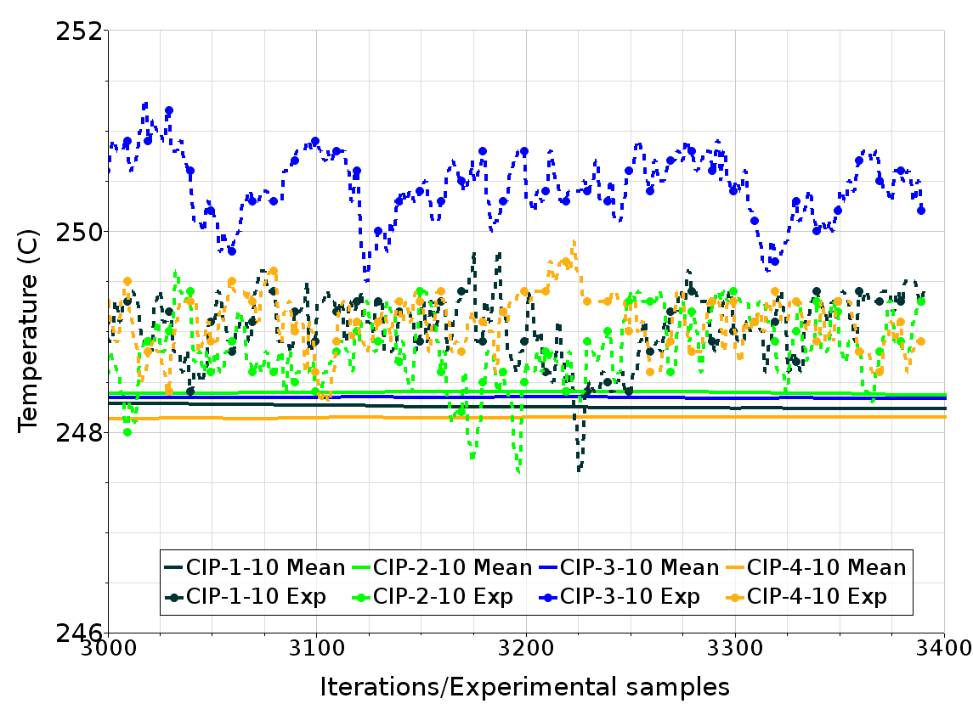
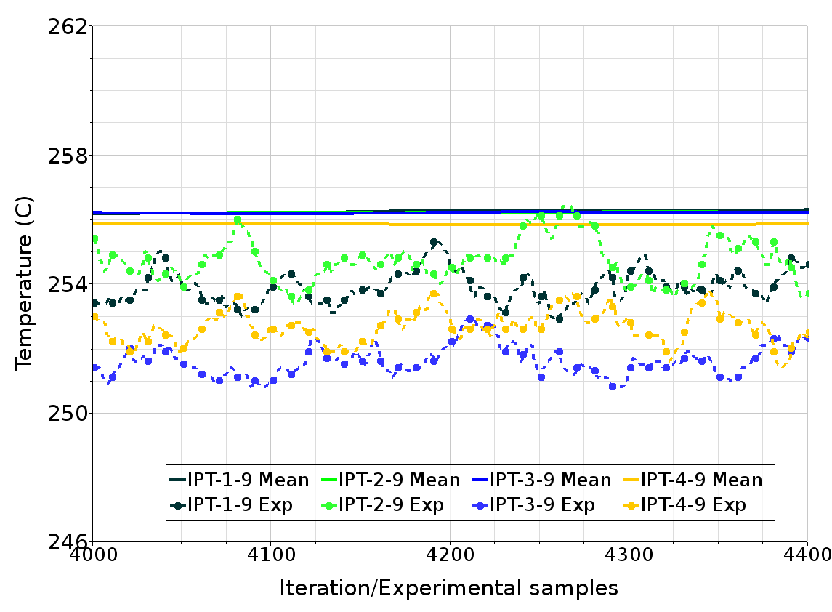
TALL-3D: Comparisons with the experiment FC
Experimental
MFR=1.8 kg/s
Numerical results:
+2 K in outlet
+3 K at TC.IPT-9
+1 K at TC.CIP-10
Error (%)
IPT | CIP
16.3 | 5.9
ENEA Brasimone, October 2017

Slide 12
Application of the offset temperature
Experimental test TG01.02.01-No heat source
for the determination of the offsets of differential temperatures
We calculated the TCs offsets inside the test section, at the vertical inner pipes point probes (IPT-x-9) and at the horizontal circular inner plate point probes (CIP-x-10).
The mean temperature on the four point probes in isothermal conditions was calculated, $\overline{T}$
The offset for each probe in isothermal conditions was calculated as difference between the temperature at each probe and the mean temperature:
ΔT₀=T_{i}- $\overline{T}$
The offset obtained ΔT₀ was subtracted from the corresponding experimental data in the test TG03.S301.01.
Application of the offset temperature
ENEA Brasimone, October 2017

Slide 13
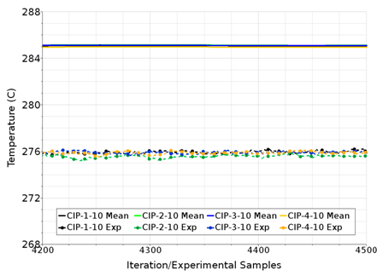
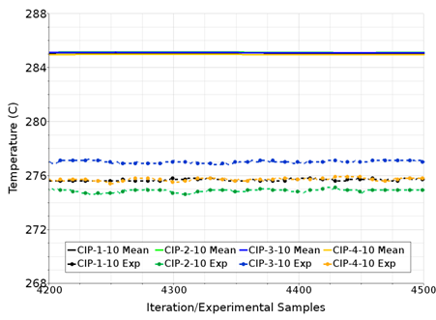
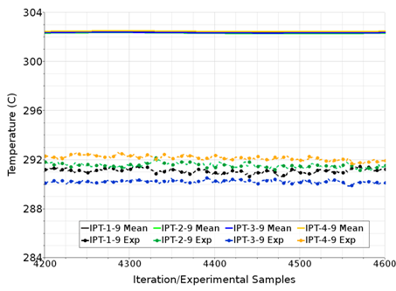
Application of the offset temperature NC
Application of the offset temperature
ENEA Brasimone, October 2017

Slide 14
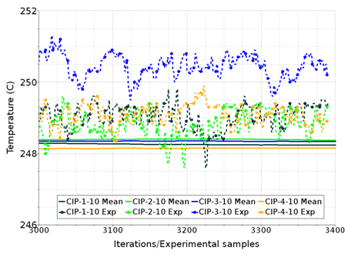
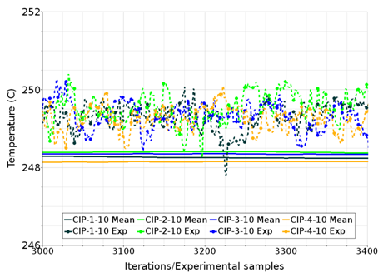
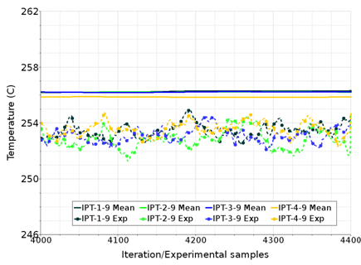
Application of the offset temperature FC
Application of the offset temperature
ENEA Brasimone, October 2017

Slide 15
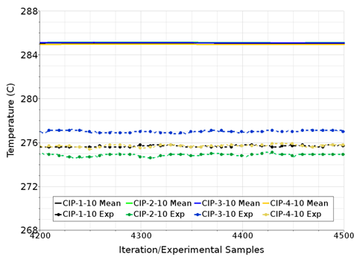
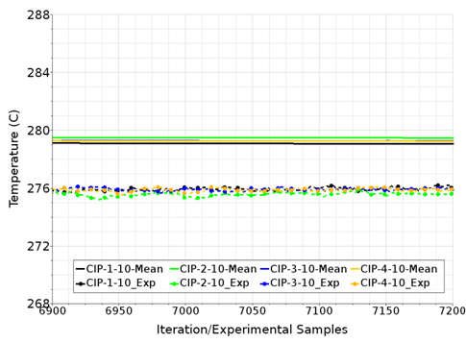
Discrepancies numerical-experimental results
underestimation of the external heat losses: heat balance was not respected
increasing the thermal conductivity of the insulators until a factor of five, the heat transfer to the external is higher and the temperature in outlet decreases by 5 degrees
Application of the offset temperature
ENEA Brasimone, October 2017

Slide 16
Discrepancies numerical-experimental results
Case | Natural circulation |  |  | Forced circulation
Thermal conductivity | Nominal λ | λx5 | Exp. | Nominal λ | λx5 | Exp.
Temp Inlet (°C) | 181 | 181 | 181 | 232 | 232 | 232
Temp Outlet (°C) | 295 | 286 | 283.8 | 252.5 | 250.8 | 250.4
ΔT Inlet-Outlet (K) | 114 | 105 | 102 | 20.5 | 18.8 | 18.4
Temp IPT (°C) | 302 | 296 | 291.2 | 256 | 254.1 | 253
Temp CIP (°C) | 285 | 279 | 275.8 | 248.2 | 247.7 | 249.3
ENEA Brasimone, October 2017

Slide 17
Thermal balance as convergence criterion
The possibility of underestimation of the external heat losses was evaluated.
This hypothesis could not lead to a satisfactory improvement without an excessive forcing of the insulators physical properties.
The thermal balance was not fully achieved (in all the cases, natural and forced circulation, there were between 50 and 100 W exceeding the heat balance)
The global thermal balance must be the primary criterion to be fulfilled without unphysical forcing.
ENEA Brasimone, October 2017

Slide 18
Thermal balance as convergence criterion
We decided to adopt the thermal balance as main criterion for the convergence and to modify the mass flow rate in order to respect this criterion.
Therefore, corresponding to the heat source of 5500 W, the mass flow rate should be
MFR=0.36 kg/s in natural circulation, instead of the experimental MFR=0.33 kg/s, for a difference of temperature inlet-outlet of 102.8 C (Outlet Temp=283.8°C, Inlet Temp=181°C)
+8.4%
MFR=2.0 kg/s in forced circulation, instead of the experimental 1.8 kg/s, for a difference of temperature inlet-outlet of 18.4°C (Outlet Temp=250.4°C, Inlet Temp=232°C)
+10%
Application of the offset temperature
ENEA Brasimone, October 2017

Slide 19
Results with the adjusted MFR
Case | dT (Exp-Num) (K) |  | ΔT (Inlet-Outlet) (K) | Error dT/ΔT (%)
 | IPTs | CIPs |  | IPTs | CIPs
N.C. MFR=0.36 kg/s | 2 | 2.4 | 102.8 | 1.9 | 2.33
F.C. MFR=2.0 kg/s | 0.5 | 2.1 | 18.4 | 2.77 | 11.4
Application of the offset temperature
ENEA Brasimone, October 2017

Slide 20
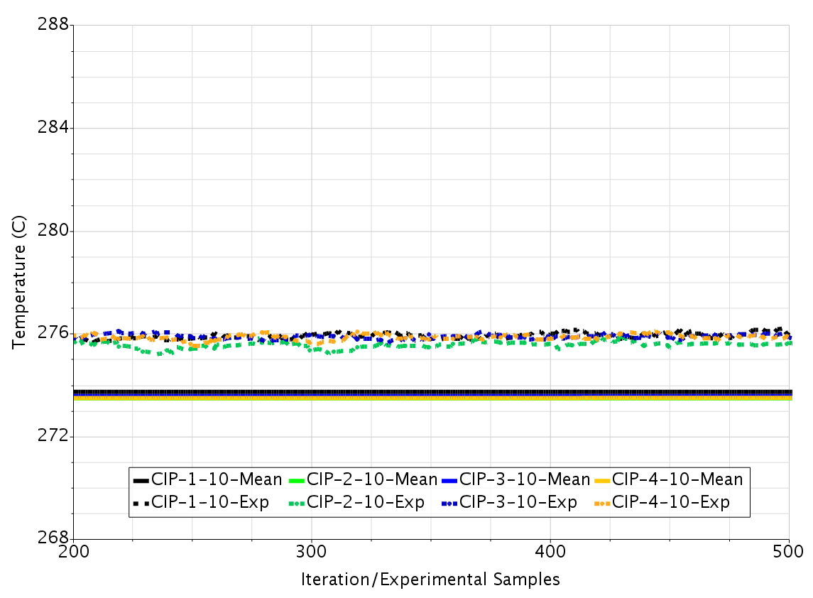
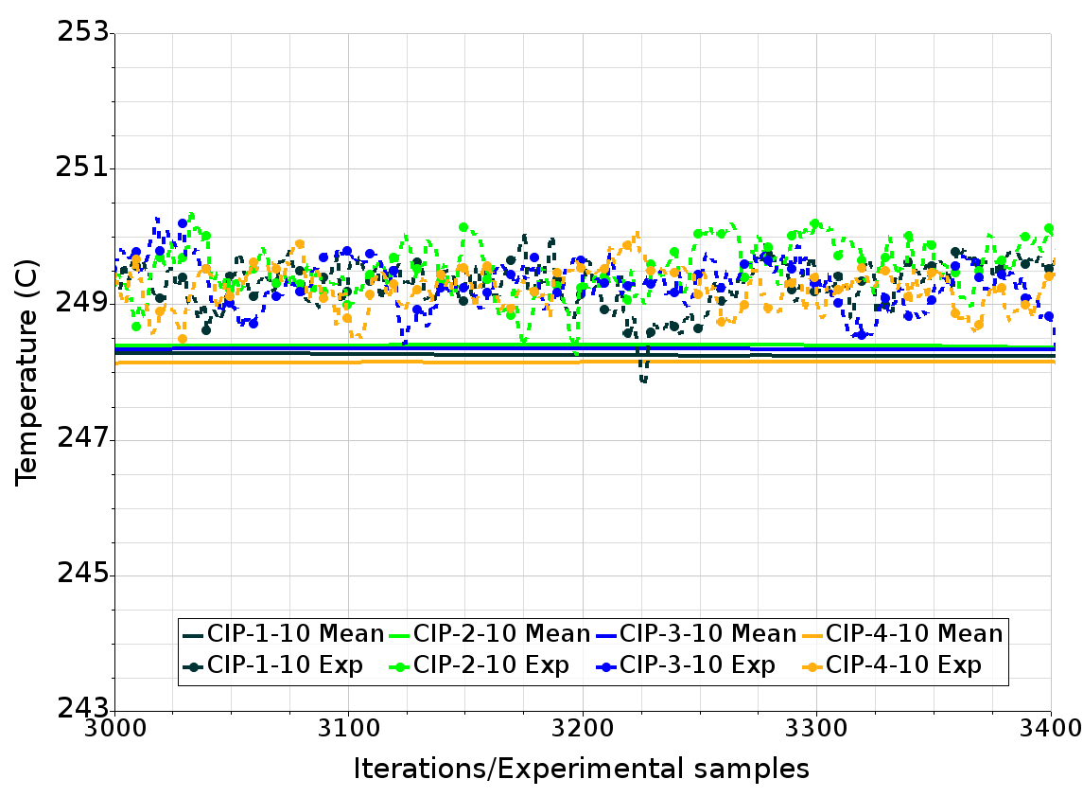
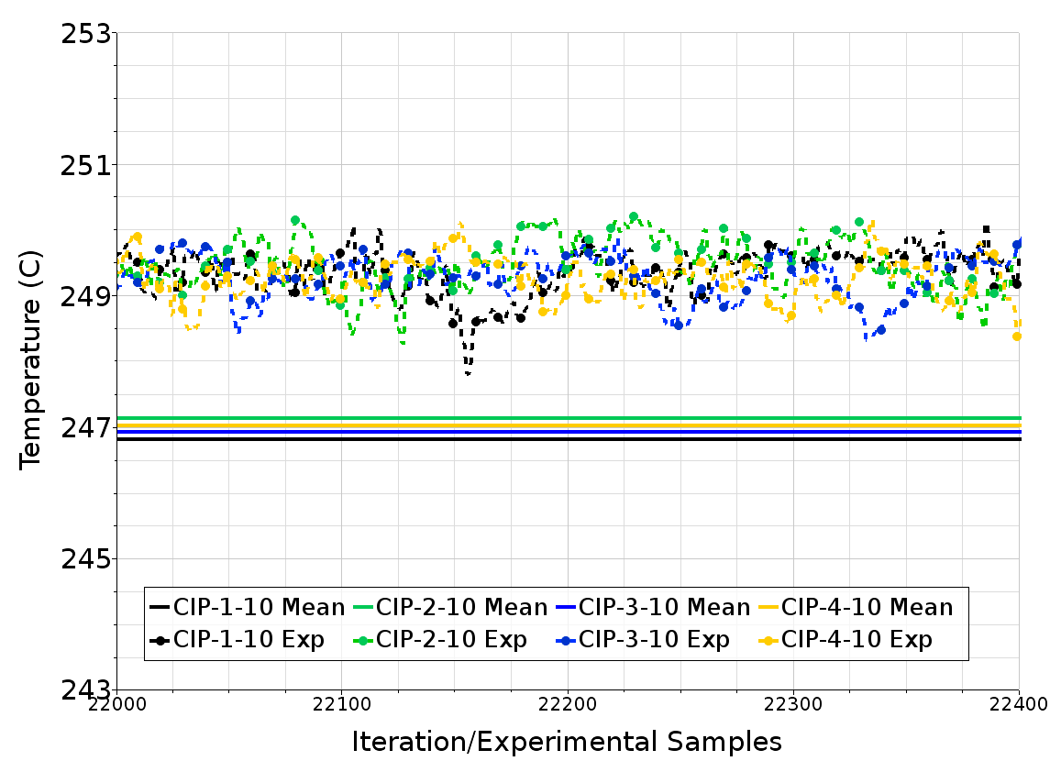
Results with exp/num MFR in NC and FC
Horizontal
Horizontal
Application of the offset temperature
ENEA Brasimone, October 2017

Slide 21
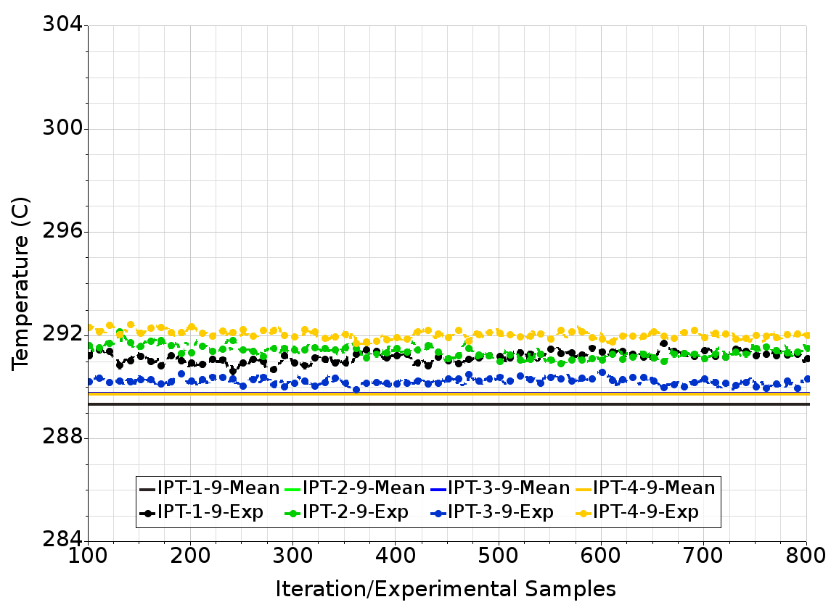
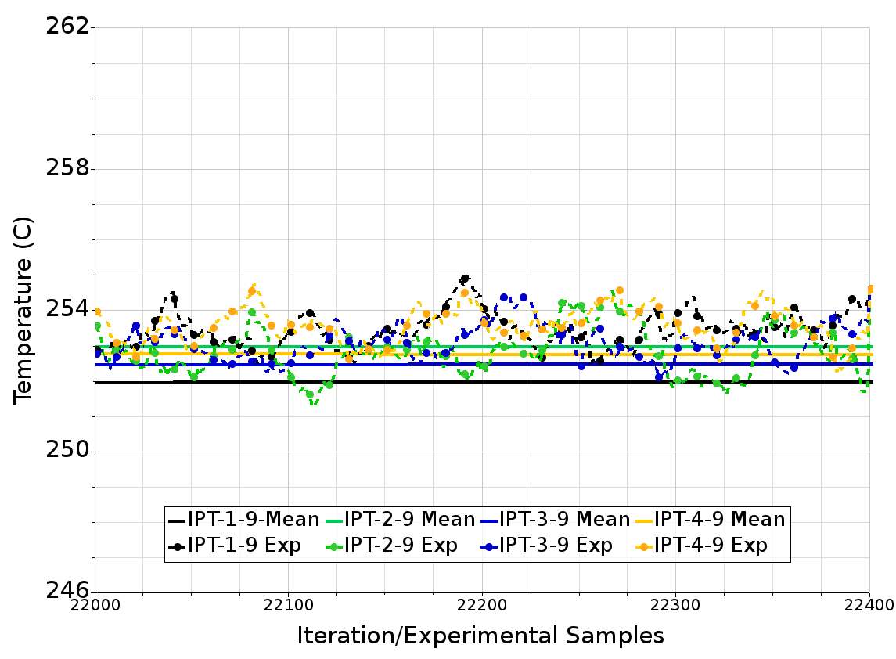
Results with exp/num MFR in NC and FC
Vertical
Application of the offset temperature
ENEA Brasimone, October 2017

Slide 22
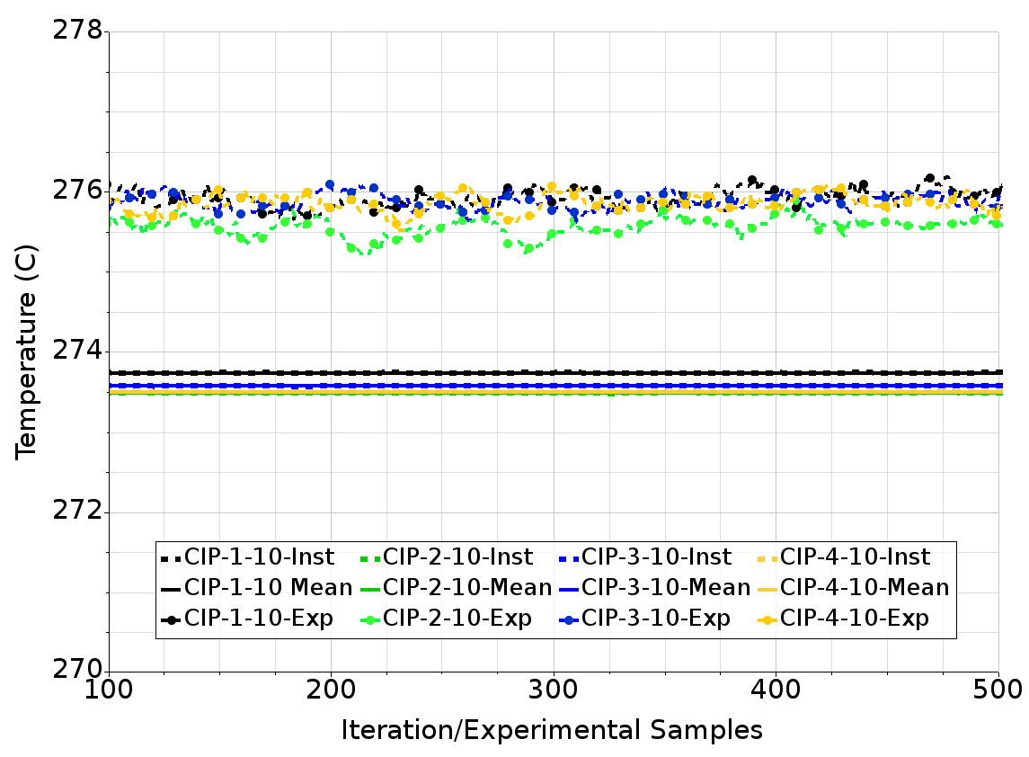
Considerations on the convergence
In the first simulations performed before March 2017, the convergence was reached only in mean.
Applying under relaxation factors by 0.7 in the energy segregated solvers, both in fluid and solid continua, the convergence is reached in N.C. but not in F.C.
Application of the offset temperature
Convergence with URF=0.7 in NC
ENEA Brasimone, October 2017

Slide 23
Convergence with relaxed solvers in N.C.
N.C. MFR=0.36 kg/s, Segregated Energy URF=0.7, full convergence
ENEA Brasimone, October 2017

Slide 24
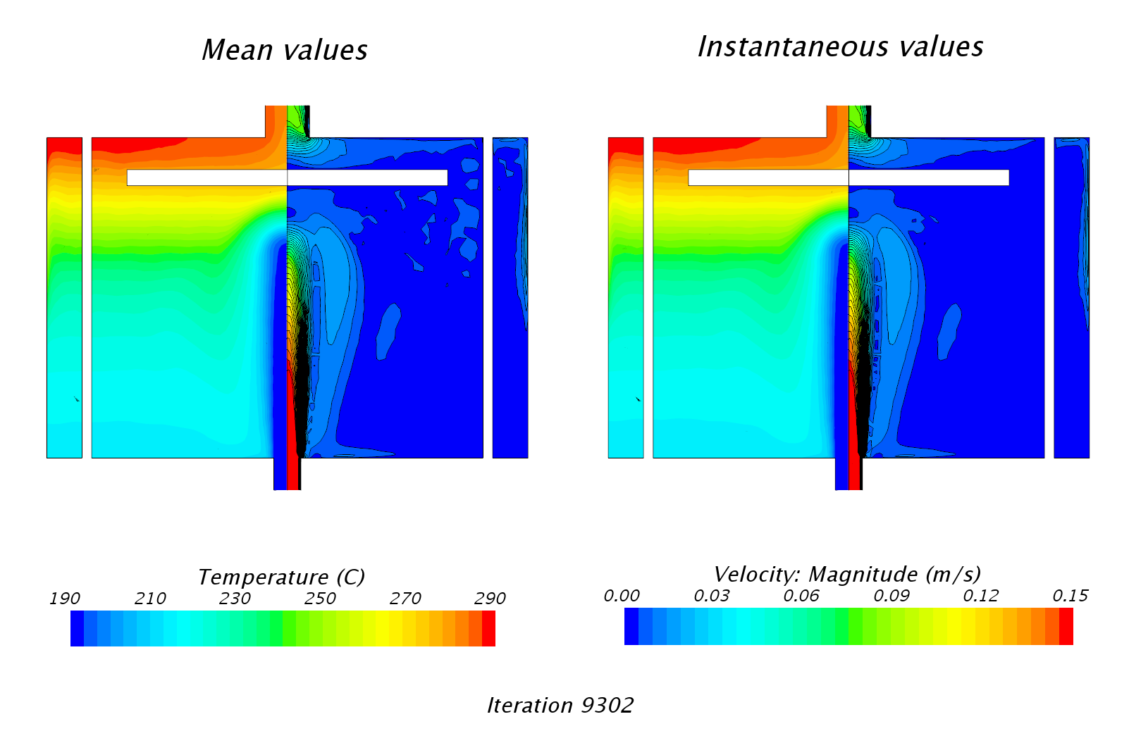
Convergence with relaxed solvers in N.C.
N.C. MFR=0.36 kg/s, Segregated Energy URF=0.7, full convergence
ENEA Brasimone, October 2017

Slide 25
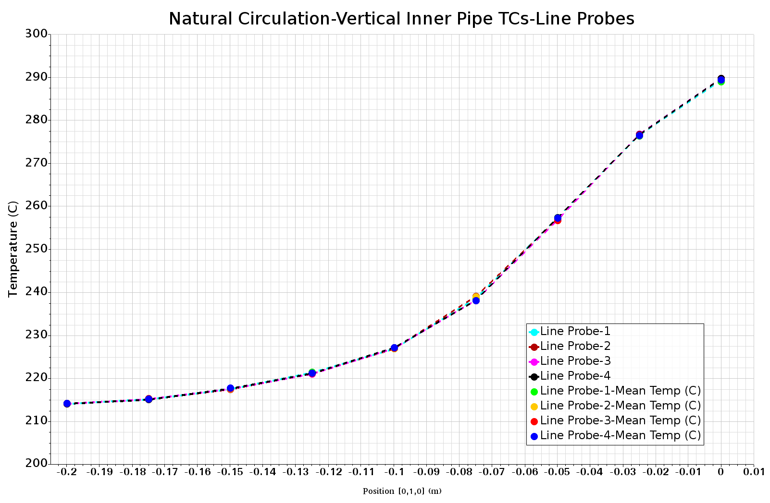
Thermal stratification
ENEA Brasimone, October 2017

Slide 26
Convergence (pointwise) with relaxed solvers in FC
ENEA Brasimone, October 2017

Slide 27
Convergence in mean with relaxed solvers in FC
ENEA Brasimone, October 2017

Slide 28
TG03.S301.06 Heat Source 10.6 kW
High power in the test section for calibration
 | Natural circulation |  | Forced circulation
 | Numerical | Experimental | Numerical | Experimental
Mass flow (kg/s) | 0.58 | 0.53 | 2.01 | 1.91
Temp Inlet (°C) | 222.4 | 222.4 | 273.3 | 273.3
TempOutlet (°C) | 346.6 | 346.6 | 309 | 309
ΔT In-Out (K) | 124.2 | 124.2 | 35.7 | 35.7
Temp IPT-9 (°C) | 356.6 | 356 | 314 | 313
Temp CIP-10 (°C) | 337.1 | 342 | 302.5 | 305
To respect the thermal balance, in the numerical model we impose a higher MFR: +7.5% in NC and +5% in FC
ENEA Brasimone, October 2017

Slide 29
TG03.S301.06 Heat Source 10.6 kW
Case | dT (Exp-Num) (K) |  | ΔT (Inlet-Outlet) (K) | Error dT/ΔT (%)
 | IPTs | CIPs |  | IPTs | CIPs
N.C. MFR=0.58 kg/s | 0.6 | 5 | 124.2 | 0.4 | 4
F.C. MFR=2.01 kg/s | 1 | 2.5 | 35.7 | 2.8 | 7
ENEA Brasimone, October 2017

Slide 30
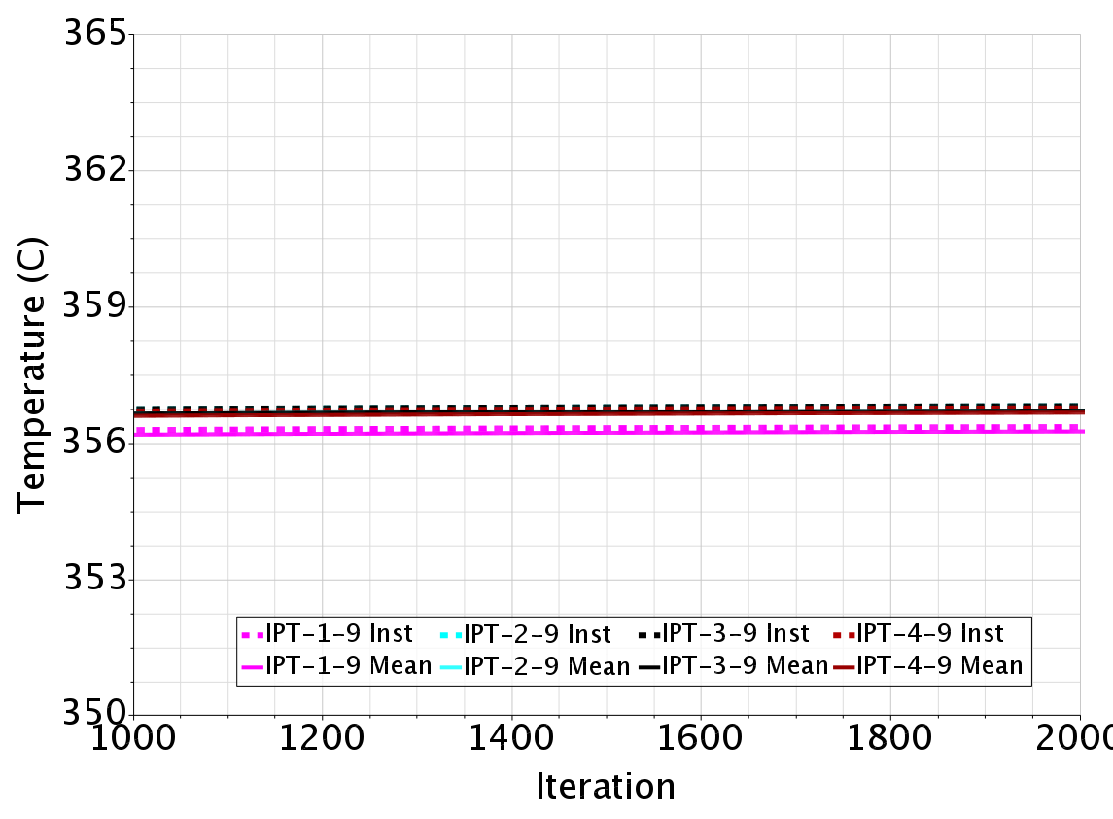
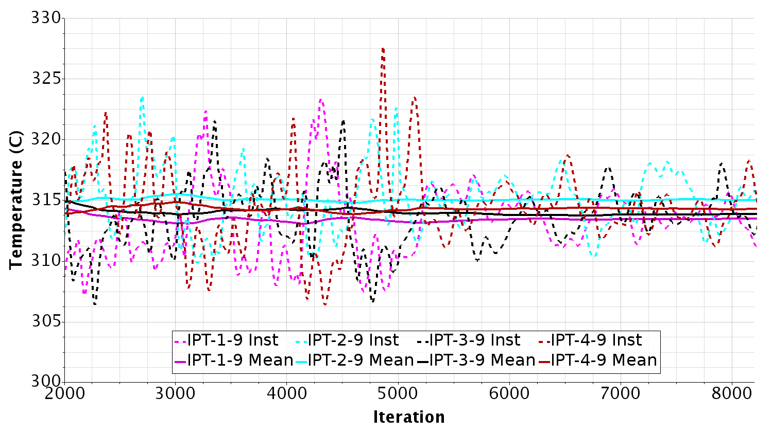
TG03.S301.06 Relaxed energy solvers
In N.C. the convergence is reached. There is no need to relax the energy solvers to obtain the convergence.
In FC, the convergence is not reached not even with a 0.7 of relaxation. There is a certain effect on the temperature oscillations when relaxation is applied.
The convergence in mean is reached.
ENEA Brasimone, October 2017

Slide 31
Convergence overview
Test case 1: NC convergence in mean and under relaxation
TG03.S301.01 FC convergence in mean only
Test case 2: NC full pointwise convergence without relaxation
TG03.S01.06 FC convergence in mean and partial convergence under relaxation
ENEA Brasimone, October 2017

Slide 32
TG03.S301.06 Full convergence in NC
ENEA Brasimone, October 2017

Slide 33
TG03.S301.06 Full convergence in NC
ENEA Brasimone, October 2017

Slide 34
TG03.S301.06 Full convergence in NC
ENEA Brasimone, October 2017

Slide 35
TG03.S301.06 Animation FC
ENEA Brasimone, October 2017

Slide 36
TG03.S301.06 Animation FC-convergence in mean
ENEA Brasimone, October 2017

Slide 37
TG03.S301.06 Animation FC
ENEA Brasimone, October 2017

Slide 38
Conclusion
A hot model of the TALL-3D test section, aimed at reproducing its general circulation has been built, progressively improved and appropriately instrumented.
Classical steady state convergence is not always reached but always shows fast convergence in mean over iterations.
Comparison is done between mean in time of experimental results and mean over iterations in the two cases of natural circulation (NC) and forced circulation (FC) of the two experimental tests simulated.
The thermal stratification is well captured.
In the forced circulation case we have a major error. This error may come from the geometrical approximation of the inner circular plate which in the experiment is provided with non-negligible channels dug up to 50% of the plate width. As the wires occupy a part of the channels, it is very difficult to have a correct numerical representation of these details.
ENEA Brasimone, October 2017

