Slide 1
PROOF-OF-PRINCIPLE OF THE CONTROL ROD EMERGENCY INSERTION IN THE MYRRHA NUCLEAR FACILITY FROM A COMBINED NUMERICAL-EXPERIMENTAL CAMPAIGN
M. Profir¹, V. Moreau¹ and G. Kennedy² ¹CRS4, Sardinia, Italy ²SCK•CEN, Mol, Belgium
Nuclear 2017 May 24-26, 2017 – Pitesti (Romania)
Notes:
1
CFD

Slide 2
Contents
MYRRHA facility – Control Rod system overview
COMPLOT experimental setup
Numerical representation of the MYRRHA configuration
Moving mesh methodology
Experimental and CFD results. Comparisons and analysis
Conclusions
2

Slide 3
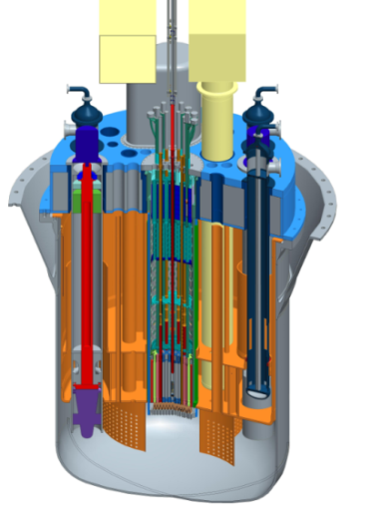
MYRRHA – Control Rod System
MYRRHA = Multi-purpose hYbrid Research Reactor for High-tech Applications
Fast spectrum irradiation facility
Critical and Accelerator Driven System (ADS) mode
Lead Bismuth Eutectic (LBE) coolant
European technology pilot plant for Gen IV LFR
Six Control Rods (CRs) in the MYRRHA critical reference core
Normal operation: reactivity control function
Inserted in the LBE from below the active core
Emergency operation: safety function (SCRAM)
Buoyancy driven
Insertion time < 1 s

Slide 4
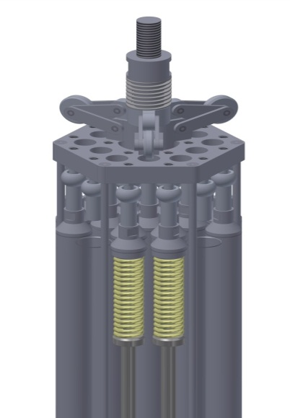
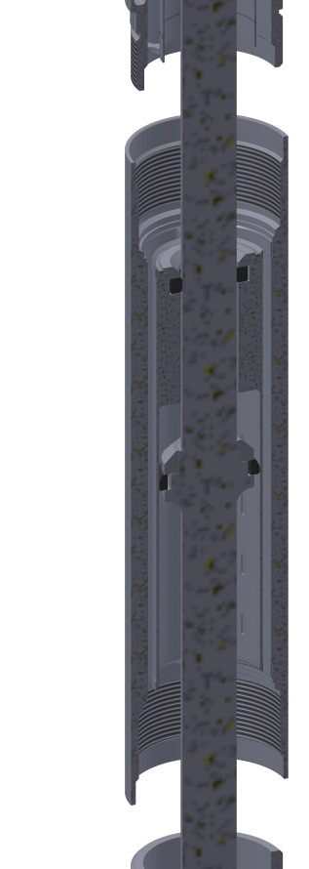
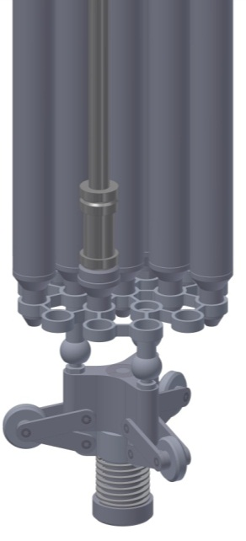
COMPLOT experimental setup. Control Rod test section
closed isothermal loop
LBE working fluid
full-scale mock-up of the MYRRHA CR installed
test section enlarged diameter-reactor upper plenum
pressurized buffer tank-maximum pressure suppression
test the CR response during an emergency SCRAM insertion

Slide 5
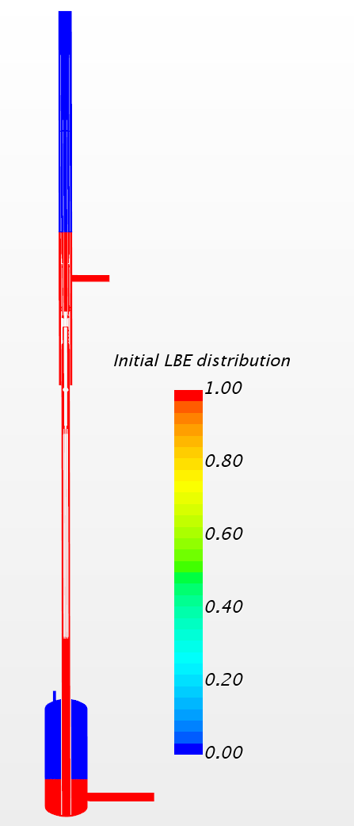
Numerical representation of the MYRRHA
configuration with STAR-CCM+
Straightforward comparison with the experimental setup
CFD model must capture the free surfaces dynamics
geometrical representation of hot and cold plena
buffer tank with an LBE inlet free surface
connection CR guide tube-COMPLOT annulus
Volume of Fluid (VOF) model
Two-phase flow setup
5

Slide 6
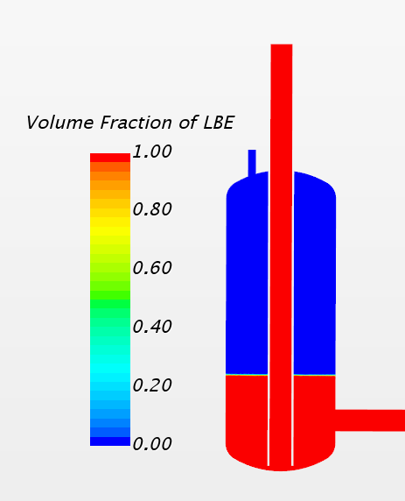
Workflow to CR dynamic simulation
MYRRHA
configuration
Initialization procedure-
stationary CR
Transient simulation-
moving CR
Include cover gas (incompressible)
Initial phases distribution
Deactivated Argon Inlet
Fixed pressure top lateral LBE outlet
Top gas pressure
Achieve mass equilibrium
Prescribed MFR bottom Inlet
Two-way coupling motion from force balance
Full flow – No flow
Activate Argon Inlet
Fixed Pressure
6

Slide 7
Mass equilibrium achievement

Slide 8
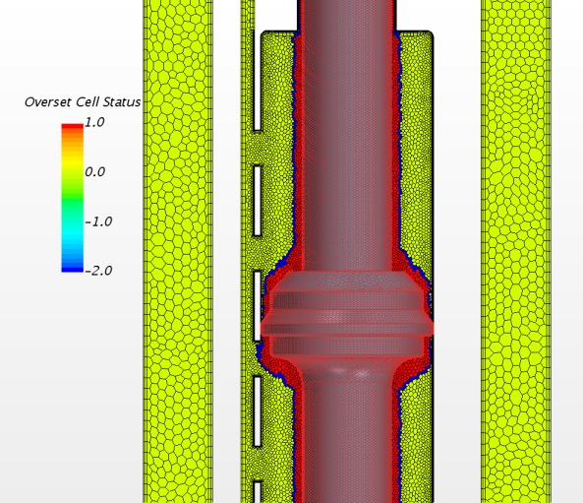
Overset Mesh methodology in STAR-CCM+
Background region
containing the flow domain
Overset region
separate region enclosing the moving body
Overset Mesh Interface
“Volume“ interface for information exchange
Conditions for a successful coupling
1-2 layers of cells attached to the moving body boundary
same mesh size in both regions in the overlapping zone.
Yellow-active cells in background region
Red-inactive cells in overset region
Blue-acceptor cells: couple solutions on the two overlapping grids

Slide 10
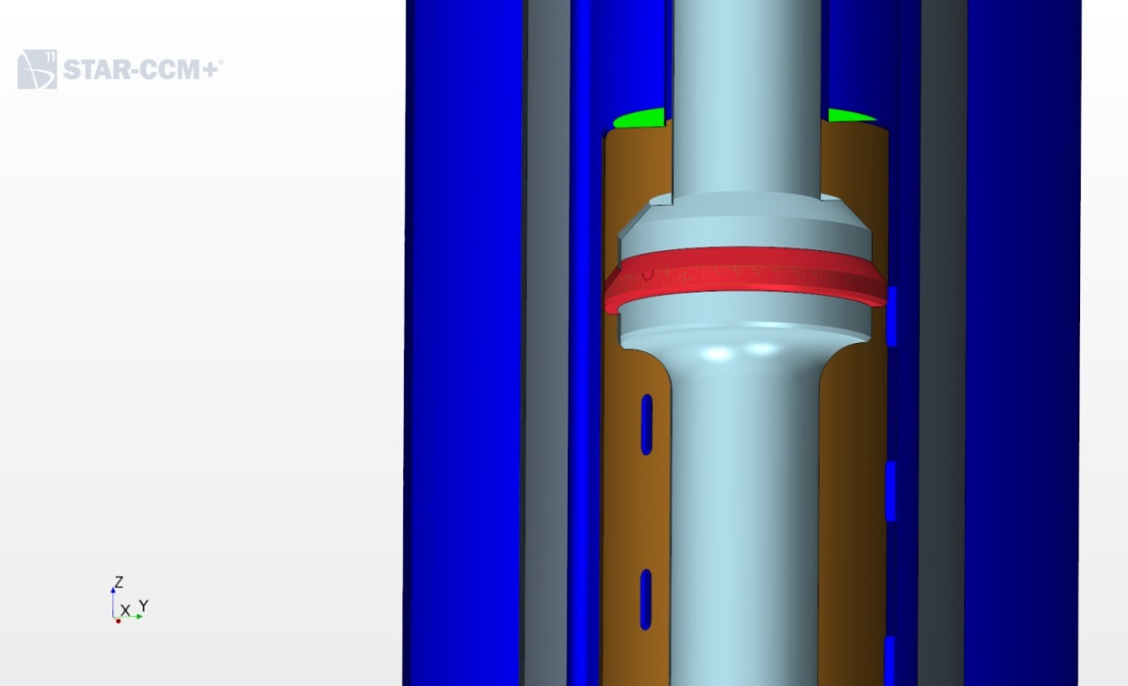
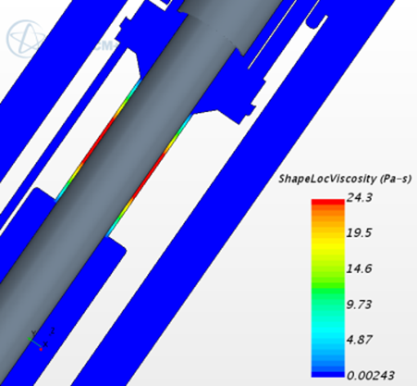
Overset Mesh methodology in STAR-CCM+
Overset Mesh Zero Gap Interface-allows contact at seal interface
To stop the bundle at full insertion a damper is used to impose a smooth deceleration. The CFD must capture the hydraulic damper effect.
Increased viscosity at the top damper-numerical seal; a graphite ring is foreseen to keep the CR assembly stable.
10

Slide 11
Two-way coupling motion from force balance
Fully explicit coupling
control rod velocity calculated by time integration of acceleration
acceleration is obtained from the resultant of the forces acting on the CR
F_{R} = (Buoyancy + Drag force)_{STAR-CCM+} – Gravitational force
CRacceleration=F_{R} /CRmass
Pre-test numerical bundle
underestimates the realistic bundle volume (and therefore buoyancy force)
limitation in generating a reliable overset mesh in a rather confined geometry
Post-test numerical bundle
the most representative and affordable pin bundle geometry, still maintaining a geometry suitable for the dynamic overlapping grids.
11

Slide 12
Experimental and CFD results (I)
The numerical model doesn’t consider the dry friction at the CR shaft feedthrough on the experimental test section.
lack of positive buoyancy force
absence of the negative friction contribution
CR dynamic displacement with pre-test bundle similar to the experimental results
No flow
Nominal flow
CR insertion time is less at higher flow rates – influence of fluid drag and dynamic pressure.
No dry-friction modelled at shaft feedthrough

Slide 13
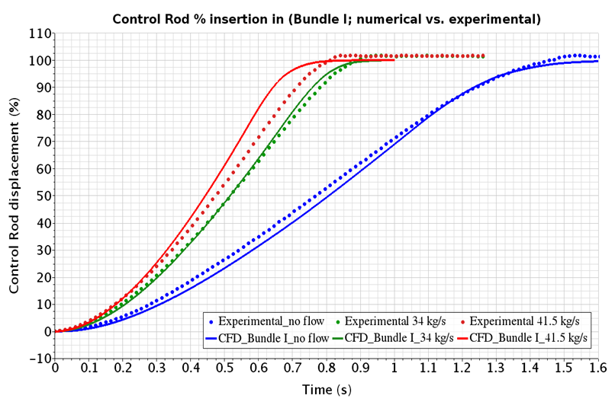
Experimental and CFD results (I)

Slide 14
Experimental and CFD results (II)
Larger post-test numerical bundle
more realistic numerical volume and buoyancy force (although still underestimated)
absence of the negative friction contribution
results in a significantly faster numerical CR bundle insertion
MFR=34 kg/s, nominal flow
15% faster than the experimental results
MFR=8 kg/s, representative of natural convection in LOF accident
14% faster than the experimental results
14

Slide 15
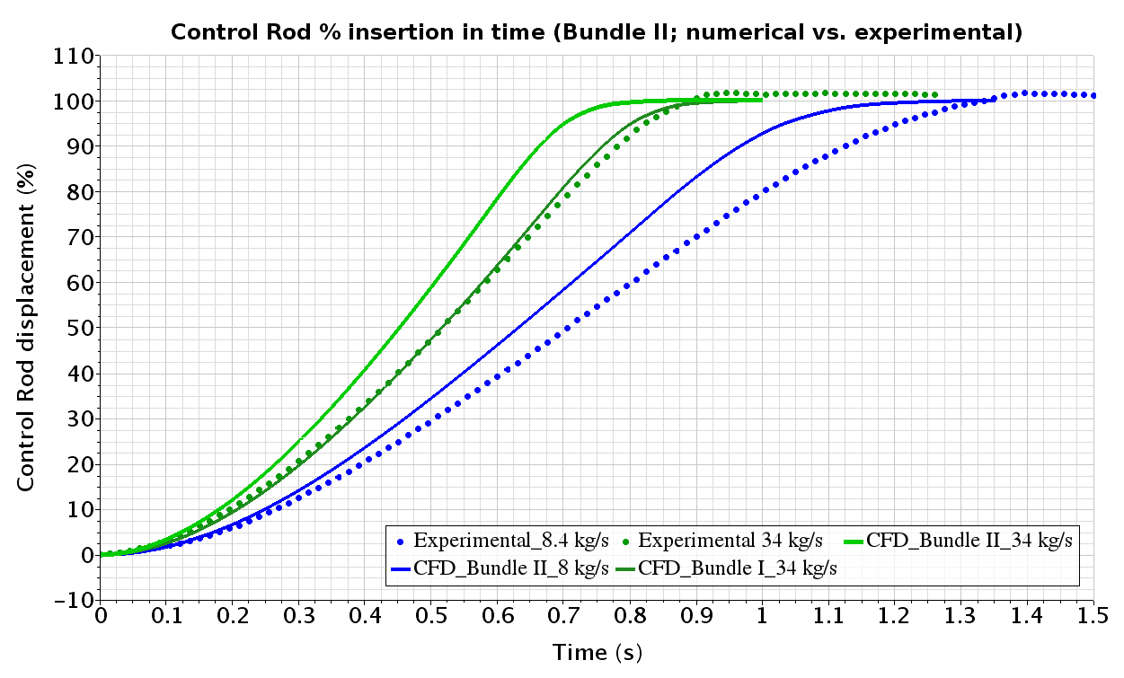
Experimental and CFD results (II)
15

Slide 16
16

Slide 21
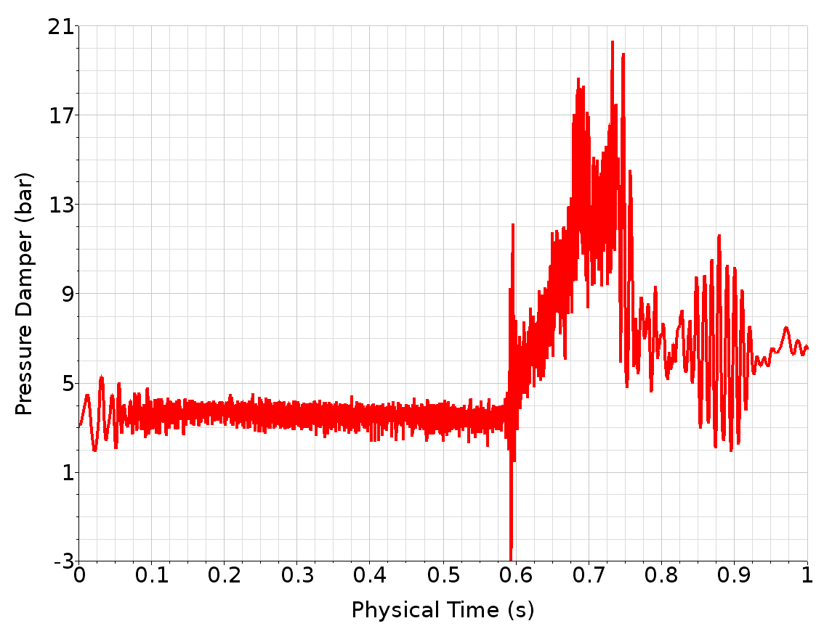
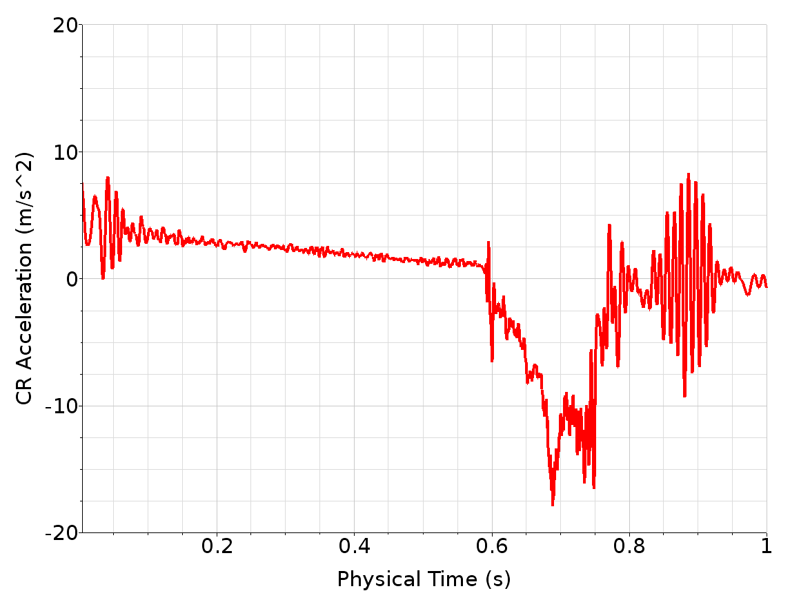
Hydraulic damper effect
well captured by the CFD simulation
consistent overpressure in the damper
numerical oscillations damper

Slide 22
From COMPLOT to MYRRHA configuration
In COMPLOT-an important added mass effect to the CR movement
In MYRRHA-no added mass effect
CR bottom closely connected to the large lower plenum
The buffer tank is removed and the prescribed MFR becomes the pressure inlet
reduction of insertion time by about 10% in absence of the riser-minor resistance of the system
COMPLOT facility is conservative with respect to CR insertion time
representative of the MYRRHA conditions

Slide 23
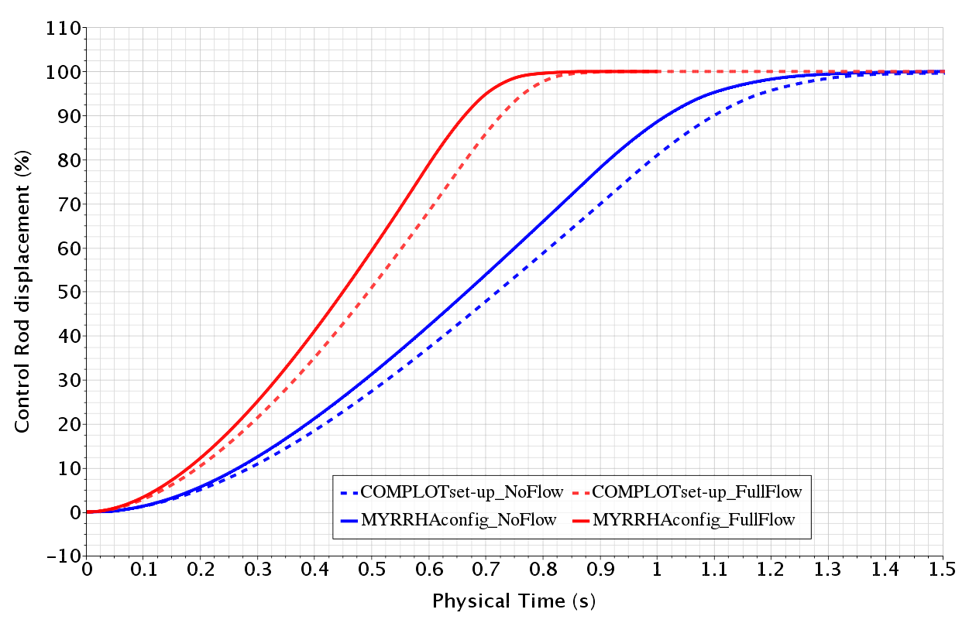
COMPLOT–MYRRHA set-up comparison
COMPLOT facility is conservative with respect to CR insertion time

Slide 24
Conclusions (I)
Successful demonstration of the CR insertion Proof-of-Principle
CR insertion time
within required 1 s for nominal flow cases
slower in no flow case and low flow case
In MYRRHA, the shaft feedthrough friction contribution will be possibly zero by design.
Insertion times will also be acceptable in no/low flow conditions.
The COMPLOT experimental scenario can be considered conservative with respect to the CR SCRAM insertion time.
The COMPLOT CR insertion times are therefore sufficiently representative of the MYRRHA conditions,
suitable for demonstrating the CR proof-of-principle,
contributing to the qualification of the MYRRHA CR design.

Slide 25
Conclusions (II)
The transient two-way coupling simulation of the CR insertion predicts the CR motion rather well.
Globally, the numerical model predicts an insertion time 15% faster than the experiment.
Although high frequency pressure oscillations exist, the resultant CR velocity and displacement curves are very smooth and representative of the experimental results.
The operating principle of the damper is well simulated.
With current experimental and numerical results and future quantification of the experimental CR shaft friction contribution, simulation accuracy could be improved further and confirm the validation of the CR numerical CFD model.
Notes:
,

Slide 26
Thank you for your attention!

