Slide 1
SESAME-MYRTE 6th progress meeting Pool modelling of CIRCE & MYRRHA
Vincent Moreau (CRS4)
Sixth Progress meeting, March 20-22, 2018
SJI Ljubljana, Slovenia

Slide 2
Part 1: CIRCE

Slide 3
Circe Foreword
From the work performed until now, we have at our disposal:
An extended data set of experimental data from the CIRCE – ICE experimental campaign
An operational numerical model of CIRCE-ICE potentially able to reproduce with simulation the experimental data
The experimental data set needs to be analyzed in itself
Aggregation and treatment of the data brings new insight on what is really happening in CIRCE-ICE
Some results were expected
Some results are surprising and need to be understood
Numerical and experimental data must be confronted
Numerical results can help improve understanding of experimental behavior
Experimental results can help improve the numerical model
Fundamental limitations of the model can be highlighted
3

Slide 4
Summary
What to confront
Type of data
What is resolved/input
Some issues
Updated numerical model
Main changes
Main Results
More on Riser and SGE
Riser Enigma
SGE enigma
New model features
Modularity and dual use
Modeling
Issues
Concluding words

Slide 5
What to confront

Slide 6
Basic numbers
Thermal considerations:
Main heating cooling ~750 kW
Flow rate 65.5 kg/s => 1K ~ 9.6 (10) kW for convection
Conjugate heat transfer (i.e. wall heat flux) ~ 10-60 kW or 1-6K
=> An uncertainty (error) of 1K in a flow average temperature induces an uncertainty (or error) of 15-100% in the wall heat flux
Residence times:
FPS active part: 1s
Conveyor: 28s
Riser: 18s (less for Argon)
SGE: 22s (Porosity 0.4)
Main: 980s ~ 16 minutes

Slide 7
Type of data
A lot of data are available but they have not all the same relevance nor the same type of numerical correspondence. We give a closer look at some of them:
- Argon flow rate
Venturi dP => LBE mass flow rate
Electric power
Thermo-couples…

Slide 8
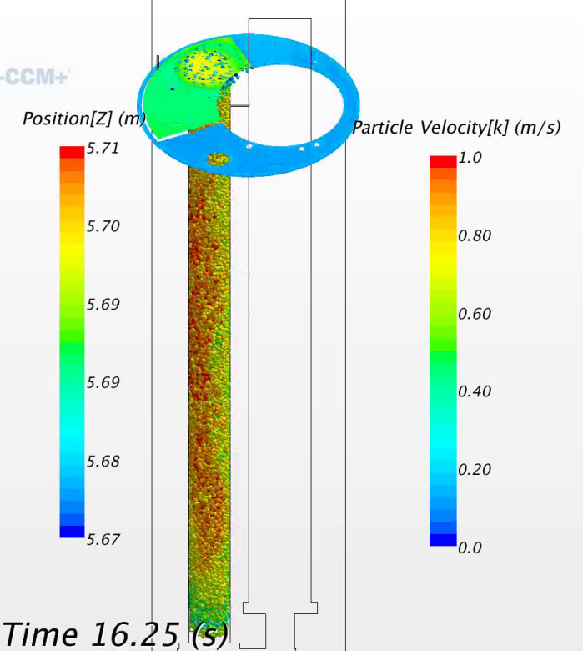
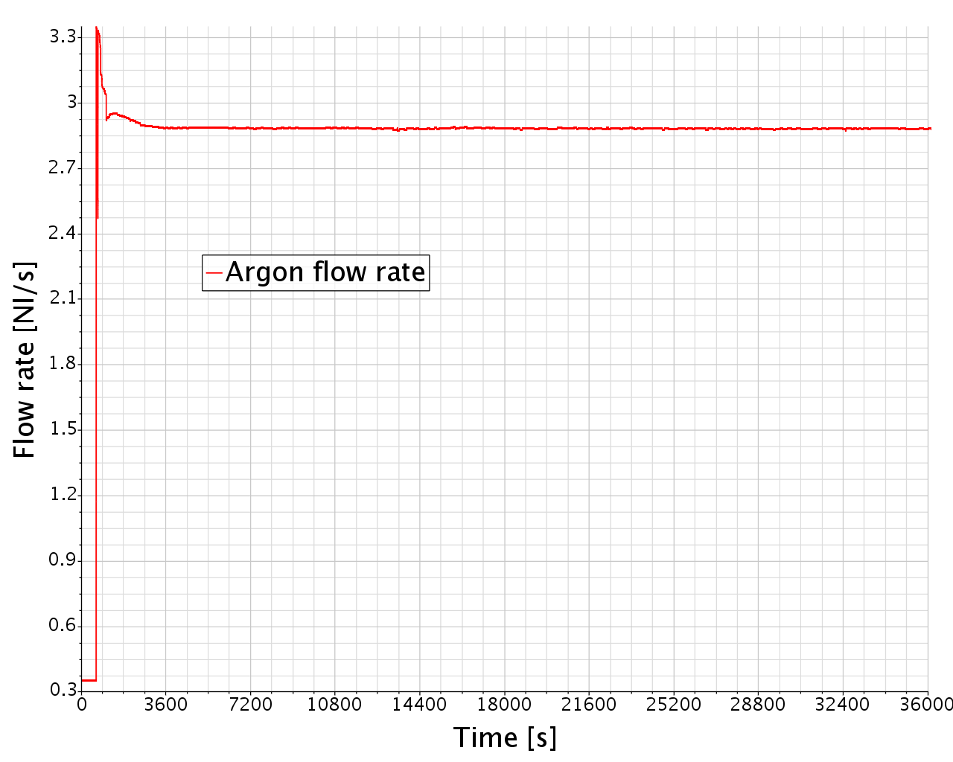
Argon flow rate
The argon flow rate as no direct counterpart in the model (no more bubbles). Only its lifting effect is taken into account through a uniform body force in the riser.
The Argon flow rate is constant at the measure point but probably not at the injector nozzle. In any case, the bubbles volume and its lifting force are not! See next slide…

Slide 9
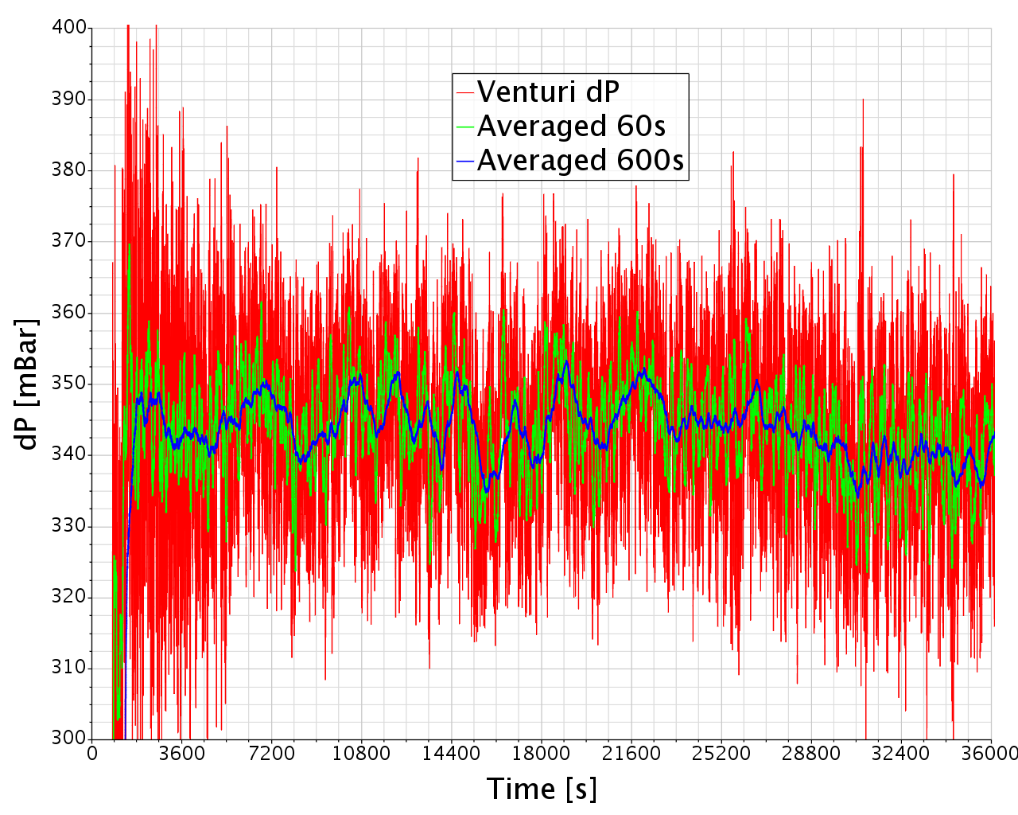
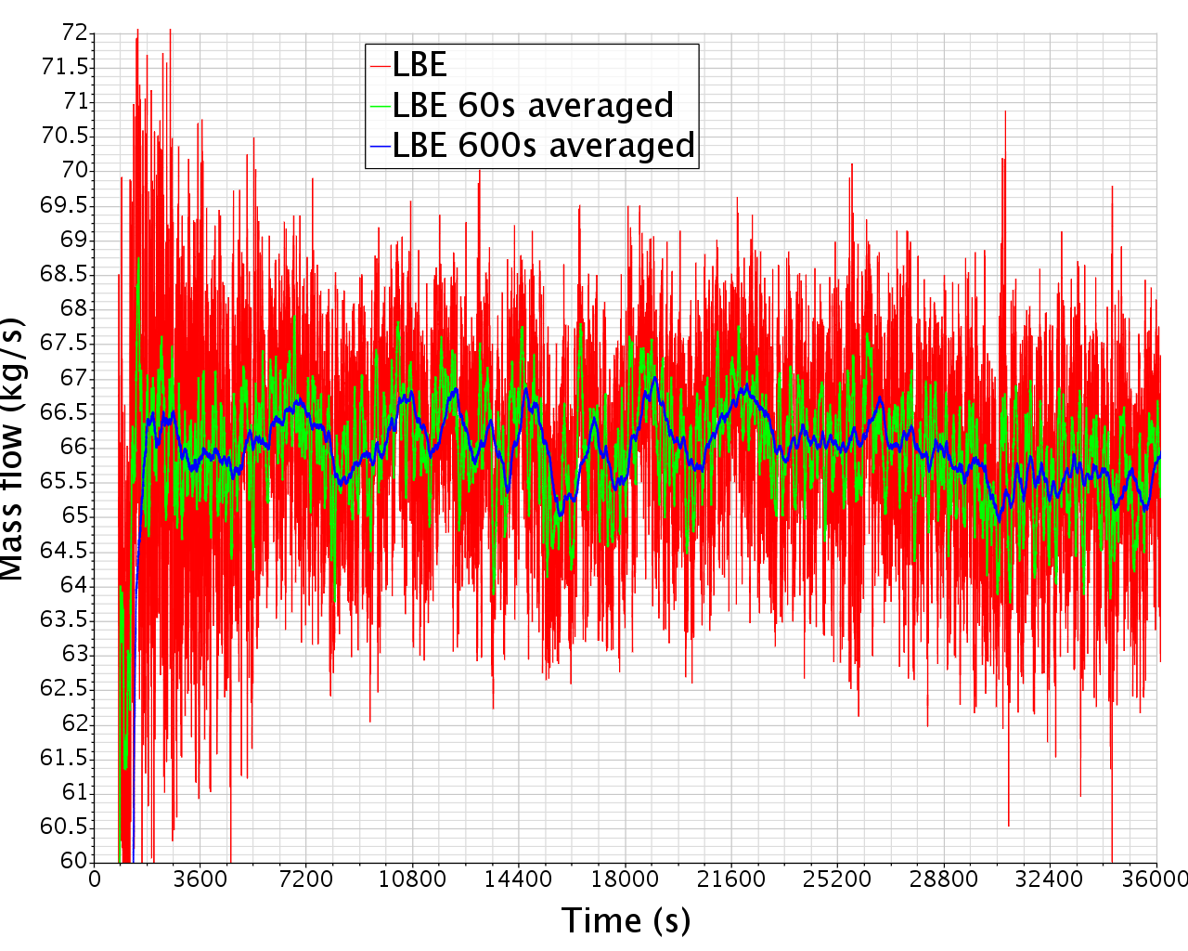
Venturi dP
The mass flow rate is calculated from the measured dP at the Venturi flow meter level, I the channel below the FPS.
The pressure drop exhibits quite large high frequency oscillations. Does that induces uncertainties in the mass flow evaluation?
The mass flow is imposed (indirectly) by the lifting force. Does the model requires the oscillations to be represented?

Slide 10
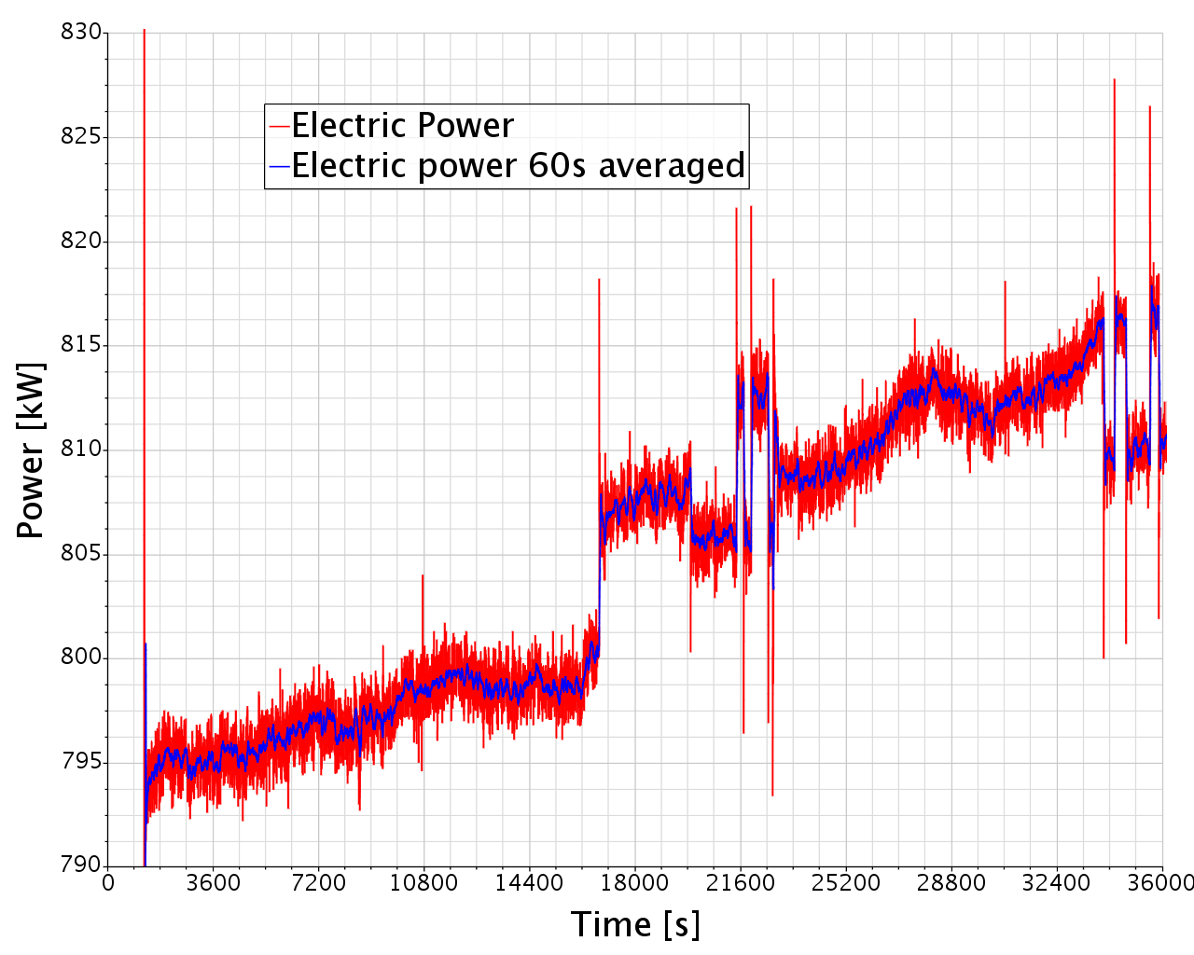
Electric power
The electric power is not totally constant in time and shows a shift of about 20 kW in 10h. Does we need to model this?
There are uncertainties of what is the exact part of the electric power that is transformed in heat in the FPS active part/passive part/dead volume.

Slide 11
Thermo-couples
The thermo-couples give pointwise information.
Pointwise information can easily be related to numerical information in two distinct cases:
The flow is well resolved at the TC location or
The temperature is uniform around the TC location.
Flow not resolved | Flow resolved
FPS: no pin bundle, no grid | Bulk
Riser/Gas separator: no bubbles | Conveyor
SGE: no bundle, no grid | Below SGE bottom grid

Slide 12
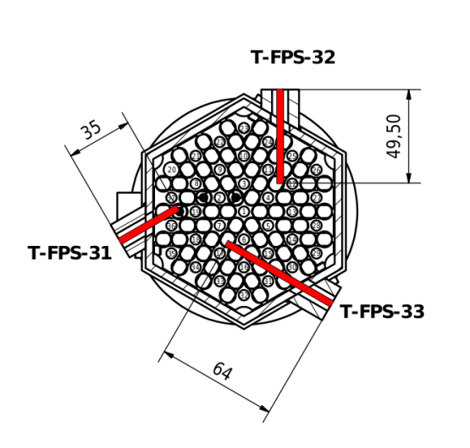
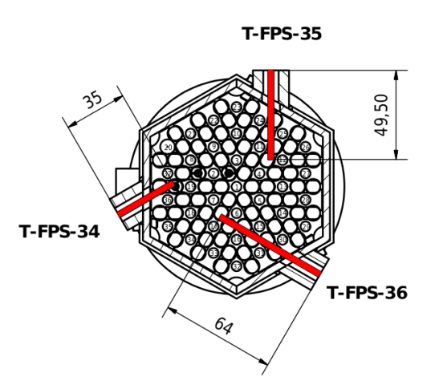
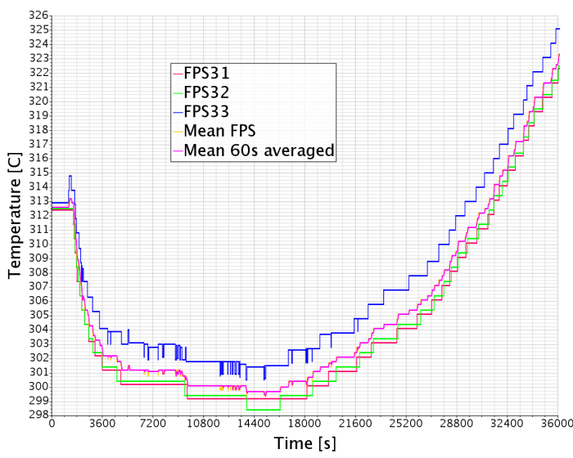
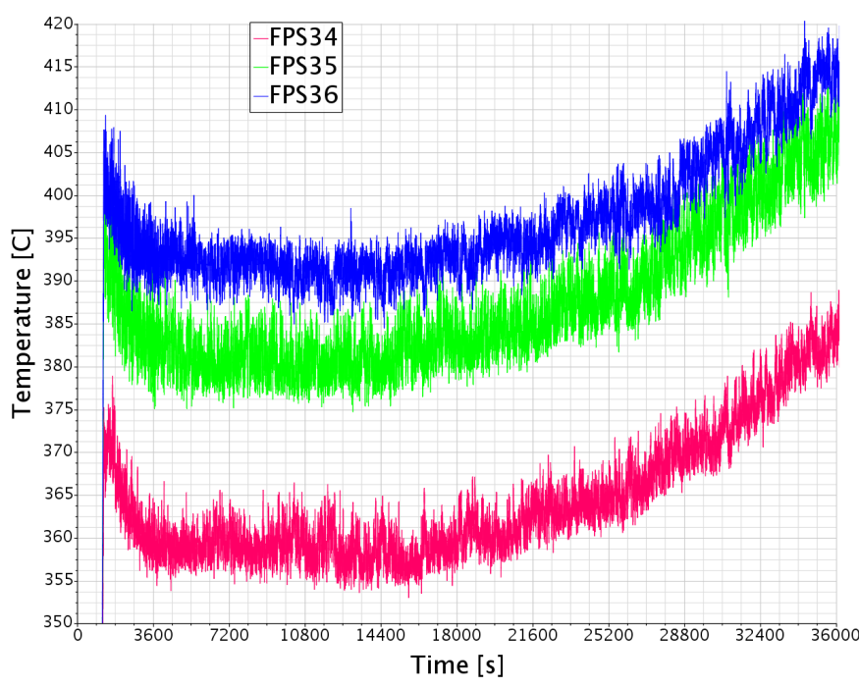
FPS inlet Thermo-couples
FPS TCs: 3 in inlet, 3 at top. Seemingly a good candidate for a flow averaged FPS inlet temperature, but not at the top.
322.6C at 10h

Slide 13
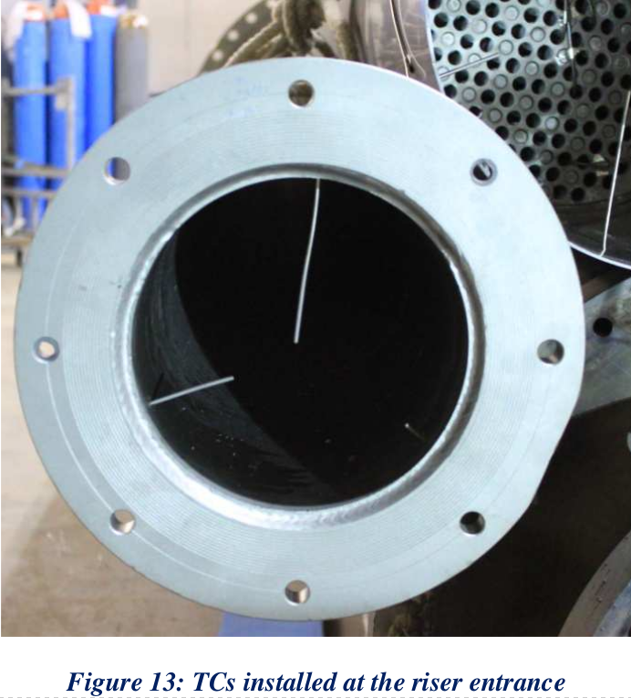
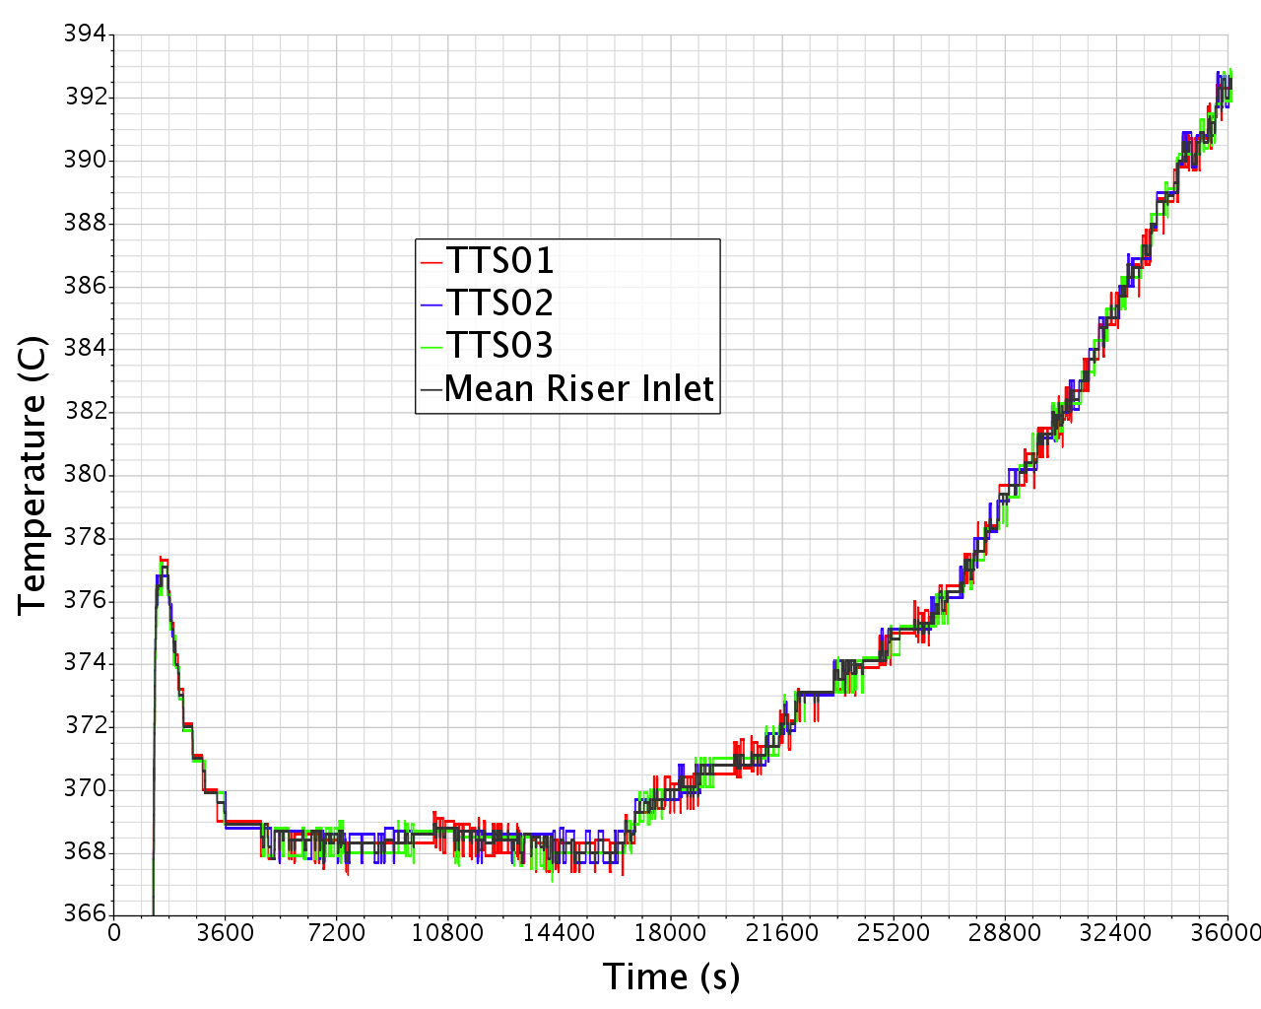
Conveyor Thermo-couples
Conveyor TCs: 3 in outlet. Possible strong interaction with the gas injector nozzle. Seemingly a good candidate for a flow averaged riser inlet temperature…

Slide 14
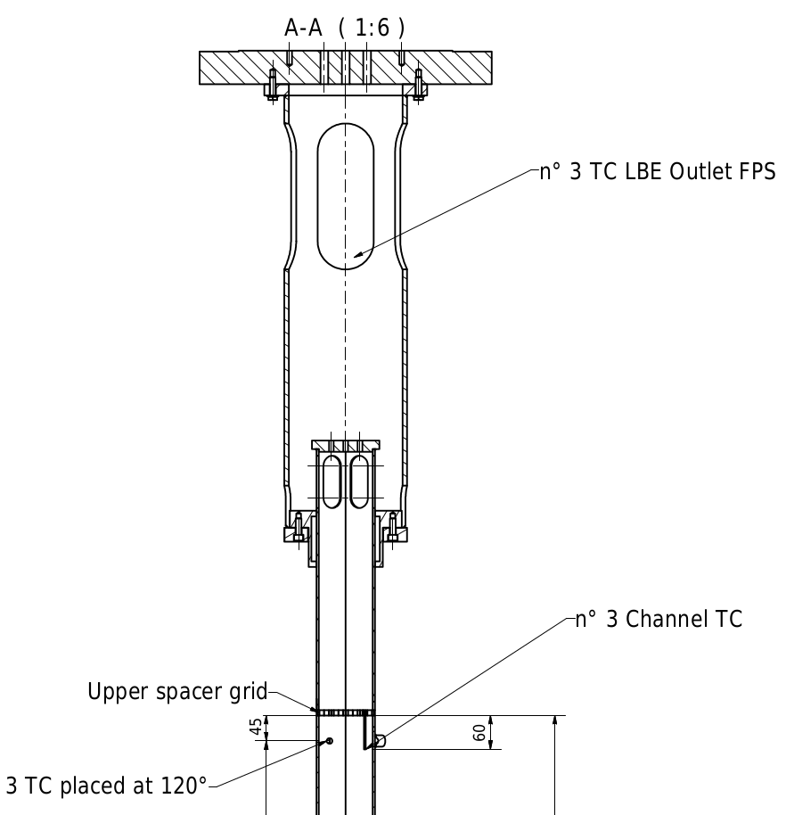
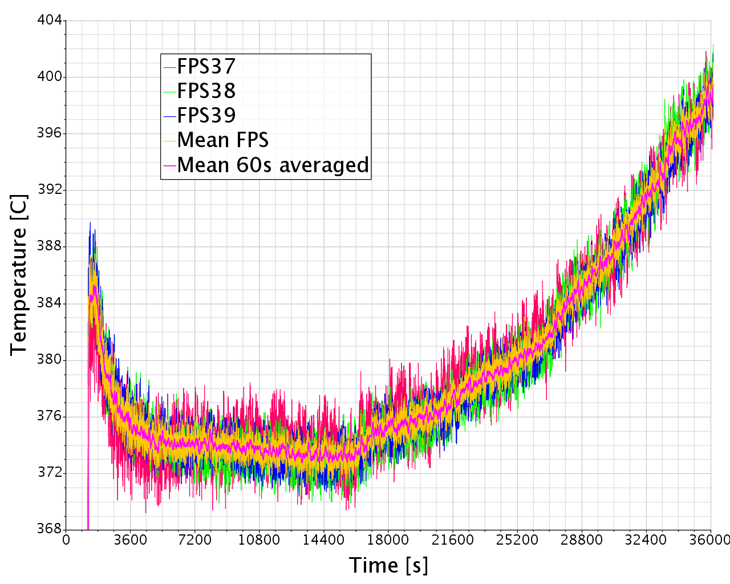
Conveyor Thermo-couples
Conveyor TCs: 3 close to the inlet. Reasonably low dispersion between TCs, mainly high frequency.
Oscillations directly caused by the mass flow variations.
Output of a non resolved region. Also too bad we do not know their exact location…
398.5C at 10h

Slide 15
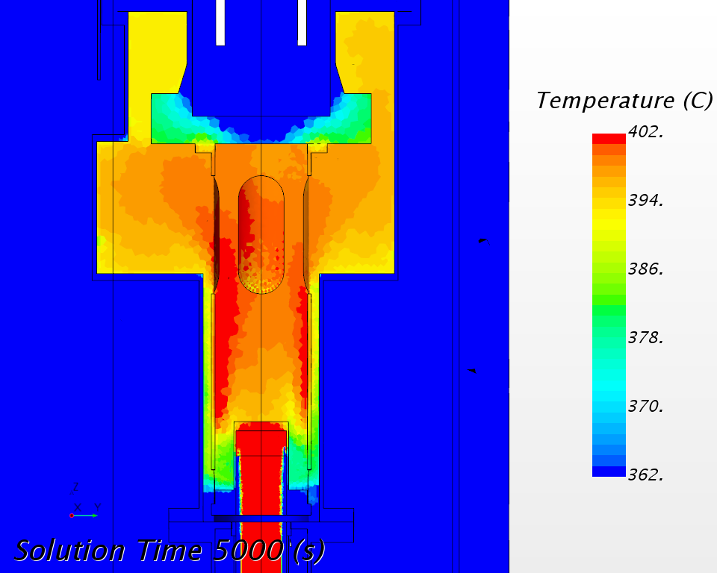
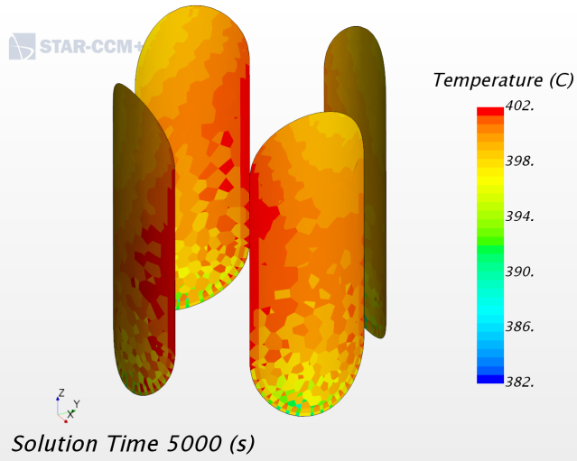
Conveyor Thermo-couples
Conveyor TCs: 3 close to the inlet. Temperature maps of the simulation without pin bundle.

Slide 16
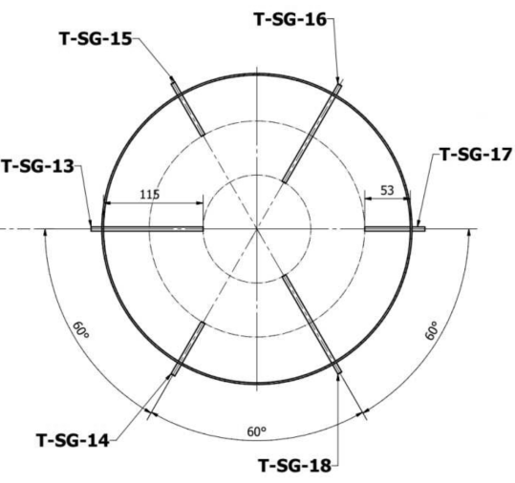
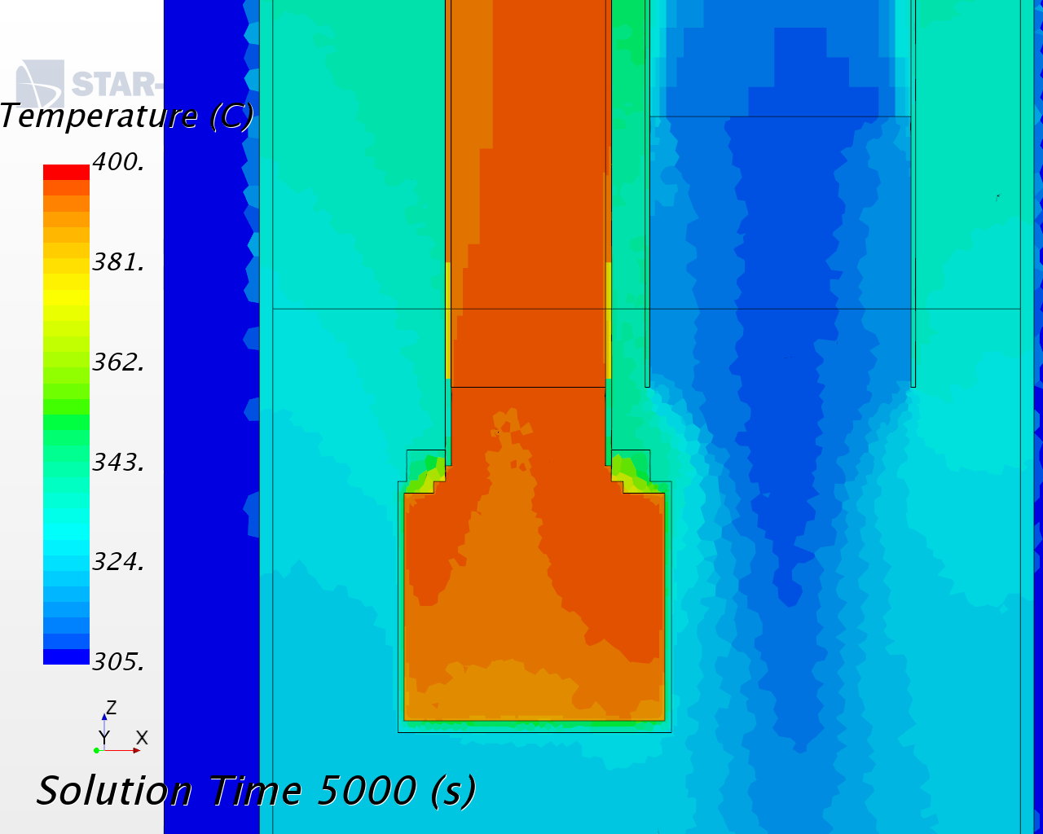
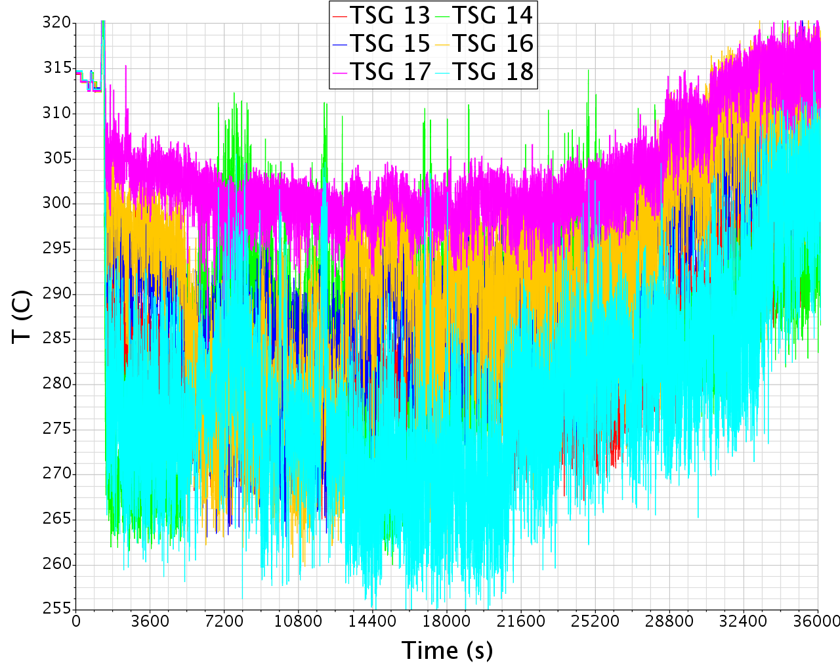
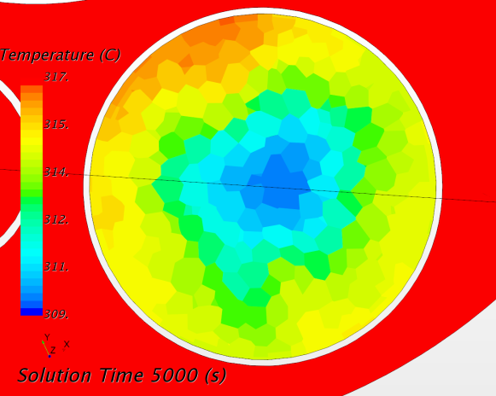
SGE outlet Thermo-couples
6 TCs below the SGE lower grid, 100mm above the SGE outlet.

Slide 17
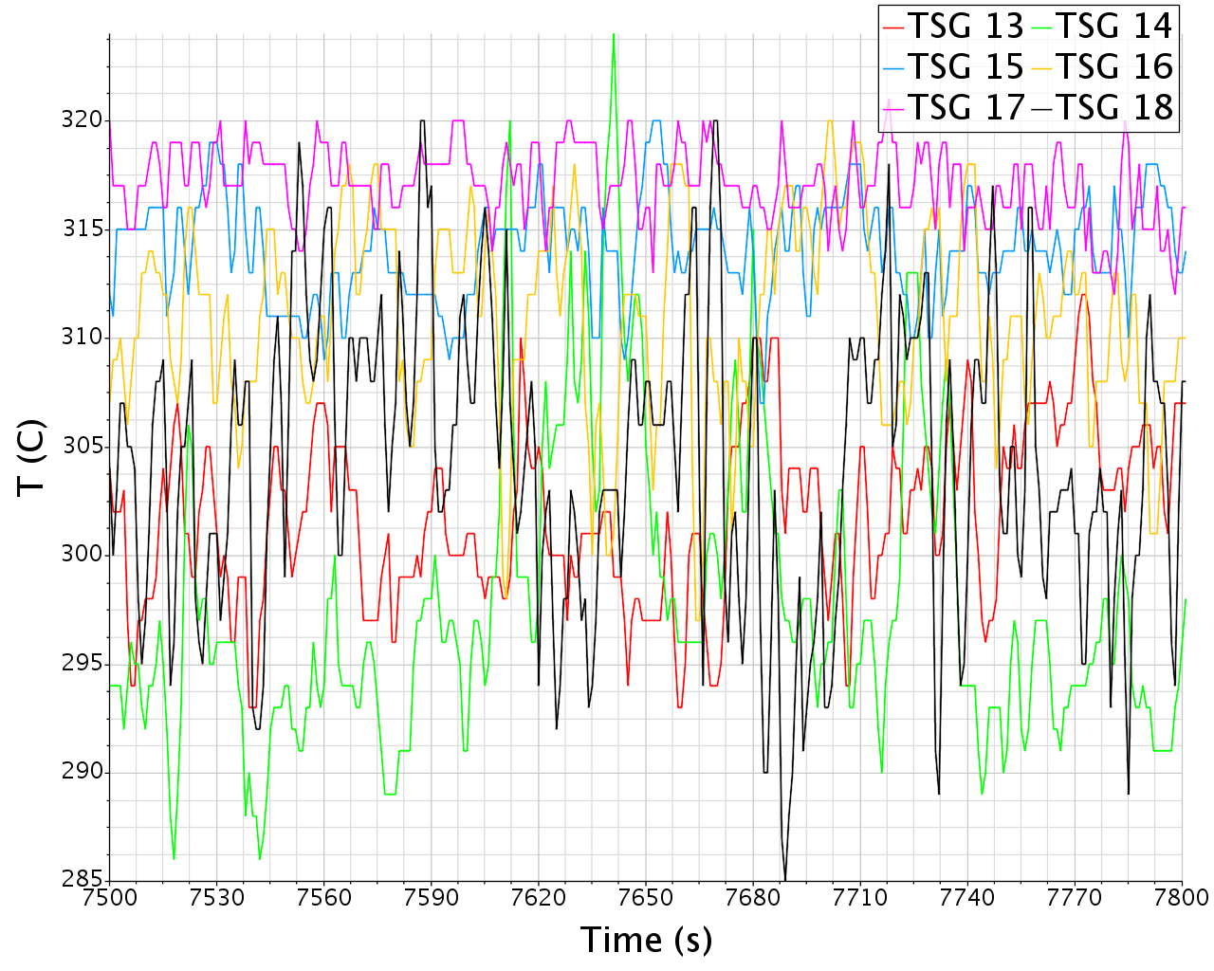
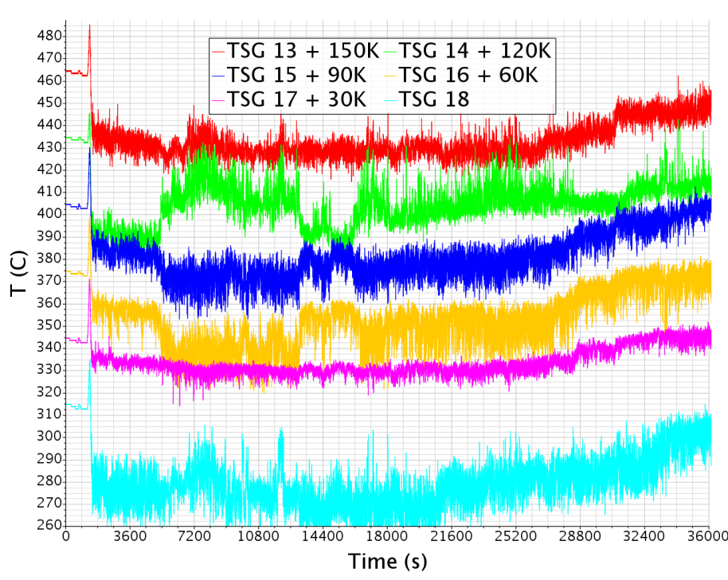
SGE outlet Thermo-couples
6 TCs below the SGE lower grid. Large oscillations up to the hour scale. Occurrences of dT>20K in few seconds.

Slide 18
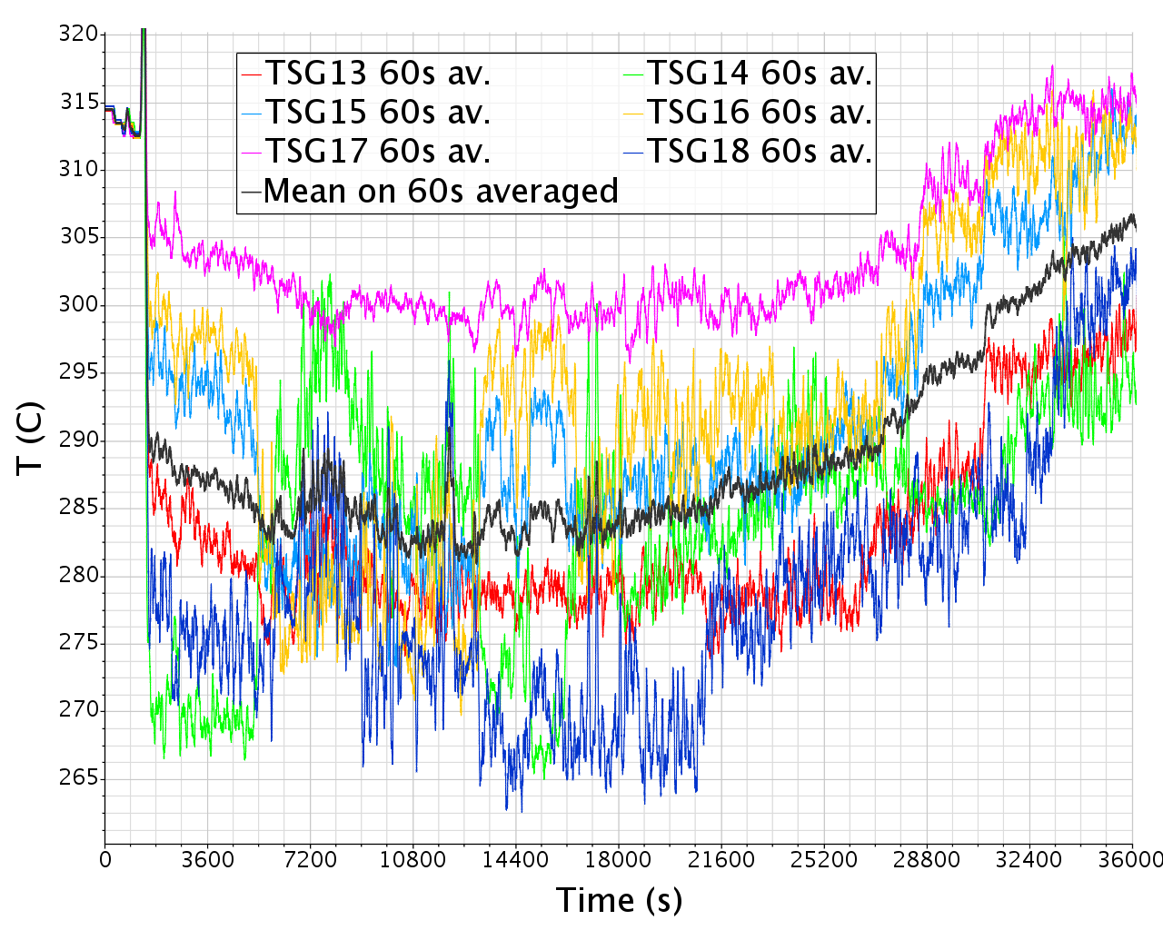
SGE outlet Thermo-couples
6 TCs below the SGE lower grid. Mean over TCs + 60s average gives a relatively smooth signal quite in line with the bulk behavior.
What is a criteria to say that the simulation capture this behavior?

Slide 19
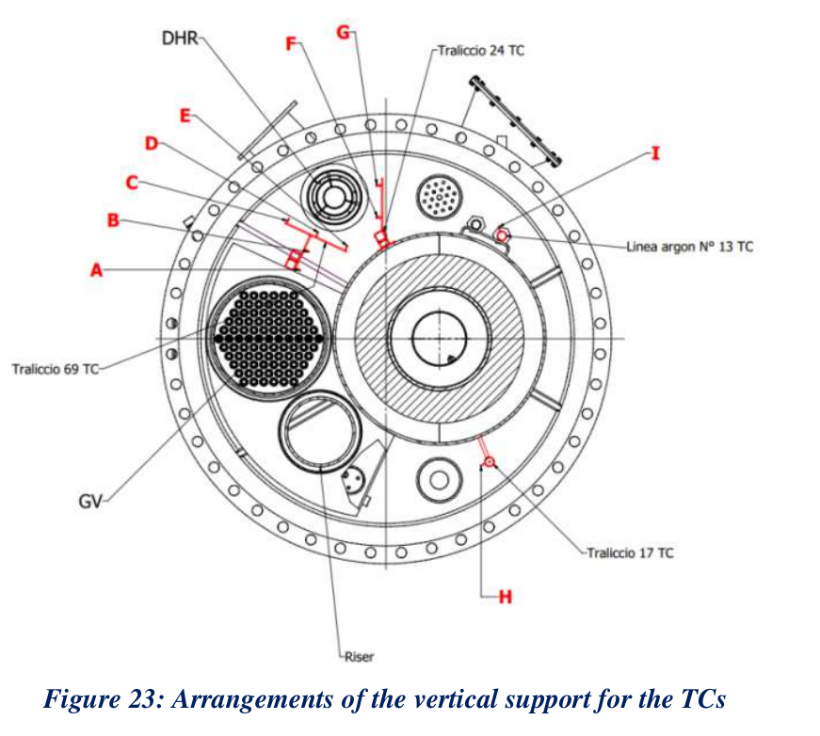
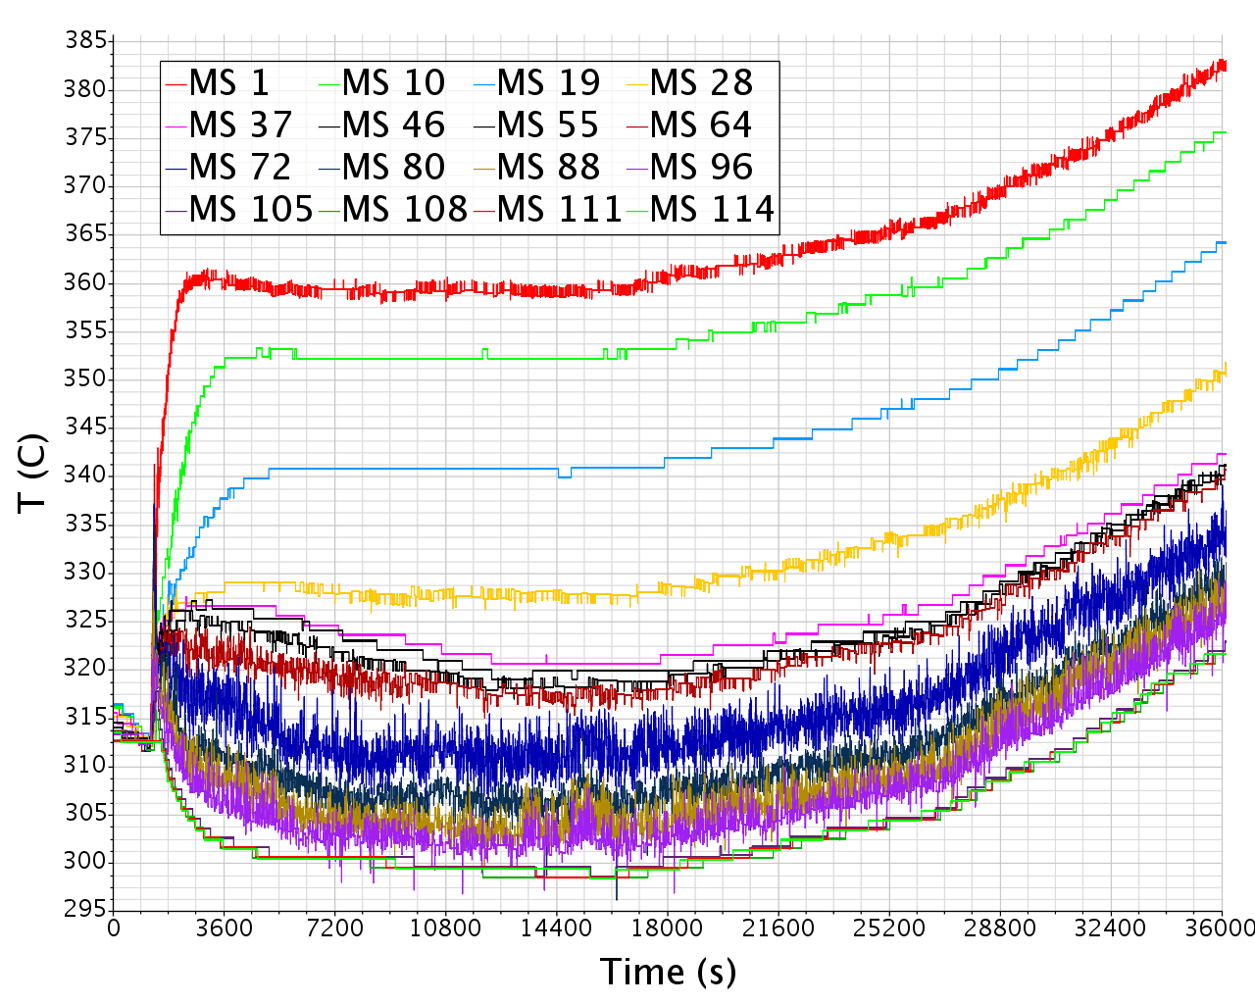
Bulk thermo-couples
119 TCs in the bulk on 9 vertical supports
All vertical profile are very similar
=> “Best “ candidate for confront
Linea A

Slide 20
Bulk thermo-couples
Issue 1
Temperatures are not stationary. The system is never in a macroscopic state of stable thermal equilibrium. The apparent steady-state in the interval [4 ; 5]h results to be unstable, therefore less likely to be numerically captured.
However, the upper and lower regions show little or no high frequency variations. And the vertical profile is largely self-similar.
=> The profile self-similarity can be confronted.
Issue 2
The central region (between the SGE shroud bottom and the conveyor bottom) and the SGE bottom extension show a high level of variability at almost all time scales.
Question
Should a numerical simulation reproduce this high level of variability?
Linea A

Slide 21
Updated numerical model

Slide 22
Main changes
FPS: radial restriction of heat source
Conveyor/Riser: increased thermal resistance (fouling)
Bypass Gas separator/Bulk by use of source/sink terms
Slightly pulsed body force in the Riser
Changed SGE cooling parameters
Colder implied secondary coolant
Radial restriction

Slide 23
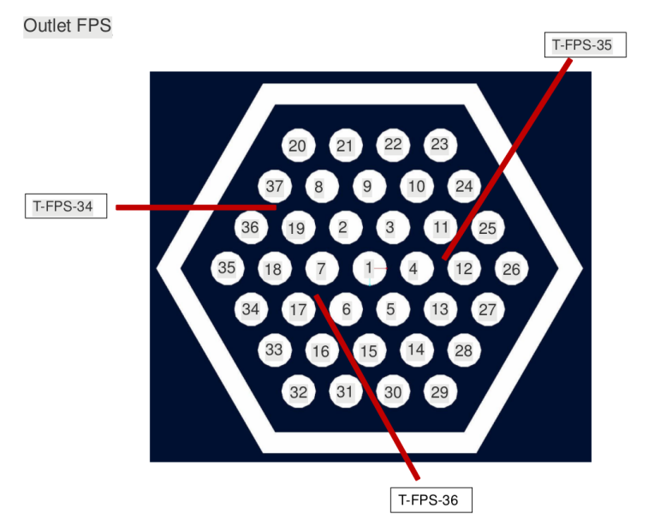
Main changes: FPS
Radial restriction of heat source.
Motivation: take roughly into account the LBE radial temperature profile observed in the dataset.
Expected effect: lower conjugate heat transfer to the bulk.
Observed effect: CHT reduced from ~10kW to ~1kW

Slide 24
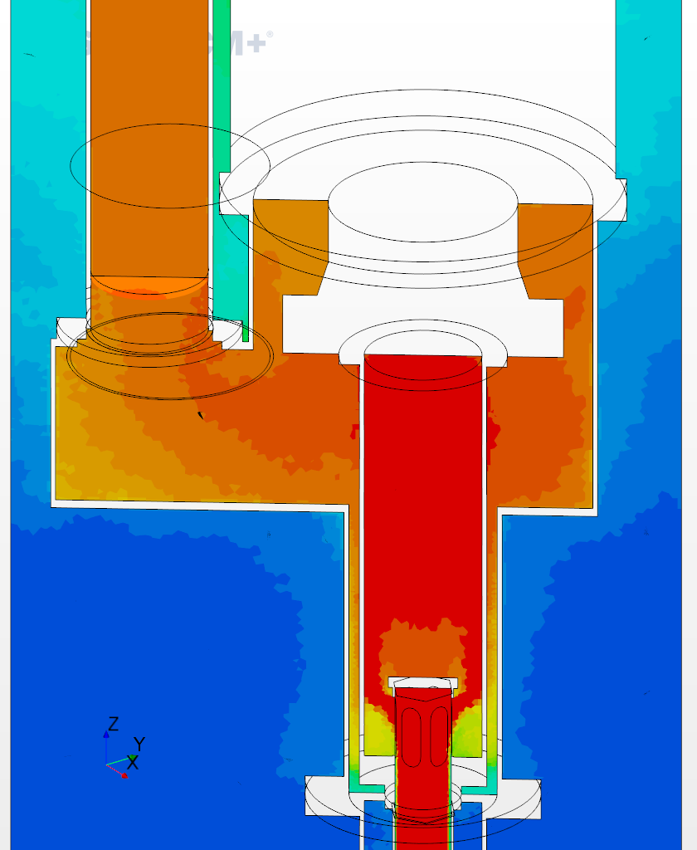
Main changes: Conveyor/Riser
Increased thermal resistance on the steel/LBE interface (fouling)
Motivation
With clean steel wall, the simulation founds a very excessive heat flux towards the bulk, about 110 kW. There are strong indications from the data set that this value is strongly overestimated, leading to an excessively cold LBE at the riser outlet.
Two possible explanations:
Strong overestimation by the numerical model
Creation of a consistent layer of oxide on the conveyor/riser wall greatly reducing the effective thermal conductivity.
In both case, adding an interface thermal resistance reduces the heat flux.
Expect result: lower heat losses, higher riser outlet temperature
Observed results: lower heat losses, from ~110kW to ~60kW, rapid riser outlet temperature by ~5K.

Slide 25
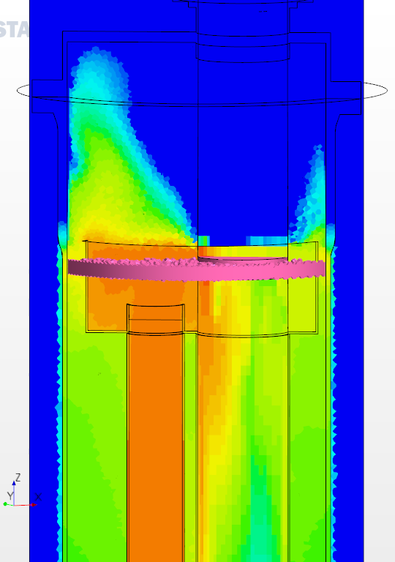
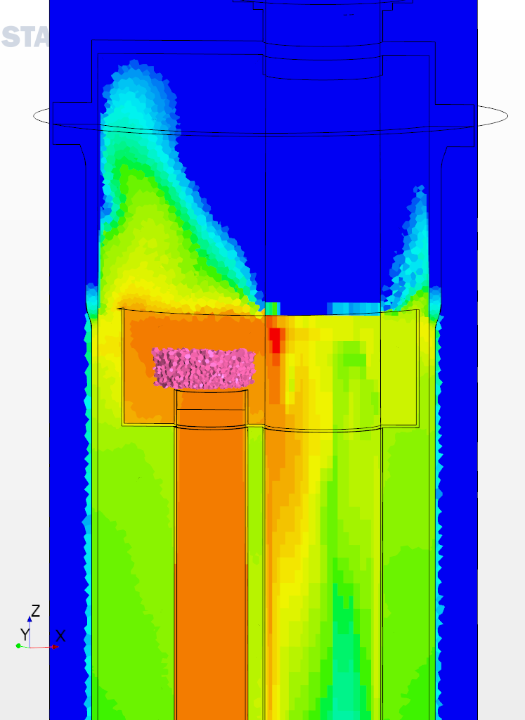
Main changes: Bypass
Bypass Gas separator/Bulk by use of localized source/sink terms in the volume fraction and the energy equation.
About 1.3kg/s (or 2%) is directly transferred together with its enthalpy from the top of the riser to the top of the bulk.
Expected effect: higher temperature at the top of the bulk.
Observed effect: slow reduction of the separator/bulk temperature difference. Note that the effect is proportional to this difference.

Slide 26
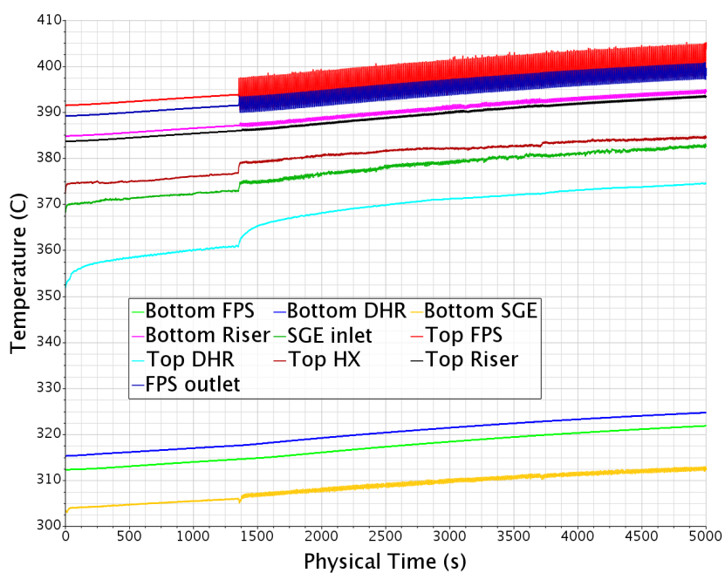
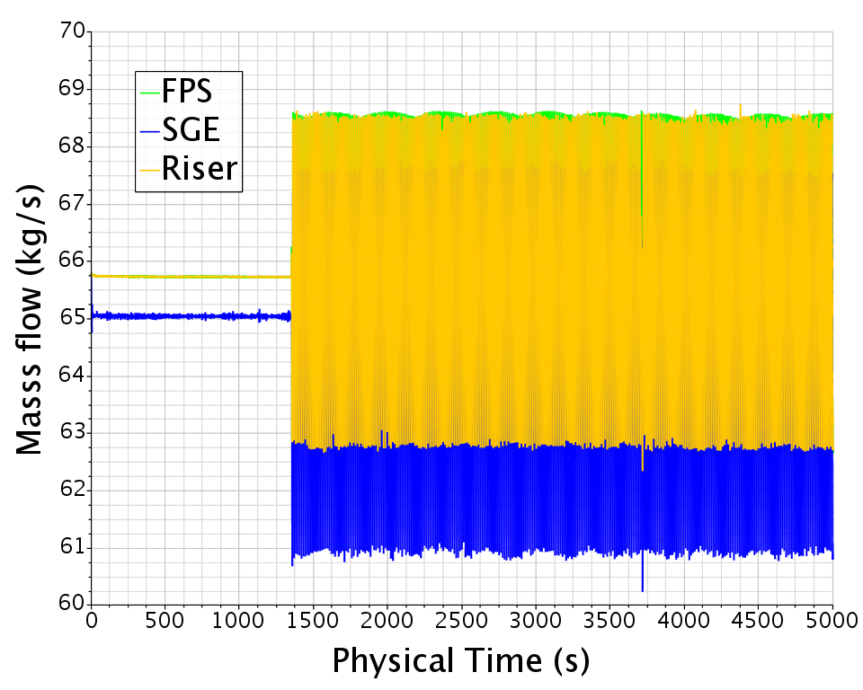
Main changes: Pulsed body force (1/2)
Slightly pulsed body force in the Riser.
Original force modulated by a 10% amplitude sinusoidal signal with period about 12s.
Motivations:
Loosely reproduce the mass flow variability
Look for potential heat transfer effects
Hopefully trigger a flow instability below the SGE outlet and in the bulk intermediary region.
Effect:
Slightly increases the conjugate heat transfer
No instability triggered…

Slide 27
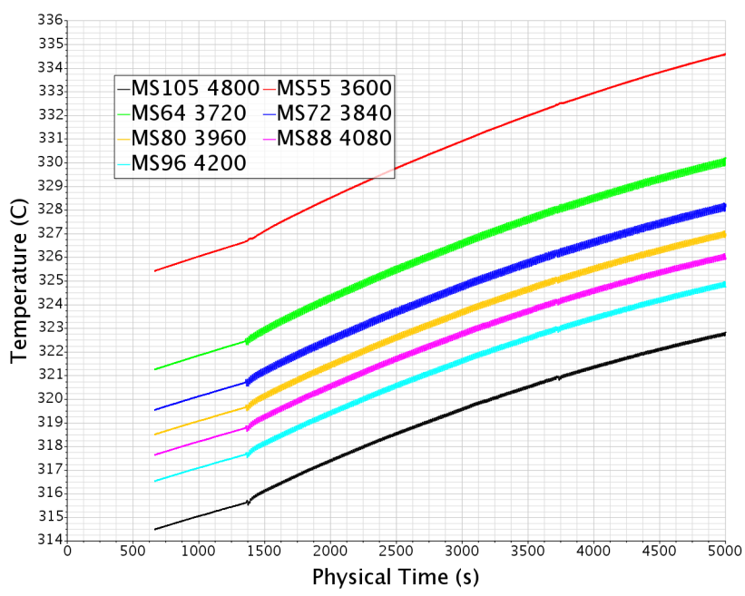
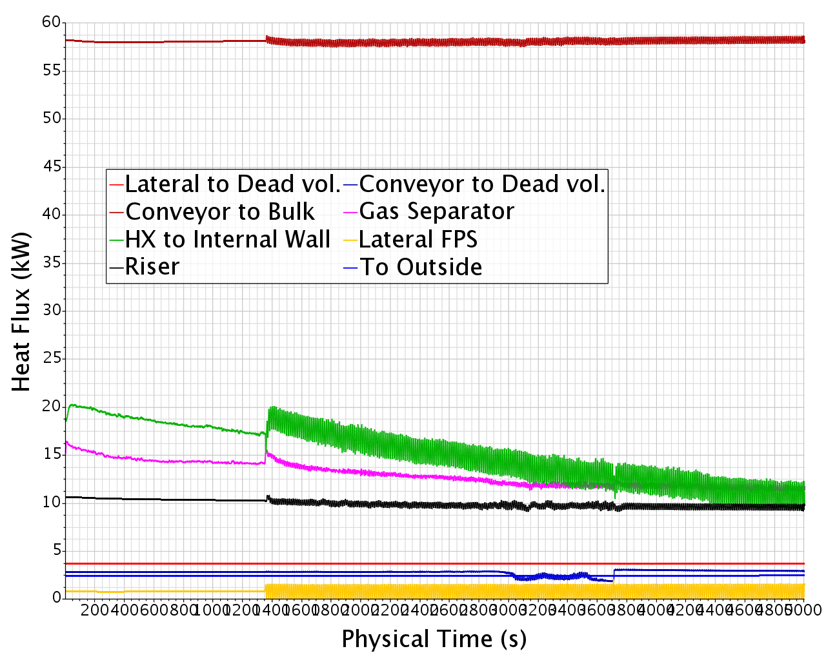
Main changes: Pulsed body force (2/2)
Slightly pulsed body force in the Riser.
Also, bypass raised from 0.7 to 1.4 kg/s.

Slide 28
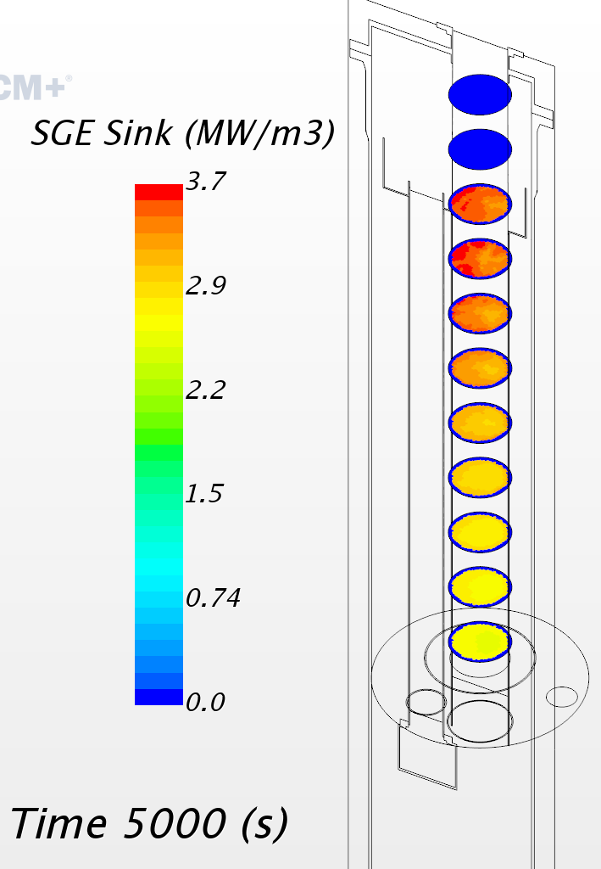
Main changes: SGE cooling (1/2)
Changed SGE cooling parameters
Colder implied secondary coolant
Radial restriction for the region of application
Motivation
Separate simulations of the SGE with the tube bundle indicate local hot stagnation regions where the distance between the tubes and the wall is greater.
Expected (and observed) effects:
Higher SGE wall temperature
Higher heat transfer to the bulk (Temporary)
Higher bulk temperature
Formula: VF_{LBE}*ρ₀*Cp₀*(T-T₀)/τ
VF_{LBE}*10340*145*(T-393)/112

Slide 29
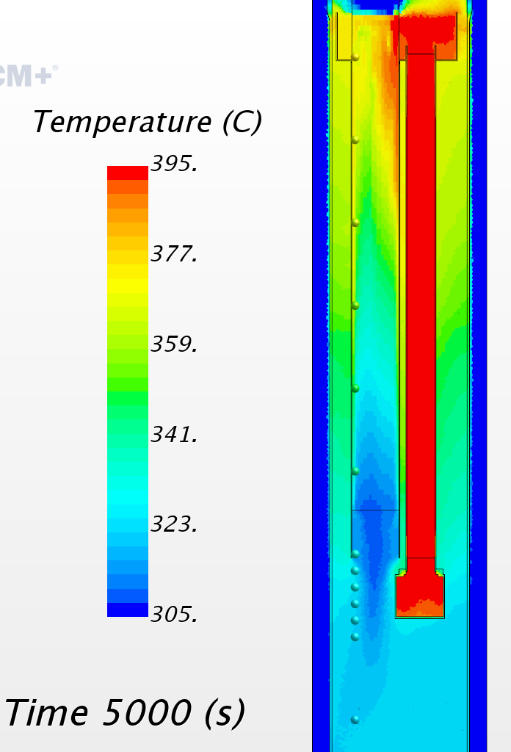
Main changes: SGE cooling (2/2)
Motivation
Separate simulations of the SGE with the tube bundle indicate local hot stagnation regions where the distance between the tubes and the wall is greater.
Expected (and observed) effects:
Higher SGE wall temperature
Higher heat transfer to the bulk (Temporary)
Higher bulk temperature
Formula: VF_{LBE}*ρ₀*Cp₀*(T-T₀)/τ
VF_{LBE}*10340*145*(T-393)/112

Slide 30
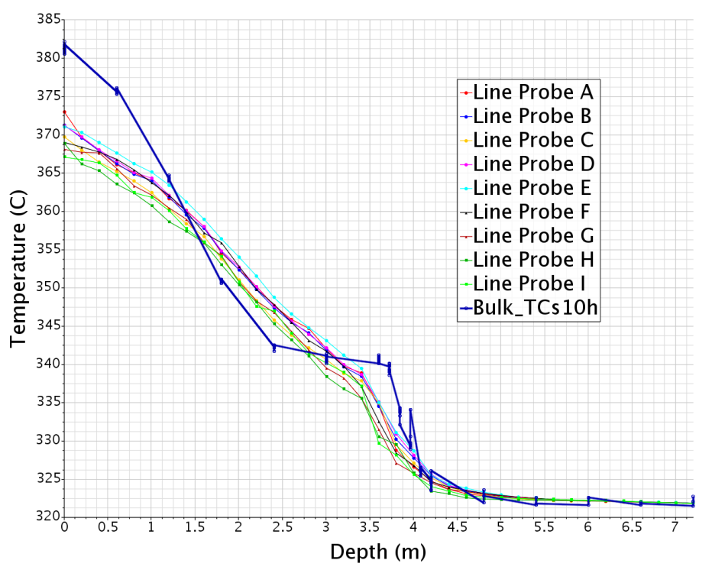
Main Result
Confront experimental/numerical:
Better global dT (but still not good)
Loss of plateau in depth [2.4 ; 3.72]m
Higher horizontal gradients

Slide 31
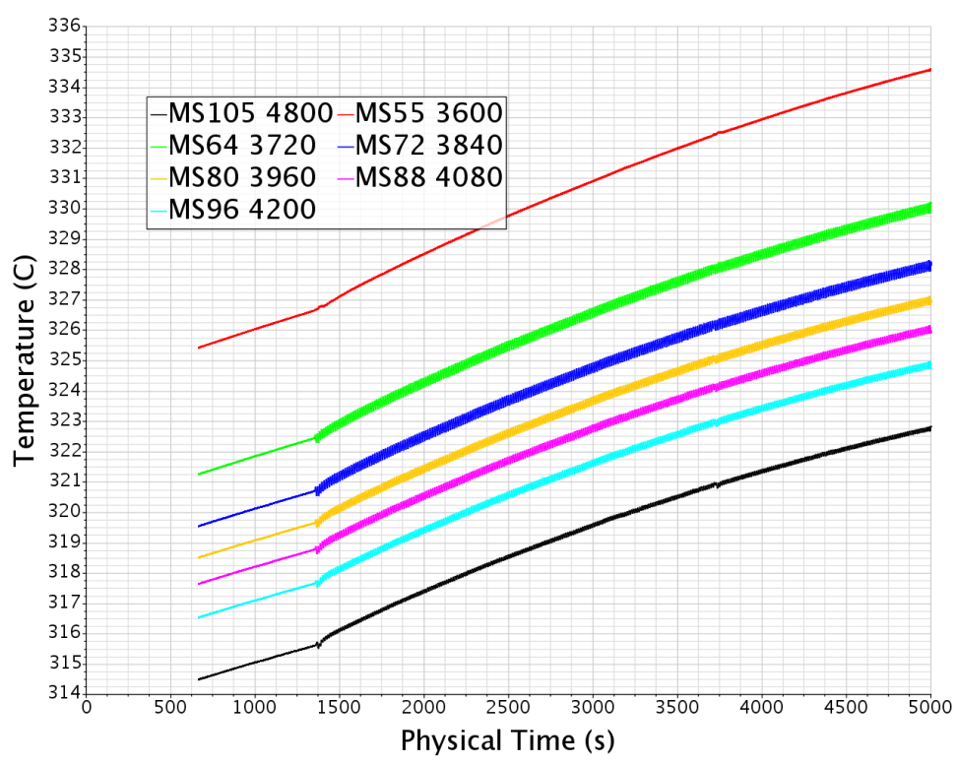
Main Result
Confront experimental/numerical:
Instable region [3.72 ; 4.2]m in experiment is stable in simulation.

Slide 32
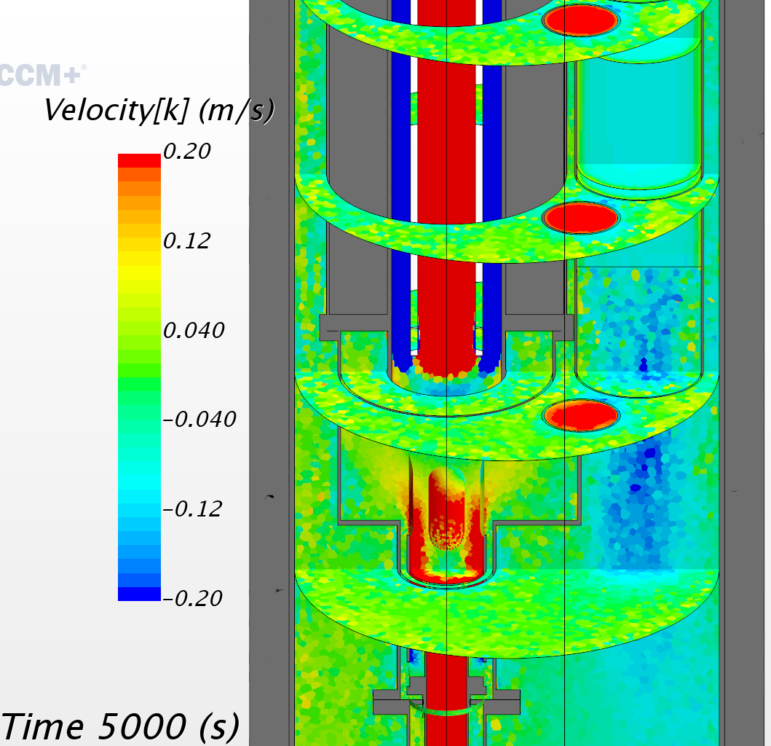
Some issues in the model
Confront experimental/numerical:
Thermal balance not completely under control (unknown heat source about 20-30 kW)
Velocity field is not “clean”, but stationarily “spotted”
The flow seems to only loosely feel the buoyancy (downcoming along the riser…)

Slide 33
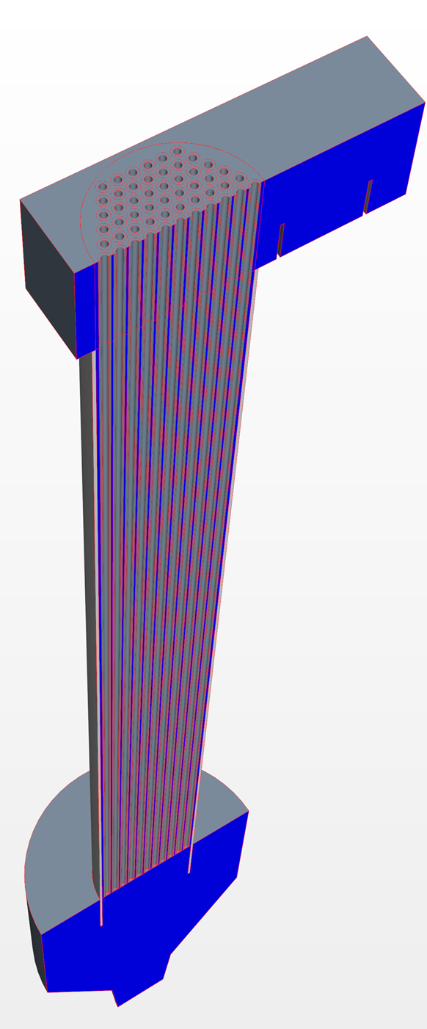
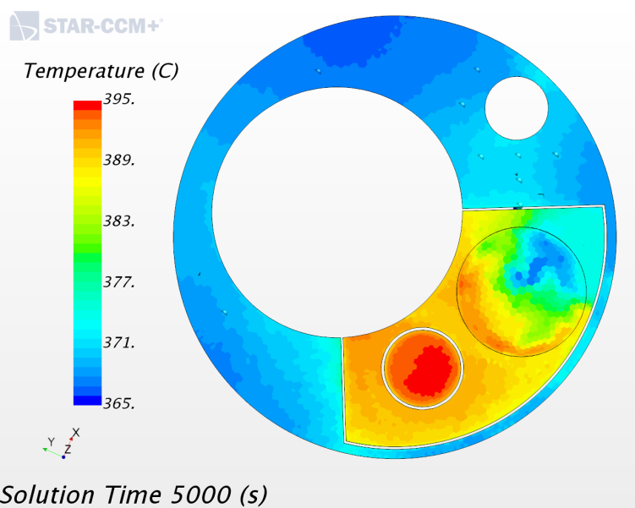
Some issues in the model
Temperature of the gas separator wall and backside SGE wall probably highly underestimated.
Cause: homogenization of the porous media flow resistance to the entire SGE cylinder strongly penalize the lateral flow pass way.

Slide 34
More on Riser and SGE

Slide 35
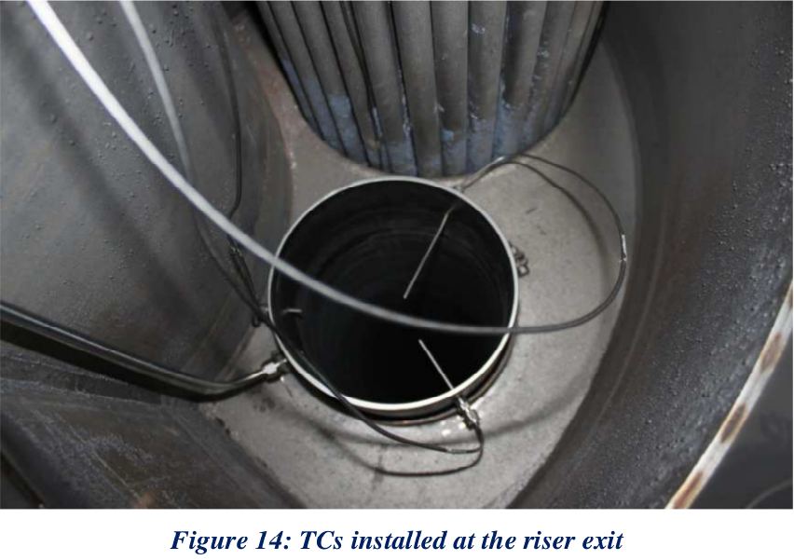
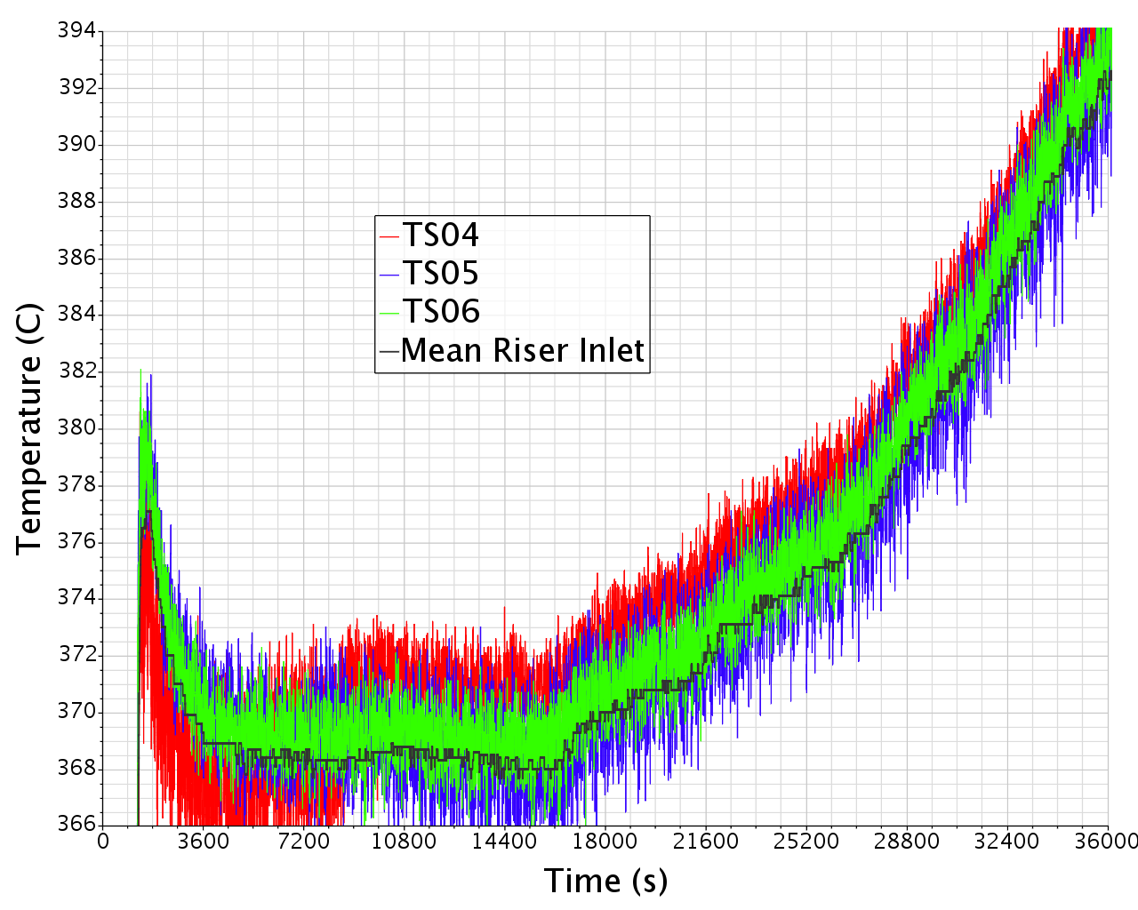
Riser (1/3)
Inlet TCs give identical smooth temperatures
Outlet temperatures show much larger high frequency oscillations
How is this possible with a bubbly flow supposed to mix very well ?

Slide 36
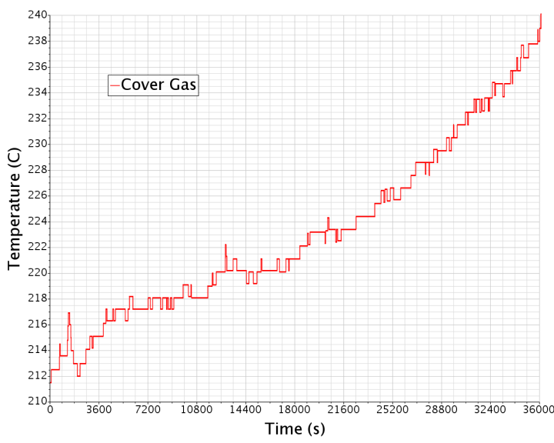
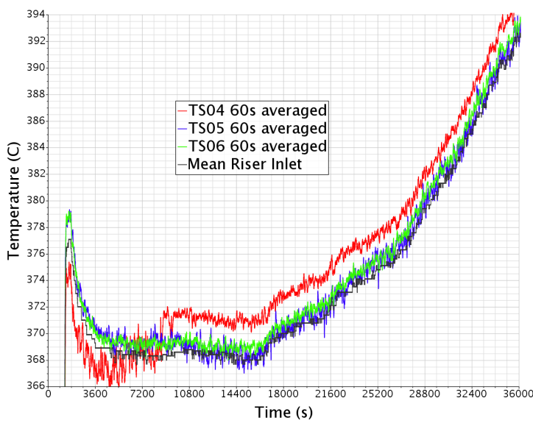
Riser (2/3)
Outlet temperatures may be underestimated due to the colder bubbles (slight) influence
But mean outlet temperature is slightly (1K~ 10kW) above the inlet one while it should be about 1 K below!
=> Either these values are only slightly representative of the flow average values if we want a confront about the wall heat flux or the outlet temperature is corrupted (by bubble induced vibration?).

Slide 37
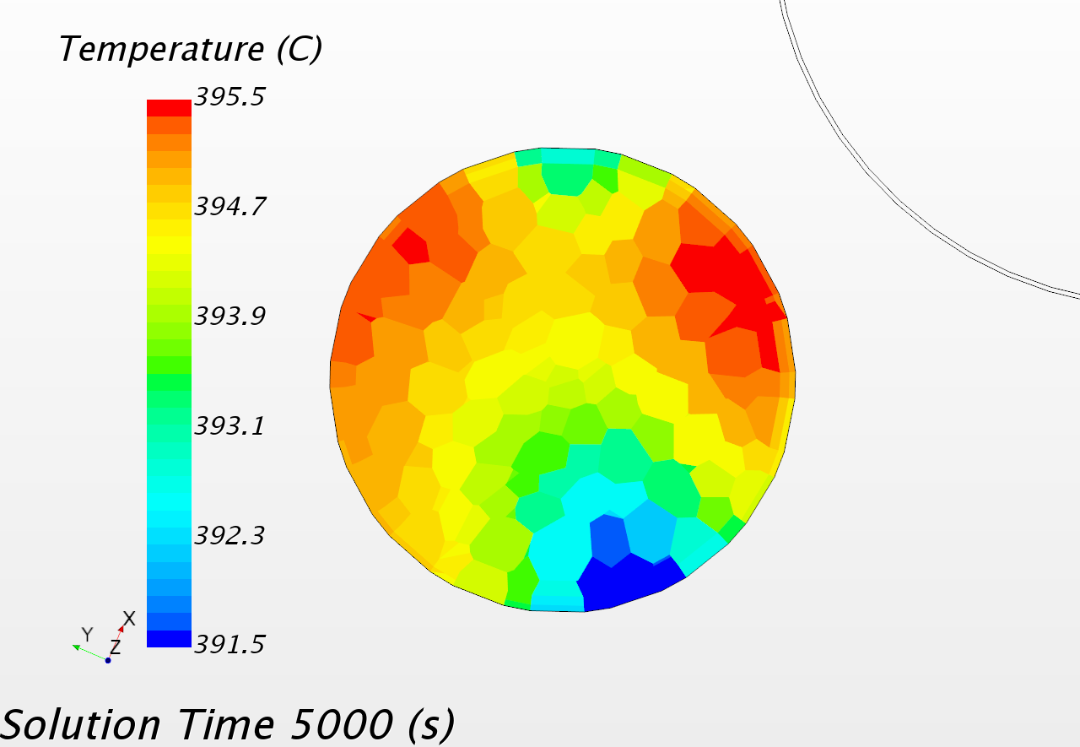
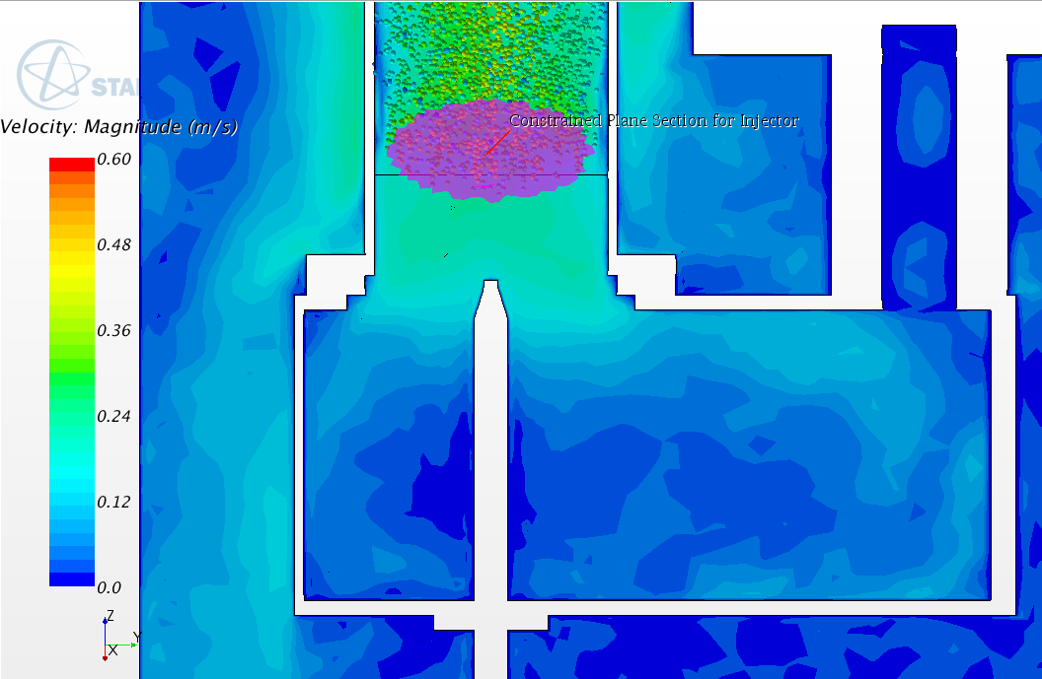
Riser (3/3)
How is this possible?
Temperature profiles in the simulation.
Unfortunately, only the inlet profile may contain some useful hint.
Mean Riser inlet flow mean temperature is 394.4 C.
TCs at 10h give 392.0 C.
Without gas entrainment local effect, all temperatures would coincide perfectly!

Slide 38
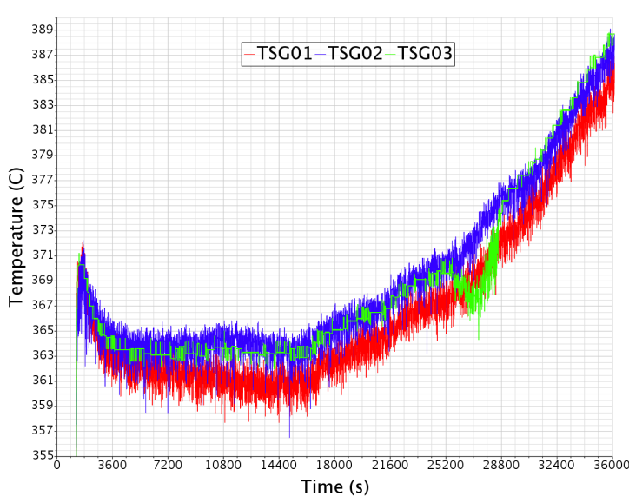
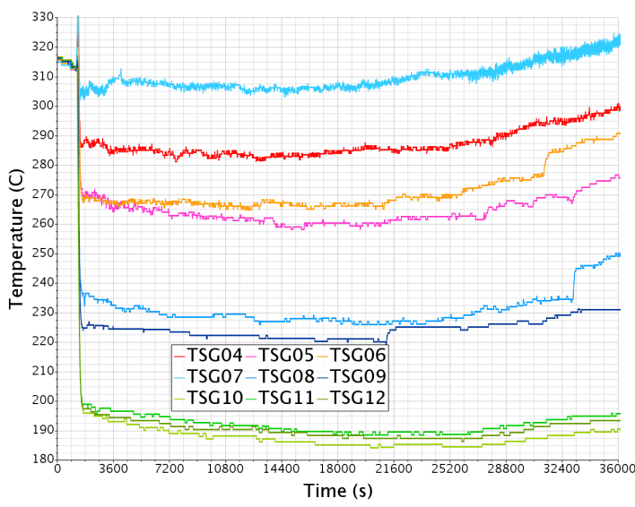
SGE LBE side
The data from the SGE are very difficult to interpret
-5K!
SGE inlet
Riser outlet
?
?
SGE bottom
SGE outlet

Slide 39
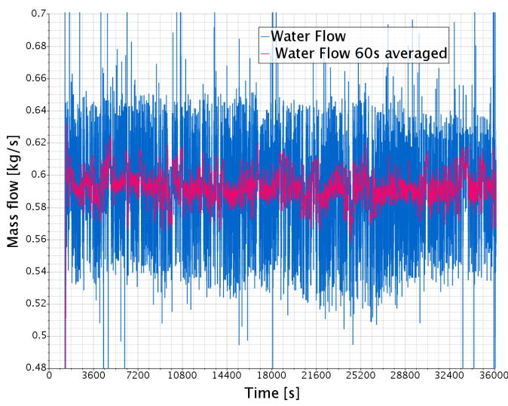
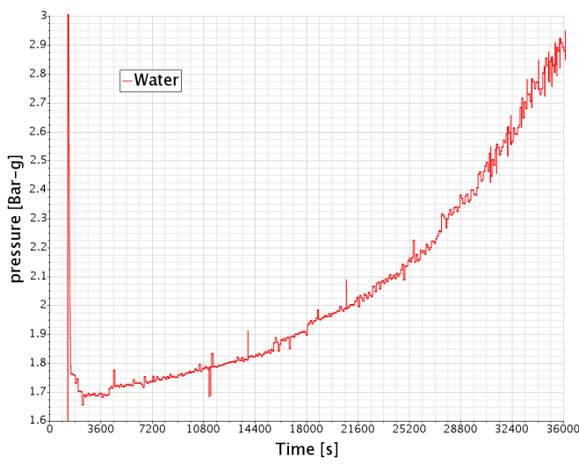
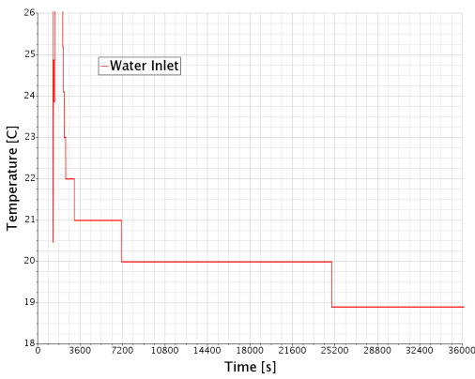
SGE Water side
Water inlet with high frequency oscillation, range 0.54-0.65kg/s
Inlet pressure slowly increasing from 1.7 to 2.9 Bar
Constant inlet T, outlet T and P.
Unknown title but probably constant during the last 3 hours.

Slide 40
SGE interpretation
Colors grouped by radius
TSG07 (pale blue) surprisingly high temperature
To a lesser extend, same thing for TSG04 (red)
Three jumps of temperature
Very homogeneous central TCs

Slide 41
SGE interpretation
Water side: high frequency activation/passivation (partial) of some bayonet tubes
Passivation more frequent with LBE temperature increase.
Mix of continuous and discontinuous phenomena
Three events of inactivation can be seen looking at the SGE bottom TCs

Slide 42
New model features

Slide 43
Modularity and dual use
The new model is much more modular than the previous one
The volume enveloping the heat exchanger is build apart: it can host either ICE or HERO
Several geometrical models of HERO and ICE of different complexity should be much more easy to implement.
Idem for the DHR
Maybe idem for the FPS.
A bypass is organized at the separator base. It can be switch on or off and calibrated easily.
Management of the entrapped LBE around the FPS can be now easily performed.

Slide 44
Modelling
The VoF setting is abandoned
Volume changes are small
Without simulating the Argon bubbles, the free surface was essentially quiet
There is no real change of the free surfaces level during the transients.
The simulation can now performed using the coupled (velocity-energy) flow setting, hopefully more adapted for buoyancy dominated flows
Thermal buoyancy should not be any more “hidden” by phase induces buoyancy.
The spotted flow should become cleansed.
Transient and steady-state simulations are now available.

Slide 45
Part 1 Conclusive words
The CIRCE-ICE data set produced for SESAME has been used for an analysis of the system during one experimental run.
The data aggregation has brought more questions than answers.
There is a large uncertainty about the heat source in combination with the FPS and conveyor conductive heat flux.
The riser TCs indicate the LBE temperature slightly higher than at the bottom and much more oscillating. This is not understood. Maybe the bubbly blow perturbs the TCs reading in an unexpected way.
The data related to the SGE show very unexpected values. The SGE behavior is much more complex than expected.
The numerical simulation resents of these issues and show quite large differences with the experiment and fails to reproduce the unstable temperature region.
A new model, better adapted to further investigation, is under construction.

Slide 46
Part 1 final word
The Steam generator is the key

