Slide 1
ALFRED Primary System: CFD Analysis of the Coolant Flow Path
Vincent Moreau
moreau@crs4.it,
Notes:
Ladies and gentlemen, Good day.
My name is Vincent Moreau and will present our work entitled “ALFRED primary system: CFD analysis of the coolant flow path”.

Slide 2
V. Moreau, M. Profir CRS4, Sardinia, Italy
M. Caramello, A. Alemberti, M. Frignani
Ansaldo Nucleare S.p.A. ,Genoa, Italy
Track 6: Liquid Metal Thermal Hydraulics
Session 6c: Pool Thermal Hydraulics
Notes:
2
This work has been performed with my colleague Manuela Profir from CRS4 in collaboration with Marco Caramello, Alessandro Alemberti and Michele Frignani from Ansaldo Nucleare.
CFD

Slide 3
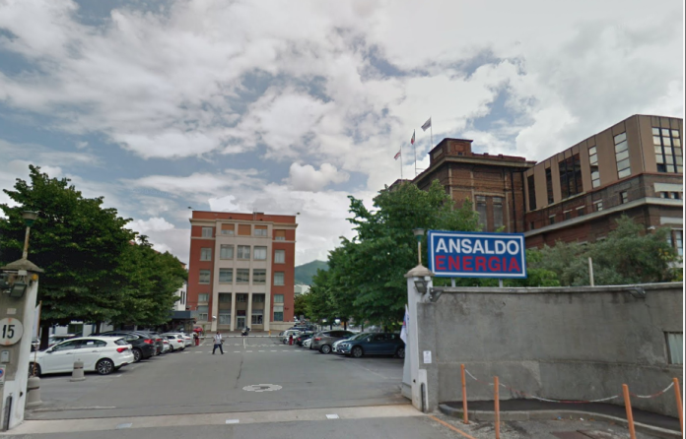
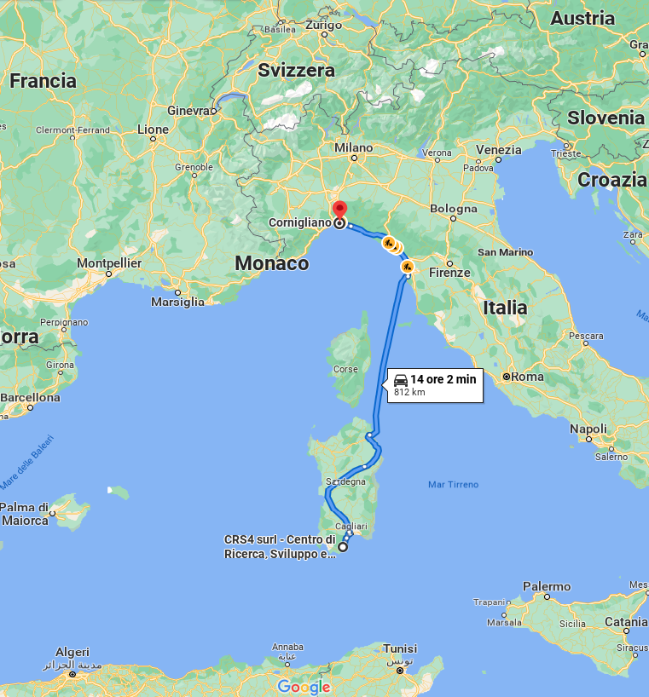
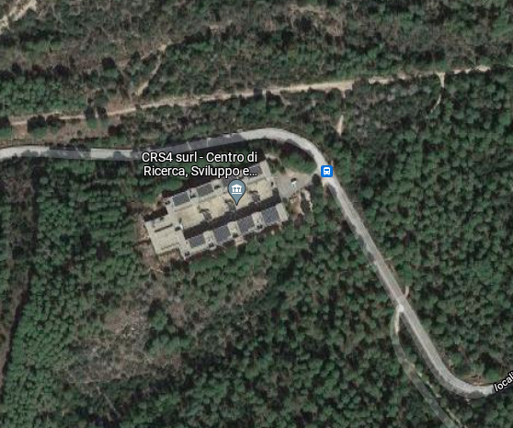
Collaboration CRS4 – Ansaldo Nucleare
CRS4
Ansaldo Nucleare
Continuation of a work started within the European project SESAME and pursued in the framework of the FALCON consortium.
Notes:
This work started within the European project SESAME and continued within the FALCON consortium framework.
It is a collaboration between CRS4 a multidisciplinary research center located in Sardinia, and Ansaldo Nucleare, in Genoa.

Slide 4
FALCON Fostering ALFRED CONstruction consortium
Led by Ansaldo Nucleare (IT), ENEA (IT) and ICN (RO), is dedicated to the development of ALFRED (Advanced Lead-cooled
Fast Reactor European Demonstrator) and to its supporting research infrastructure in Romania.
Notes:
The FALCON consortium is dedicated to the development of ALFRED and to its supporting research infrastructure in Romania.

Slide 5
ALFRED in numbers and in brief
Lead Cooled Nuclear Reactor Demonstrator
Primary system: cylinder ~10 m high and 8 m diameter.
3 Primary Pumps (PP)
3 Steam Generators (SG), pressure loss 0.5 Bar
1 Core, pressure loss 1.0 Bar
3 different free surface levels
Power: 300 MW_{th}
Mass flow rate: 17, 000 kg/s
Thermal cycle: 400 ⁰C – 520 ⁰C at SG, + ~5 K at the Core
Notes:
ALFRED is a Lead Cooled Nuclear Reactor Demonstrator.
The primary system is pool type and is enclosed in a cylinder about 10m high and 8m diameter
It consists of
three primary pumps
three steam generators for a half bar pressure loss
And an active core for a 1 bar pressure loss.
There are three separate free surfaces.
The core is rated 300 MWth The mass flow rate is 17 metric ton per second
For a thermal cycle 400-520 degree C at the steam generator.

Slide 6
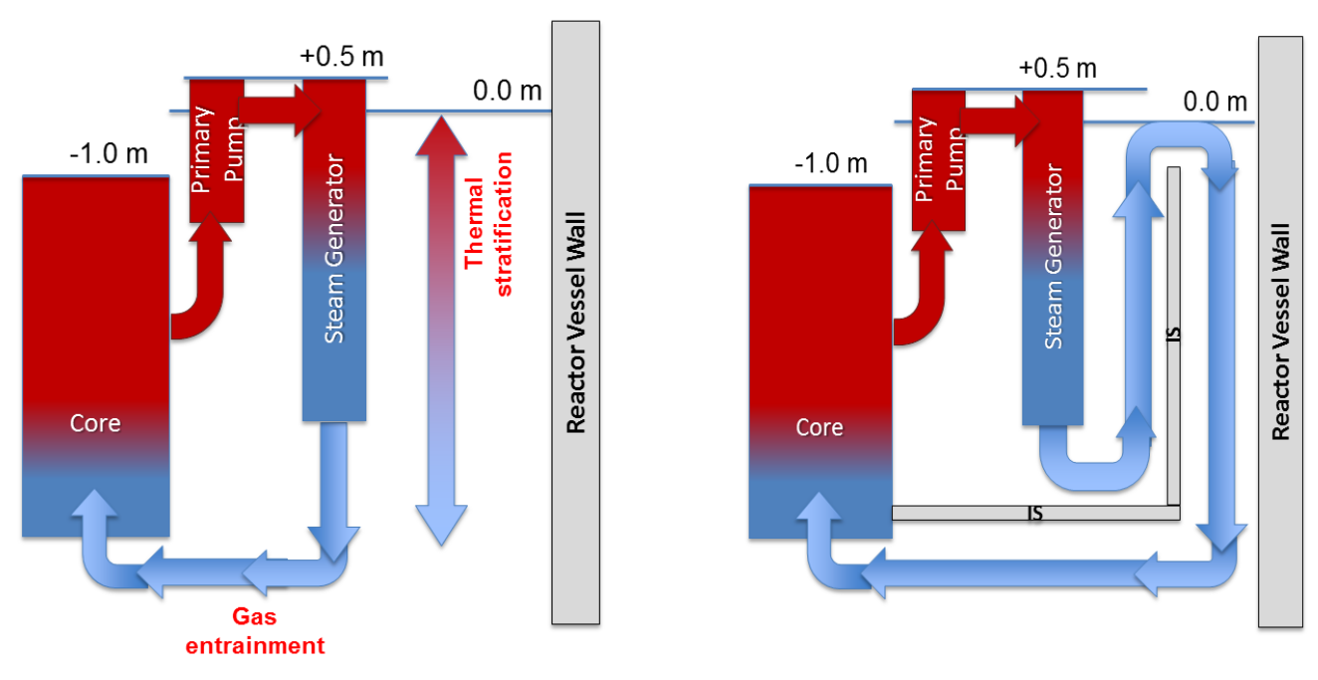
ALFRED “Old Configuration” main issues and how it is addressed*
Old
New
The old configuration was subject to thermal stratification and Gas entrainment in case of SG tube rupture.
An internal structure (IS) has been added.
* M. Frignani, A. Alemberti, M. Tarantino, ALFRED: A REVISED CONCEPT TO IMPROVE POOL RELATED THERMAL-HYDRAULICS, SESAME International Workshop Petten, The Netherlands, 19-21 March, 2019
Notes:
The ALFRED old configuration was subject to thermal stratification and Gas entrainment in case of SG tube rupture.
An internal structure, shown on the right, has been added with the objective of actively cool the vessel wall and to avoid a direct path from the SG outlet to the core.

Slide 7
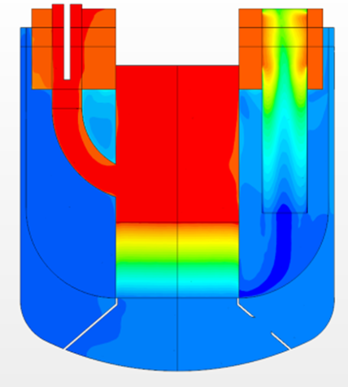
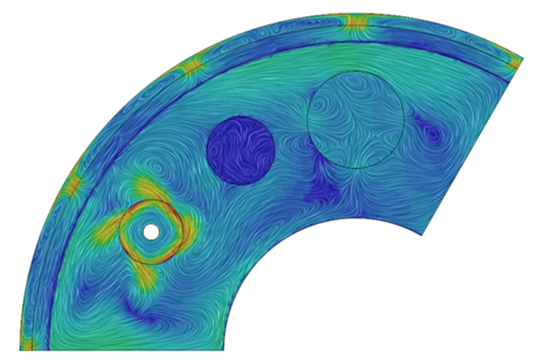
ALFRED upgraded configuration, 1/3 numerical model
ACS
Hot plenum
Cold plenum
SG
PP
IS
DC
Core
Notes:
Taking profit of the symmetries, the CFD model treats only one third of the primary coolant volume.
The representation on the left shows two non co-planar vertical sections: the first crossing the PP, and the second crossing the SG.
The flow path is as follows.
The cold fluid is heated while rising through the core.
It enters the PP duct and is released into the hot plenum.
It enters the SG from the top where it is cooled down.
From the SG bottom, the coolant rises up and impinges the vessel wall through windows at the top of the internal structure.
The fluid leaps down along the vessel and turns back to the core bottom.

Slide 8
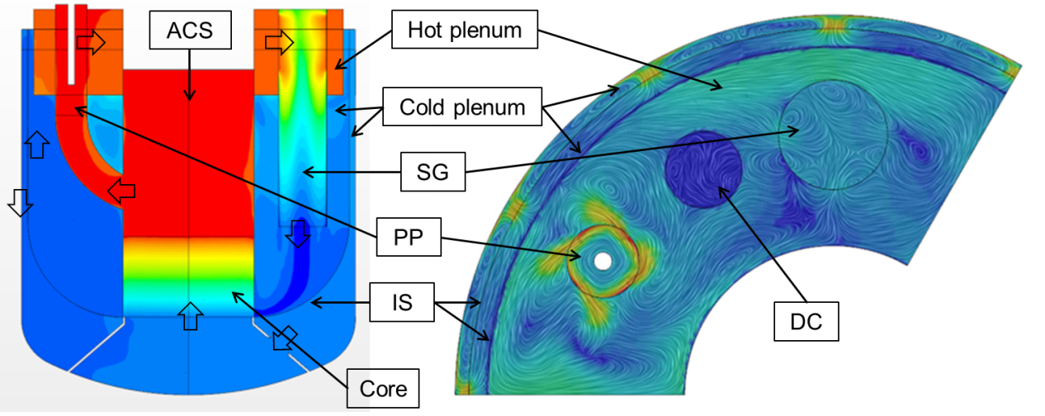
Numerics of Steady States: a few pills
PP: mass flow rate imposed from balance between a local high volumetric force and a high hydraulic resistance, swirl added at the local volume top
SG:
2 parameters volume heat sink, a reference temperature and a time scale, adjusted to impose the outlet temperature;
porous media with quadratic hydraulic resistance giving 0.5 bar pressure loss at nominal
IS: conducting baffles in lieu of structural parts, thermal resistance from foreseen width, 3cm or 5 cm.
Notes:
The numerical domain is a closed loop without inlet nor outlet.
The simulations are performed at a prescribed mass flow rate, enforced at the PP dedicated volume from a balance between a local high volumetric force and a high hydraulic resistance. Swirl is added at the top of the volume.
The nominal cold fluid temperature is enforced at the SG outlet. Control is obtained with a two-parameter volumetric thermal sink consisting of a secondary side temperature and a characteristic time.
Inertial hydraulic resistance is adjusted to give 0.5 bar pressure drop at nominal.
The internal structure is represented by conducting baffles in lieu of structural parts, their thermal resistance is set from the local IS foreseen width: 3 or 5 cm.

Slide 9
The modular geometrical model: motivation and observation
The cold pool is connected by a series of windows in the IS
We want to find a good choice for the position, the number and the size of the windows
The objective is to keep the vessel wall as cold as possible
The geometrical configuration must be acceptable also in PLOF and PLOF+LOCA
Need for an easy and safe change of configuration keeping intact the physical models
Many simulations foreseen: only steady states => no free surface flows
All foreseen free surfaces are staggered with a 0.5 m vertical pitch.
Notes:
We now motivate the development of the modular geometrical model.
First, the cold pool is connected by a series of windows in the IS
We want to find a good choice for the position, the number and the size of the windows,
We need to keep the reactor vessel as cold as possible at minimum cost in pressure loss.
We need resilience also in PLOF and PLOF+LOCA configuration.
We need a safe and easy access to changes of the flow settings keeping intact the physical models.
With a large number of simulation foreseen, only steady-states were a priori affordable, impeding the free-surface explicit modelling.
Most relevant is that all foreseen free surfaces are staggered with a 0.5 m vertical pitch.

Slide 10
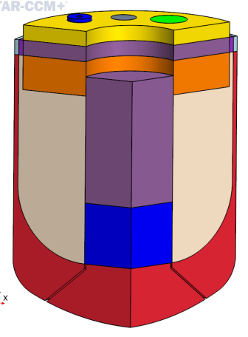
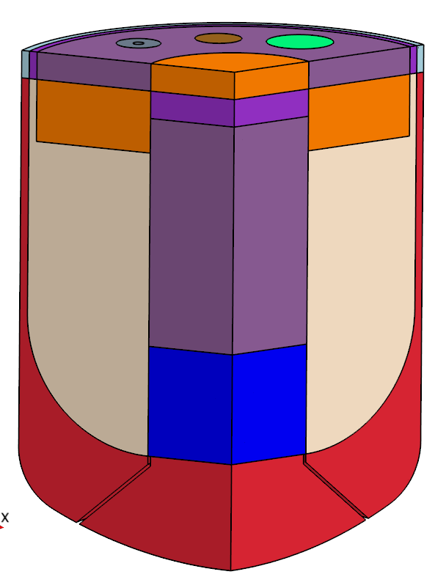
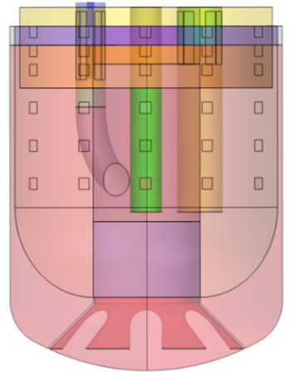
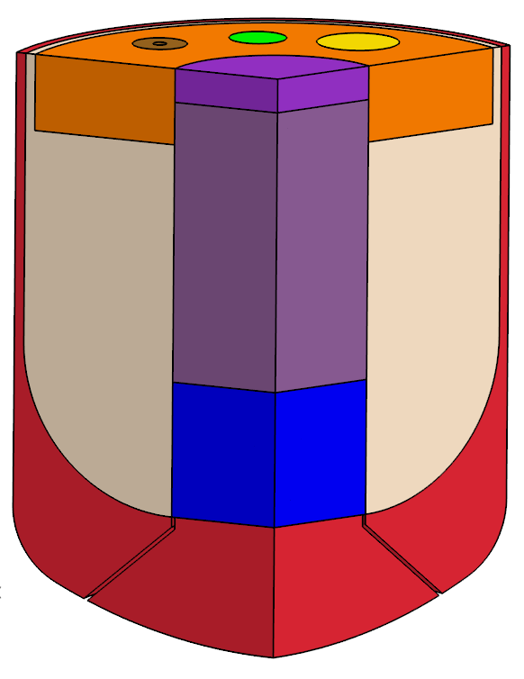
The modular geometrical model: illustration
Slicing horizontally the 1/3 geometrical model a couple of times
Star-Ccm+ allows easy module activation/deactivation
Idem for the window horizontal layers
IS windows
Nominal
PLOF
PLOF+LOCA
Notes:
This leads to the conception of our modular geometrical model.
The geometrical volume is horizontally sliced twice and each piece is treated separately
This is convenient because the software allows a quite easy activation or deactivation of each single volume.
This is also true for the window layers seen by transparency on the left.
In particular, this structuration clearly shows that in LOCA, with its lower free surface, only the upper window layer lies in the cover gas region.
We are now presenting some of the most salient results from simulations in this framework.

Slide 11
Mesh independence study
Varying independently the base size and the BL inflation (total size 3 cm)
Larger cell base size => slightly higher pressure drop
Less cells in BL => slightly lower wall heat flux
For preliminary evaluations, the coarser mesh is sufficient
Notes:
A mesh independence study has been performed.
For preliminary evaluations, understanding that it slightly overestimates the pressure losses and slightly underestimates the wall heat fluxes, the coarser mesh is considered sufficient.

Slide 12
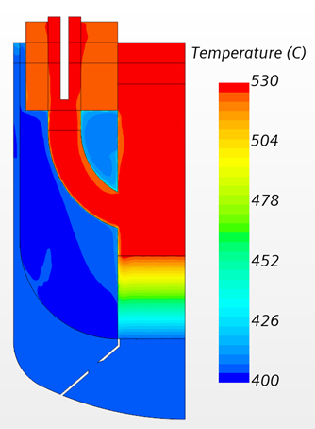
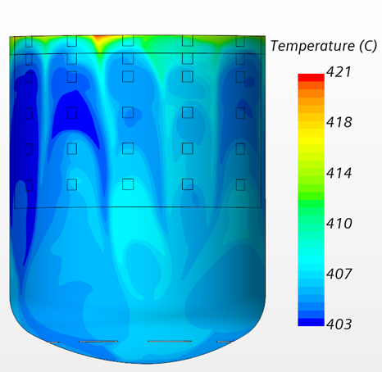
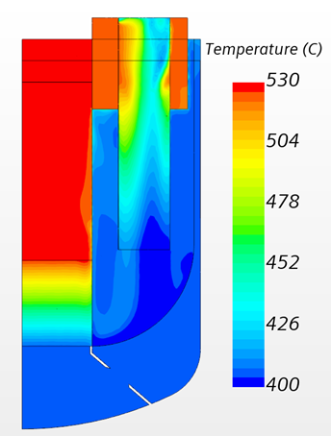
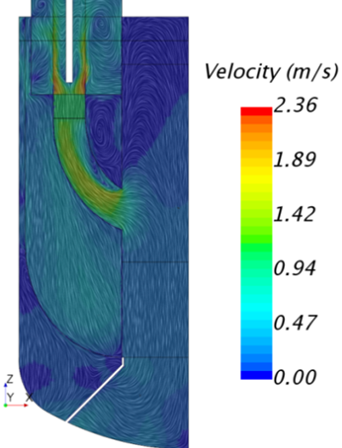
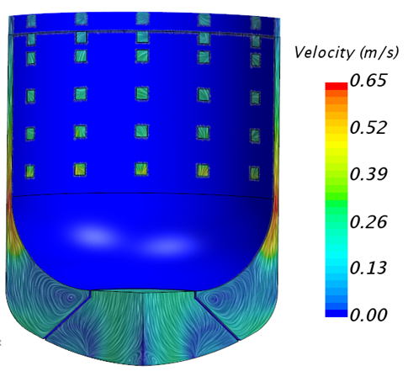
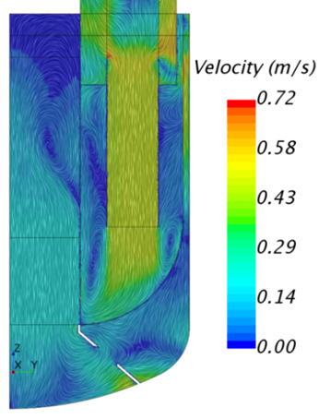
Simulation in nominal condition: all windows open
Maximum vessel temperature “only” 421 ⁰C
Most of the fluid flowing through the lower windows
Notes:
In nominal condition with all windows open, the hot plenum is at about 520 C, while the vessel maximum temperature on the vessel is much lower at 421 C. From the bottom images, we see the flow across the windows increasing from top to bottom.

Slide 13
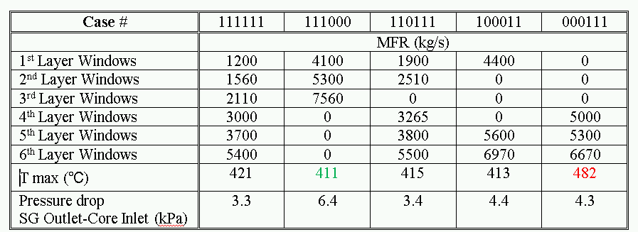
Parametric study closing/opening selected window layers
The vessel maximum temperature is the lowest at 411 ⁰C with the 3 upper layers open at a 3 kPa over cost in pressure loss
With only the 3 lower window layers open, strong stratification occurs and the vessel maximum temperature peaks at 482 ⁰C
The lowest pressure drop happens when all windows are open.
Notes:
Selective opening or closure of window layers has been investigated. We make three observations:
First, the vessel maximum temperature is the lowest at 411 ⁰C with only the 3 upper layers open.
Second, opening only the 3 lower layers, like in the old design, a strong thermal stratification makes the maximum vessel temperature peak at 482 C.
Third, the lower pressure drop arises when all windows are open. The pressure gain is however nearly irrelevant.

Slide 14
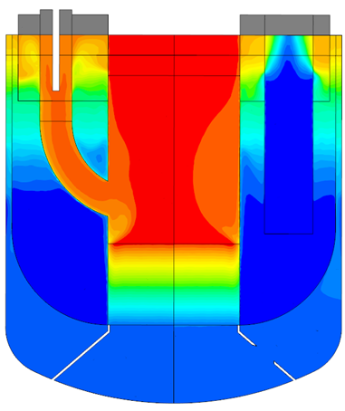
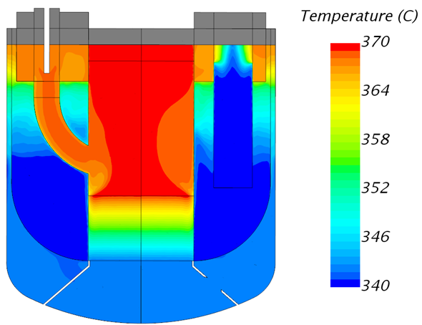
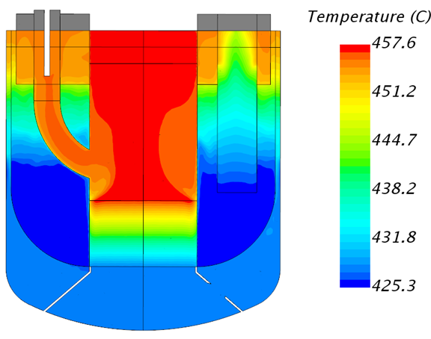
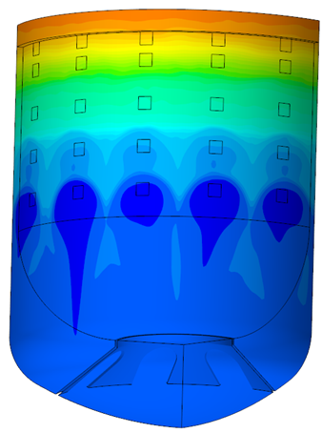
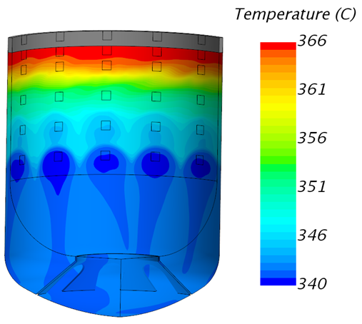
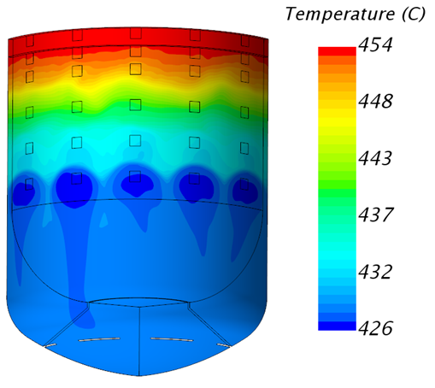
All windows open, 2% nominal power, PLOF and PLOF+LOCA
Reduced thermal cycle ~30K
Thermal stratification
Negligible perturbation from LOCA
DHR mode, ~7% lower mass flow rate due to a lower SG thermal barycenter
Much higher temperature in DHR mode, making it the more critical case
SG normal mode
SG normal mode+LOCA
SG in DHR mode
Low temperature
Notes:
For all windows open, we look at PLOF and PLOF+LOCA at 2 % nominal power configuration.
Natural convection is efficient in both cases and the thermal cycle is reduced to about 30 K.
Thermal stratification is strong but temperatures stay low when the SG still works in normal mode, see center and left.
With the SG in DHR mode, see on the right, temperatures are much higher. The 30 K of thermal stratification becomes of concern.

Slide 15
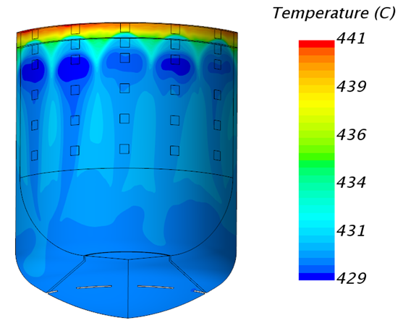
2% power DHR mode: closing the bottom windows
All window layers open
Only 3 top window layers open
=> “Only 3 top window layers open” becomes the reference
Notes:
Still about the 2% power DHR mode, closing the 3 lower window layers strongly reduces the stratification.
Therefore, the configuration with only the three top layers open become the reference choice.

Slide 16
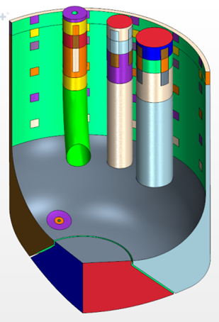
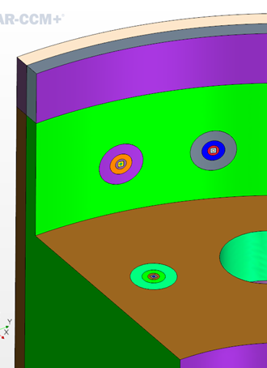
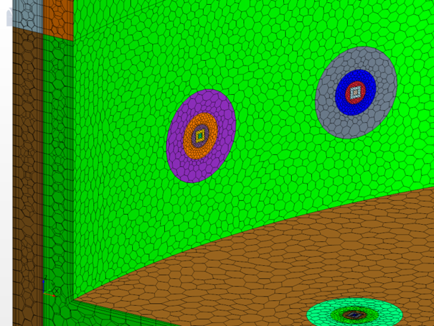
Effect of loss of integrity of the IS
Series of concentric potential holes are installed in the IS baffles and can be activated/deactivated individually
In the cold plenum bypassing the windows
At the hot plenum bottom wall
At the hot plenum side wall
Staggered between two windows
Aligned with a window
Notes:
This last series of simulation investigates the effects of the internal structure loss on integrity .
The numerical model is revamped localizing series of concentric baffles that can be changed individually into internal interfaces allowing bypass flows.
The potential holes are installed:
In the cold plenum bypassing the windows
At the hot plenum bottom wall
And at the hot plenum side wall
Either staggered between two windows
Or aligned with a window
which happens to be the most interesting case as discussed now

Slide 17
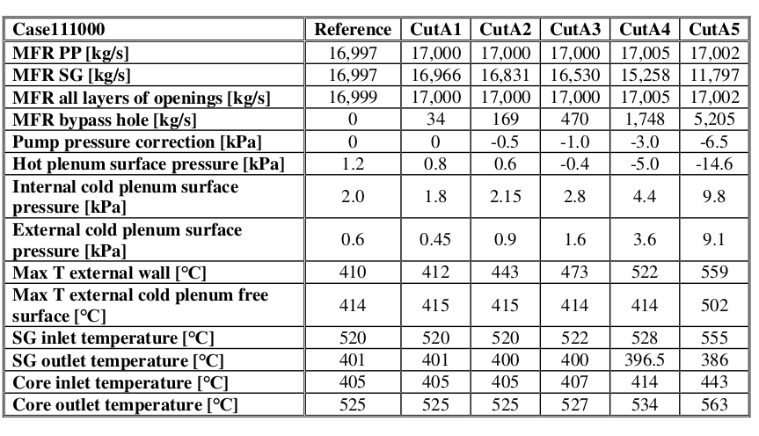
Results for the cut series aligned with the window
We can get a flavor of what happens depending on the bypass flow rate
Looking at the vessel max T, at 169 kg/s, we can expect thermal fatigue
For large bypass, the SG outlet T decreases while the Core inlet T increases
Surface thermal effects are averted at the hot surface/SG inlet before the cold one
Notes:
We indicate 3 pieces of information that can be inferred from this chart, depending on the bypass flow rate.
First, from the maximum temperature on the vessel wall, already for 169 kg/s, impingement on the wall occurs with a temperature increase above 30 K. this impinging flow is likely to be unsteady and induce thermal fatigue.
Second, when the bypass flow becomes large, from 10% on, the SG outlet temperature decreases, while the core inlet temperature increases. This combined effect is a clear signature of a large flow bypassing the SG, independently of its exact position.
Last, we can observe that surface thermal effects are averted at the hot surface or at the SG inlet before being seen at the cold free surface.

Slide 18
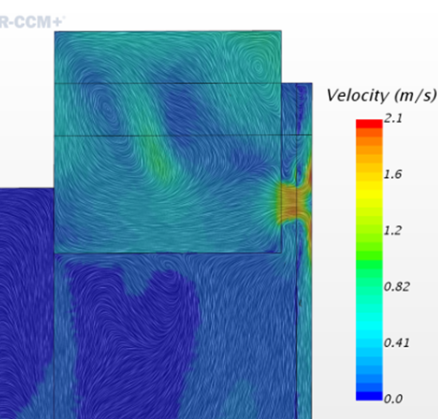
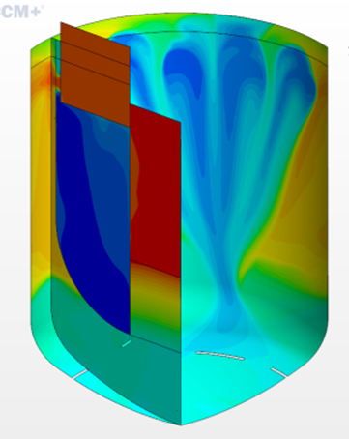
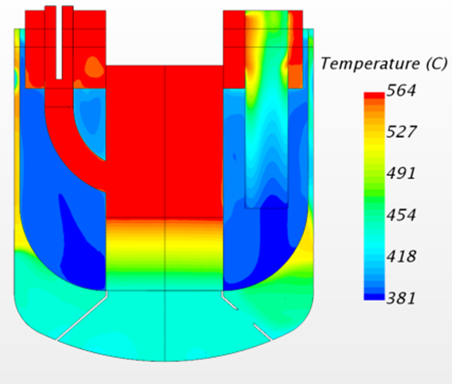
What happens when the bypass is very large (~30%)
Hot flow invades a large part of the down-comer with appearance of possible buoyancy stagnation effects
The SG outlet becomes colder while all the rest becomes hotter
A ~2m/s hot jet impinges the vessel wall
Notes:
When the bypass flow is about 30% here is what we readily observe:
On the left, hot flow invades a large part of the down-comer along the vessel, with appearance of possible buoyancy stagnation effects
At the center, we see a colder SG outlet flow together with a hotter hot plenum and a hotter core inlet flow
On the right, a 2 m/s hot jet impinges the vessel wall

Slide 19
Concluding words
The design of the ALFRED reactor coolant system has been improved adding an internal structure aimed at keeping the vessel cold and at impeding gas entrainment to the core.
A specific and versatile CFD model, carefully balancing between accuracy, (safe) ease of use and computational cost, has been built and heavily operated.
The model is suitable for preliminary evaluations of various kind in steady-state operation and has confirmed the improvement effectiveness and the overall resilience of the system, be it in normal operation, PLOF or PLOF+LOCA
The information obtained improves the knowledge of the system and allows to guide the design towards further optimization.
Notes:
To conclude… (read)

Slide 20
Thank you for your attention

