Slide 1
Advanced Nuclear Safety Evaluation of Liquid Metal Using Systems
3rd Technical Review Meeting
WP2.1 Deformed bundle simulation
Blind pre-tests
Vincent Moreau, Manuela Profir, CRS4
10-04-24

Slide 2
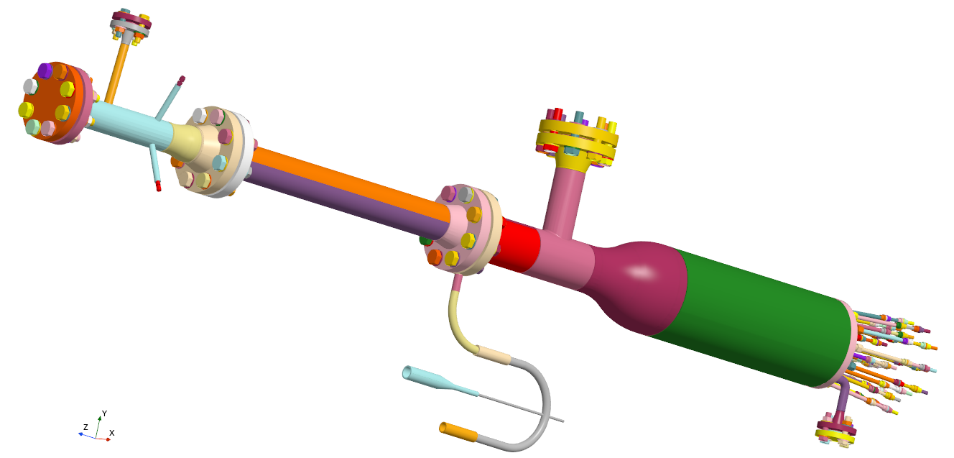
Pre-test simulations
CAD provided by ENEA
Almost CFD grade and directly uploaded in STARCCM+ 3D-CAD
Reworked in STARCCM+ 3D-CAD
Methodology should be adaptable to an “unknown” deformation shape

Slide 3
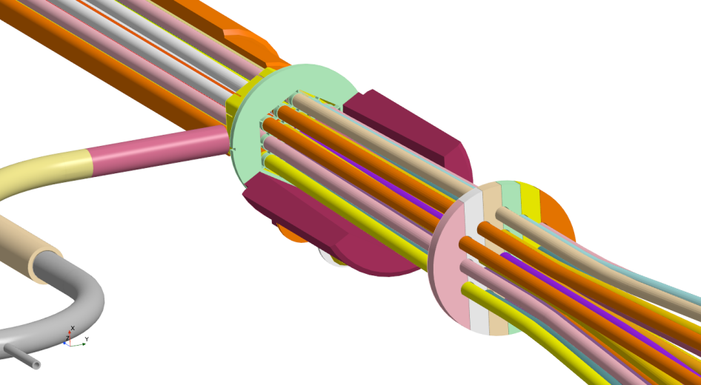
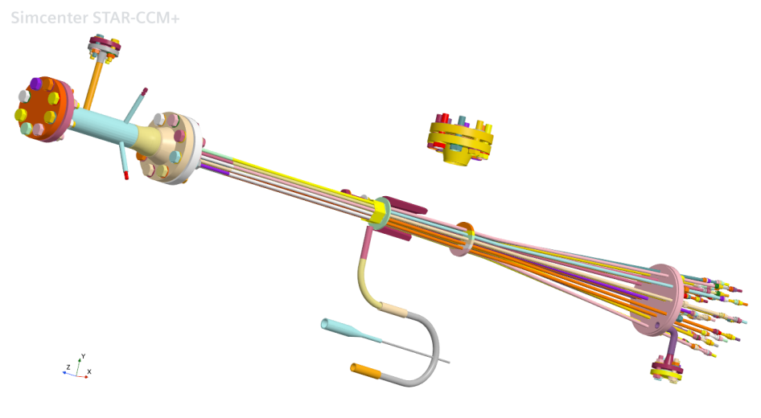
Pre-test simulations
CAD provided by ENEA
Reworked in STARCCM+ 3D-CAD
Bright idea allowing to reduce the computational domain!

Slide 4
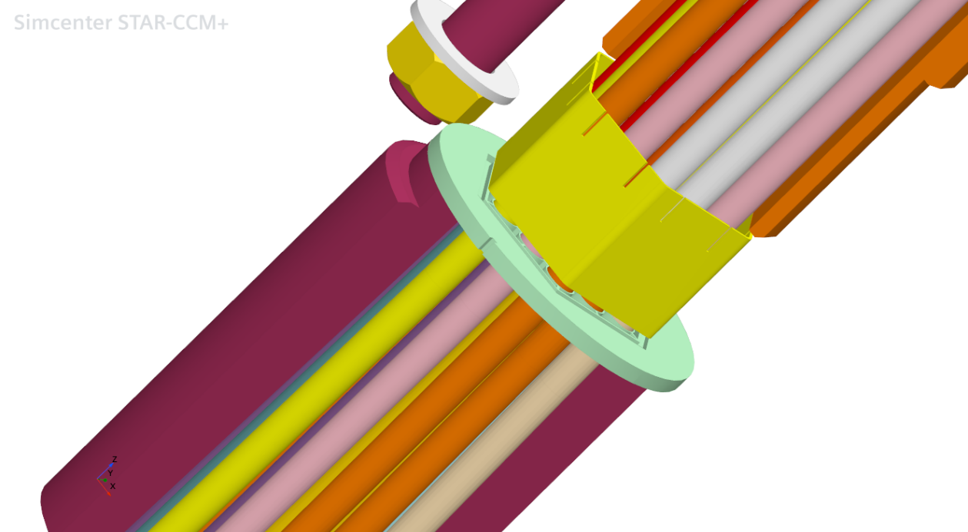
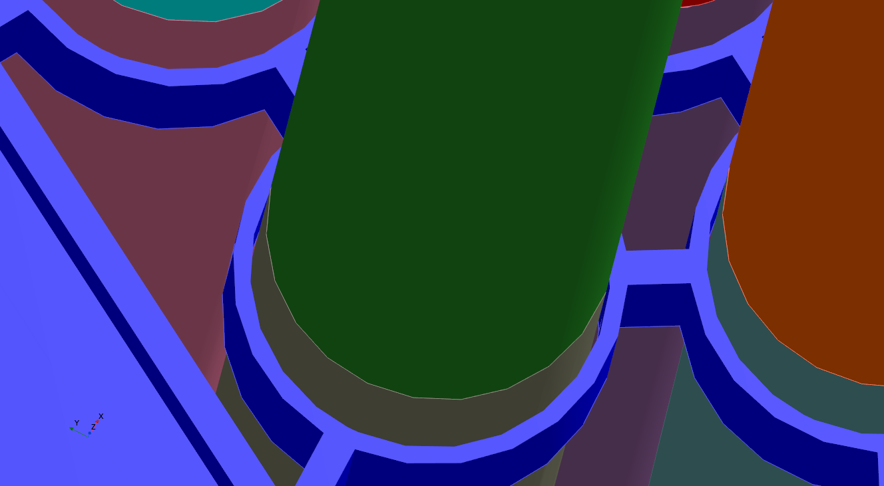
Pre-test simulations
CAD provided by ENEA
Reworked in STARCCM+ 3D-CAD: some parts simplified

Slide 5
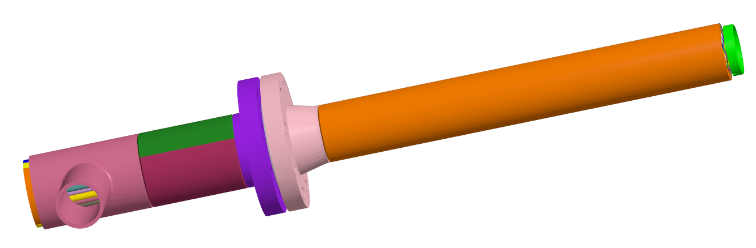
Pre-test simulations
STARCCM+ geometry
From the lateral intake to ~13 cm above the active region
Structures: only the pin simulator bundle active part

Slide 6
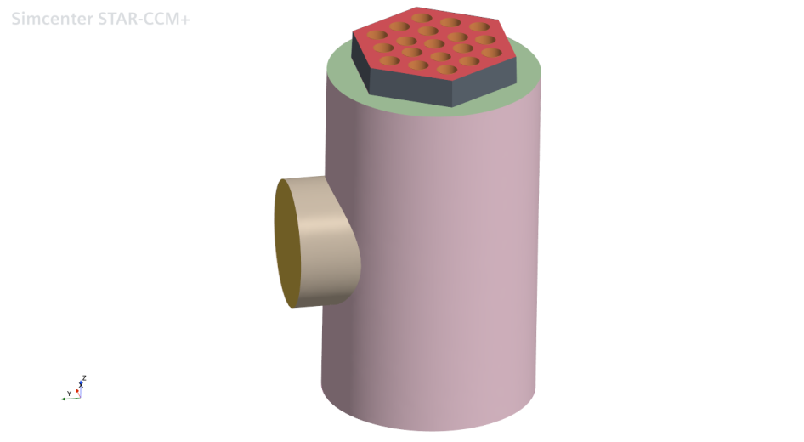
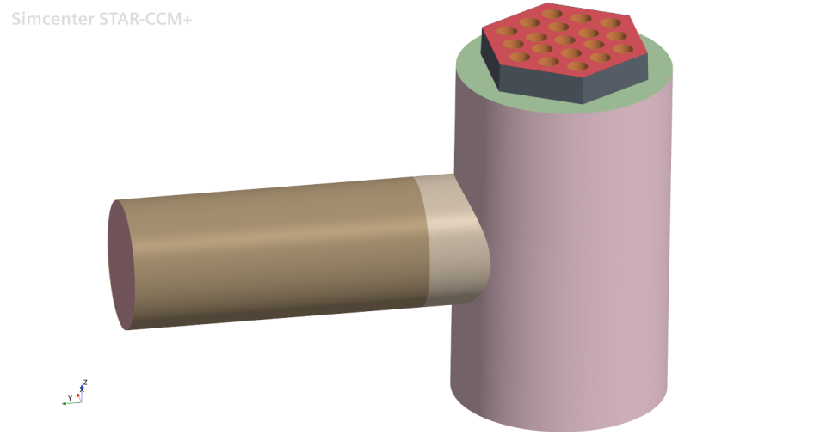
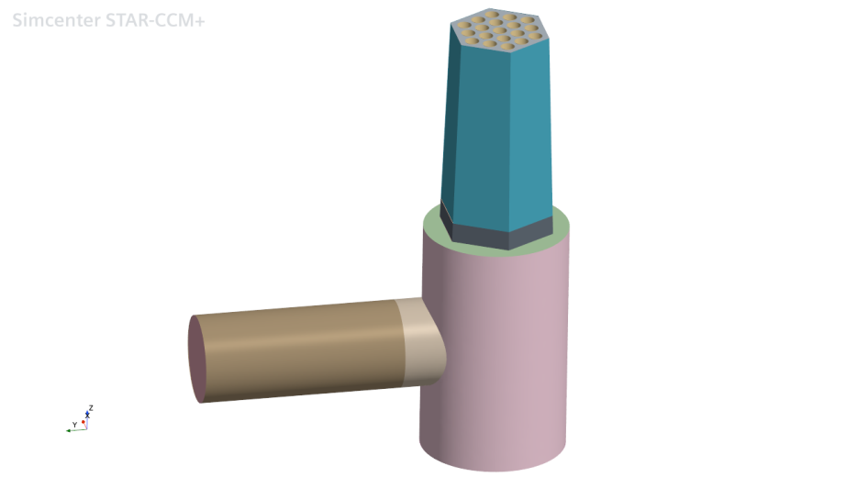
Pre-test simulations
STARCCM+ 3D-CAD geometry
Region / mesh organization: 1-low fluid domain, 2- Intake extension, 3- Convergent extension

Slide 7
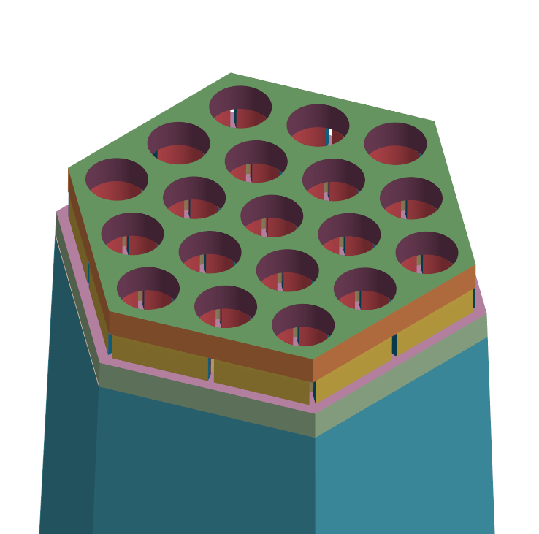
Pre-test simulations
STARCCM+ geometry
Organization: 1) around spacer, 2) Active part and 3) Outflow

Slide 8
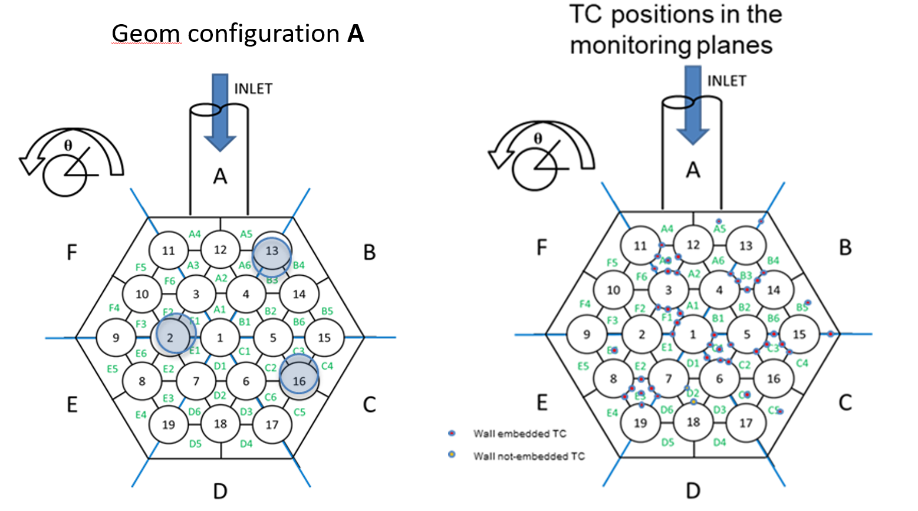
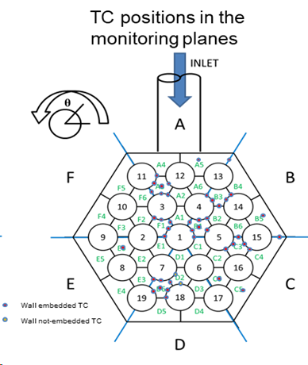
Pre-test simulations
TCs position
TCs moved from C1 to B1 as well as from E3 to D6
They are placed at 2 measurement planes (Z=300mm and Z=500mm)

Slide 9
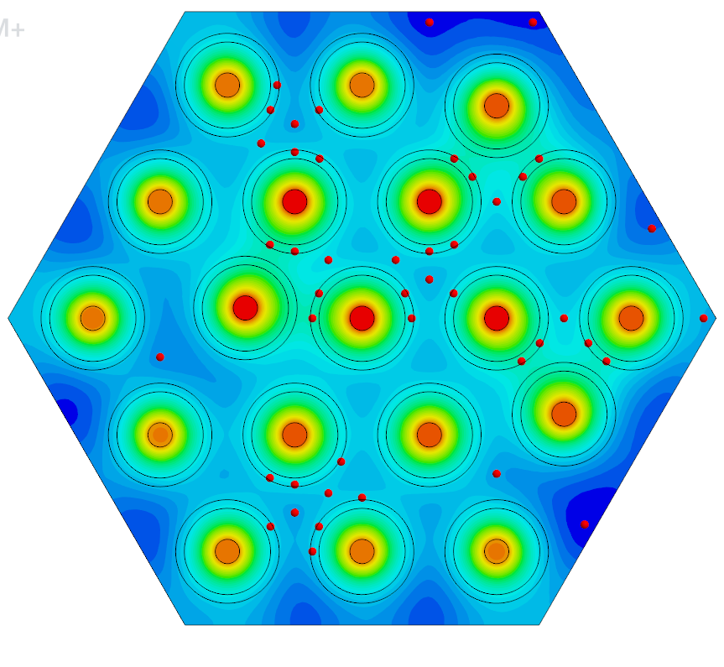
Pre-test simulations
TCs position
Probes location for data extraction

Slide 10
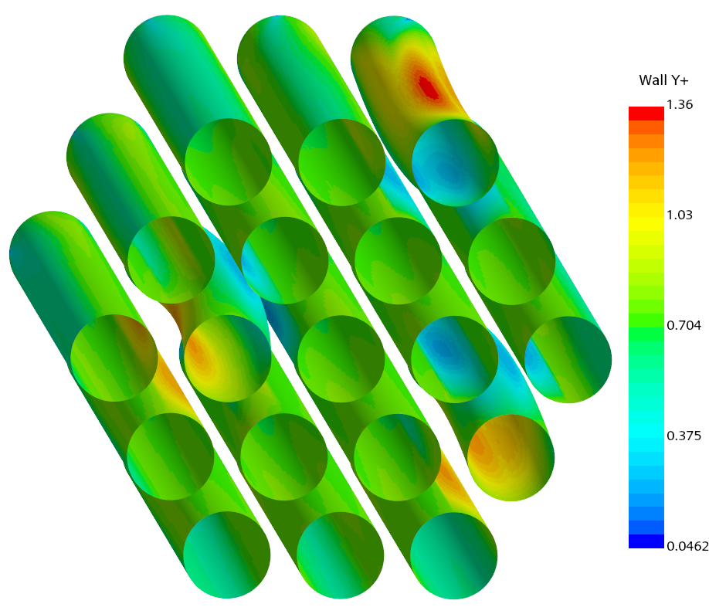
Pre-test simulations
Three cases under investigation
Numerical setting inherited from pre-pre-tests
Same mesh for all three cases
Case | Inlet T (C) | Flowrate (kg/s) | Power (kW) | dT (K) | Riser mean wall Y+
3A | 400 | 19.0 | 222 | 80 | 2.2
4A | 400 | 12.7 | 222 | 120 | 1.7
7A | 400 | 5.0 | 29 | 40 | 0.7

Slide 11
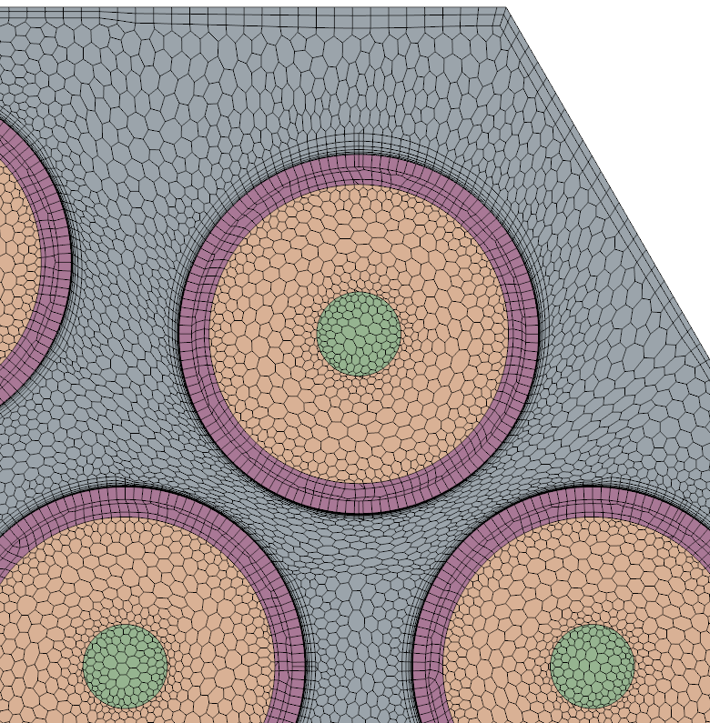
Pre-test simulations
TCs position issue
Numerical probes give mean cell temperature
TCs tend to be larger than the cell size
Embedded TCs are 0.35 mm wide
The clad DT is about 11 K over 0.35 mm.
A mismatch of 0.1 mm is 3 K!
Uncertainty, both experimental and numerical may be much higher than foreseen
As an attempt to minimize the numerical measure error, we create a 0.35 mm wide external clad layer.
Similar issue for the 0.5 mm wide bulk TCs

Slide 12
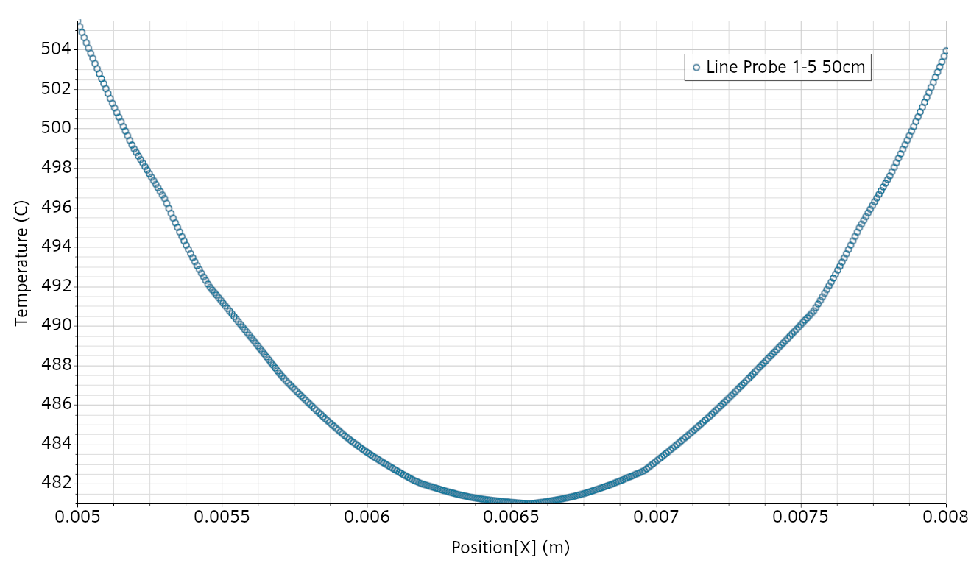
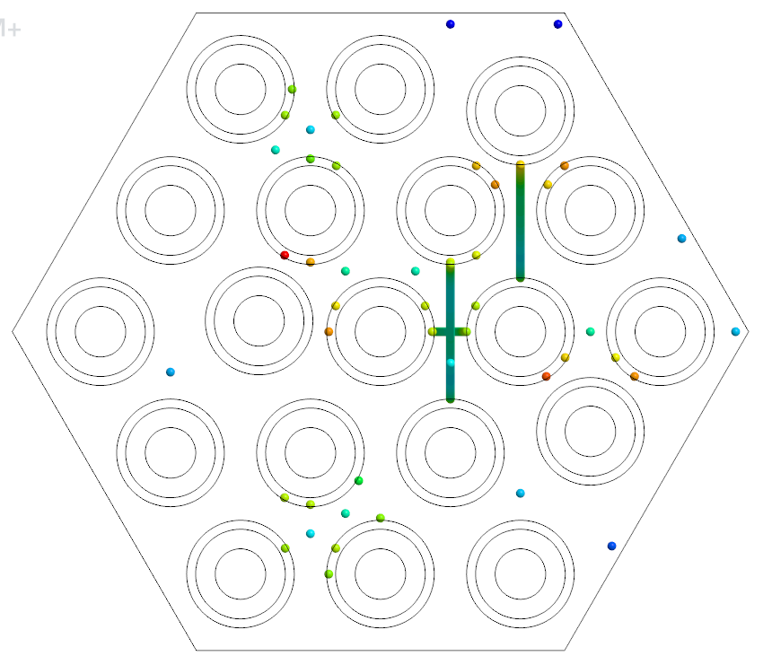
Pre-test simulations
TCs position issue
Similar issue for the 0.5 mm wide bulk TCs
Profile T between Pin 1 and Pin5 (3mm).
Lead => No real bulk temperature
Very sensitive to the exact TC position.

Slide 13
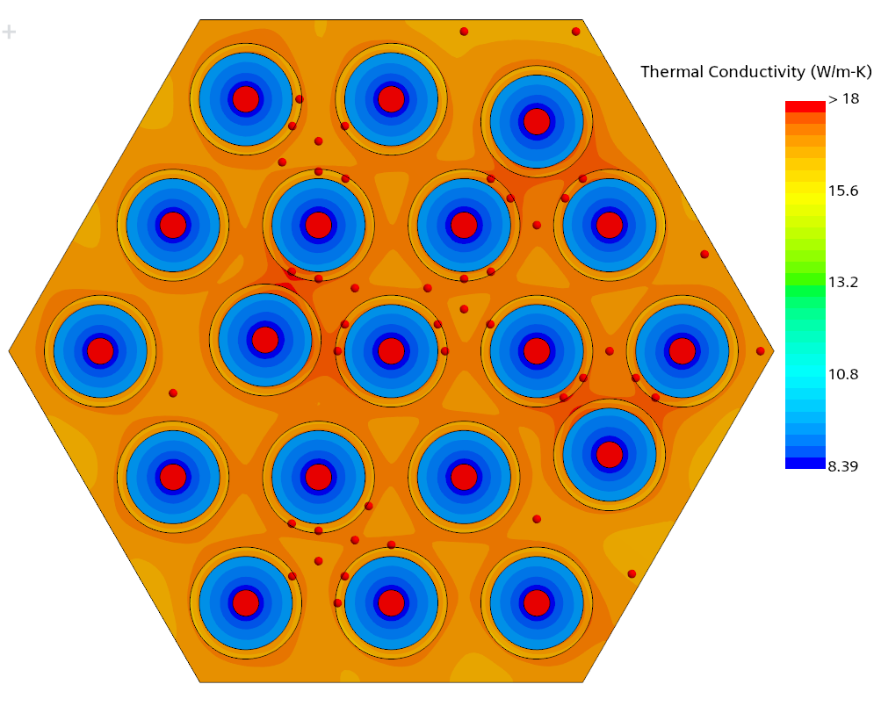
Pre-test simulations
Effect of thermal conductivity
Only matters when there is a large transverse thermal flux: i.e. only deformed pins and neighbors.
Boron Nitride more resistive at higher temperature.
Difference with steel is higher for Case 4A and reaches ~5 K at TC 31 – 76.
The uncertainty on the BN thermal conductivity may impact the TC measure by a few K.
TC 31

Slide 14
Pre-test simulations
Simulation results: mesh sensitivity on Case 3A
Very similar results on selected TCs but denser 2D mesh chosen because: lower Y+ and still quite manageable for steady simulations.
Case3A Ref. 4, 200, 1.5 mm 300 Layers Active 6 BL Active Riser 0.3 mm 0.3 mm, 6 BL Note
Pressure drop active [kPa] 9.99 9.97 10.11 9.60 9,88
Pressure drop Inlet-Outlet [kPa] 31.01 31.01 31.30 30.49 30.99
Mean Active Pin Wall Y+ 9.8 9.8 3.5 5.5 2.2
TC 07 A5 mid 412.6 412.7 412.9 413.3 413.3 Wrapper
TC 52 A5 up 420.2 420.3 419.8 420.5 420.2 ‘’
TC 14 D6 mid 432.6 432.9 433.3 432.9 433.0 Bulk
TC 59 D6 up 461.0 460.9 461.5 460.2 460.9 ‘’
TC 19 B2-B3 mid 450.9 451.4 451.2 450.5 450.5 Channel
TC 64 B2-B3 up 490.8 491.1 491.1 492.4 491.9 ‘’
TC 15 D2-D6 mid 446.9 447.3 447.0 446.1 446.3 ‘’
TC 60 D2-D6 up 478.3 478.4 478.1 477.1 477.3 ‘’
TC 31 04-13 mid 492.1 492.0 492.6 492.4 492.2 Front Pin 13
TC 76 04-13 up 520.3 520.4 521.2 522.5 522.2 ‘’
TC 40 07-19 mid 477.3 477.4 476.9 475.8 475.4 Front Pin 19
TC 85 07-19 up 507.9 507.9 507.3 506.2 505.9 ‘’
Riser Fluid Mesh [k] 2,677 3,863 3,345 5,566 6,665
Whole Mesh [k] 7,061 9,500 7,756 12,853 14,030

Slide 15
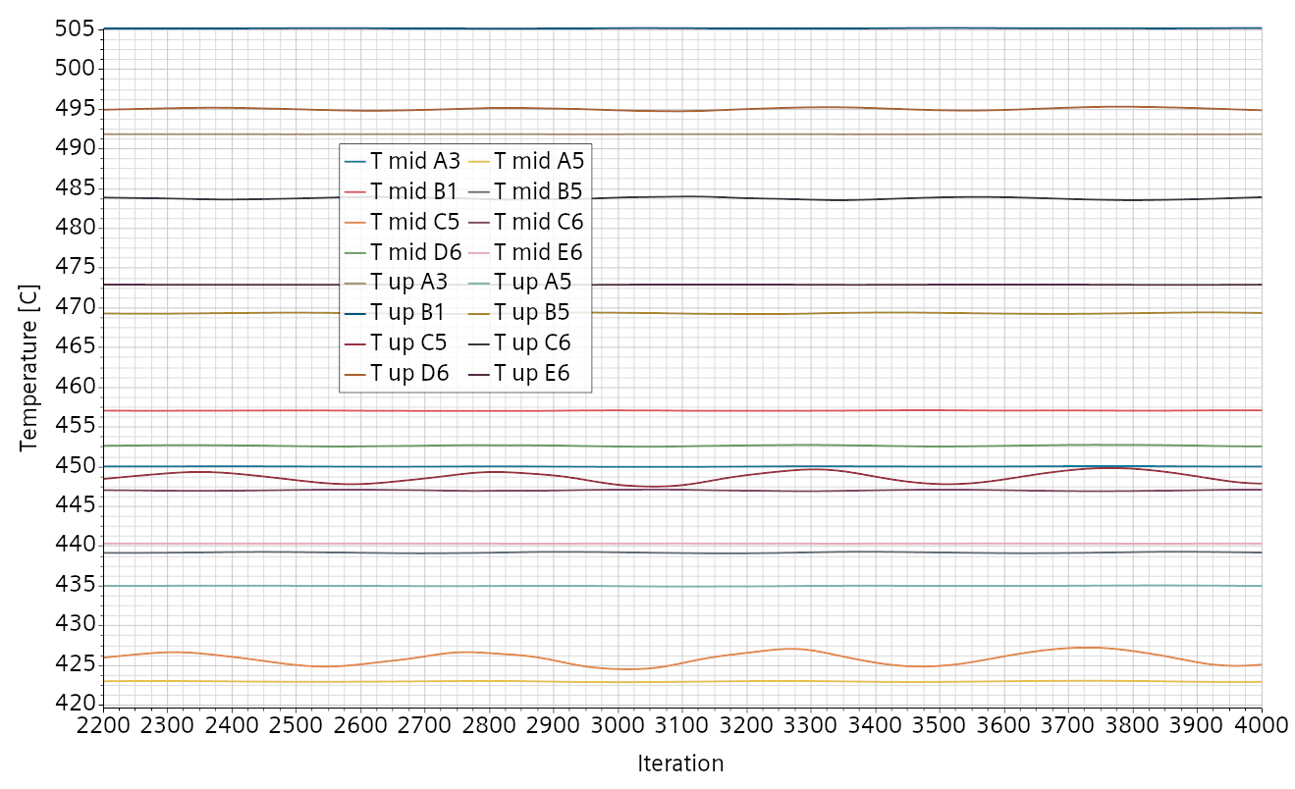
Pre-test simulations
Simulation results: Case 4A, appearance of a low temperature instability
Relevant only in sector C5
Same if riser layers increased from 200 to 300 => could likely be related to a flow instability

Slide 16
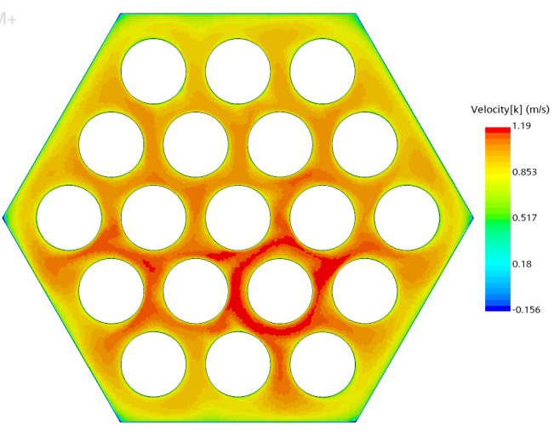
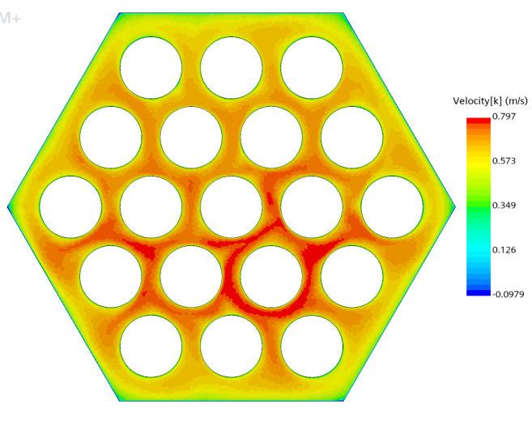
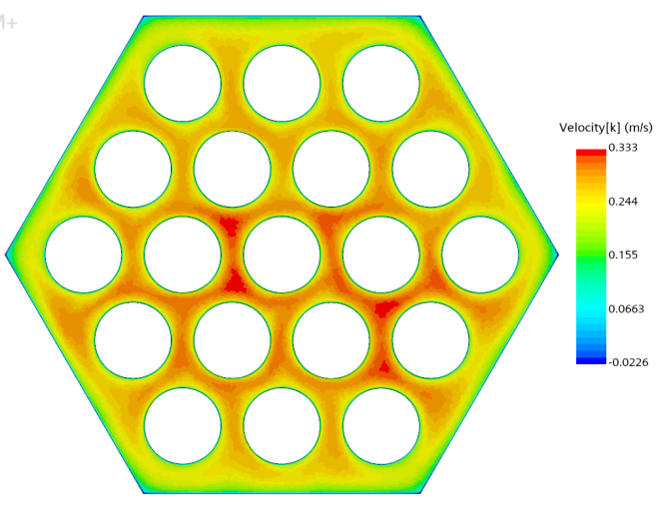
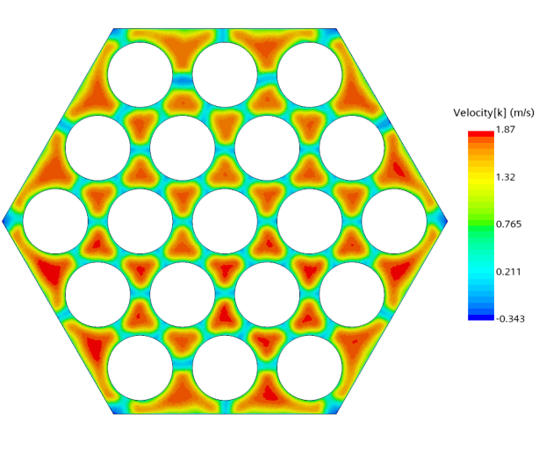
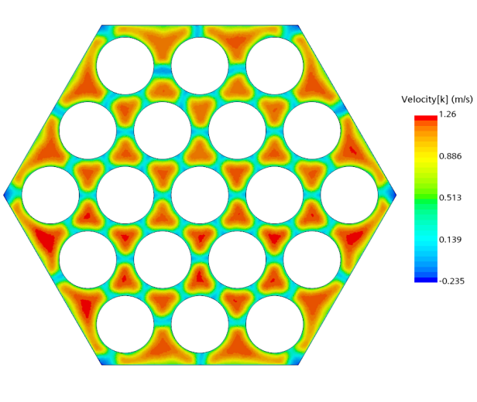
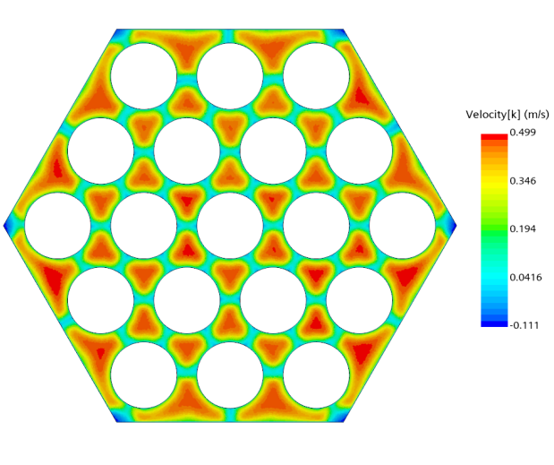
Pre-test simulations
Simulation results: Case 3A and 4A, effect of the spacer
Regularizing the flow asymmetry. Taken 5 mm below and 5 mm above the spacer
3A, 19 kg/s
4A, 12.7 kg/s
7A, 5kg/s
Below
Above

Slide 17
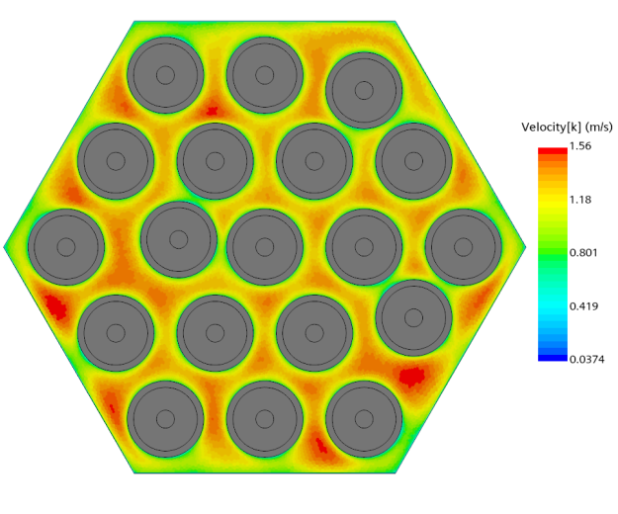
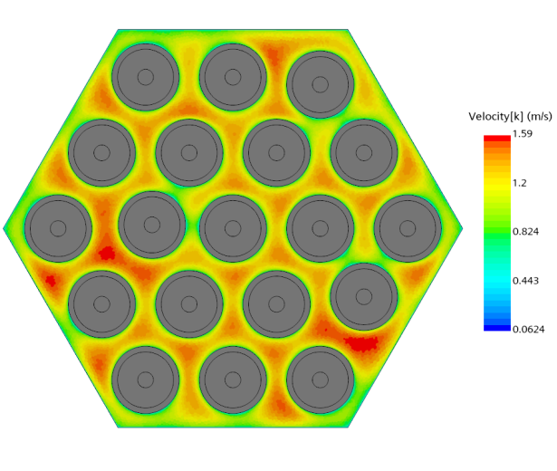
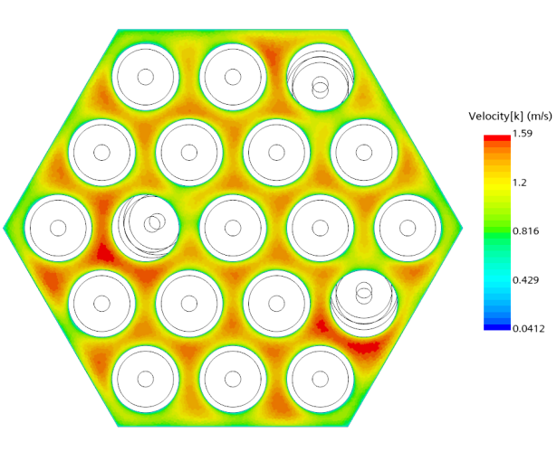
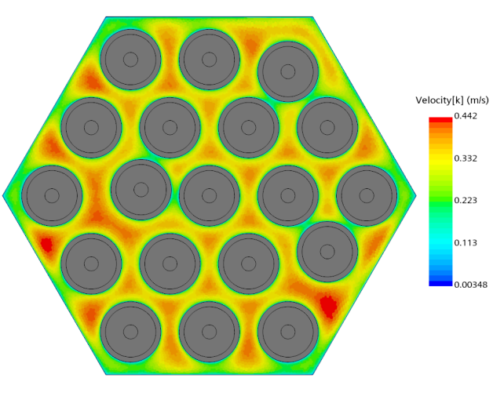
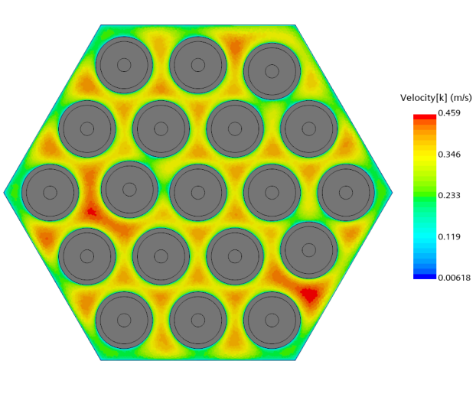
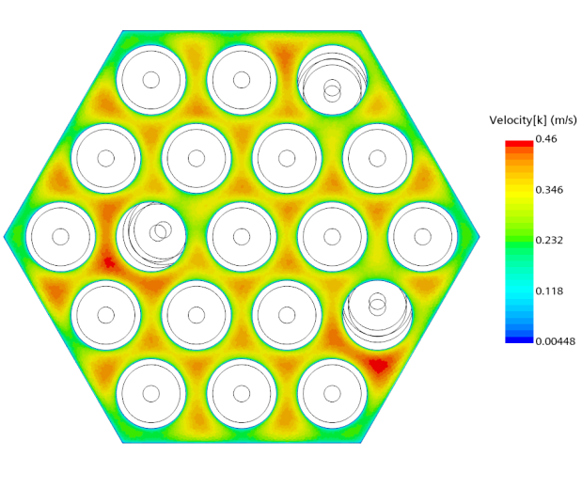
Pre-test simulations
Simulation results: Case 3A and 7A, Vertical velocity along active part
Lower velocity in the smaller channels. Hysteresis effect when deformation is over.
3A, 19 kg/s
7A, 5 kg/s
30 cm
50 cm
60 cm

Slide 18
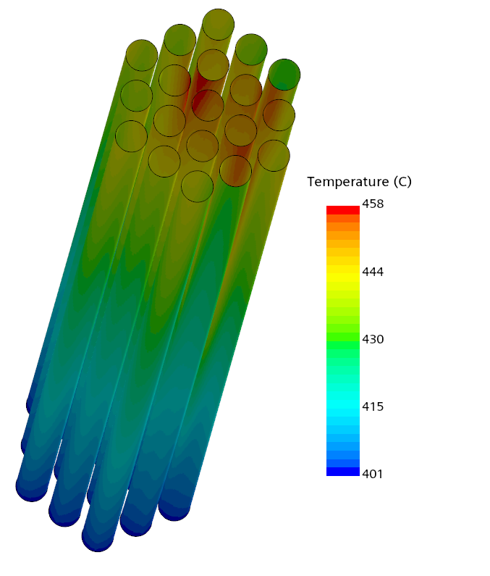
Pre-test simulations
Simulation results: Case 3A and 7A, Clad external temperature
Maximum on top in deformed pins
Combined effect of slower flow and of a smaller channel feed by the same heat flux
3A, 19 kg/s
7A, 5 kg/s

Slide 19
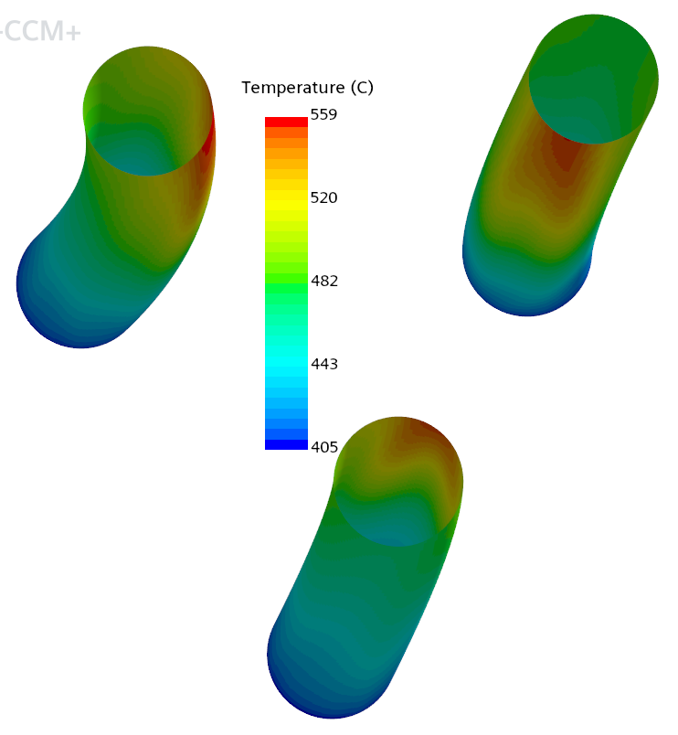
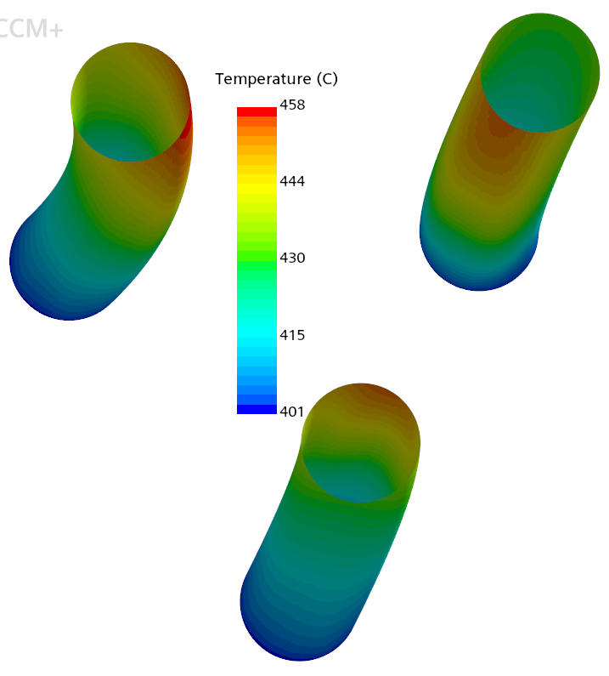
Pre-test simulations
Simulation results: Case 3A and 7A, Clad external temperature
Maximum on top in deformed pins
Combined effect of slower flow and of a smaller channel feed by the same heat flux
3A, 19 kg/s
7A, 5 kg/s

Slide 20
Pre-test simulations
Conclusions
The pre-tests simulations have been performed without particolar complication
The very high thermal gradients makes the TC positioning and temperature interpretation very challenging
The BN thermal conductivity and its temperature dependence impact the clad temperature in case of transversal heat flux
The maximum clad temperature arise at the top of the deformed pins
It is caused by the combined effect of slower flow and of a thinner channel
No particular issue is forseen for the conduction of the experiment.

Slide 21
Verification Study
References
MMMD Hussain & V Moreau (2023). Appendix to Deliverable D2.2 HELENA deformed bundle pre-pre-test simulations

