Slide 1

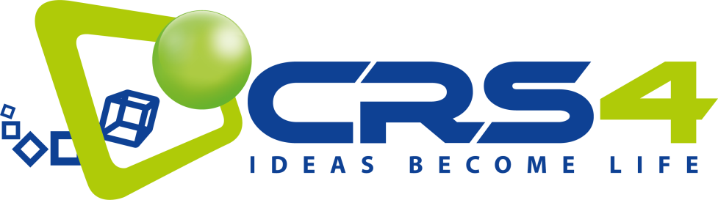
.
Technological Research Action Necessary for Safe PARtitioning and Nuclear Transmutation
Task 7.1.3 Primary pool system. Transient scenarios: seismic analysis
Manuela Profir, Vincent Moreau, CRS4
WP7.1. 1st Workshop on
State-of-the-art on Thermal-Hydraulics
13-14 March-2025
Petten - The Netherlands
This project has received funding from the European Union`s Horizon EURATOM 2023 NRT 01 nuclear research and training programme under grant agreement No. 101166386

Slide 2
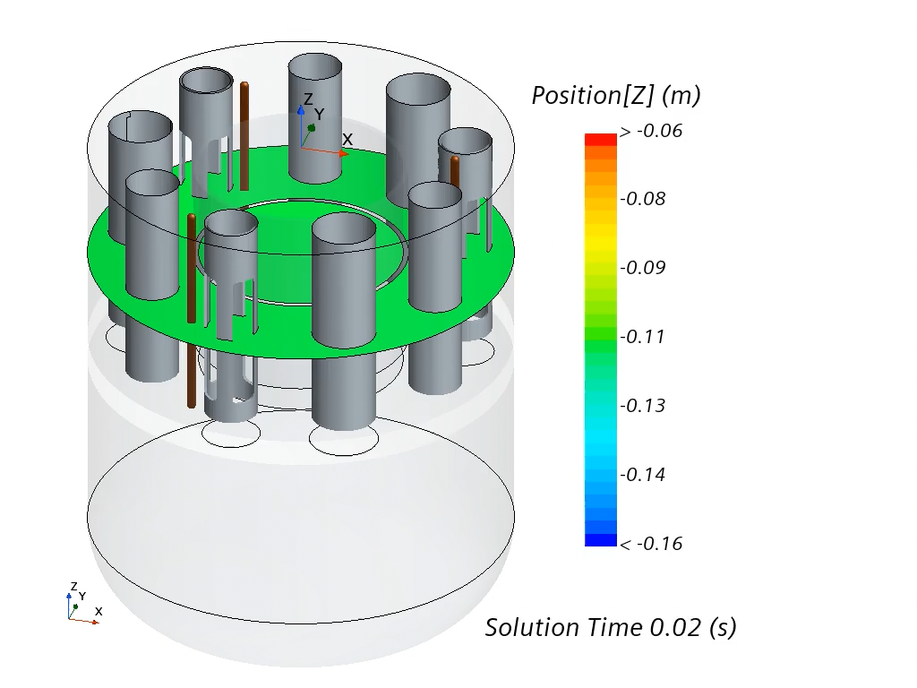

Goal
From PASCAL proposal: “To further enhance the modelling and computational readiness level of sloshing dynamics in compact liquid-metal filled pools and to retrieve the expected impact forces and dislocations on the involved components for a reference system (e.g. ALFRED).”
CFD oriented approach: qualify the CFD for the simulation of seismic induced sloshing effects of the primary coolant in a GEN-IV reactor.
Practical aim: check if a realistic but large seismic event could trigger a large sloshing dynamics potentially damageable for ALFRED system integrity.

Slide 3
Scaling
The first experimental campaign was based on a simple geometry, a partially filled vertical cylinder under harmonic forcing with different amplitudes and frequencies.
For a partially filled vertical cylinder, the resonance frequency is known and is independent of the specific weight: water or mercury can represent lead
The cylinder is filled with water up to a height H=1.5R: the linear theory predicts a negligible bottom effect on the resonance frequency.
Only consider kinematic similarities: only length and time are involved.
Geometrical similarity: our leading parameter is a reference length => cylinder radius.
The cylinder diameter could be determined considering that is must be the largest possible for measurement accuracy and easily purchasable on the market.
The filling depth should be such that upon scaling, the experimental campaign (Royon-Lebeaud, 2005) could be replicated with the SHAKESPEARE table, limited to a maximum displacement amplitude of 4.5 cm. (Muller et al., 2023; Grasso, 2024)

Slide 4
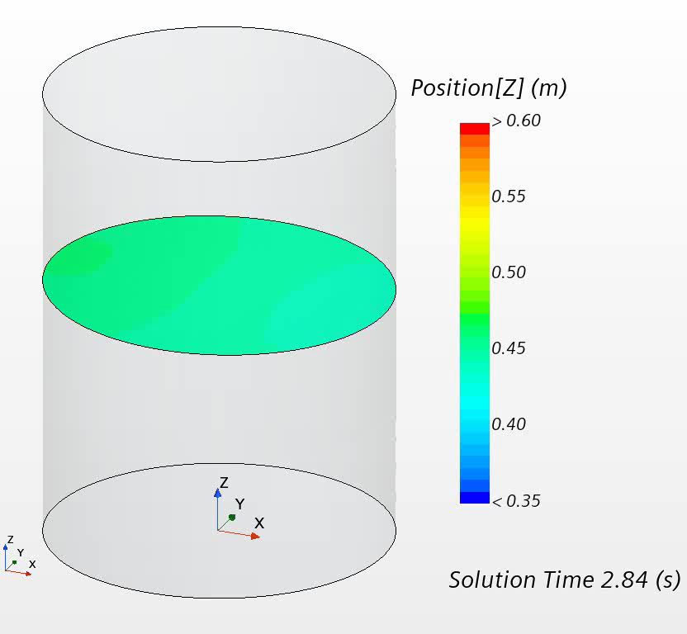
Validation
In the Royon-Lebeaud work it is suggested that there is a transition to chaotic behavior at some point when the frequency is increased towards the resonance frequency.
Surprisingly, the transition frequency observed experimentally by VKI was about 2% of the resonance frequency earlier.
The transition to chaos was numerically observed at the same value, within 0.1%, as in the VKI experiments.
CFD simulations could be made quantitatively accurate enough to capture a stability transition behavior accurately.
Sloshing is mainly characterized by the resonance frequency. For sufficiently large cylinders, the natural frequency scales with the inverse square root of the radius (Myrillas et al., 2015) => having to extrapolate to ALFRED, time scales with the radius square root and the acceleration is an invariant of the scaling

Slide 5

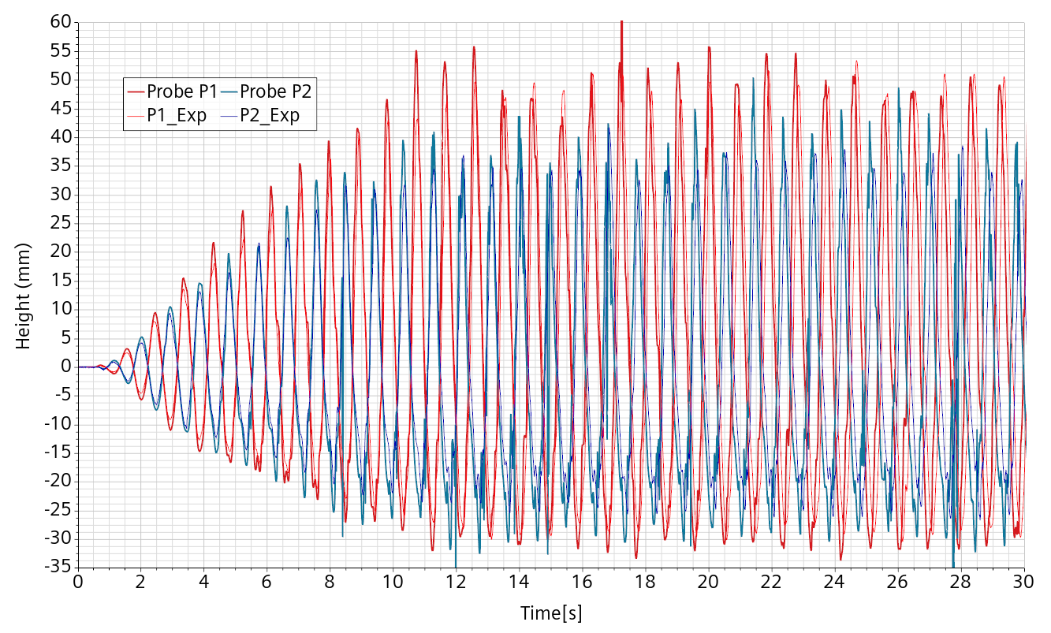
Validation
Validation was performed on a water mock-up of ALFRED filled with 40 liters of water, previously determining the scaling law for extrapolation to ALFRED.
The CAD file was provided by VKI to CRS4 as basis for the CFD geometry.
The length ratio between ALFRED and the mockup estimated at 18.4. The geometrical scaling ratio is about 1/18.4=0.054.
Modelling has been shown to be operative, functional and validated by comparison with experimental data provided by VKI.

Slide 6
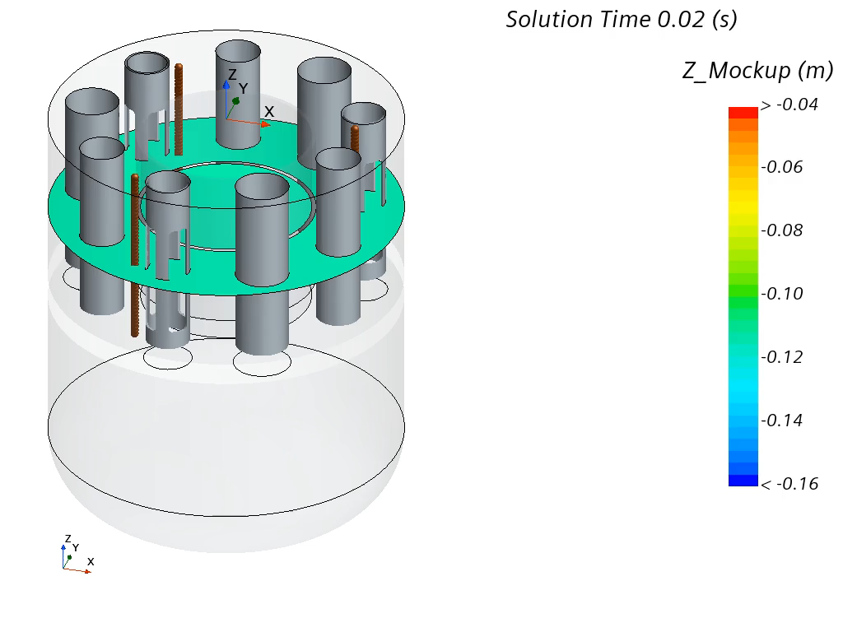
State of the art
Simulations have a minor value without experimental confirmation, but once this is acquired, extrapolation to situations not experimentally feasible can be performed with a reasonable confidence.
For a real earthquake simulation, the scaling laws from the ALFRED design size to the mock-up size are applied.
Acceleration being an invariant of the scaling, the acceleration data can be used directly provided that time is consistently contracted. The mock-up flow of time is about 4 times faster than the real ALFRED flow of time.
The duration of an earthquake is contracted accordingly. The displacement signal induced by the earthquake is scaled by applying the geometric and time scaling laws for the mock-up simulation.

Slide 7
Outcomes
Under large seismic events, the damage risk is overwhelmingly dominated by the forcing from the highest acceleration frequencies of the earthquake.
The force signal is strongly correlated to the imposed seismic acceleration, with only a tiny contribution coming from the surface wave.
It is therefore clear that an “unprotected” ALFRED is much less threatened by sloshing effects during a severe seismic event than by the high frequency vibrations which are way more soliciting.
The sloshing effect remains small during the most critical part of the event but survives and becomes dominant towards the end of the event, but never really significant.
Once a damping system is designed, it would be safer to repeat the exercise with a more accurate ALFRED numerical model, also in an optimization perspective.

Slide 8
What now?
Mitigation of seismic events is primarily a structural issue. Possible damaging sloshing impact comes at secondary order and can seriously be evaluated only when the damping systems are more defined.
Pool LFRs could also be considered in marine environment:
  For ship propulsion
  Installed in offshore barge
  Installed on a pond or lake
Considering a “working” ALFRED, low frequency, high amplitude forcing is expected: heave (up and down), sway, surge, roll, pitch, and yaw.
Heave in particular acts as a varying gravity and impacts the relation between the different free-surface levels.
In turn, it induces mass transfer variations between volumes, including the core.
A variable flow in the core may create thermal fatigue and is worth evaluating.
Notes:
Sway=
Surge=
Roll=
Pitch=inclinazione
Yaw=

Slide 9
What now?
Medium scale experimental facility to test a fully equipped water mockup of ALFRED/SMR composed of:
  A large 6 degrees of freedom shaking table.
  Framework to suspend the mockup and its damping system
  Damping systems
  Mockups with installed working pumps
  Water as working fluid
Given the shaking table capabilities, the mockup scaling is limited by:
  Its weight
  The required relative displacement amplitude.
A sort of MYRRHABELLE++ on SHAKESPEARE ++ as an ATHENA water cousin.

Slide 10
Some impressive videos
https://www.youtube.com/watch?v=Y7kKcIsBKDo
https://www.youtube.com/watch?v=141Zmuw9Xcg
https://www.youtube.com/watch?v=Sj3iI9jZCX8

